Slide 1
New UMSI Initiatives
December 2017

Slide 2
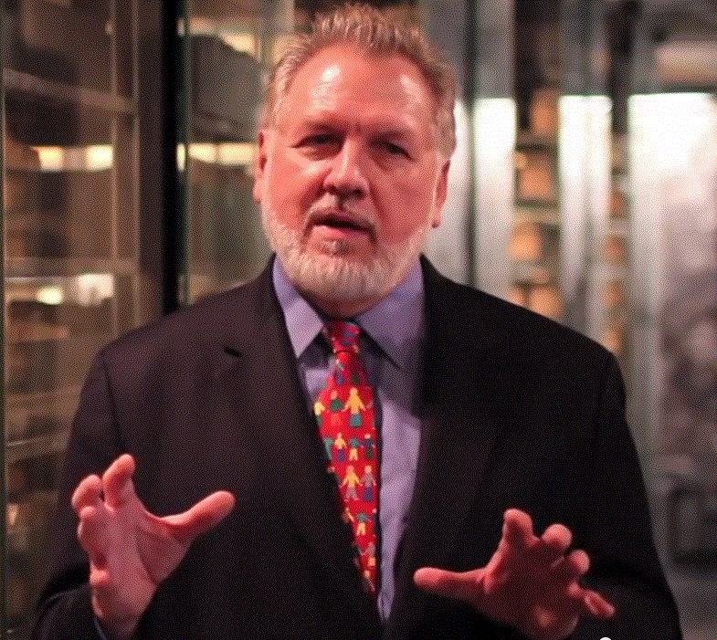
A Brief Introduction
13 Years on Wall Street
10 Years in management consulting
17 years in NGOs
Former Global CIO at IFRC
Former CIO at STC/US & UK
Co-founder and former Chairman of NetHope.org
More on LinkedIn, Google and www.eghapp.com
Notes:
When I was 38, I read a comment by Handy saying we could expect to have 5 careers; for the millennials, they can expect to have 14 jobs…by the time they are 38! (see https://www.youtube.com/watch?v=XrJjfDUzD7M at 02:15)
http://www.amazon.com/The-Age-Unreason-Charles-Handy/dp/0875843018
Charles Handy, http://www.texasventures.us/india/images/leader2_1.jpg …five careers

Slide 3
My Goals
Teach: help train the next generation of technology leaders for nonprofits; launch and upgrade Crisis Informatics and IT Leadership courses mat UMSI
Research: develop, launch and sustain three initiatives: The Connectivity Lab, the Data4Good Center, and the NetHope-UMSI Internship program
Partner: bring the ICT4D practitioners, academics and technology companies to the same table to better collaborate and jointly solve humanitarian-information problems
Consult: bring the resources to bear to advise nonprofit organizations on the use of new data science opportunities, and help prepare the future data scientists to work with them

Slide 4
A Framing Story…
Steve Denning told this story about Zambia and the World Bank at the 2005 NetHope Summit. It went something like this:
  "In June of 1995, a health worker in a tiny town in Zambia went to the Web site of the Centers for Disease Control and the got the answer to a question about the treatment for malaria. Remember that this was in Zambia, one of the poorest countries in the world, and it happened in a tiny place 600 kilometers from the capital city. But the most striking thing about this picture, at least for us, is that the World Bank isn't in it. Despite our know-how on all kinds of poverty related issues, that knowledge isn't available to the millions of people who could use it. Imagine if it were. Think what an organization we could become."
This was the springboard story that got him started on knowledge management at the World Bank. Imagine if nonprofits had access to a broad collection of data sets and trends that could inform their decision making and contribute to the body of knowledge about our many development and relief programs?

Slide 5
Big Data and the Nonprofit World
When I'm asked about the importance of the big data revolution for nonprofits, I say we first need to get past all the silos of small data we collect--these are a potential source of big data sets, if we mine the published PDF reports and seek to aggregate our spreadsheets.

Slide 6
The Framing Questions
I am launching three initiatives at the UM School of Information, to essentially address three questions:
How do we solve problems when our a-list of tools are swept away?
Can we gain important insights by combining all the “small” data in the silos of NGO reports into “big data”?
Can student and tech company workers learn more by working side-by-side in the under-resourced world of NGO IT?

Slide 7
An Integrated set of initiatives
Crisis Informatics + IT Leadership Courses
Internship
Program
The Connectivity Lab
Data4Good
Center
…a work in progress

Slide 8
The Data4Good Center

Slide 9
The IT Strategic and Budget Context

Slide 10
The Problem?
Data science (big data, etc.) is beyond the reach of small nonprofits;
Comparative data for technology use among small nonprofits is lacking;
Fundraising data dwarfs beneficiary data

Slide 11
The What & How?
IT agility index among NGOs
IT relevancy index among NGOs
IT assessments in crises
Crisis technology trends
NGO PDF report mining
Big data sets (donated/shared) and analyses for small NGOs
Partnering with UN/OCHA HDC in The Hague

Slide 12
Increasing Scope & Complexity
Phase 1
Phase 2
Phase 3
 |  |  |  |  | NGO Reports Narrative
 | IT Agility Index | Refugee Camps Usage Data | 1-2 NGO Report Time series | NGO Reports Data Tables
CIO4Good Survey | IT Relevancy Index
Complexity
Scope

Slide 13
Increasing Change Requires More Agility

Slide 15
NGO IT Spending

Slide 16
Benefits?
Access to Big Data and analytics for small organizations
Better NGO decision-making
A clearing house for selected NGO research data

Slide 17
How can students get involved?
Sign up for Crisis Informatics course in the fall
Join the Advisory Committee for Crisis Informatics (ACCI)
Contact Ed Happ at ehapp@umich.edu

Slide 18
Value for Technology Co. Partners
Help impact the contributions of data science to nonprofit work
Encourage the democratization of data among nonprofits and their supporters
The ability to test the impact of grants against large program data sets based on structured and unstructured data
Enhance a CSR program with employee “fellows” assignments working in the Data4Good Center

Slide 19
The Connectivity Lab

Slide 20
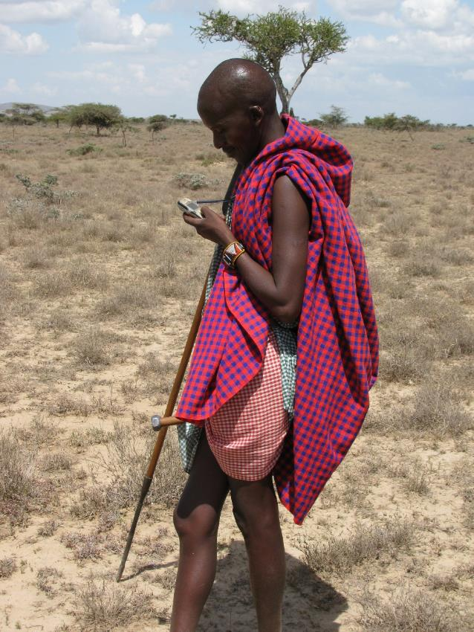
Masai with Cell Phone - Kenya

Slide 21
The Problem?
Working with technology in the sometimes-connected developing world is different and hard
Only 40% of the developing world has a mobile internet connection; less than 40% have smartphones
The design constraints for technology in the developing world are significant
The digital divide persists for the foreseeable future

Slide 22
The Persistent Digital Divide

Slide 23
The What & How?
Dial-a-context telecommunications environment
Simulate crisis scenario for voice and data
Immersion experience: problem solving in a bi-modal crises simulation
Test apps and systems in constrained environments
The UL for fit-for-purpose developing country apps

Slide 24
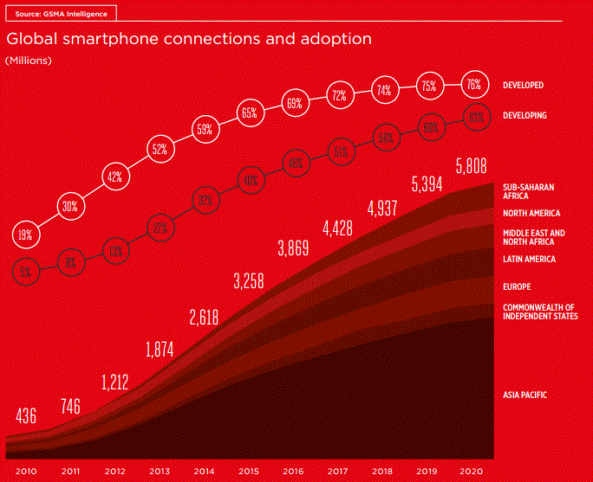
It’s Getting Better, But is Still Uneven
How do we solve problems and build apps in a 2G world?
The numbers are 66% and 65% for the Developed World; the gap is narrowing, but not much…
Welcome to the Digital Divide

Slide 25
Benefits
Sensitize entrepreneurs for relevant design
Learn how to work with technology in crises
A test-bed for lightweight apps and devices

Slide 26
How can students get involved?
Sign up for Crisis Informatics course in the fall
Join Advisory Committee for Crisis Informatics (ACCI)
Contact Ed Happ at ehapp@umich.edu

Slide 27
Value for Technology Co. Partners
Test hardware and software for emerging countries and disaster response before deploying
Train employees engaged with disaster response in a controlled lab environment
Create scenarios for future employees to be able to lead and solve problems in chaotic and under-resourced situations
Enhance a CSR program with employee “fellows” to assist in the connectivity lab

Slide 28
The UMSI - NetHope Internship Program

Slide 29
The Problem?
Some long-established roles for internship programs:
  front-line experience in organizations of interest,
  mutual “test driving” for students and org’s,
  a strong step in the recruiting process for employment opportunities for graduates
Humanitarian sector has supported interns in the program areas, such as public health, but technology interns are rare.
Persistent underfunding of IT in NGOs and coming revolution of rethinking most business as digital enterprises, the time is ripe for creating a feeder system of IT talent for nonprofit work.
NetHope and UMSI are at this crossroads
Convergence: NGOs have unfunded tech project needs; tech company employees want to work on NGO problems; tech students want to work with NGOs and Tech Co’s.

Slide 30
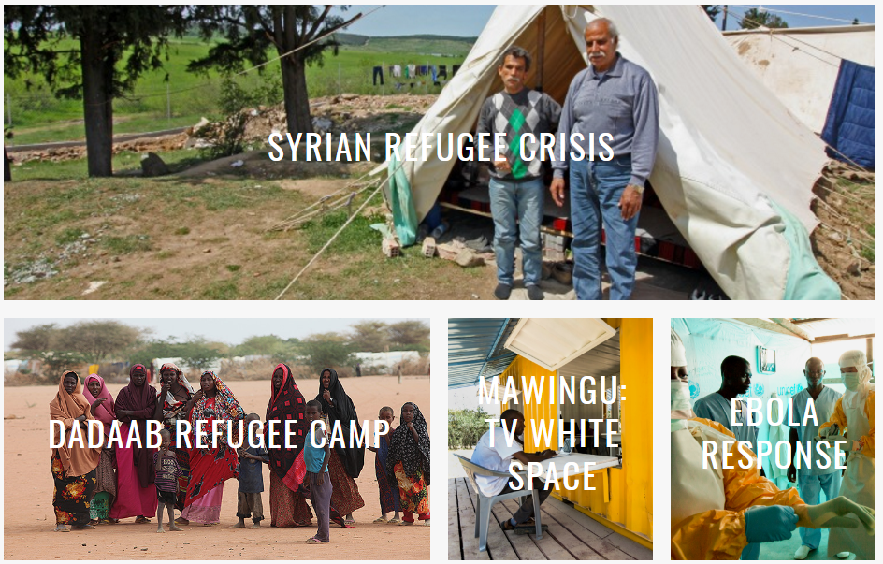
NetHope Field Projects

Slide 31
The What, How and When?
Three Program Roles:
  Providing a talent pool of technology savvy students
  Providing the “match-making” of nonprofit needs, student talent and tech company employees
  Providing the funding for interns who are placed at NetHope members
    UMSI Office of Career Development has funding to assist student interns working internationally and domestically in public sector, high-impact opportunities.
    In addition, UMSI and NetHope will jointly seek additional funding to grow and enhance the program and its management.
Pilot launching this month for the summer 2018 internship season
Project proposals from NGOs due mid-December

Slide 32
Benefits?
Students can benefit from experiencing technology contexts in other cultures and helping solve real problems.
Facilitating students’ engagement in meaningful internship experiences that enhance their education, and leveraging that experience for employment in fulfilling careers.
NGOs can benefit from an internship program that allows them to expand their use of IT, especially in running field innovation trials.
Having strong information technology graduates employed in nonprofit organizations enhances Corporate participation.
Availability of students to include in front-line research projects at humanitarian and other nonprofit organizations.

Slide 33
How can students get involved?
Sign up with the Engaged Learning Center to express interest in this internship program
Contact Ed Happ at ehapp@umich.edu or Kelly Kowatch at kkowatch@umich.edu for more details

Slide 34
Value for Technology Co. Partners
Help develop the next generation of leadership who can adapt to disruptions in developing countries
Students may work on NGO IT projects focused on a given tech platforms
Students may do a “two-for” tour: one semester in field and one at tech co.
Access to a cadre of well-balanced, experienced students for recruiting
Opportunity for a UMSI-NetHope co-branded intern program
Enhance a CSR program with employee-student “buddy system” field assignments

Slide 35
Conclusion

Slide 36
The wisdom of professors
A wise system analysis teacher, many years ago, noted that “everything is deeply inter-twingled”
What these three initiatives, and the Crisis Informatics course bring to UMSI is an integrated set of benefits…
Notes:
Tom DeMarco, Systems Analysis seminar, circa 1977.

Slide 37
An Integrated set of benefits
Crisis Informatics + IT Leadership Courses
Field Experience
UMSI-NetHope Interns
The Connectivity Lab
IT-Crisis Simulation
Data4Good
Center
Applied Data Science
Test Devices and Apps for data collection
Decision Support
Data Science Curriculum
…a work in progress

Slide 38
The NGO Data Science Opportunity
Nonprofits are missing the advantage of the big data and data science revolution, because,
Much nonprofit data are locked in PDF report silos
Impact data is rarely aggregated for scope and time
Creating the big data from the small data is a research and decision-support opportunity

Slide 39
Why UMSI?
UMSI’s mission is at the intersection of people, information and technology.
Bringing together the Connectivity Lab, Data4Good and Internship initiatives provide the occasion and space to develop a future data science curriculum and cross-department certification to prepare the next generation of data analysts for nonprofit work.

Slide 40
How can you be a part of it?
Students:
Sign up for Crisis Informatics course in the fall
Join Advisory Committee for Crisis Informatics (ACCI)
Contact Ed Happ at ehapp@umich.edu
Technology Companies and Sponsors:
Become a sponsor for one of more of the initiatives
We are seeking to raise $1.3M over three years* to launch and take these to scale
We are looking for employees to volunteer time to work with us on the initiatives
And we need hardware, software and data to support them
* See the draft budget estimate spreadsheet

Slide 41
Notes:
https://www.si.umich.edu/

