Slide 1
Succeeding in under-resourced, design-constrained, high-stakes settings –
Opportunities & Risks of Technology in NGOs
Edward G. Happ
GIEP Lecture
17 Apr. 2017 rev.

Slide 2
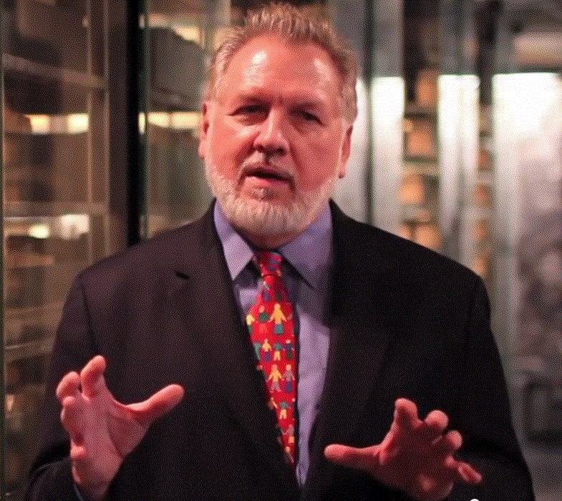
A Brief Introduction
13 Years on Wall Street
10 Years in management consulting
17 years in NGOs
Former Global CIO at IFRC
Former CIO at STC/US & UK
Co-founder and former Chairman of NetHope.org
More on LinkedIn, Google and www.eghapp.com
Connect!
Notes:
When I was 38, I read a comment by Handy saying we could expect to have 5 careers; for the millennials, they can expect to have 14 jobs…by the time they are 38! (see https://www.youtube.com/watch?v=XrJjfDUzD7M at 02:15)
http://www.amazon.com/The-Age-Unreason-Charles-Handy/dp/0875843018
Charles Handy, http://www.texasventures.us/india/images/leader2_1.jpg …five careers

Slide 3
Thesis
Constrained environments can bring out the best in those trying to make IT work

Slide 4
We will look at
1) Examples of crises & disaster
2) An IT Strategic framework
3) Context-sensitive IT
4) The Collaboration Imperative

Slide 5

1. Examples Crises & Disaster

Slide 6
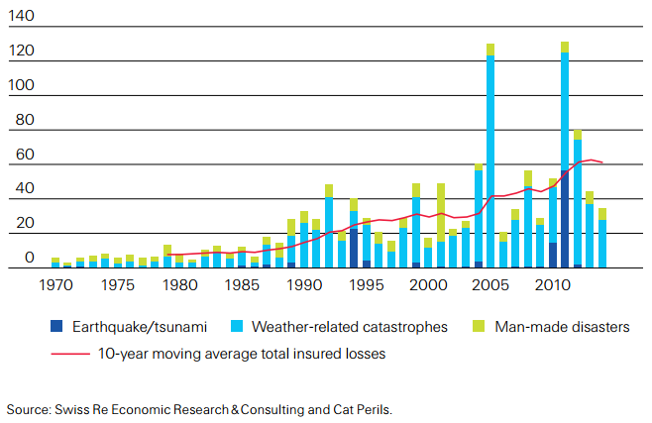

Disaster Costs Continue to Rise
6
6
Notes:
http://www.swissre.com/sigma/
http://media.swissre.com/documents/sigma2_2015_en_final.pdf
Figure 3, p. 5
Insured catastrophe losses, 1970–2013
1992: Hurricane Andrew
1994: Northridge earthquake
1999: Winter Storm Lothar
2001: 9/11 attacks
2004: Hurricanes Ivan, Charley, Frances
2005: Hurricanes Katrina, Rita, Wilma
2008: Hurricanes Ike, Gustav
2010: Chile, New Zealand earthquakes
2011: Japan. New Zealand earthquakes,
Thailand flood
2012: Hurricane Sandy

Slide 7
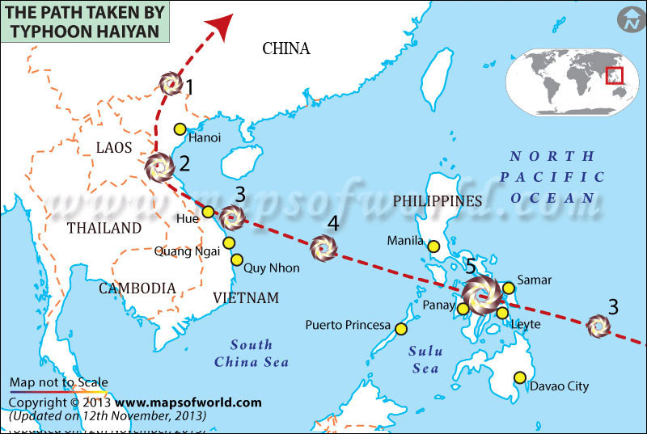
7
Notes:
http://www.washingtonpost.com/blogs/worldviews/wp/2013/11/15/8-maps-that-explain-why-typhoon-haiyan-hit-the-philippines-so-hard/

Slide 8
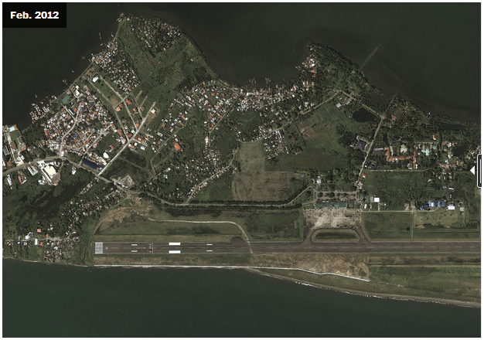
Tacloban Airport Before
8
Notes:
http://www.washingtonpost.com/blogs/worldviews/wp/2013/11/15/8-maps-that-explain-why-typhoon-haiyan-hit-the-philippines-so-hard/

Slide 9
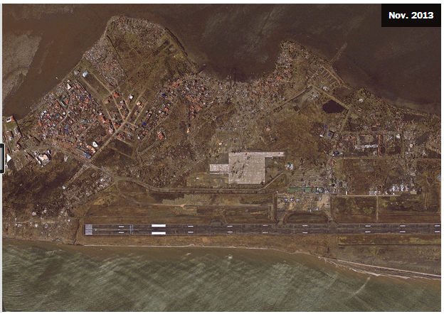
Tacloban Airport After
9
Notes:
http://www.washingtonpost.com/blogs/worldviews/wp/2013/11/15/8-maps-that-explain-why-typhoon-haiyan-hit-the-philippines-so-hard/

Slide 10
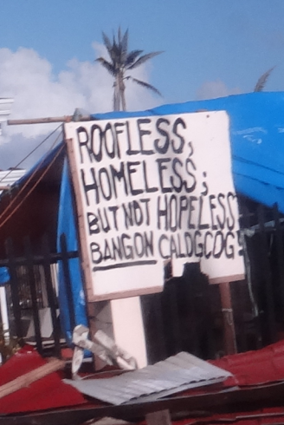
RC Philippines Response – Jan. 2014
By the Numbers:
16 million people affected
6,201 deaths reported
4 million people displaced
1.14 million houses damaged
Source: NDRRMC, 14 Jan. 2014
10
Notes:
IFRC: Philippines Typhoon Haiyan, FACT SitRep 20, 29 January 2014, pg. 1

Slide 11
Three ICT Things Different in Haiyan DR
Telco networks recovered before NGO VSATs were set up
BYOT extended to relief workers
ICT Collaboration worked
11

Slide 12
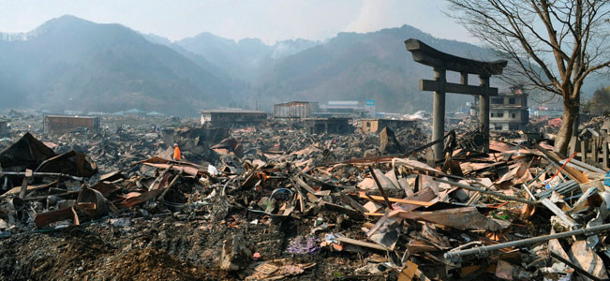
Japan Tsunami Aftermath – 14 Mar 11
A destroyed landscape in Otsuchi village,
Iwate Prefecture in northern Japan” -- Reuters/Kyodo
12
Notes:
http://news.yahoo.com/s/ap/ap_on_bi_ge/as_japan_earthquake_nuclear_crisis

Slide 13
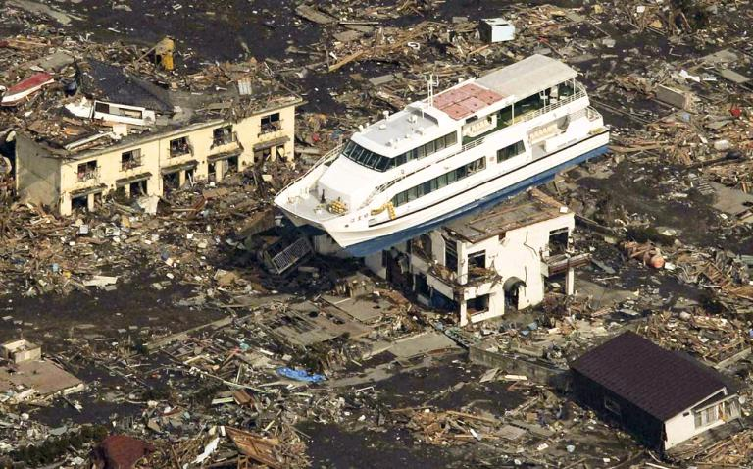
Japan Tsunami Aftermath – 14 Mar 11

Slide 14
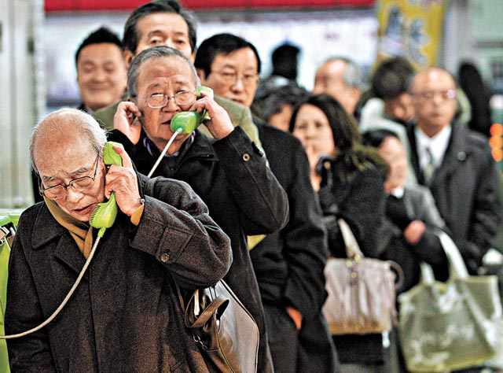
People need to know their loved ones are safe
“People need Information as much as water, food,
medicine or shelter.
Information can save lives, livelihoods and resources.
Information bestows power.” –World Disasters Report 2005
14
Notes:
http://voices.washingtonpost.com/blog-post/tsuna.JPG

Slide 15
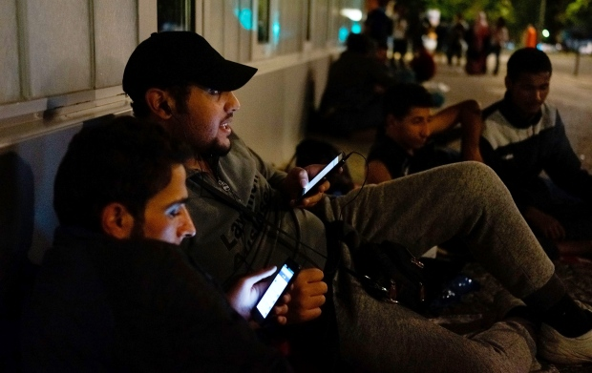
Syrian Refugees – Sep. 2015
Information to survive
“Refugees from Syria use smartphones to connect with relatives back home as they wait outside a government office in Berlin last month.” --Carsten Koall/Getty
Notes:
http://www.cbc.ca/news/world/for-syrian-refugees-smartphones-are-a-lifeline-not-a-toy-1.3221349

Slide 16
Three ICT Things Different in Syrian DR
Beneficiaries led in technology (70% of youth have smartphones)
Top questions were about information (next slide)
Lack of coordination among receiving countries (getting better)
16

Slide 17
Top Questions of Refugees in Greece
Where am I?
Do you have WiFi?
Where can I buy food and water?
Where can I breastfeed my baby?
Where is the bus to Germany?
Can I take a taxi?
How do I register?
Why am I being fingerprinted?
How long must I stay here before I can leave?
Where can I change money?
--Tyler Jump (IRC), Huffington Post, 29-Oct-2015
17
Notes:
http://www.huffingtonpost.com/tyler-jump/common-questions-refugees-ask-when-arrive-europe_b_8400118.html

Slide 18
Phases of a Disaster Response
Preparedness
First Response
Scaling up
Transition
Learning
Stage 0
Stage 4
Stage 1
Stage 3
Stage 2
18

Slide 19
This is Changing…
Preparedness
First Response
Scaling up
Transition
Learning
Stage 0
Citizens
Beneficiaries
Volunteers
Corp’s
Stage 4
Stage 1
Stage 3
Stage 2
19

Slide 20
Timeline of a Disaster Response
Stage 0: Preparedness
  Example: Typhoon preparedness in Bangladesh
  This is the best investment (5:1)
Stage 1: Within hours of disaster striking
  Example: CRS in sectarian fighting in eastern Congo
  This is the Highly Individual, Highly Mobile ICT stage
Stage 2: Within two weeks of disaster striking
  Example: Relief International in Bam, Iran earthquake
  Small Group,
  Mobile/Temporary ICT stage
Stage 3 – From one-six months following a disaster striking to multi-year.
  Large Group,
  Permanent ICT stage
Stage 4 – Learning
  Example: NetHope members in Pakistan earthquake response
  Don’t waste mistakes
20
Notes:
Bangladesh cyclone: 3,000 fatalities in 2007 versus 138 000 in 1991 and 500,000 in 1970
Factor of 50-100 reduction due to advance evacuation of 3.2M people and stockpiles of relief supplies, i.e. disaster preparedness! (see http://fe4.news.re3.yahoo.com/s/time/20071119/wl_time/howbangladeshsurvivedthecyclone )

Slide 21
Bangladesh Cyclone Fatalities
Preparedness
Works!
Due to
planning, training,
early warning,
advance evacuation
of 3.2M people,
and stockpiles
of relief supplies
21
Notes:
Bangladesh cyclone: 3,000 fatalities in 2007 versus 138 000 in 1991 and 500,000 in 1970
Factor of 50-100 reduction due to advance evacuation of 3.2M people and stockpiles of relief supplies, i.e. disaster preparedness! (see http://content.time.com/time/world/article/0,8599,1685330,00.html )

Slide 22
Changing Priorities By Program Type
For emergency response, time and volume are king;
for development, cost and quality reign
Ranking factors 1-4, 1=highest
22
Notes:
For emergency response, time and volume are king; for development, cost and cost reign

Slide 23
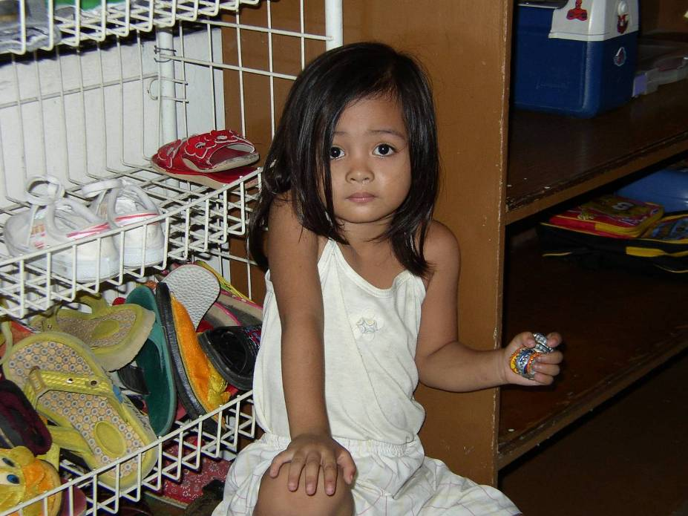
Good Enough…
Following the Tsunami response, a marketing director recalled, “We didn’t have time to have all the meetings, all the reviews, and all the approvals.” “We had to make on-the-spot-decisions.” “The interesting thing”, she continued,” is that nothing fell apart.” “Maybe we could make decisions like that everyday.”
Save the Children Day care Center in Manila
“The Good Enough Principle “ June 2008

Slide 24
The Lesson of the Bottle-caps
Simple, basic toys are good enough
She brought her toys with her to the center
She had already adopted these toys as hers
Now change the word
“toys” to
“technologies”

Slide 25
2. An IT Strategic Framework

Slide 26

Parable of the Rocks
26
Notes:
http://www.flickr.com/photos/weeping-willow/2852177218/

Slide 27
What’s the single most important strategic question?

Slide 28
What’s my destination?

Slide 29
Strategy is about connecting the dots, seeing around the corners and choosing a destination.
29

Slide 30
Technology is a Key to Building Capacity
More Effective Impact
At Greater Scale
Effective, Efficient, Scalable Programs
Hiring
Training
Partnering
Advocacy
Tools
Processes
Standards
Systems Impact
Funding Support

Slide 31
An NGO IT Strategy Approach
Get in
Competitive
or Leading
BENEFICIARY
“Differentiating”
Beneficiary & Field Facing
Increasing Impact for Beneficiaries
PROGRAM
“Improving Program Delivery”
Increasing Impact for Beneficiaries
Move up
OPERATIONAL
“Helping the Organization Run”
Efficient
Donor & HQ
Facing
FOUNDATIONAL
“Keeping the Lights On”
Get out
31

Slide 32
3. Context Sensitive ICT

Slide 33
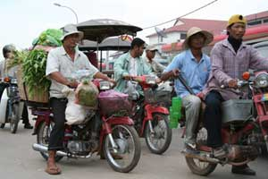
The Sometimes Connected Internet
Internet Village Motoman Network
Notes:
http://www.developingtelecoms.com/content/view/687/59/
Internet Village Motoman “Already, innovative ICT projects in Cambodia have helped connect remote rural schools to the internet,” said Tony Bates. “With NGN technology things can only get better.”
Cambodia was picking itself up and could show the way to several developing nations. Mr Bates went on to cite the example of a First Mile Solutions project called “Internet Village Motoman”, which used new ICT to provide internet access for 15 solar-powered village schools, telemedicine clinics, and the governor’s office in a remote province of Cambodia - using five Honda motorcycles.
The project worked by equipping new schools in the villages with solar panels on the roof to provide sufficient energy to run a computer for six hours and providing an e-mail link via a motorcycle delivery system.
Early every morning, five Honda motorcycles leave the hub in the provincial capital of Banlung, where a satellite dish donated by Shin Satellite links the provincial hospital and a special skills school to the Internet for telemedicine and computer training.
The motorcycle drivers, equipped with a small box and antenna at the rear of their vehicle that downloads and delivers e-mail through a wi-fi (wireless) card, begin the day by collecting the e-mail from the hub's dish, which takes just a few seconds.
Then, as they pass each school and one health centre, they transmit the messages they have downloaded and retrieve any outgoing mail queued in the school or health centre computer, also equipped with a similar book-sized transmission box. They then go on to the next school. At the end of the day they return to the hub to transmit all the collected e-mail to the Internet for any point on the globe.
“This is an example of technology changing the quality of life, it is testament to the power of engineering.” While the telecoms industry is “not inventing technology for technology’s sake, we respond to consumer demand across the broadest possible consumer base.”
TDS helped to highlight the fact that developing nations are now a major part of that consumer base, and have now become the primary focus of the telecommunication industry’s attention, particularly with regards to NGN technology, this also being the conclusion expressed elsewhere in this review, of Fernando Lagraña, Executive Manager of ITU Telecom World.
“The industry has the potential of benefiting the developing world in ways we hadn’t even deemed possible a few years ago,” he said. “We must ensure that the future of the industry is shaped by the needs of the least developed and developing world.”

Slide 34
A mere six per cent in low-income countries have access to the Internet, compared to a massive 76 per cent in high-income countries.
Welcome to the digital divide.
--IFRC, World Disasters Report, October 2013
34

Slide 35
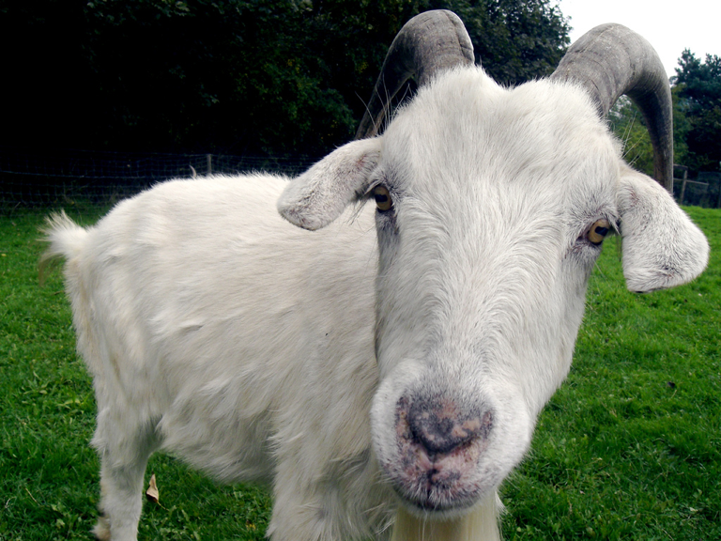
Twitter or the Goat?
35
Notes:
http://www.redhot.org/wp-content/uploads/2013/11/goat.jpg

Slide 36
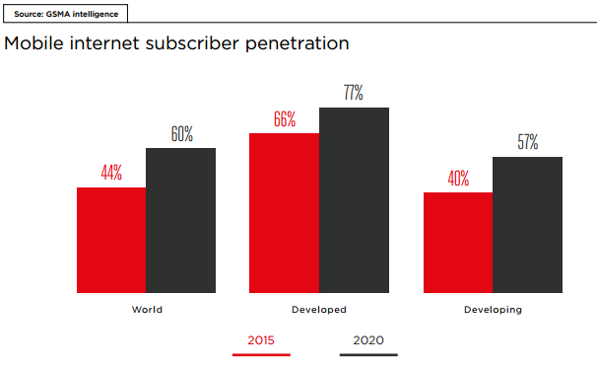
Even by 2020, the Digital Divide is still a problem
The Future Digital Divide
36
Notes:
GSMA, “The Mobile Economy 2016”, p. 39 http://www.gsmamobileeconomy.com/

Slide 37
We need to meet people where they are, with the technology they have adopted.
37

Slide 38
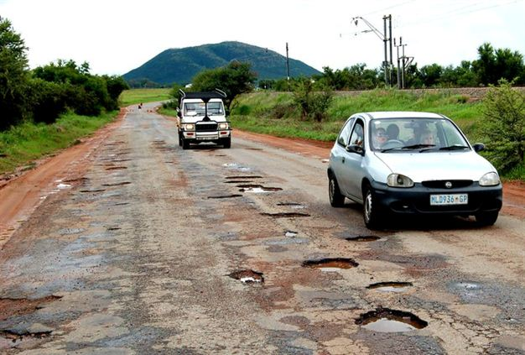
The Internet Highway in Rural Africa
38

Slide 39
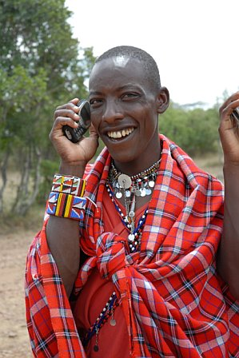
For the rest
of the world,
this is the Internet
39
Notes:
Masai Warrior at Ikelani Using Cell Phone, Jupiter research Blog, Julie Ask, October 06, 2006; http://weblogs.jupiterresearch.com/analysts/ask/archives/007174.html

Slide 40
2G Tuesdays at Facebook
“The initiative is designed to help employees empathize with users in booming markets like India, Thailand, and much of Latin America, but also to help them work out what they could improve about the app to make it more usable on slower connections.”
–The Verge, Oct. 2015
TUE
2G
40
Notes:
http://www.theverge.com/2015/10/28/9625062/facebook-2g-tuesdays-slow-internet-developing-world
https://en.wikipedia.org/wiki/Dial-up_Internet_access#Using_compression_to_exceed_56k

Slide 41
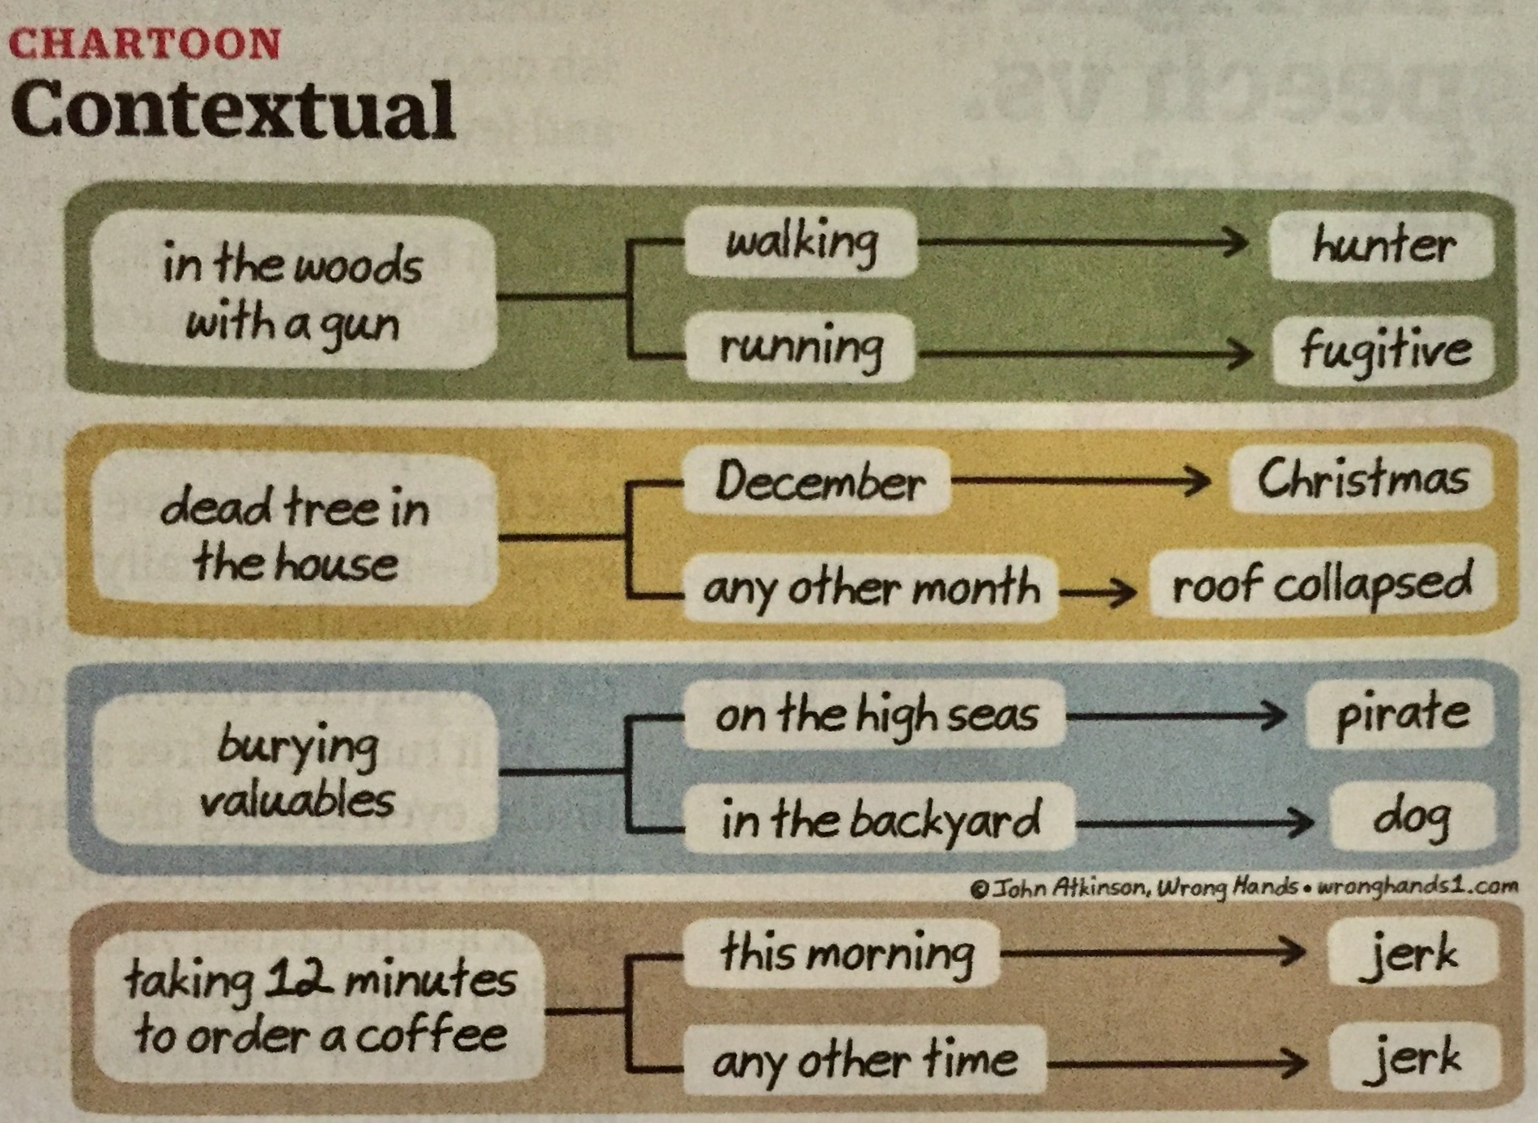
Another perspective on why context is so important, and rarely equivalent.
Notes:
John Atkinson, Time, March 13, 2017, p. 20

Slide 42
4) The Collaboration Imperative

Slide 43
The Problem: NGOs invest a fifth of corp. IT
5x
18x
4x
Notes:
43
43

Slide 44
Closing the Productivity Gap: A New Calculus
A back of the envelop calculation for taking a $5M IT
department in a $200M NGO to $23M
Charity Factor
Collaboration Factor
56%
Gap Remains
Notes:
A fictitious $200M NGO; 1,700 users

Slide 45
Leveling the NGO - Corp IT Playing Field

Slide 46
Non Profit IT Departments Can’t Play the Odds
IF
  57% of ERP projects don't realize their ROI (Nucleus Research)
  66% IT projects fail (Standish Chaos DB)
  NGOs spend a 20th what corporations do (Tuck survey)
  And we are spending donors’ dollars
THEN
We must find a better way...
46
Notes:
46

Slide 47
Key Conclusion: we can’t do it alone
Even if we tripled IT spending, we will still be playing catch-up for just keeping the lights on.
And…
Notes:
47

Slide 48
Keeping the Lights-On is Irrelevant!
It’s more a commodity each day; consider that:
  “We can't get close to what Google and Amazon can do in their data centers” –Peter Cochrane
Why then are we in the data center business?
48

Slide 49
We Need to Push the Pyramid at Both Ends
Get in
Competitive
or Leading
BENEFICIARY
“Differentiating”
Beneficiary & Field Facing
PROGRAM
“Improving Program Delivery”
Increasing Impact for Beneficiaries
OPERATIONAL
“Helping the Organization Run”
Efficient
Donor & HQ
Facing
FOUNDATIONAL
“Keeping the Lights On”
Get out

Slide 50





























The NetHope Collaboration: 33 50 Member NGOs
Notes:
From “Turning the Pyramid Upside Down, The Impact and Future of Technology in Nonprofits,” NTEN Tech Leadership Academy, Sept. 2011

Slide 51
The New Collaboration
Who Are You Partnering With?
“Who has expertise I can trust?”
Shared Services & Assessments
SHARED
SPECIALIZATION
JOINT PROJECTS
“What can we build together?”
NRK, Phase 2 Satellites
Increasing Level of Trust
PARTNERING
“How can we work with corporations?”
Cisco, Microsoft, Intel Grants
BASIC INFO SHARING
“What are my peers doing?”
Meetings, Conference Calls

Slide 52
Why NetHope Works?
We have…
  History: NetHope has been at it for almost 10 years: building trust since 2001
  Hunger: NGO IT are beggars – don’t underestimate value of under-funding
  Humility: extending trust to centers of excellence in other members
  Partnering: corporate partners buy-in to the leverage of collaboration and having impact with technology

Slide 53
Nancy Lublin’s book Zilch provides an interesting perspective on the lack of resources, a pervasive NGO problem. She sees it as an opportunity. Having nothing to work with brings out the creativity of people. It also reminds us why we work at nonprofit organizations in the first place. It is not about money; it’s about mission
Notes:
Nancy Lublin, Zilch: The Power of Zero in Business, Portfolio Hardcover, 2010.

Slide 54
Things you can do if you’re small
Get Out:
Get the hardware and software free or near free (Techsoup, corporate donations off-lease, etc.)
Get seats in training classes from partners (e.g., corps, larger organizations)
Form a cooperative for basic things like support
Get In:
Develop a strategy and plan with an informal board of IT advisors
Form a cooperative for experiments like I4D
Move Up:
Connect with beneficiaries through their phones (see MobileActive.org)
54
Notes:
See my Blog post: “Ten Ways Small NGOs Can Collaborate”, http://eghapp.blogspot.com/2012/02/ten-ways-small-ngos-can-collaborate.html

Slide 55
Conclusion

Slide 56

Advice from a Hockey Legend
“I skate to where the puck is going to be,
not where it has been.” --Wayne Gretzky

Slide 57
What we can learn from disaster relief about ICT?
  Urgent: communications are a matter of life and death
  Fast: the technologies that work now may not be the technologies with which you are familiar
  Good enough: some old tech gets the job done (e.g. radio)
  Improvising: mash-ups can solve the problem
  Humanitarian: information is aid
57

Slide 58
Take-aways
Constrained environments are an asset
Know your destination: “get out, get in, and move up”
Pay attention to the big rocks
Context is at the center
Small NGOs can act like big NGOs by collaborating

Slide 59
How to get involved?
Sign up for Crisis Informatics course in the fall
Join the ad hoc Advisory Committee for Crisis Informatics (ACCI)
Join the wiki: http://crisisinformatics.wikispaces.com/
Volunteer (the Red Cross and Peace Corps are recruiting)
Contact Ed Happ at ehapp@umich.edu
59

Slide 60
Further Reading
Blogs:
http://eghapp.blogspot.com/ (Current)
http://granger-happ.blogspot.com/ (Dartmouth Sabbatical)
Web site (see the articles & presentations link) http://www.eghapp.com
Email: ehapp@ifrc.org
Twitter: @ehapp
LinkedIn: http://www.linkedin.com/profile/view?id=1906312
Books: Managing Technology to Meet Your Mission, chap. 11
  We are Better Together, http://collaboration-book-project.blogspot.com/

Slide 61
Notes:
https://www.si.umich.edu/

