Slide 1
Managing the Disasters within what we can learn from disaster relief
Edward G. Happ
Global CIO, IFRC
ISCRAM, 21 May 2014

Slide 2
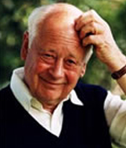
A Brief Introduction
13 Years on Wall Street
10 Years in management consulting
15 years in NGOs
Current Global CIO at IFRC
Former CIO at STC/US & UK
Co-founder and former Chairman of NetHope.org
More on LinkedIn, Google and www.eghapp.com
Connect!
2
Notes:
Charles Handy, http://www.texasventures.us/india/images/leader2_1.jpg …five careers

Slide 3

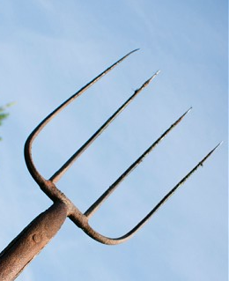
The Jackass Theory
Notes:
“…motivational theories can be divided into two types, push theories and pull theories……(or) pitch fork theories on the one hand and carrot theories on the other …Since we prefer to look to the nature of the animal himself, ours is probably best called a jackass theory” --George Kelly, 1969
http://www.centrepcp.co.uk/motivation.htm
George Kelly, 1969 Man’s construction of his alternatives”. In B. Maher (ed) Clinical Psychology and Personality: The Selected Papers of George Kelly. Wiley, p. 81).
What is pulling and pushing us? Social Media? Connected Citizens? Disruptive Change?
http://3.bp.blogspot.com/-HzJuzqXKzRM/TfKibvUCnzI/AAAAAAAAAB4/AoGn5V0iu24/s400/Donkey.jpg
http://i.telegraph.co.uk/multimedia/archive/02527/pitchfork_2527682b.jpg

Slide 4
Thesis
If we look at the characteristics of disaster response, we can gain insights in how to move forward in the midst of disruptive change in our organizations.

Slide 5
The Fabric of
Disaster Response

Slide 6
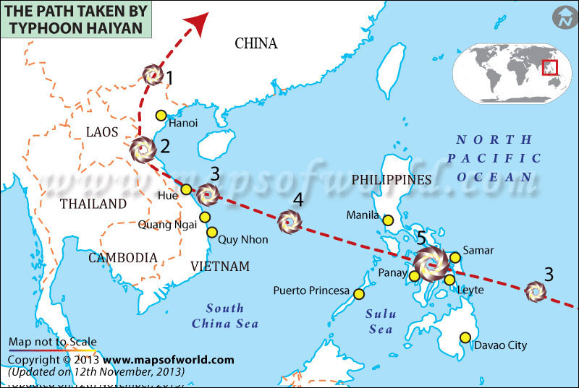
6
Notes:
http://www.washingtonpost.com/blogs/worldviews/wp/2013/11/15/8-maps-that-explain-why-typhoon-haiyan-hit-the-philippines-so-hard/

Slide 7
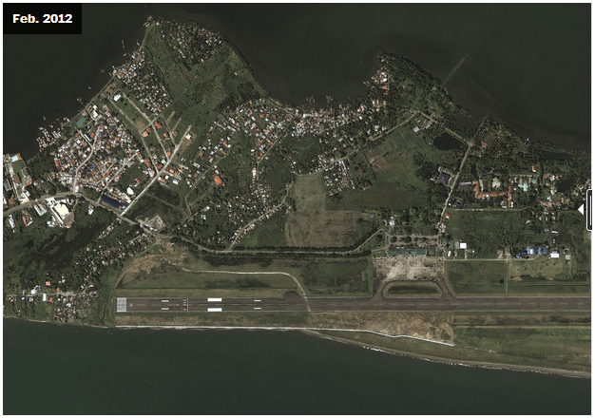
Tacloban Airport Before
7
Notes:
http://www.washingtonpost.com/blogs/worldviews/wp/2013/11/15/8-maps-that-explain-why-typhoon-haiyan-hit-the-philippines-so-hard/

Slide 8
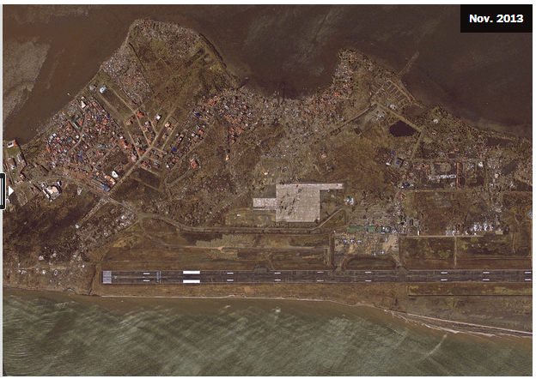
Tacloban Airport After
8
Notes:
http://www.washingtonpost.com/blogs/worldviews/wp/2013/11/15/8-maps-that-explain-why-typhoon-haiyan-hit-the-philippines-so-hard/

Slide 9
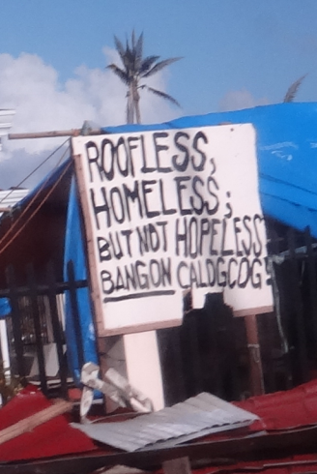
RC Philippines Response
By the Numbers:
16 million people affected
6,201 deaths reported
4 million people displaced
1.14 million houses damaged
Source: NDRRMC, 14 Jan. 2014
9
Notes:
Photo by Joseph Oliveros, IFRC, Dec. 2103. IFRC: Philippines Typhoon Haiyan, FACT SitRep 20, 29 January 2014, pg. 1

Slide 10
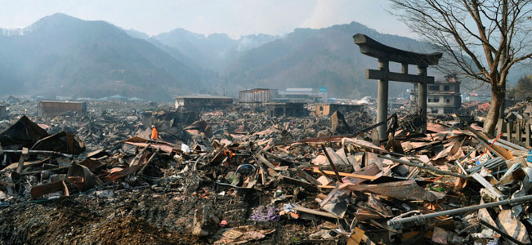
Japan Tsunami Aftermath – 14 Mar 11
A destroyed landscape in Otsuchi village,
Iwate Prefecture in northern Japan” -- Reuters/Kyodo
10
Notes:
http://news.yahoo.com/s/ap/ap_on_bi_ge/as_japan_earthquake_nuclear_crisis

Slide 11
Timeline of a Disaster Response
Stage 0: Preparedness
  Example: Typhoon preparedness in Bangladesh
  This is the best investment (5:1)
Stage 1: Within hours of disaster striking
  Example: CRS in sectarian fighting in eastern Congo
  This is the Highly Individual, Highly Mobile ICT stage
Stage 2: Within two weeks of disaster striking
  Example: Relief International in Bam, Iran earthquake
  Small Group, Highly Mobile/Temporary ICT stage
Stage 3 – From one-six months following a disaster striking to multi-year.
  Large Group - Permanent ICT stage
Stage 4 – Learning
  Example: NetHope members in Pakistan earthquake response
  Don’t waste mistakes
11
Notes:
Bangladesh cyclone: 3,000 fatalities in 2007 versus 138 000 in 1991 and 500,000 in 1970
Factor of 50-100 reduction due to advance evacuation of 3.2M people and stockpiles of relief supplies, i.e. disaster preparedness! (see http://fe4.news.re3.yahoo.com/s/time/20071119/wl_time/howbangladeshsurvivedthecyclone )

Slide 12
Connections of a Disaster Response
Preparedness
First Response
Scaling up
Transition
Learning
Stage 0
Stage 4
Stage 1
Stage 3
Stage 2
12

Slide 13
Bangladesh Cyclone Fatalities
Preparedness
Works!
13
Notes:
Bangladesh cyclone: 3,000 fatalities in 2007 versus 138 000 in 1991 and 500,000 in 1970
Factor of 50-100 reduction due to advance evacuation of 3.2M people and stockpiles of relief supplies, i.e. disaster preparedness! (see http://fe4.news.re3.yahoo.com/s/time/20071119/wl_time/howbangladeshsurvivedthecyclone )

Slide 14
Changing Priorities By Program Type
For emergency response, time and volume are king;
for development, cost and quality reign
Ranking factors 1-4, 1=highest
14
Notes:
For emergency response, time and volume are king; for development, cost and cost reign

Slide 15
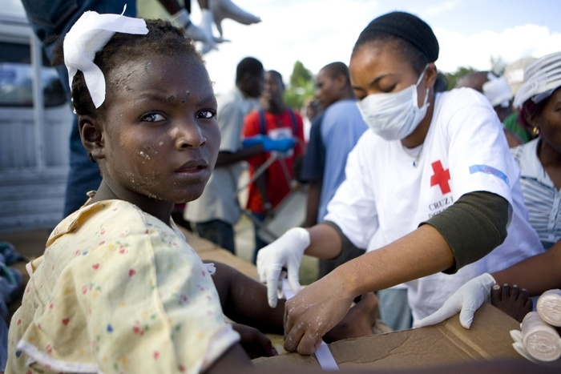
Haiti – 19 Jan 10
15
Notes:
http://www.ifrc.org/en/news-and-media/photo-galleries/2010/haitiearthquake-januaryI-2010/

Slide 16
An IT Strategy Interlude
Get in
Competitive
or Leading
BENEFICIARY
“Differentiating”
Beneficiary & Field Facing
Increasing Impact for Beneficiaries
PROGRAM
“Improving Program Delivery”
Increasing Impact for Beneficiaries
Move up
OPERATIONAL
“Helping the Organization Run”
Efficient
Donor & HQ
Facing
FOUNDATIONAL
“Keeping the Lights On”
Get out

Slide 17
Innovation at the margins
User Devices
Network
Enterprise apps
Data
User apps
Historical IT
all components provided
Current
Users bring
their own devices & apps
Future
Users bring
their own networks

Slide 18
Innovation at the margins
User Devices
Network
Enterprise apps
Data
User apps
Local innovation
more likely and sustainable at the outer
layers of IT delivery

Slide 19
Innovation at the margins
User Devices
Network
Enterprise apps
Data
User apps
Standard core
It is unlikely
users will have or should have their own Finance, HR, Supply Chain, and Legal applications and data

Slide 20
An NGO Supply Chain
Beneficiary engagement
Assessment
Country – Sub-Office
Reporting
Plan
Procure
Ship
Warehouse
Ship
Ben. Track
For development, procurement is competitive; for emergency response, procurement is pre-determined and agile
Beneficiary tracking is key in the NGO supply chain; commercial SCM applications lack this
Beneficiary engagement is increasing in the supply chain
20
Notes:
For development, operational budget planning happens first; competitive bids are < 3 days due to relationships with suppliers; so often the same process for ER

Slide 21
Crisis Needs
1: Is my family OK?
2: Can I get food, water, shelter?
3: Can we communicate? (Voice/Data)
21
Notes:
21

Slide 22
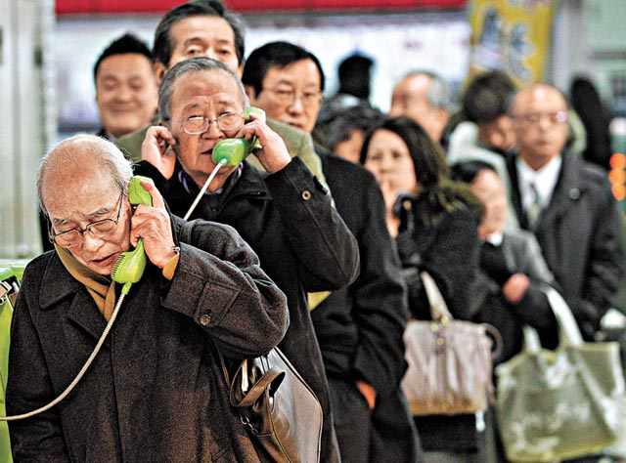
Japan 2011
22
Notes:
http://voices.washingtonpost.com/blog-post/tsuna.JPG

Slide 23
People need to know their loved ones are safe
“People need Information
as much as water, food, medicine or shelter.
Information
can save lives, livelihoods and resources.
Information
bestows power.”
–World Disasters Report 2005

Slide 25
Three ICT Things Different in Haiyan DR
Telco networks recovered before NGO VSATs were set up
BYOT extended to relief workers
ICT Collaboration worked

Slide 26
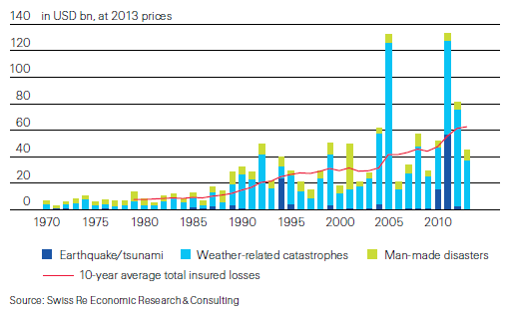
Disaster Costs Continue to Rise
26
Notes:
http://www.swissre.com/sigma/
http://media.swissre.com/documents/sigma1_2014_en.pdf
Figure 3
Insured catastrophe losses, 1970–2013
1992: Hurricane Andrew
1994: Northridge earthquake
1999: Winter Storm Lothar
2001: 9/11 attacks
2004: Hurricanes Ivan, Charley, Frances
2005: Hurricanes Katrina, Rita, Wilma
2008: Hurricanes Ike, Gustav
2010: Chile, New Zealand earthquakes
2011: Japan. New Zealand earthquakes,
Thailand flood
2012: Hurricane Sandy

Slide 27
Some Lessons

Slide 28
Ten Lessons
What we can learn from disaster relief about management of organizations?
  Urgent
  Fast
  Lean
  Attentive
  Flat
  Good enough
  Costs are last
  Preparing is not executing
  Improvising
  Humanitarian
28

Slide 29

Urgent…
There is a burning platform
and we are jumping on it.
Opposite of a change initiative
29
Notes:
“
“The Burning Platform, the Boiled Frog and the Rusting Platform”, Publishing Technology blog, August 9, 2011
http://www.publishingtechnology.com/2011/08/burning-platform-boiled-frog-rusting-platform/

Slide 30
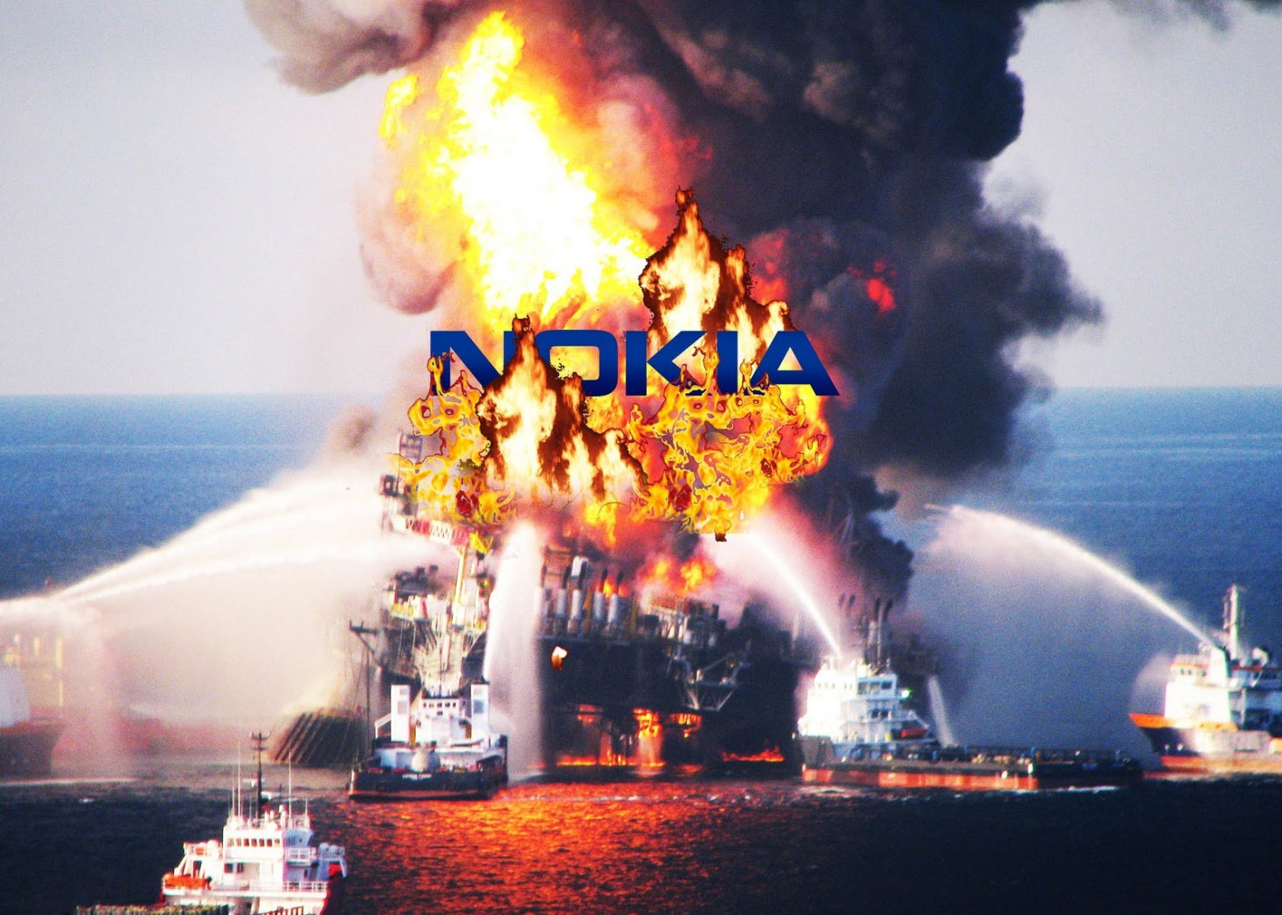
A burning platform
Nokia’s new CEO Stephen Elop described the company’s situation as
“Standing on a burning platform”. –Feb. 2011
30
Notes:
http://engageinnovate.wordpress.com/2011/09/23/the-burning-platform-and-other-recommended-readings-in-strategy/
http://blogs.wsj.com/tech-europe/2011/02/09/full-text-nokia-ceo-stephen-elops-burning-platform-memo/

Slide 31
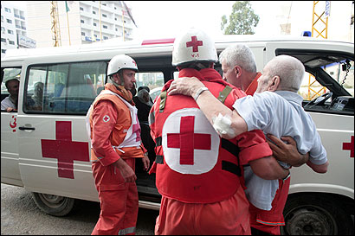
Fast…
31
Notes:
http://www.boston.com/news/world/articles/2006/07/25/ambulance_drivers_tell_tales_of_horror/

Slide 32
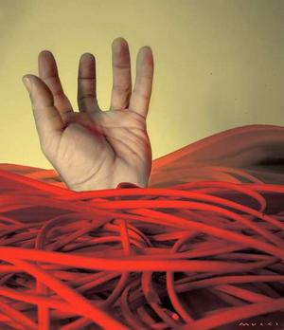

Lean…
32
Notes:
http://www.asiantrader.biz/industry-news/Small+firms+are+sceptical+over+theCoalition%27s+pledge+to+cut+red+tape/705
http://librarylostfound.com/2013/06/07/mrs-weiss-scissors-rules/

Slide 33
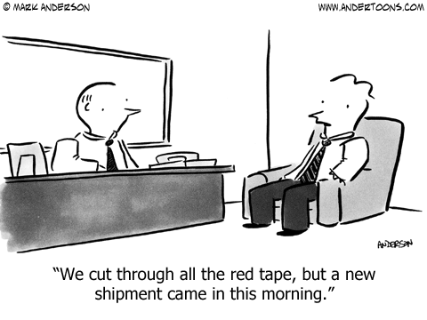
….and stay cut
33
Notes:
http://www.andertoons.com/business/cartoon/4548/we-cut-through-all-red-tape-but-new-shipment-came-in-this-morning

Slide 34


Attentive…
Amplifying the whispering
34

Slide 35

Flat…
Rule #1: Use good judgment in all situations.
There will be no additional rules.
35
Notes:
Nordstrom Rules:
Rule #1: Use good judgment in all situations.
There will be no additional rules.
http://en.wikipedia.org/wiki/Nordstrom#Employee_handbook
http://cdn.styleblazer.com/wp-content/uploads/2013/12/get.jpg

Slide 36
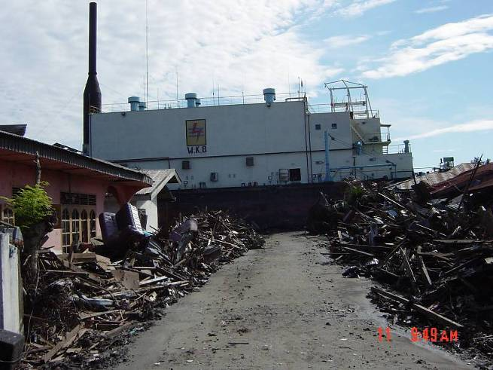
Good Enough…
Following the Tsunami response, a marketing director recalled, “We didn’t have time to have all the meetings, all the reviews, and all the approvals.” “We had to make on-the-spot-decisions.” “The interesting thing”, she continued,” is that nothing fell apart.” “Maybe we could make decisions like that everyday.”
Banda Aceh, 2004
36
“The Good Enough Principle “ June 2008

Slide 37
Costs are Last…
Ranking factors 1-4, 1=highest
37
Notes:
For emergency response, time and volume are king; for development, cost and cost reign

Slide 38
Preparing & executing…
Ready
Fire
Aim
Ready
Aim
Fire
Ready
Aim
Ready
Aim
Ready
38
Notes:
See Tom Peters discussion on Ready-Fire-Aim

Slide 39
Improvising
The Apollo 13 story was featured in the 1995 film with Tom Hanks and Kevin Bacon. The incredible events that unfolded in April 1970 gripped the nation and the world.
On April 13,
56 hours into the mission, an oxygen tank in the service module that contained the astronauts’ support systems exploded.
Notes:
The NASA account of the accident is here: http://nssdc.gsfc.nasa.gov/planetary/lunar/ap13acc.html

Slide 40
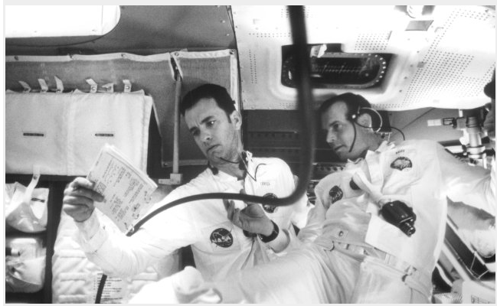
The Apollo 13 story
“And you, sir, are a steely-eyed missile man”
Notes:
http://www.youtube.com/watch?v=5giXXW_UdaM
Photo: http://www.imdb.com/media/rm1413254656/tt0112384

Slide 41
Five things…
Urgent! Life or death crisis
Improvising under time-pressure
Scarcity is not a limitation
Good-enough works
High collaboration
41

Slide 42
Humanitarian…
We care
  People are vulnerable
  People are hurting
The customer is the first responder
  90% of first responders are local people
  Resilience is not a gift
Notes:
It’s ownership

Slide 43
Disruptive Change

Slide 44
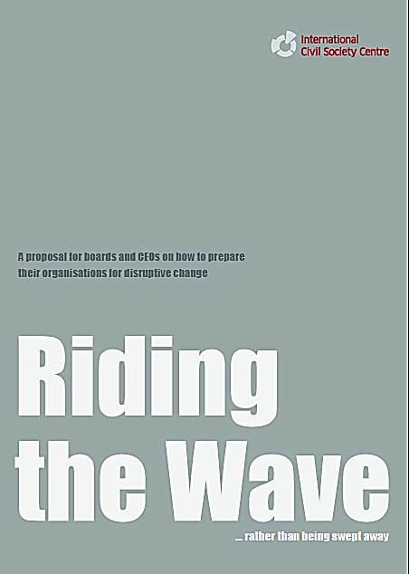
Disruptive Change
The topic of disruptive change has gone main-stream; no NGO leader doubted its relevance, threat and opportunity.
International Civil Society Centre, Berlin, October 2013
http://icscentre.org/area/riding-the-wave
44
Notes:
http://icscentre.org/area/riding-the-wave

Slide 45
Scale + speed + surprise
= disruption
“…over the last 20 years change itself has changed: it has become faster, more fundamental and more surprising. When these three elements come together, we experience disruption.”
--Riding the Wave, October 2013

Slide 46

Industries RIP
46
Notes:
Motley Fool Newsletter, August 3, 2013, at 15:36 here: http://www.fool.com/fool/free-report/18/sa-cabletvaudio-253366.aspx?source=isaspodft0000782

Slide 47
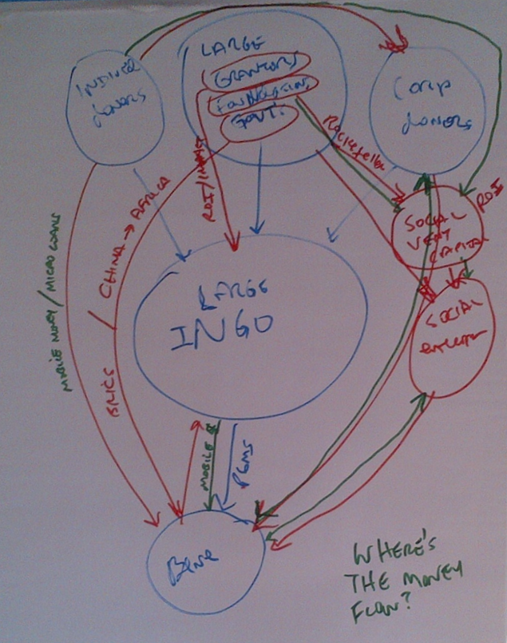
Large INGOs have been the trusted intermediaries between those with the money and those in need, but the avenues are changing.
Notes:
Flipchart from Disruptive Change WG in Bellagio, June 2013

Slide 48
Ask Some Key Questions…
What disruptive technology change has impacted other sectors that could potentially impact the humanitarian sector?
How have we used positive mindset to embrace disruptive change as opportunity rather than a threat?
What types of leadership skills and approaches are needed for periods of rapid change?
When and how has adaptability trumped preparedness in handling disruptive change such as disasters?
When has organizational humility been a greater asset than organizational pride in times of massive change?
eghapp.blogspot.com
48
Notes:
See 21 questions in Blog article.

Slide 49

2013 World Disasters Report
A mere 6% in low-income countries have access to the Internet, compared to a massive 76% in high-income countries.
Welcome to the digital divide.
--IFRC, World Disasters Report, October 2013
49
Notes:
https://www.ifrc.org/publications-and-reports/world-disasters-report/world-disasters-report-2013/

Slide 50
“90% of lives saved after disasters are saved by local people.
“But these 90% of ‘first responders’ in the most vulnerable contexts are the least likely to have access to life-saving technologies, such as early warning systems and life-saving mobile phone messages.”
--IFRC, World Disasters Report, October 2013

Slide 51

Twitter or the Goat
51
Notes:
Story told by Mary Jane Samkele, of Transparency International, Zimbabwe; twitter or the goat to get citizen feedback? At Global Perspectives Conference in Johannesburg, 14 Nov 13.
http://www.redhot.org/wp-content/uploads/2013/11/goat.jpg

Slide 52
"Two recent Gallup polls showed that although 96% of chief academic officers believe they’re doing a good job of preparing students for employment,
only 11% of business leaders agree that graduates have the requisite skills for success in the workforce. And this is all occurring while higher education leaders were convinced that they were innovating all along."
--Clayton M. Christensen and Michelle R. Weise, Boston Globe, May 09, 2014
Notes:
http://www.bostonglobe.com/opinion/2014/05/09/moocs-disruption-only-beginning/S2VlsXpK6rzRx4DMrS4ADM/story.html

Slide 53

Riding the Wave
http://icscentre.org/area/riding-the-wave
53
Notes:
http://icscentre.org/area/riding-the-wave

Slide 54
Some Responses

Slide 55
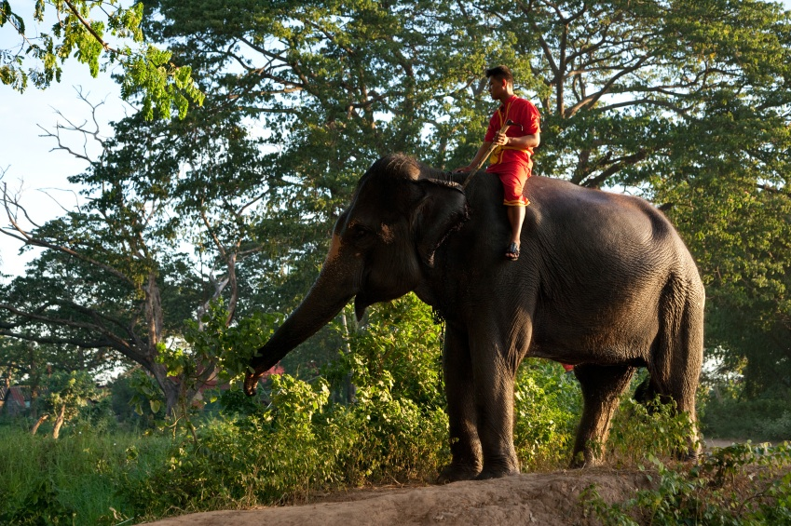
Change is Hard
55
Notes:
http://www.terrainfirma.co.uk/blog/wp-content/uploads/2011/11/elephant.jpg

Slide 56
"Often the first step to gaining the new insight necessary for innovation is to unlearn. "
--Frank Barrett, Yes to the Mess
Notes:
Barrett, Yes to the Mess: Surprising Leadership Lessons from Jazz, HBR Press, 2012, p. xi.

Slide 57
What do NGOs respond to?
Evidence base
Competition
Addressing Risks
57

Slide 58
If the Horse is Dead…
How an NGO might respond
  Buy a stronger whip
  Change riders
  Declare as a core value
  Appoint consultants
  Rewrite performance standards
  Create a training program
  Form a project team
  Promote the dead horse
58
Notes:
http://www.caseconsultingservices.com/tips/if-the-horse-is-dead-you-should-dismount-bernard-ross/ May 30, 2011.
Also cited by Harry Jones, here: http://www.achievemax.com/blog/2008/01/10/horse-dismount/ for a longer list
Cf. http://answers.yahoo.com/question/index?qid=20090121141525AAzkRdv

Slide 59
If the horse is dead, you should dismount.
*Purportedly from the tribal wisdom of the Dakota Indians

Slide 60

How to Make a Switch…
Direct the Rider
Motivate the Elephant*
Shape the Path
*Find the feeling
Shrink the change
Grow your people
60

Slide 61
Three Take-aways…
The priorities in a disaster response are the opposite of how our organizations are run
Four characteristics can drive the change
  The value of speed
  The value of local
  The value of good-enough (Zilch)
  The value of improvising (ready, fire, aim)
Why Bother? Because disruptive change is upon us
61

Slide 62
Further Reading
Blogs:
http://eghapp.blogspot.com/ (Current)
http://granger-happ.blogspot.com/ (Dartmouth Sabbatical)
Web site (see the articles & presentations link) http://www.eghapp.com
Email: ehapp@ifrc.org
Twitter: @ehapp
LinkedIn: http://www.linkedin.com/profile/view?id=1906312
Books: Managing Technology to Meet Your Mission, chap. 11
  We are Better Together, http://collaboration-book-project.blogspot.com/

Slide 63

Questions?

Slide 65
Appendix

Slide 66
Ten Lessons
What we can learn from disaster relief about management of organizations?
  Urgent: There is a burning platform and we are jumping (Opposite of change initiative)
  Fast: people need attention immediately
  Lean: red tape is something to be cut
  Attentive: listen and amplify the voice of those on the ground
  Flat: Management requests are overhead; diminishing returns on process
  Good enough is good enough
  Costs last: Don't worry about the costs, worry about the speed
  Preparing is not executing: Planning is preparedness, not execution
  Improvising: Apollo 13: make do, get in done, opportunity to shine, all hands on deck
  Humanitarian: care, trust, and humility
66

Slide 67
If the Horse is Dead…
How an NGO might respond:
  Buy a stronger whip to see if we can improve performance.
  Change riders to get a better match of styles.
  Declare as a core value, “This is the way we have always ridden this horse, and it fits with our culture.”
  Appoint consultants to study the horse, come up with creative uses for it. Arrange to visit other charities to see how they ride dead horses.
  Rewrite performance standards to incorporate riding dead horses.
  Create a training program to help people ride dead horses.
  Form a project team to find uses for dead horses.
  Promote the dead horse to a management position.
If the Horse is Dead, You Should Dismount*
*Purportedly from the tribal wisdom of the Dakota Indians
Notes:
http://www.caseconsultingservices.com/tips/if-the-horse-is-dead-you-should-dismount-bernard-ross/ May 30, 2011.
Also cited by Harry Jones, here: http://www.achievemax.com/blog/2008/01/10/horse-dismount/ for a longer list
Cf. http://answers.yahoo.com/question/index?qid=20090121141525AAzkRdv

