Slide 1
Opportunities & Risks of Technology in NGOs
Edward G. Happ
ESC Professional Development Meeting
26 Oct 2022

Slide 2
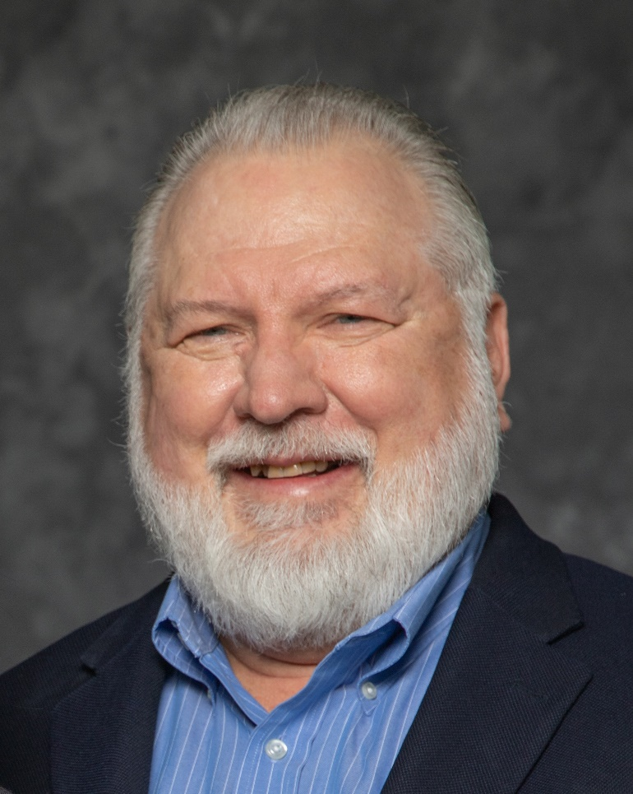
A Brief Introduction
13 Years on Wall Street
10 Years in management consulting
17 years in NGOs
5 years teaching at UMSI
Former Global CIO at IFRC
Former CIO at STC/US & UK
Co-founder and former Chairman of NetHope.org
Contact: ehapp@umich.edu
More on LinkedIn, Google and www.eghapp.com
Connect!
Notes:
When I was 38, I read a comment by Handy saying we could expect to have 5 careers; for the millennials, they can expect to have 14 jobs…by the time they are 38! (see https://www.youtube.com/watch?v=XrJjfDUzD7M at 02:15)
http://www.amazon.com/The-Age-Unreason-Charles-Handy/dp/0875843018
Charles Handy, http://www.texasventures.us/india/images/leader2_1.jpg …five careers

Slide 3
Thesis
Constrained environments can bring out the best in those trying to make technology work

Slide 4
We will look at
An NGO IT Strategic framework
Context-sensitive IT
The Collaboration Imperative
Freeware

Slide 5
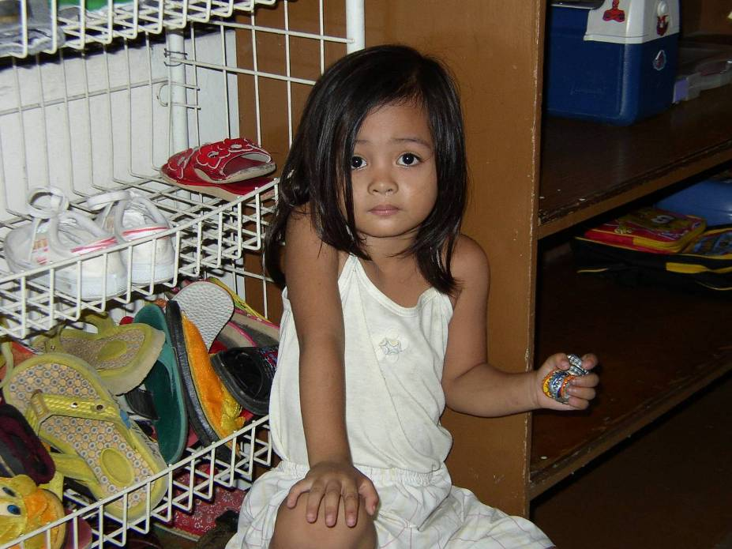
Good Enough…
A young girl wandered in from the street while I was taking photos in a day care center in Manila.
She wanted to be a part of the action.
It was not until I returned to the US and enlarged the photo, I noticed she was holding a dozen bottle-caps in her left hand.
These were her toys for the day.
Save the Children Day care Center in Manila
Notes:
“Bottle-caps,” LTYM #304, http://www.hpmd.com/hpmd/personal/LTYMstories.nsf/links/304
Compare my paper, “The Good Enough Principle,“ Dartmouth, June 2008

Slide 6
The Lesson of the Bottle-caps
Simple, basic toys are good enough
She brought her toys with her to the center
She had already adopted these toys as hers
Now change the word
“toys” to
“technologies”

Slide 7

1) An IT Strategic Framework

Slide 8

Parable of the Rocks
8
Notes:
“The Big Rocks,” LTYM #291, http://www.hpmd.com/hpmd/personal/LTYMstories.nsf/links/291
http://www.flickr.com/photos/weeping-willow/2852177218/

Slide 9
What’s the single most important strategic question?

Slide 10
What’s our destination?

Slide 11
Strategy is about connecting the dots, seeing around the corners and choosing a destination.
11

Slide 12
Technology is a Key to Building Capacity
More Effective Impact
At Greater Scale
Effective, Efficient, Scalable Programs
Hiring
Training
Partnering
Advocacy
Tools
Processes
Standards
Systems Impact
Funding Support
Save the Children, circa 2008

Slide 13
An NGO IT Strategy Approach
Get in
Competitive
or Leading
BENEFICIARY
“Differentiating”
Beneficiary & Field Facing
Increasing Impact for Beneficiaries
PROGRAM
“Improving Program Delivery”
Increasing Impact for Beneficiaries
Move up
OPERATIONAL
“Helping the Organization Run”
Efficient
Donor & HQ
Facing
FOUNDATIONAL
“Keeping the Lights On”
Get out
13

Slide 14
2) Context Sensitive ICT

Slide 15
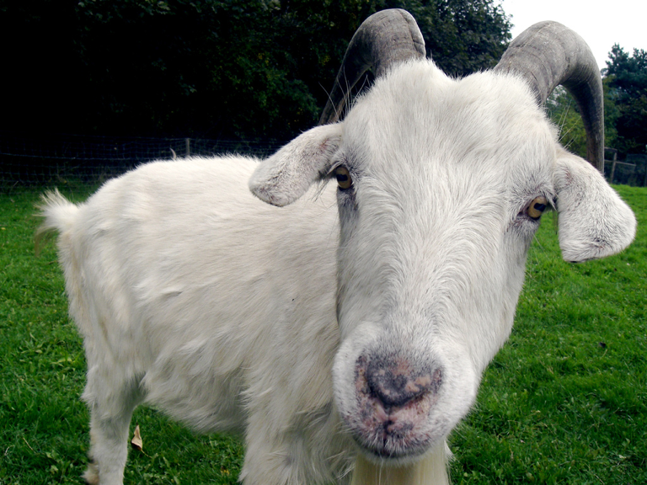
Twitter or the Goat?
Transparency Intl in Zimbabwe had conference on disruptive change
Colleagues suggested using Twitter like a focus group to gather citizen input on corruption.
But 70% of Zimbabwe population is rural, with no access to the Internet.
To find out what people think who can't use Twitter…
bring goat to local village & announce feast. 100 people will come to roast and you will have rich conversation about corruption: best focus group.
Twitter or the goat? In Zimbabwe, pick the goat.
15
Notes:
NGO was Transparency International
“Twitter or the Goat,” LTYM, #323 http://www.hpmd.com/hpmd/personal/LTYMstories.nsf/links/323
Photo credit: http://www.redhot.org/wp-content/uploads/2013/11/goat.jpg

Slide 16
We need to meet people where they are, with the technology they have adopted.
16

Slide 17
Mobile First
% of U.S. adults who say they own a …
 | Cellphone | Smartphone
1/10/2018 | 95% | 77%
2/7/2019 | 96% | 81%
2/8/2021 | 97% | 85%
 | Tablet computer | Desktop/laptop computer
1/10/2018 | 53% | 73%
2/7/2019 | 52% | 74%
2/8/2021 | 53% | 77%
Pew Research Center, 2018-2021, https://www.pewresearch.org/internet/fact-sheet/mobile/

Slide 18
3) The Collaboration Imperative

Slide 19
Non Profit IT Departments Can’t Play the Odds
IF
  57% of large IT projects don't realize their ROI (Nucleus Research)
  66% IT projects fail (Standish Chaos DB)
  Small NGO IT spend is a 20th of corporations (Tuck survey)
  And we are spending donors’ dollars
THEN
We must find a better way...
19
Notes:
19

Slide 20
Key Conclusion: we can’t do it alone
Even if we tripled IT spending, we will still be playing catch-up for just keeping the lights on.
And…
Keeping the lights on is irrelevant.
Notes:
20

Slide 21
The New Collaboration
Who Are You Partnering With?
“Who has expertise I can trust?”
Shared Services & Assessments
SHARED
SPECIALIZATION
JOINT PROJECTS
“What can we build together?”
Increasing Level of Trust
PARTNERING
“How can we work with corporations?”
Cisco, Microsoft, Salesforce
BASIC INFO SHARING
“What are my peers doing?”
Meetings, Conference Calls

Slide 22
4) Freeware

Slide 23
Nancy Lublin’s book Zilch provides an interesting perspective on the lack of resources, a pervasive NGO problem. She sees it as an opportunity. Having nothing to work with brings out the creativity of people. It also reminds us why we work at nonprofit organizations in the first place. It is not about money; it’s about mission
Notes:
Nancy Lublin, Zilch: The Power of Zero in Business, Portfolio Hardcover, 2010.

Slide 24
Things you can do if you’re small
Get Out:
Get the hardware and software free or near free (TechSoup, corporate donations off-lease, etc.), and use the Cloud!
Get seats in training classes from partners (e.g., corps, larger organizations)
Form a cooperative for basic things like support
Get In:
Develop a strategy and plan with an informal board of IT advisors
Form a cooperative for experiments like I4D
Join an NGO-IT group like NTEN.org
Move Up:
Connect with beneficiaries through their phones (see TechSoup for the latest free apps)
24
Notes:
See my Blog post: “Ten Ways Small NGOs Can Collaborate”, http://eghapp.blogspot.com/2012/02/ten-ways-small-ngos-can-collaborate.html

Slide 25
TechSoup’s 21 categories
Accounting
Antivirus
Business and Technology Planning
Cloud Computing
Communications
Computers and Electronics
Databases and Analytics
Donor and Grants Management
Fundraising
Green Technology
Human Resources
IT Support and Services
Mobile
Operating Systems
Security
Servers and Networks
Telecommuting
Training and Education
Travel and Accommodations
Web and Graphic Design
Website Management
Most Dept’s use tech to run; IT is the glue of the organization
Notes:
https://www.techsoup.org/get-product-donations

Slide 26
What’s a consultant to do?
First ask good questions…
Is technology/digital one of the focus areas of the CEO/ED?
Has technology been aligned with the organization’s mission and strategy? How does it help move these forward?
What technologies did they use during the pandemic that had good results and should continue?
What did not work so well and should stop?
Is there a person dedicated to overseeing the technology, its selection, roll out, training, upgrades, security, and licensing?
How is technology supported in their organization? Who answers user’s and client’s questions?
What is the mix of cloud and on-premises hardware, software, tech services?
Do you have goals for how tech can improve productivity and efficiency in the org?

Slide 27
But, even if the software is free…
The oversight,
selection,
roll out,
training,
upgrades,
security,
licensing
all cost at least people-time
Question #5

Slide 28
Conclusion

Slide 29
Take-aways
Constrained environments are an asset
Know your destination: “get out, get in, and move up”
Pay attention to the big rocks
Beware of “free” costs
Context is at the center
Small NGOs can act like big NGOs by collaborating

Slide 30
ehapp@umich.edu
Notes:
https://www.si.umich.edu/

Slide 31
Appendix

Slide 32
Further Reading
Blog: http://eghapp.blogspot.com/
Web site (see the articles & presentations link) http://www.eghapp.com
Email: ehapp@umich.edu
LinkedIn: https://www.linkedin.com/in/edward-g-happ/
Books: Managing Technology to Meet Your Mission, chap. 11
  We are Better Together, http://collaboration-book-project.blogspot.com/
  Letters to a Young Manager, http://www.hpmd.com/hpmd/personal/LTYMstories.nsf/vwBook?OpenView
  IT’s About the Conversation (beta), https://docs.google.com/document/d/1rKh7jVeP0naPfP-tliAiHb9h06_pvGJvefuB5tcMCsQ/
  Crisis Informatics Management (beta), https://docs.google.com/document/d/12ULKaMl4-MD8rYOSADHhmWfSTllc2uv5PBOah5UoM8w/

