Slide 1
Decision-making in International Org’s what we can learn from disaster relief
SI-523 Information and Control
23 January 2017

Slide 2
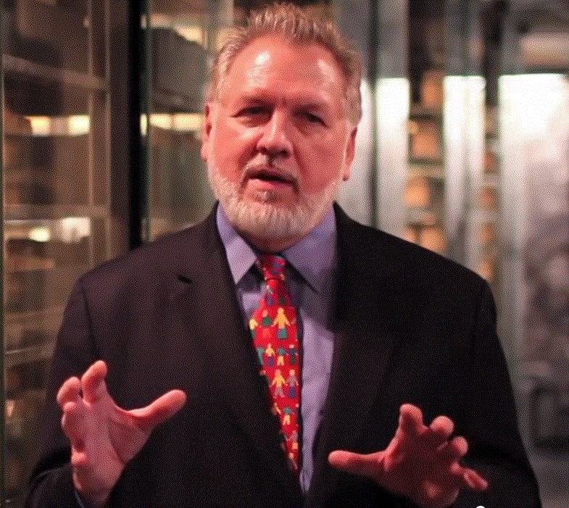
A Brief Introduction
13 Years on Wall Street
10 Years in management consulting
17 years in NGOs
Former Global CIO at IFRC
Former CIO at STC/US & UK
Co-founder and former Chairman of NetHope.org
More on LinkedIn, Google and www.eghapp.com
Connect!
2
Notes:
When I was 38, I read a comment by Handy saying we could expect to have 5 careers; for the millennials, they can expect to have 14 jobs…by the time they are 38! (see https://www.youtube.com/watch?v=XrJjfDUzD7M at 02:15)
http://www.amazon.com/The-Age-Unreason-Charles-Handy/dp/0875843018
Charles Handy, http://www.texasventures.us/india/images/leader2_1.jpg …five careers

Slide 3
Project Teams as a Microcosm

Slide 4
Decision-making on project teams
Brainstorming…
What roles have you experienced on project teams?
What methods of decision-making have you used on teams?
?

Slide 5
The Power of the Deadline
“Deadlines refine the mind. They remove variables like exotic materials and processes that take too long. The closer the deadline, the more likely you'll start thinking waaay outside the box.”
--Adam Savage, MythBusters
Notes:
Read more at: https://www.brainyquote.com/quotes/keywords/deadline.html

Slide 6
Thesis
If we look at the characteristics of disaster response, we can gain insights in how to make decisions in the midst of disruptive change in our organizations.

Slide 7
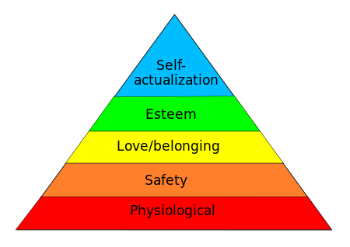
Maslow’s Hierarchy of Needs
Crisis
Development
Notes:
https://en.wikipedia.org/wiki/Maslow%27s_hierarchy_of_needs

Slide 8
The Fabric of
Disaster Response

Slide 9
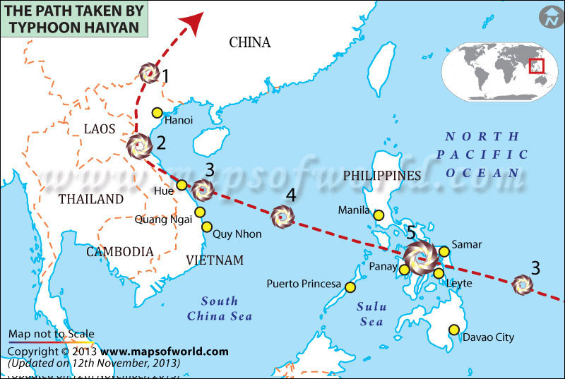
9
Notes:
http://www.washingtonpost.com/blogs/worldviews/wp/2013/11/15/8-maps-that-explain-why-typhoon-haiyan-hit-the-philippines-so-hard/

Slide 10
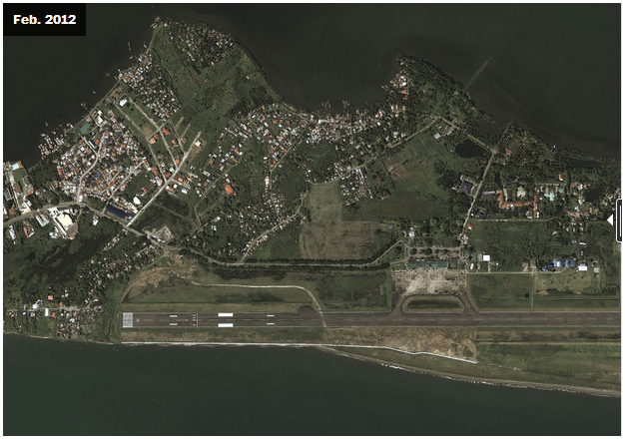
Tacloban Airport Before
10
Notes:
http://www.washingtonpost.com/blogs/worldviews/wp/2013/11/15/8-maps-that-explain-why-typhoon-haiyan-hit-the-philippines-so-hard/

Slide 11
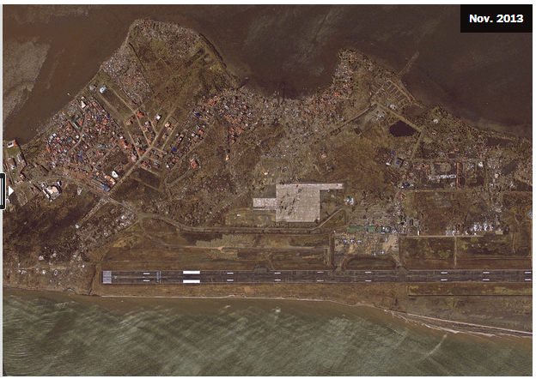
Tacloban Airport After
11
Notes:
http://www.washingtonpost.com/blogs/worldviews/wp/2013/11/15/8-maps-that-explain-why-typhoon-haiyan-hit-the-philippines-so-hard/

Slide 12
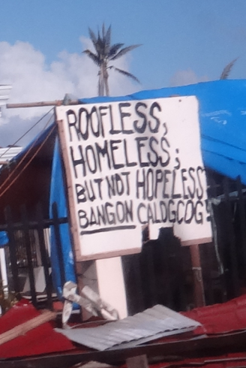
RC Philippines Response
By the Numbers:
16 million people affected
6,201 deaths reported
4 million people displaced
1.14 million houses damaged
Source: NDRRMC, 14 Jan. 2014
12
Notes:
IFRC: Philippines Typhoon Haiyan, FACT SitRep 20, 29 January 2014, pg. 1

Slide 13
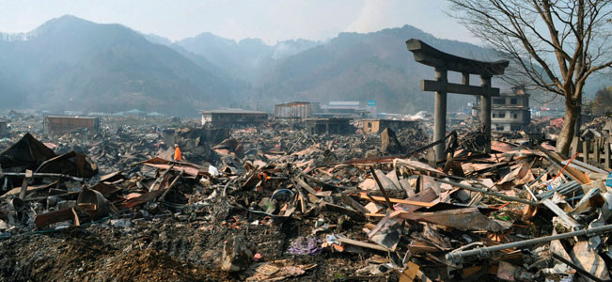
Japan Tsunami Aftermath – 14 Mar 11
A destroyed landscape in Otsuchi village,
Iwate Prefecture in northern Japan” -- Reuters/Kyodo
13
Notes:
http://news.yahoo.com/s/ap/ap_on_bi_ge/as_japan_earthquake_nuclear_crisis

Slide 14
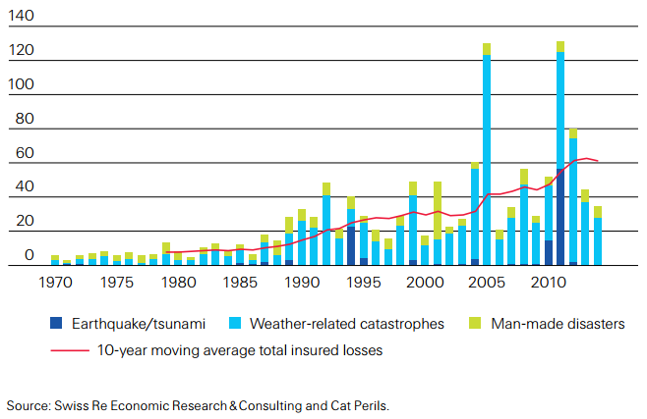

Disaster Costs Continue to Rise
14
14
Notes:
http://www.swissre.com/sigma/
http://media.swissre.com/documents/sigma2_2015_en_final.pdf
Figure 3, p. 5
Insured catastrophe losses, 1970–2013
1992: Hurricane Andrew
1994: Northridge earthquake
1999: Winter Storm Lothar
2001: 9/11 attacks
2004: Hurricanes Ivan, Charley, Frances
2005: Hurricanes Katrina, Rita, Wilma
2008: Hurricanes Ike, Gustav
2010: Chile, New Zealand earthquakes
2011: Japan. New Zealand earthquakes,
Thailand flood
2012: Hurricane Sandy

Slide 15
Timeline of a Disaster Response
Stage 0: Preparedness
  Example: Typhoon preparedness in Bangladesh
  This is the best investment (5:1)
Stage 1: Within hours of disaster striking
  Example: CRS in sectarian fighting in eastern Congo
  This is the Highly Individual, Highly Mobile ICT stage
Stage 2: Within two weeks of disaster striking
  Example: Relief International in Bam, Iran earthquake
  Small Group, Highly Mobile/Temporary ICT stage
Stage 3 – From one-six months following a disaster striking to multi-year.
  Large Group - Permanent ICT stage
Stage 4 – Learning
  Example: NetHope members in Pakistan earthquake response
  Don’t waste mistakes
15
Notes:
Bangladesh cyclone: 3,000 fatalities in 2007 versus 138 000 in 1991 and 500,000 in 1970
Factor of 50-100 reduction due to advance evacuation of 3.2M people and stockpiles of relief supplies, i.e. disaster preparedness! (see http://fe4.news.re3.yahoo.com/s/time/20071119/wl_time/howbangladeshsurvivedthecyclone )

Slide 16
Connections of a Disaster Response
Preparedness
First Response
Scaling up
Transition
Learning
Stage 0
Stage 4
Stage 1
Stage 3
Stage 2
16

Slide 17
Bangladesh Cyclone Fatalities
Preparedness
Works!
Due to
planning, training,
early warning,
advance evacuation
of 3.2M people,
and stockpiles
of relief supplies
17
Notes:
Bangladesh cyclone: 3,000 fatalities in 2007 versus 138 000 in 1991 and 500,000 in 1970
Factor of 50-100 reduction due to advance evacuation of 3.2M people and stockpiles of relief supplies, i.e. disaster preparedness! (see http://content.time.com/time/world/article/0,8599,1685330,00.html )

Slide 18
Changing Priorities By Program Type
For emergency response, time and volume are king;
for development, cost and quality reign
Ranking factors 1-4, 1=highest
18
Notes:
For emergency response, time and volume are king; for development, cost and cost reign

Slide 19
Crisis Needs
1) Is my family OK?
2) Can I get food, water, shelter?
3) Can we communicate? (Voice/Data)
19
Notes:
19

Slide 20
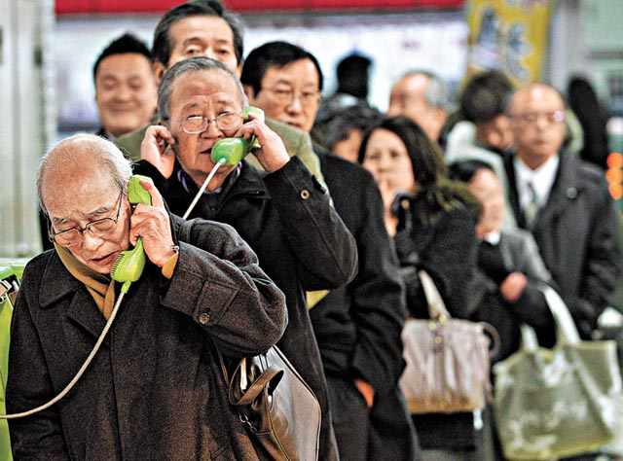
Japan 2011
20
Notes:
http://voices.washingtonpost.com/blog-post/tsuna.JPG

Slide 21
People need to know their loved ones are safe
“People need Information
as much as water, food, medicine or shelter.
Information
can save lives, livelihoods and resources.
Information
bestows power.”
–World Disasters Report 2005

Slide 22
Technology in Disaster Response
Notes:
DR - ICT Factors v10.xlsx

Slide 23
Three ICT Things Different in Haiyan DR
Telco networks recovered before NGO VSATs were set up
BYOT extended to relief workers
ICT Collaboration worked

Slide 24
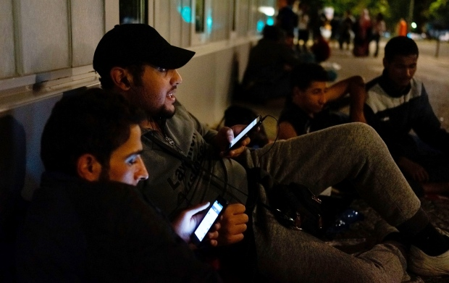
Syrian Refugees – Sep. 2015
Information to survive
“Refugees from Syria use smartphones to connect with relatives back home as they wait outside a government office in Berlin last month.” --Carsten Koall/Getty
Notes:
http://www.cbc.ca/news/world/for-syrian-refugees-smartphones-are-a-lifeline-not-a-toy-1.3221349

Slide 25
Three ICT Things Different in Syrian DR
Beneficiaries led in technology (70% of youth have smartphones)
Top questions were about information (next slide)
Lack of coordination among receiving countries (getting better)
25

Slide 26
Top Questions of Refugees in Greece
Where am I?
Do you have WiFi?
Where can I buy food and water?
Where can I breastfeed my baby?
Where is the bus to Germany?
Can I take a taxi?
How do I register?
Why am I being fingerprinted?
How long must I stay here before I can leave?
Where can I change money?
--Tyler Jump (IRC), Huffington Post, 29-Oct-2015
26
Notes:
http://www.huffingtonpost.com/tyler-jump/common-questions-refugees-ask-when-arrive-europe_b_8400118.html

Slide 27
Crisis Management Changes Things
Notes:
Work\2017\Crisis Management Matrix v1.xlsx

Slide 28
Nonprofits As A Leadership Case

Slide 29
What Don’t Nonprofits Do Well?
Death by consensus – participation paralysis: the strategic plan case
Quality over reach – the Asia Area day-care case
Accountability – the irony and loss of the university model
Metrics – reporting on input rather than impact

Slide 30
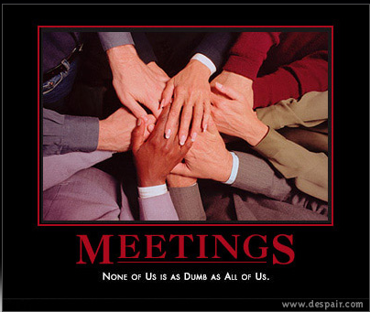
Death by Consensus
Notes:
The Monitoring & Evaluation (M&E) roundtable: no deadline meant a few nonprofits org’s laid our a 5-year project plan for measurement!
No deadline, no single, senior owner.
Image: http://despair.com/meetings.html

Slide 31
What Do Nonprofits Do Well?
Missions that matter
Engage employees hearts and minds
Collaboration rather than competition
Work-life balance –self directed rather than fewer hours
Pragmatic, “good enough” approach to services
We have engaging stories to tell and images to show

Slide 32
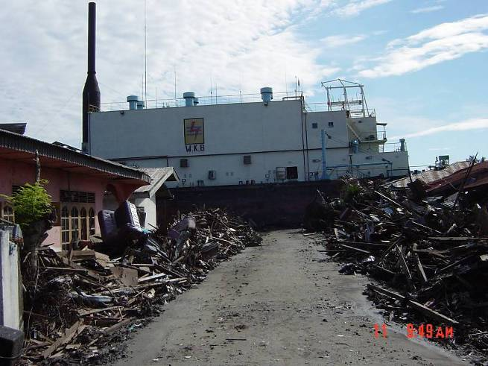
What is this large object?
a very large ship 5 miles inland in the middle of the road
Banda Aceh, Indonesia 2004

Slide 33
Cisco Fellowship Program Take-Aways
Learn how to manage in chaotic times
  disaster response
How to manage with fewer resources
Influence and relationship management
  how to be the “glue”
Collaborate by example
Gaining a long-term rather than quarterly view
“Fellows became more holistic in their thinking” – Tae Yoo, VP

Slide 34
Some Lessons

Slide 35
Ten Lessons
What we can learn from disaster relief about management of organizations?
  Urgent
  Fast
  Lean
  Attentive
  Flat
  Good enough
  Costs are last
  Preparing is not executing
  Improvising
  Humanitarian
35

Slide 36
What we can learn from disaster relief about decision-making?
  Urgent: There is a burning platform and we are jumping (Opposite of a change initiative)
  Fast: people need attention immediately
  Lean: red tape is something to be cut
  Attentive: listen and amplify the voice of those on the ground
  Flat: Management requests are overhead; diminishing returns on process
  Good enough is good enough
  Costs are last: Don't worry about the costs, worry about the speed
  Preparing is not executing: Planning is preparedness, not execution
  Improvising: Apollo 13: make do, get in done, opportunity to shine, all hands on deck
  Humanitarian: care, trust, and humility
36

Slide 37
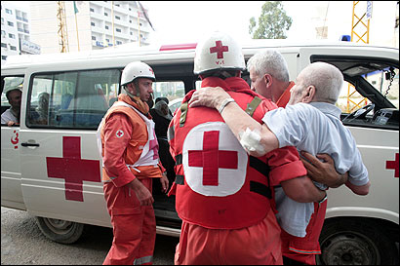
Fast…
37
Notes:
http://www.boston.com/news/world/articles/2006/07/25/ambulance_drivers_tell_tales_of_horror/

Slide 38
Good Enough…
Following the Tsunami response, a marketing director recalled, “We didn’t have time to have all the meetings, all the reviews, and all the approvals.” “We had to make on-the-spot-decisions.” “The interesting thing”, she continued,” is that nothing fell apart.” “Maybe we could make decisions like that everyday.”
Banda Aceh, 2004
“The Good Enough Principle “ June 2008

Slide 39
Improvising
The Apollo 13 story was featured in the 1995 film with Tom Hanks and Kevin Bacon. The incredible events that unfolded in April 1970 gripped the nation and the world.
On April 13…
56 hours into the mission, an oxygen tank in the service module that contained the astronauts’ support systems exploded.
Notes:
The NASA account of the accident is here: http://nssdc.gsfc.nasa.gov/planetary/lunar/ap13acc.html

Slide 40
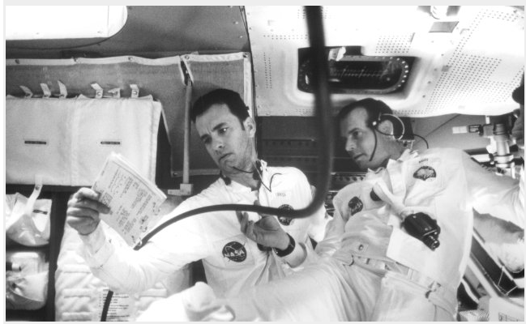
The Apollo 13 story
“And you, sir, are a steely-eyed missile man”
https://www.youtube.com/watch?v=UcFlrGRfzWk
Notes:
See the video clip, here: https://www.youtube.com/watch?v=UcFlrGRfzWk
Photo: http://www.imdb.com/media/rm1413254656/tt0112384

Slide 41
Five things…
Urgent! Life or death crisis
Improvising under time-pressure
Scarcity is not a limitation
Good-enough works
High collaboration
41

Slide 42
Humanitarian…
We care
  People are vulnerable
  People are hurting
The customer is the first responder
  90% of first responders are local people
  Resilience is not a hand-out…
  it’s preparation and adaptability
Notes:
It’s ownership

Slide 43
Project Management Case – Overcoming Obstacles

Slide 44
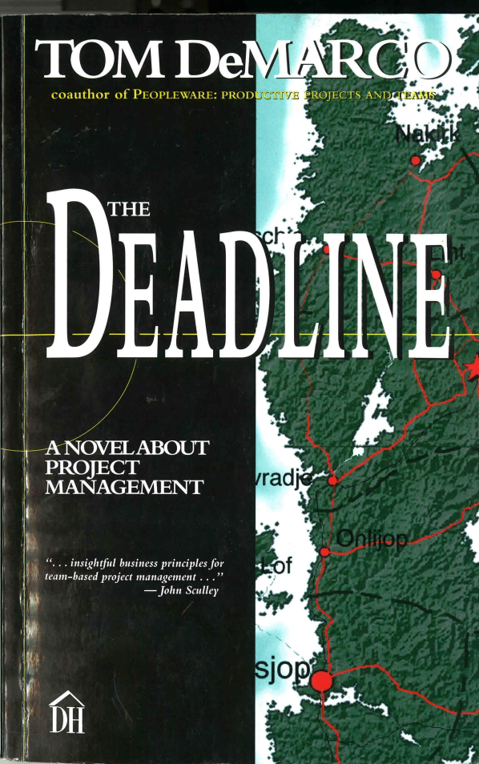
A Project Management Novel?
Chapter 11,
The case of The Sinister Minister Belok…

Slide 45
Lessons from this story?
What would you do?
What “pathological political” situations have you seen in your work?
How did the team solve the problem?
What was Thompson’s leadership style?

Slide 46
Some Take-aways
#1: the power of the AND is greater than the power of the OR
Remember: We are here “to do good work and to learn”
A key indicator of power politics is the refusal to listen… “I will not hear talk of delivering any later than that”… “Do as you're told”
“There is no such thing as a job with no politics”
The answer came from the team not the leader
A gelled team is your most valuable project asset
Breaking the iron triangle of projects: senior management can control only 2 but must give the 3rd to the project team

Slide 47
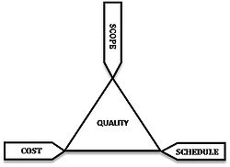
The Iron Triangle –
Seek to Optimize Three Factors
The client can only demand two
See http://en.wikipedia.org/wiki/Project_management_triangle

Slide 48
Conclusion

Slide 49
Three Take-aways…
The priorities in a disaster response are the opposite of how NGO organizations are run
Four characteristics can drive the change
  The value of speed
  The value of local
  The value of good-enough (Zilch)
  The value of improvising (ready, fire, aim)
Why Bother? Because disruptive change is upon us
49

Slide 50
Further Reading
Blogs:
http://eghapp.blogspot.com/ (Current)
http://granger-happ.blogspot.com/ (Dartmouth Sabbatical)
Web site (see the articles & presentations link) http://www.eghapp.com
Email: ehapp@ifrc.org
Twitter: @ehapp
LinkedIn: http://www.linkedin.com/profile/view?id=1906312
Books: Managing Technology to Meet Your Mission, chap. 11
  We are Better Together, http://collaboration-book-project.blogspot.com/

Slide 51
Notes:
https://www.si.umich.edu/

