Slide 1
CIO Summit 2016
Selected Remarks
Edward G. Happ
Director of IT & Global CIO
30 May – 3 June 2016

Slide 2
Opening Remarks

Slide 3
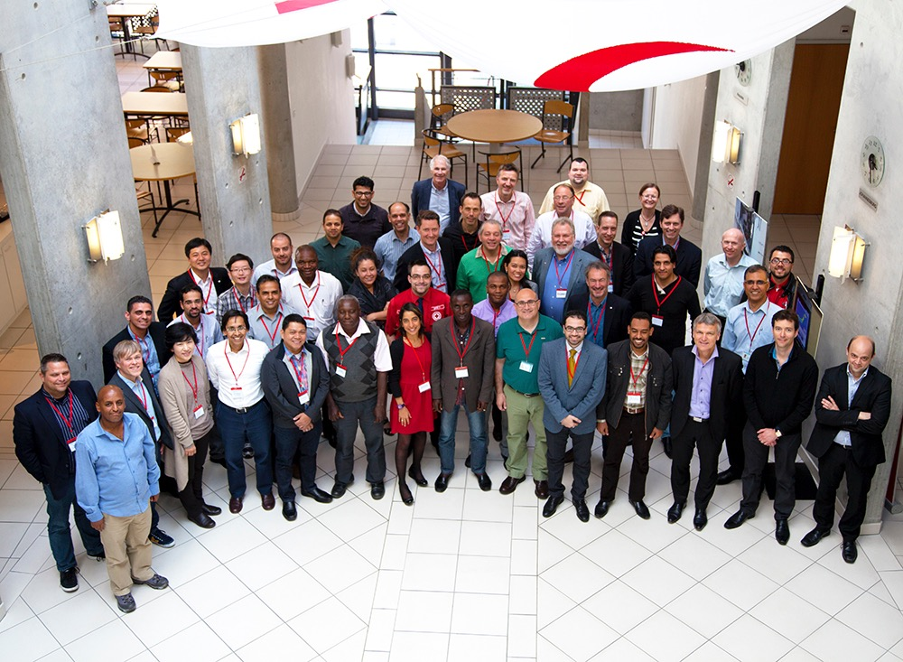
We are the diversity of technology
73 Participants
From 30 National Societies
5 IFRC Regions
IFRC in Geneva
Corporate Partner-sponsors

Slide 4
We listened to your feedback
More workshops
More case studies and group discussions
More opportunities to socialize
More time to discuss issues over meals
Translation into French, Spanish, Arabic
Remote access/ webcast
Recorded sessions
Mobile ready agenda

Slide 5
We are taking 4.5 days together…
8 workshops
4 keynote speeches
7 panels
7 working groups
A mix of RC IT & Program Practitioners, Technology Companies, and Academics
To share, to listen, to discuss …

Slide 6
Our theme is Innovation
Innovation:
from the Latin root innovare,
“to change”
“act of introducing something new,
to 'make new' “
Notes:
* http://www.thefreedictionary.com/, http://www.dictionary.com/, http://www.businessdictionary.com/

Slide 7
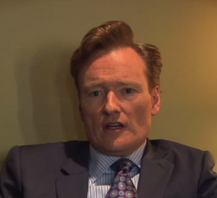
How about something more memorable…
"I know innovation when I'm completely confused. If someone does something in or around the office that just confuses me and angers me and makes me feel stupid, I assume it must be pretty innovative. That's what innovation looks like to me. If I feel like a cat watching a sunset, then I know what I'm seeing is true innovation." — Conan O'Brien
Notes:
http://www.fastcompany.com/3011745/30-second-mba/conan-obrien-how-do-you-know-innovation-when-you-see-it

Slide 8
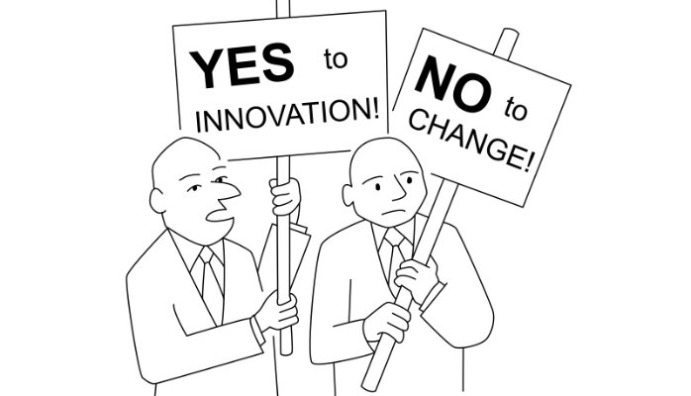
Or a “poke in the eye”…
7
Notes:
https://www.linkedin.com/pulse/yes-innovation-change-rohit-malik

Slide 9
Or just plain scary…
Heard at Davos…
“Digital is the main reason just over half of the companies on the Fortune 500 have disappeared since the year 2000.” --CEO of Accenture
It is the perhaps the sign of the greatest hubris that as humanitarians we think we are immune.
Notes:
http://www.weforum.org/agenda/2016/01/9-quotes-that-sum-up-the-fourth-industrial-revolution

Slide 10
Why did we organize this summit?
To connect and share with leaders in ICT in the RC Movement
To discuss issues of common interest, and share good practices and successes between NSs
To reinforce collaboration between ICT and other functions in our organizations, as well as collaboration between the Federation and NSs
To hear from and connect with IT leaders
To rollout NS IT Health-check self-assessments and DD Toolkit
Join the RC CIO summit group on yammer to see the agenda and latest updates: https://www.yammer.com/rcciosummit/#/home

Slide 11
IT Priorities for the Next 5 Years

Slide 12
1. From the supply side of relief to the consumer side
(rise of the beneficiary)

Slide 14
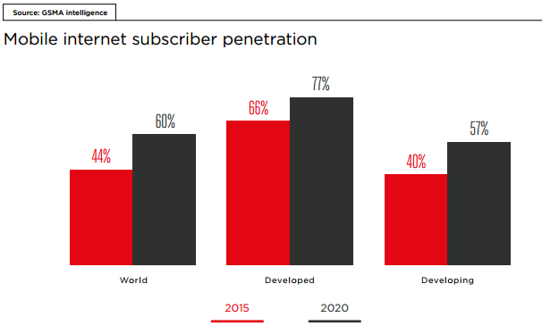
Even by 2020, the Digital Divide is still a problem
The Future Digital Divide
Notes:
GSMA, “The Mobile Economy 2016”, p. 39 http://www.gsmamobileeconomy.com/

Slide 15
We need to meet people where they are, with the technology they have adopted

Slide 16
2. Technology is growing faster than traditional IT can keep up

Slide 17
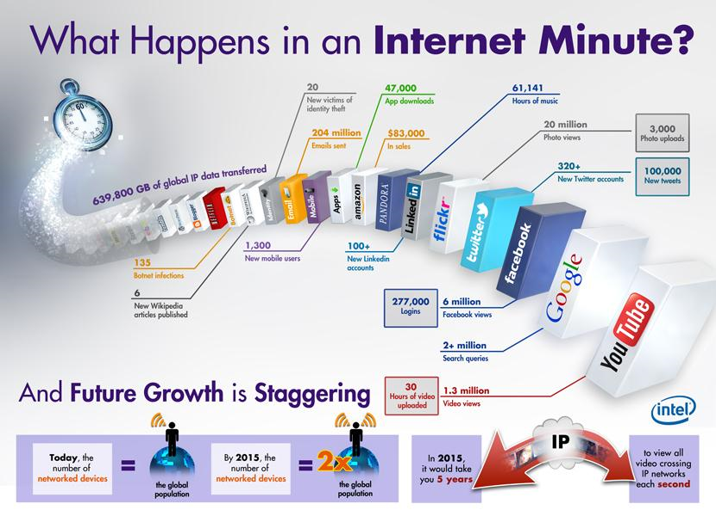
4.4 IT Infographic
Use “Internet minute” graphic or IT History timeline
6 of 11 co's cited were founded since 2001
Notes:
https://incsights.files.wordpress.com/2014/01/whathappensinaninternetminute.png
Netflix 1997, Blogger 1999, Wikipedia 2001, Amazon 1994, Pandora 2000, LinkedIn 2002, Flickr 2004, Twitter 2006, Facebook 2004, Google 1998, YouTube 2005

Slide 18
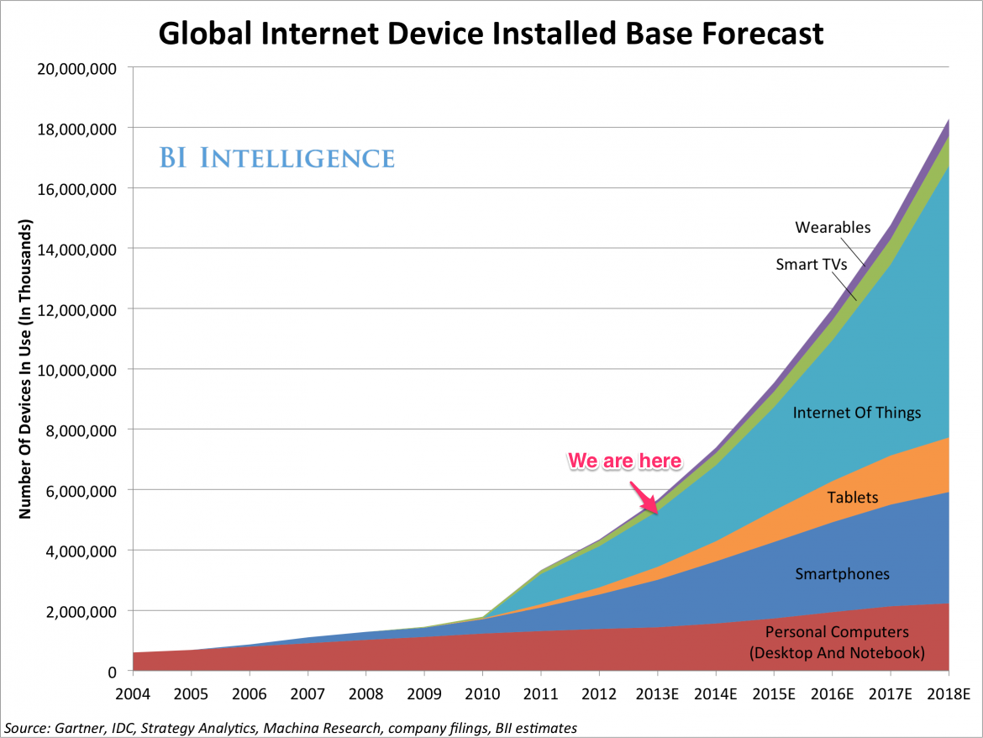
How to keep pace? Traditional IT fails
Now we are here
Time of the chart
We were here
Notes:
http://static4.businessinsider.com/image/52d53fe66bb3f78422d4ec45/by-2018-the-internet-of-things-will-be-bigger-than-the-smartphone-tablet-and-pc-markets-combined.jpg

Slide 19
Innovation moving to the core of IT
Historical IT – all
components provided
User Devices
Network
Enterprise apps
Data
User apps
Local innovation is more likely
and sustainable at the outer
layers of IT delivery
Current Era – Users bring
their own devices and apps
Future Era – Users bring
their own networks
Standard core – it is unlikely
users will have or should have their own Finance, HR, Supply Chain, and Legal
applications and data
External crowd-sourced data is
pushing the internal data paradigm
19

Slide 20
The technology world is accelerating
Technology change is geometric; the curve is accelerating
The demand for IT is also accelerating
Can IT control it all? No! Can we provide it all? No!
Our role must change, become more nuanced and best leverage the knowledge of the IT team
Rather than keep pace as a provider, IT needs to keep pace as the trusted advisor and partner

Slide 21
3. We need to expand from provider-trucks to advisor-cabs, etc.

Slide 22
App-systems provided versus consumer/local apps
22

Slide 23

We can’t keep up with support demand
If we can’t add resources, we must change the process
Support
Demand
Support
Capacity
The desire for high touch support is at odds with flat IT resources
As the portfolio grows, the support demand grows
23
Notes:
http://www.istockphoto.com/stock-photo-4237972-funnel.php

Slide 24
The Future of IT in a More Nuanced World
IT Functions & Services
Increasing IT Risk & Investment
Traditional IT
Increasing IT Risk & Investment
24

Slide 25
Closing Remarks

Slide 26
4.5 Days Later…
8 workshops
4 keynote speeches
6 panels
6 presentations
3 working groups
A mix of RC IT & Program Practitioners, Technology Companies, and Academics
To share, to listen, to discuss …

Slide 27
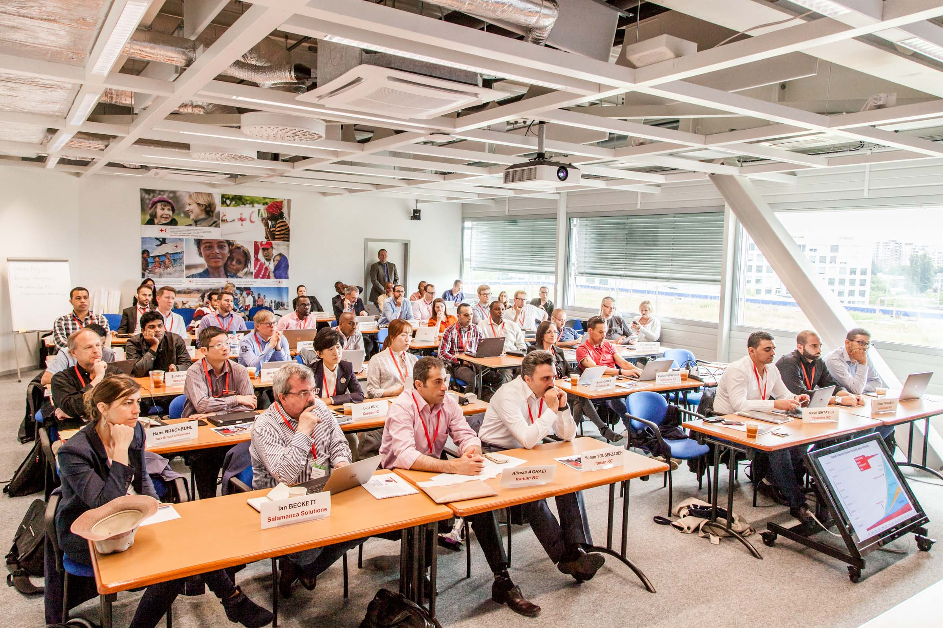
This was our room

Slide 28
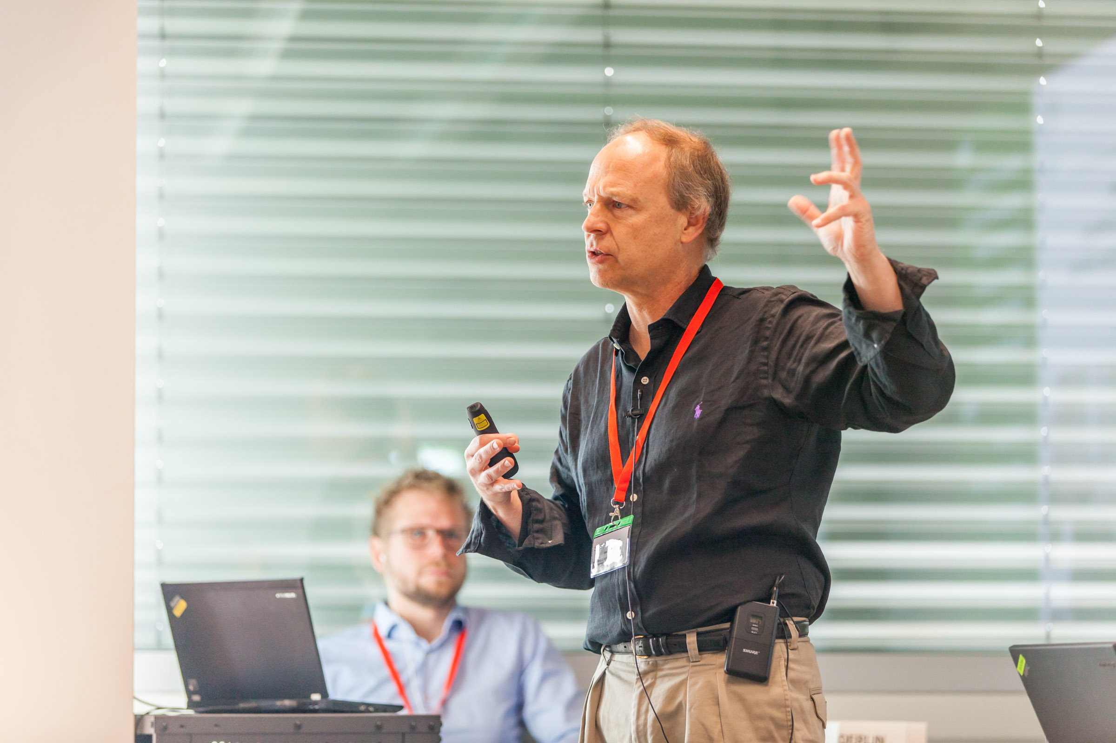
We were shocked by future trends

Slide 29
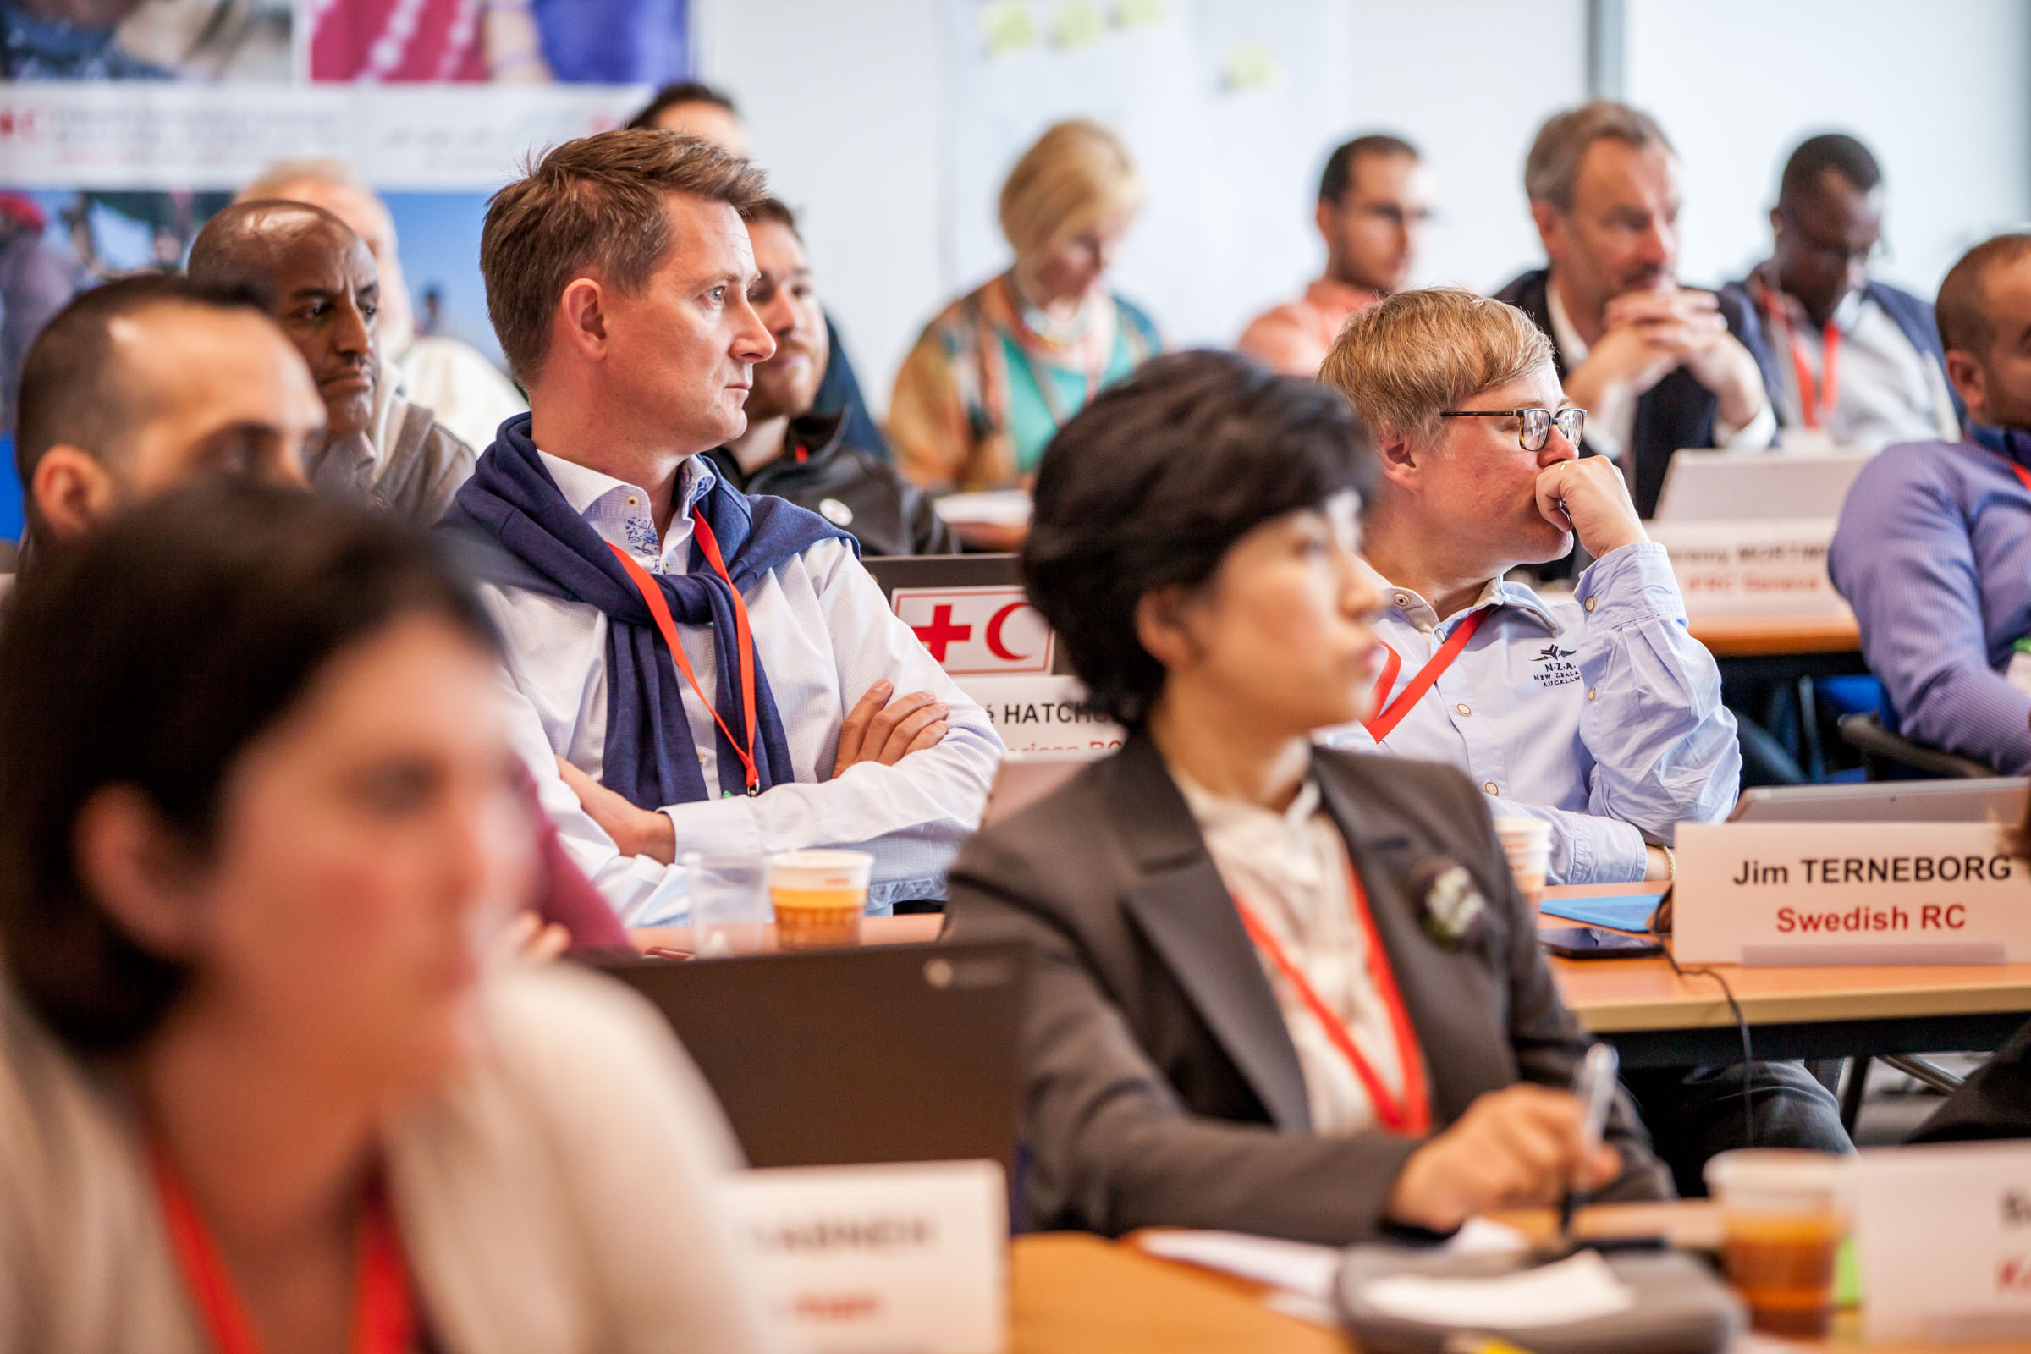
We listened

Slide 30
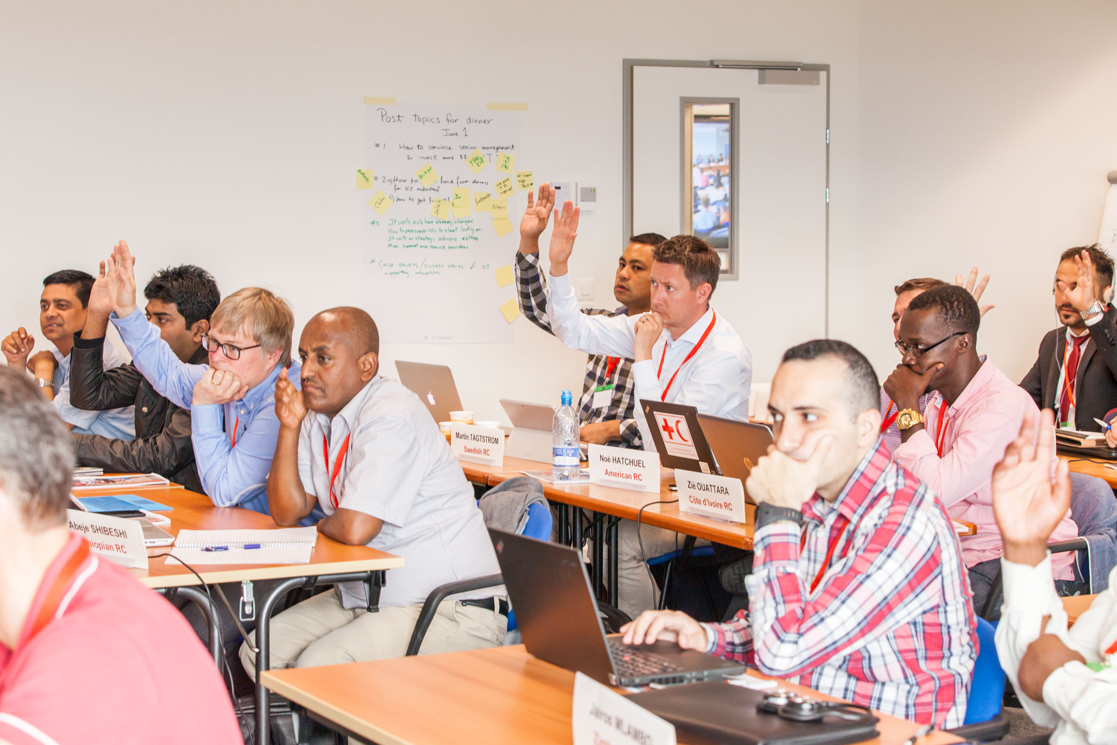
We asked questions

Slide 31
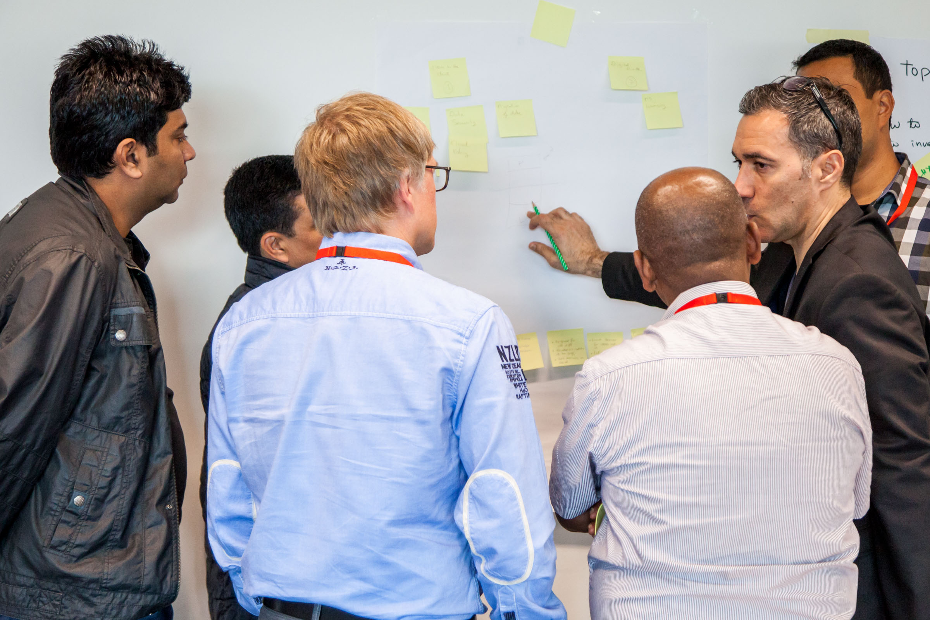
We collaborated

Slide 32
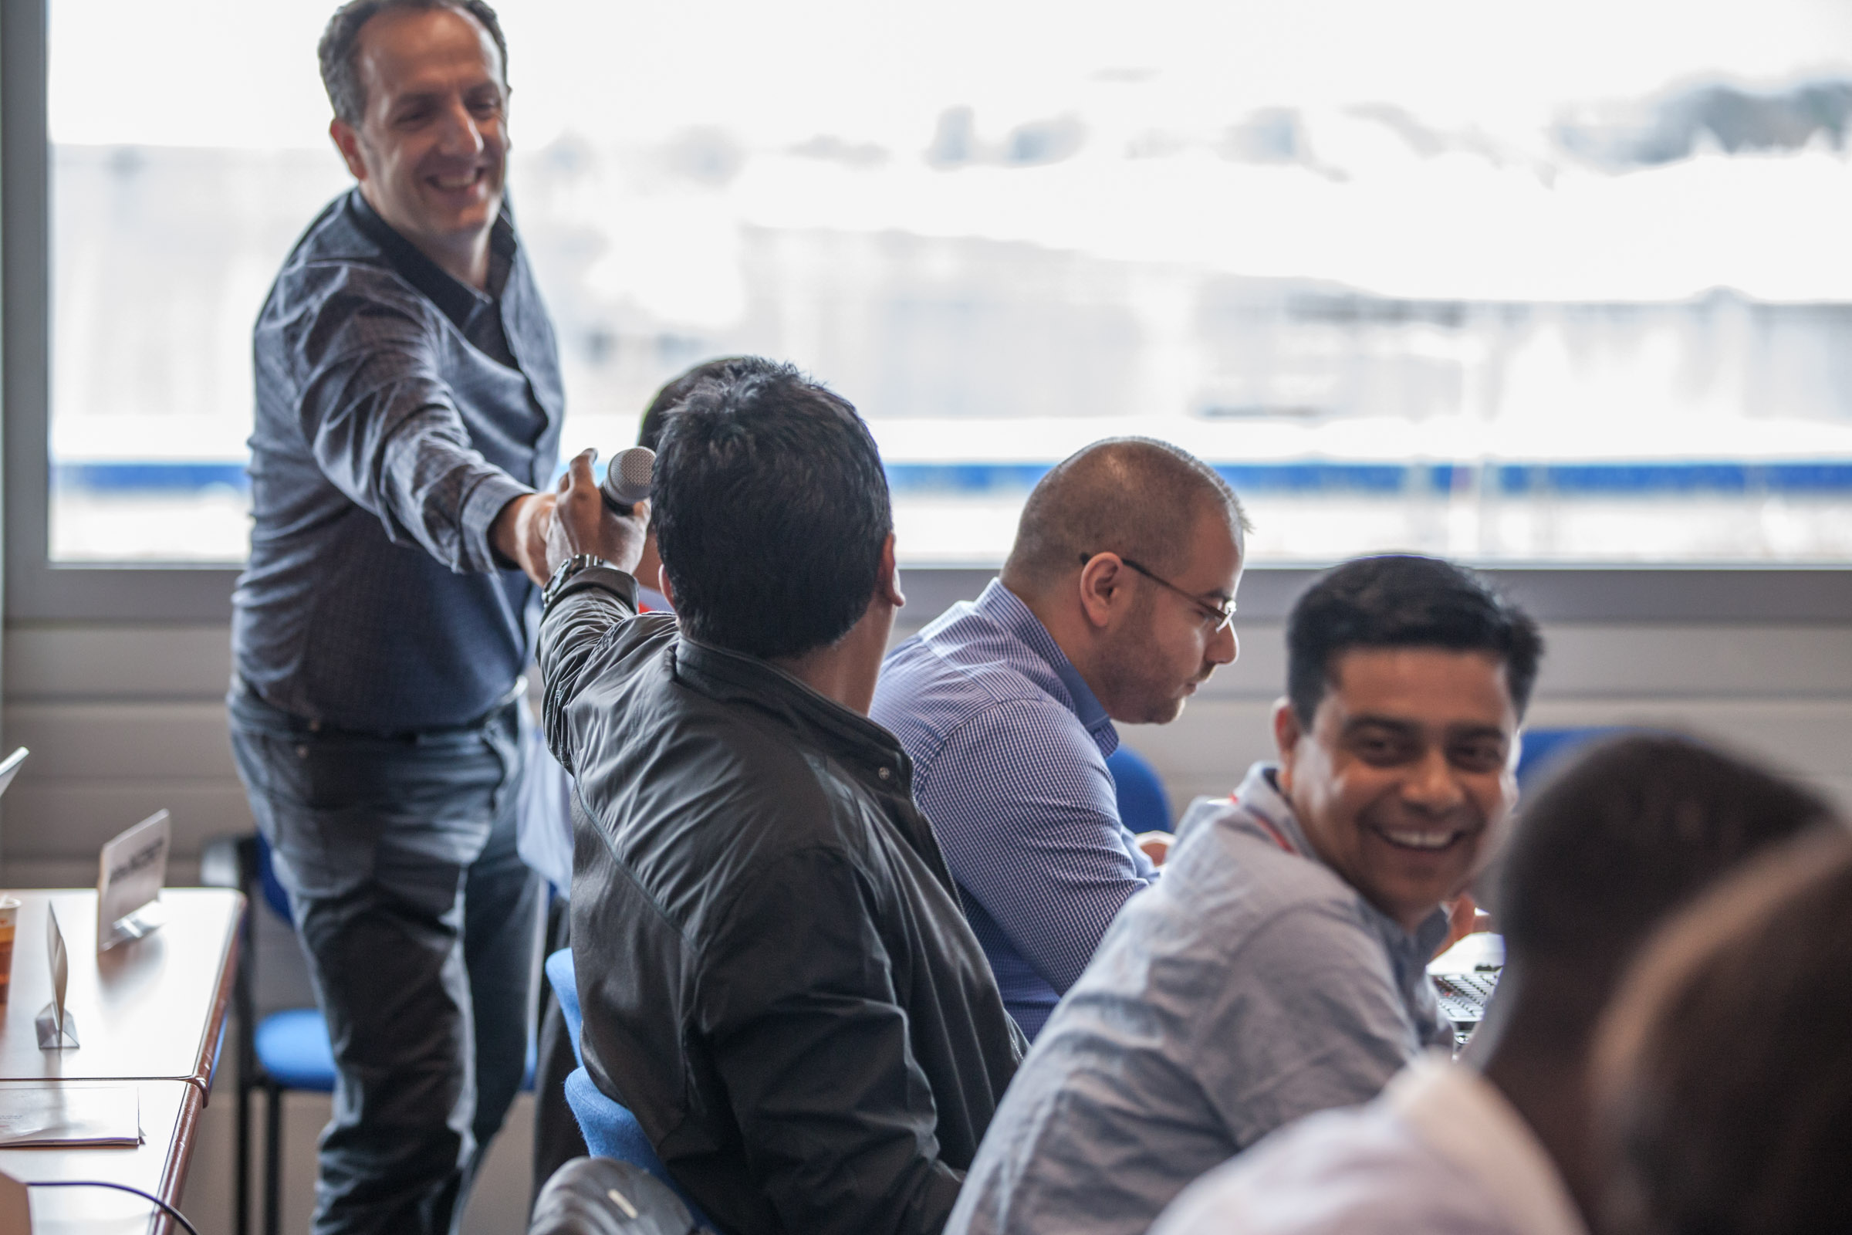
We helped each other out

Slide 33
Innovation?
"I know innovation when I'm completely confused. If someone does something in or around the office that just confuses me and angers me and makes me feel stupid, I assume it must be pretty innovative. That's what innovation looks like to me. If I feel like a cat watching a sunset, then I know what I'm seeing is true innovation." — Conan O'Brien
Notes:
http://www.fastcompany.com/3011745/30-second-mba/conan-obrien-how-do-you-know-innovation-when-you-see-it

Slide 34

Or a “poke in the eye”…
7
Notes:
https://www.linkedin.com/pulse/yes-innovation-change-rohit-malik

Slide 35
Would we agree?
“If you must use the word, here is the best definition:
Innovation is significant positive change.
It’s a result. It’s an outcome.”
--Scott Berkun
Notes:
http://scottberkun.com/2013/the-best-definition-of-innovation/

Slide 36
To Continue the Conversation…
Use Yammer: https://www.yammer.com/rcciosummit
See the slide decks on Sched: https://ciosummit2016.sched.org/
And of course, the photo library on Dropbox (see the emails)

Slide 37
Did we achieve our objectives?
To connect and share with leaders in ICT in the RC Movement
To discuss issues of common interest, and share good practices and successes between NSs
To reinforce collaboration between ICT and other functions in our organizations, as well as collaboration between the Federation and NSs
To hear from and connect with IT leaders
To rollout NS IT Health-check self-assessments and DD Toolkit
Join the RC CIO summit group on yammer to see the agenda and latest updates: https://www.yammer.com/rcciosummit/#/home

Slide 38
What you can do for us…
If you see the value and importance in this annual CIO Summit, We would like you to write a letter to your SG and say so. Ask that he or she pass on your note to our IFRC SG. As the IT leaders in the RC Movement, let’s make our voices heard!

Slide 39





Thanks again to our corporate sponsors

Slide 40


And our RC sponsors
Thank you for the support and generosity of PNS and corporate sponsors to make the summit more inclusive.
Special thanks to Anitta for sponsoring additional countries.

Slide 41
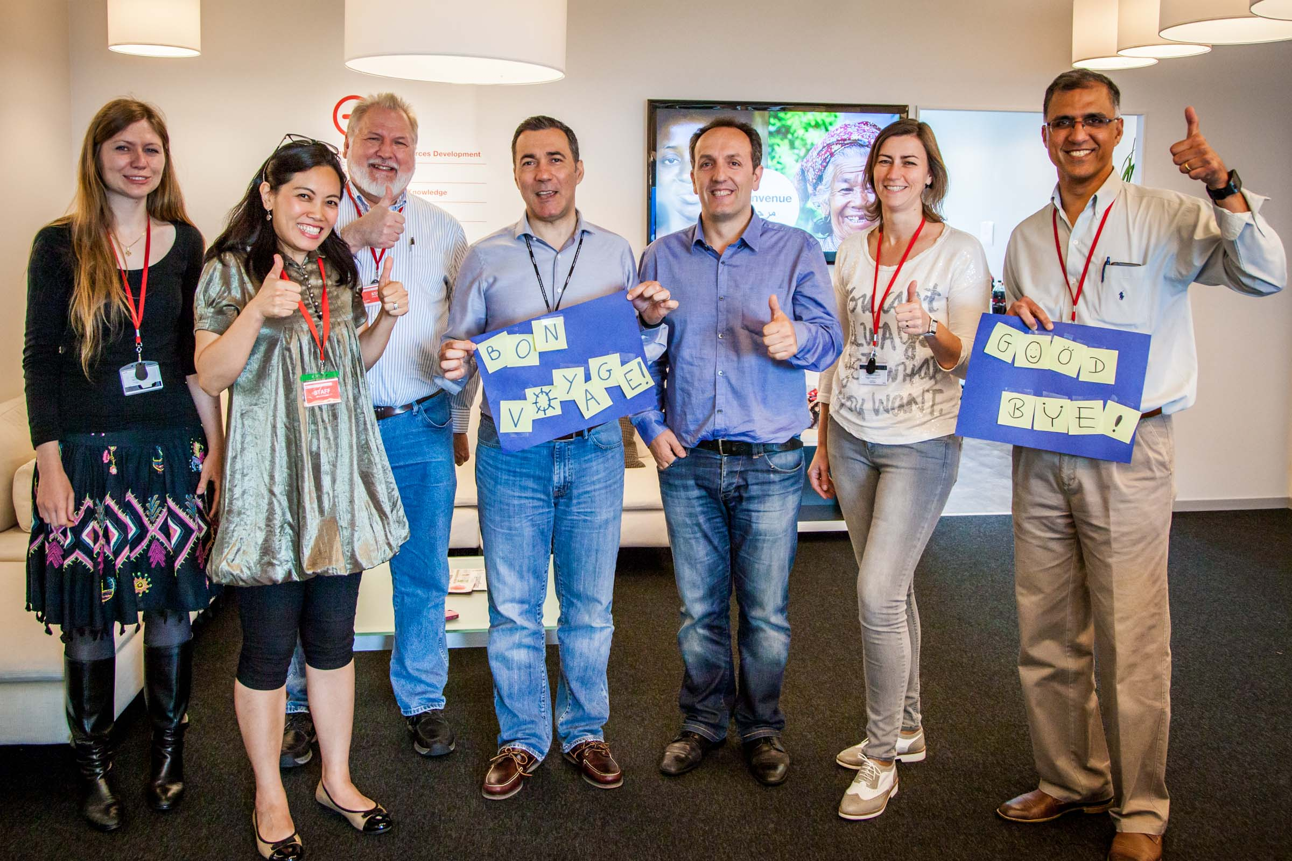
And Special Thanks to our SteerCo Team
For the hundreds of hours of dedication & professionalism:
        Delphine,
        Elise,
        Shirley,
        Alvaro,
        Jeremy,
        Sanjiv
      And Adem, Louis and the entire IFRC IT team

Slide 42
And here’s a final “thanks” …
Diogo’s video
YouTube: https://youtu.be/PrzJuaf3l7s

Slide 43
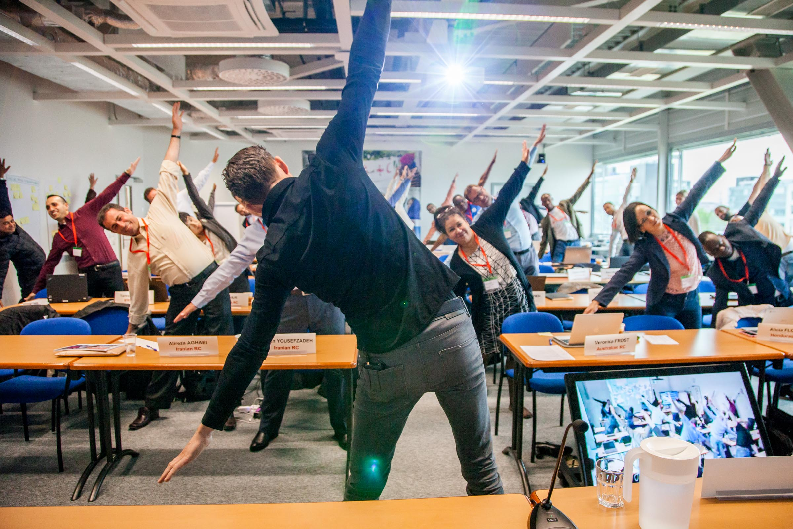
And who could forget the yoga break?

Slide 45
Appendix

Slide 46
Innovation, Invention and Improvement
“Innovation differs from invention in that innovation refers to the use of a better and, as a result, novel idea or method, whereas invention refers more directly to the creation of the idea or method itself. Innovation differs from improvement in that innovation refers to the notion of doing something different (Lat. innovare: "to change") rather than doing the same thing better.” –Wikipedia entry for Innovation
Notes:
http://en.wikipedia.org/wiki/Innovation

Slide 47
IT Strategy and History in 3 sentences
History:
We accomplished more change and transformation than anyone realized
Among our three pillars, getting out of the lights-on business was most successful
DDI success (“get into” pillar) grew despite declining investment and resources
Strategy:
Technology is growing faster than traditional ways can keep up
We need to expand from provider-trucks to advisor-cabs, etc.
The capacity building model needs to be applied where citizen-users are in charge
Three Flips:
Model of power flips from the supply side of relief to the consumer side (rise of the beneficiary)
  From humanitarian intermediary services to beneficiary-demand services
From IT driven technology to Consumer driven technology (the apps curve)
From the IT provider role to consultant/advisor/guide

Slide 48
Five Shifts
Five Flips
From traditional IT provider role to Advisor, Convener, Broker for users (as for NSs)
From support provision to user self-service
From standards to choices
From reported data to data sets for users' analysis
From high support cost to higher investment in core business
See slide 160 in larger strategy deck:
From GVA support to Global support
From provider IT to consultative IT
From innovation silos to coordinated hubs
From data reports to data sets
From shadow IT to feeder IT
From digital divide to healthy ICT
From standard devices to “anywhere, anytime, anyplace technology
From fragmented objectives to aligned objectives

Slide 49
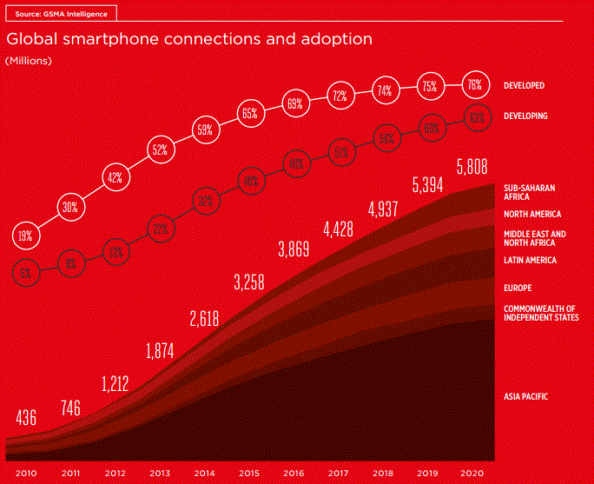
Notes:
GSMA, “The Mobile Economy 2016”, p. 14

Slide 50
“However, despite the impressive progress, this will still leave a huge digital divide in many parts of the developing world. By the end of the decade, more than 40% of the population will still lack internet access, with most of the excluded population living in rural areas.” –GSMA 2016. p. 39
Notes:
http://www.gsmamobileeconomy.com/

Slide 51
