Slide 1
COVID, Crisis Informatics and IT
Edward G. Happ
Executive Fellow UMSI
March 19, 2020

Slide 2
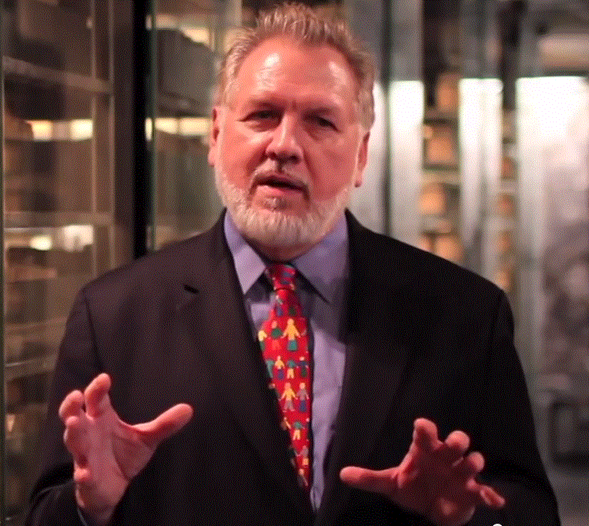
Who I Am…
3 years teaching Crisis Informatics and IT Mgmt
40 years in IT, 38 in IT mgmt
13 years on Wall Street
10 years in mgmt consulting
17 years in NGOs
Former Global CIO at IFRC
Former CIO at STC/US & UK
Co-founder and former Chairman of NetHope.org
More on LinkedIn, Google and www.eghapp.com
Making Connections for Good
– People, Comm’s, Ideas
Connect!
Notes:
When I was 38, I read a comment by Handy saying we could expect to have 5 careers;
For the millennials, US Dept. of Labor estimates you can expect to have 14 jobs…by the time they are 38! (see https://www.youtube.com/watch?v=XrJjfDUzD7M at 02:15)
http://www.amazon.com/The-Age-Unreason-Charles-Handy/dp/0875843018
Charles Handy, http://www.texasventures.us/india/images/leader2_1.jpg …five careers

Slide 3
What is the question for today?
How do humanitarian and IT crises parallel and disrupt each other? The case of COVID-19

Slide 4
Crises - Two Types of Time
Humanitarian Crises
Technology Crises
migration
long
People outage
9/11, Pandemic
long
drought
famine
ebola
Types of Outage
COVID (2020)
Duration
Spanish Flu (1918)
Duration
Fire Scenario
Insurance Threshold
wildfire
software
hurricane
hardware
tsunami
network
earthquake
electrical
short
short
slow
Onset
sudden
slow
Onset
sudden
The time for emergency preparedness follows a similar line
But money spent preparing is the opposite curve

Slide 5
Risk Framework
COVID-19
high
Black Swans
The Risk Frontier
(Optimal Insurance Threshold)
Impact
low
low
Likelihood
high
The decision: with scarce resources, which risk would you address first?

Slide 6
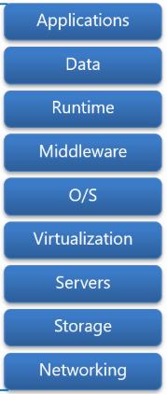
Operating the IT Stack
Key IT Managers questions: Where are my single points of failure? What’s my plan-B? For example, electricity?
You manage* (or you manage those who manage the traditional IT stack)
Security
*A key single point of failure:
you and your people (and your
partners’ people)
Climate
You also manage*
(the supporting structure)
Electrical
Notes:
https://dachou.github.io/2018/09/28/cloud-service-models.html

Slide 7
COVID & the IT Responsibility Shift
Keep customers running
Keep systems and employees running
With COVID, the internal people become external customers

Slide 8
But, you say, that’s why we have a Business Continuity Plan (BCP)!
If you lose your team, who runs the BCP?
That’s the 9/11 and COVID question.
Except, for COVID, your backup team may also be out.

Slide 9
Your worst case, last resort choice?
Shut down the business.
…or, quarantine your backup team now!

Slide 10
Ripley’s 3-Ds Arc of Disaster Response
Where are you?
Action!
high
Response Level
Decisive Moment
Deliberation
Denial
Low
Start
Time
end

Slide 11
Resiliency and Improv
Improvising is about the “and” –trying, building on it,
adjusting as you go.
“Resilient people … possess three characteristics:
a staunch acceptance of reality;
a deep belief, often buttressed by strongly held values, that life is meaningful;
and an uncanny ability to improvise.
You can bounce back from hardship with just one or two of these qualities, but you will only be truly resilient with all three. These three characteristics hold true for resilient organizations as well.”
–Diane Coutu, “How Resilience Works”, HBR, May 2002
Sound like innovation?

Slide 12
How do you decide? It depends
Openly share health data?
Covid-19
USA
Expedient
Ebola,
Sierra Leone
“HHS Issues Limited Waiver of HIPAA Sanctions Due to Coronavirus”, Mar. 17, 2020
Open Text,
Syria
Action Basis
Emergency
Relief
Development
Programs
Principle
Low
Crisis Urgency
High
Notes:
https://healthitsecurity.com/news/hhs-issues-limited-waiver-of-hipaa-sanctions-due-to-coronavirus

Slide 13
Key Take-aways
You can’t plan for a 100-year event, but you can improvise
Your key single point of failure is losing people
Everyone becomes an external customer
With increased crisis urgency come more expedient decisions

Slide 14
Next steps
Join or create a collaboration group to share best practices. There are two operating in the nonprofit space.
Read up on disaster response (e.g. Amanda Ripley’s book).
Experiment and share what works; this is a broader community than our immediate organizations.

Slide 15
Q&A, Discussion

