Slide 1
NetHope Global Member Summit 2012
Chairman’s Report
Edward G. Happ
October 9, 2012

Slide 2
NetHope Summit 2007
Notes:
Redmond, May 2007
JL showed the “Did You Know…” presentation
Created in 2006 by a Colorado High School teacher and his class
Six years later, they are now in college

Slide 3
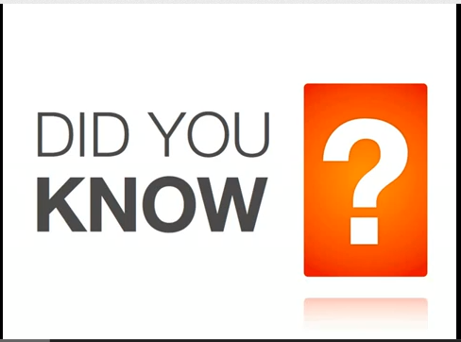
“Did You Know” Version 6.0 …2012
http://www.youtube.com/watch?v=XVQ1ULfQawk
Notes:
http://www.youtube.com/watch?v=XVQ1ULfQawk

Slide 4
A Super Nova of Multiple Dimensions
Explosion of information
Explosion of connected users
Explosion of applications
Notes:
http://www.williamsclass.com/EighthScienceWork/StellarEvolution.htm

Slide 5
Explosion of Information

Slide 6
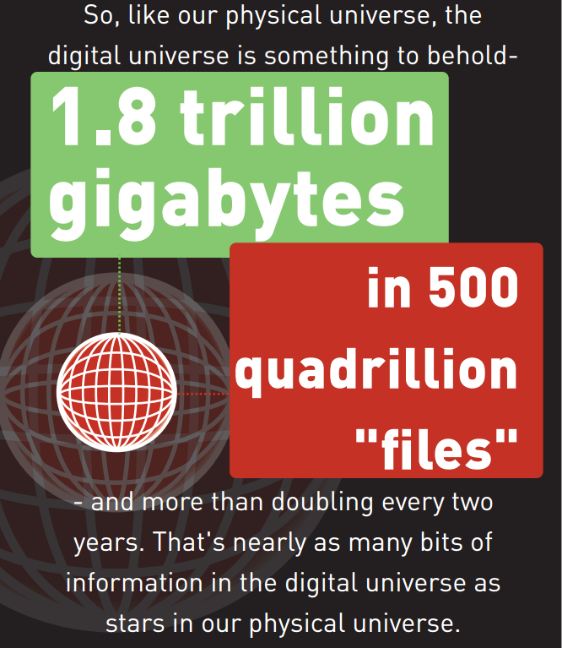
EMC – IDC Digital Universe Study, June 2011
Notes:
http://www.emc.com/leadership/programs/digital-universe.htm
http://www.emc.com/collateral/about/news/idc-emc-digital-universe-2011-infographic.pdf

Slide 7
Explosion of connected users
“By the end of 2012, the number of mobile-connected devices will exceed the number of people on earth, and by 2016 there will be 1.4 mobile devices per capita” (over 10 billion mobile connected devices) --Cisco Visual Network Index Forecast, February 2012
Notes:
http://www.cisco.com/en/US/solutions/collateral/ns341/ns525/ns537/ns705/ns827/white_paper_c11-520862.html

Slide 8
Explosion of connected users
Mary Meeker, Gigaom, April 2012
Notes:
http://gigaom.com/2010/04/12/mary-meeker-mobile-internet-will-soon-overtake-fixed-internet/

Slide 9
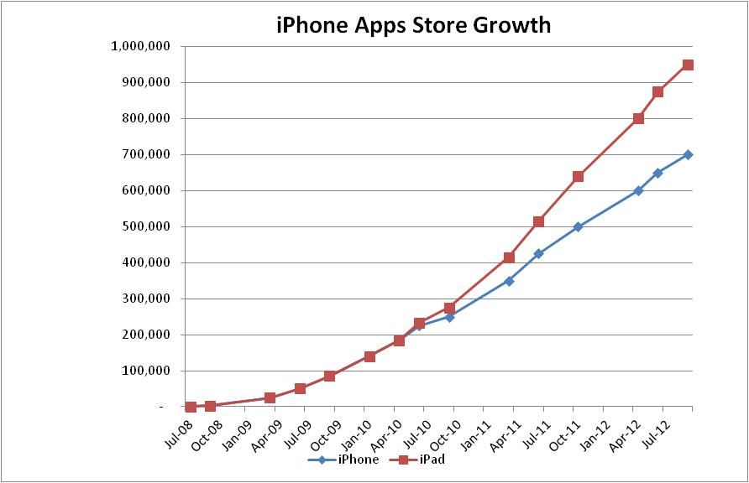
Explosion of mobile applications

Slide 10
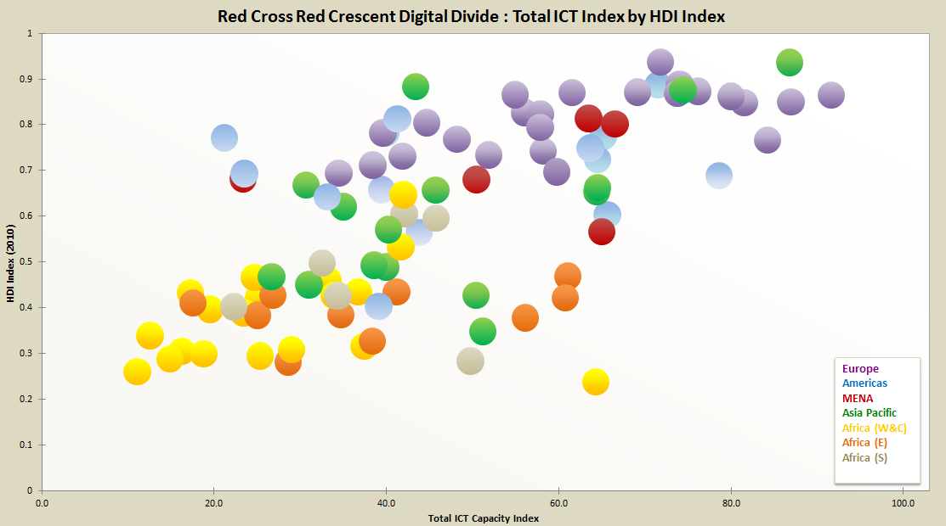
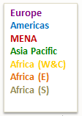
An Internal Digital Divide - RCRC
Lower ICT Index
Higher ICT Index
Human Development Index from the United Nations Development Program’s Human Development Report .
ICT index from a 2011 survey of NS ICT capacity, derived from 18 ICT capacity factors (self reported).
Notes:
Based on responses from 116 National Societies; raise issue of widening gap as all move up the ICT capacity curve.

Slide 11
…If all this doesn't scare you,
check your pulse

Slide 12
But where there is great change…
there is great opportunity

Slide 13
Returning to our six values to guide us
Technology matters
We are at the intersection of technology and nonprofit work
We advocate and interpret ICT benefits for the sector
Benefitting all benefits one
Our brand of partnering means shifting from a ‘do then share’ to a ‘share then do’ mentality
larger organizations : take a leadership position on collaboration
Learning through collaboration
Ready, fire, aim… fire, aim, fire aim, fire aim
Notes:
We advocate two ways: for beneficiaries and the field, and for using tech in nonprofit org’s

Slide 14
Returning to our six values to guide us
Build for the field
Cultivate headquarters humility
Expect the pyramid to flip… discover and harvest
Bias for action
When times are uncertain, smart organizations “vary like mad”
Pilots and prototypes and agility as core competencies
Trust above all else
Value the faith and integrity we have with each other

Slide 15
Lesson from the movies
“Whatever comes out of these gates, we got a better chance of survival if we work together”
Notes:
http://www.youtube.com/watch?v=xXOPAPxZEpk (see 06:07 - 07:12 on this trailer)
Battle of Zama
Why did Carthage win over Rome this time?
There’s value in banding together
http://en.wikipedia.org/wiki/Gladiator_(2000_film)

Slide 16
Some questions to ponder
How are you amplifying the voice of technology from beneficiaries?
How are you increasing ICT agility to adjust faster, shorter, cheaper?
How do we enable the beneficiary portfolio of applications?

Slide 17
Appendix

Slide 18
A parting thought…
"I've seen a heap of trouble in my life, and most of it never came to pass." --Mark Twain

Slide 19
Add Michael Crichton quote on we know nothing about the future, this from the author of Jurassic Park We need a new zoom level: Gisli's blog: data flood needs aggregation: meaningful pooling Shift happens - did you know 2020 Robots in Millennium man -- Imagine cup robots/ model helicopters to crawl disaster areas LinkedIn advanced search for Food Security + Red Cross --connecting q&a across org's Connect + conversations HQ to Field Field to field Beneficiary to beneficiary Information explosion Connectivity explosion Apps explosion Meta apps - Filters --shift happens

Slide 20
What do we need to do to succeed?
First and foremost, we need what I call ‘headquarters humility’, the openness to solutions coming from the far reaches of our organization and others. The best answers may in fact come from the poorest countries, from people we least expect. We need to discover and harvest the best of what is happening in the field.
Second, we need to shift from a ‘do then share’ to a ‘share then do’ mentality. We need to look first to how we can partner to meet a need, instead of developing me-too solutions and sharing the war stories later. Sharing stories may be essential to starting a collaboration, but there must be a shift to doing things together from the outset.
Finally, the larger organizations among us, who have the resources to go it alone, need to take a leadership position on collaboration. This is part of our give-back to the non-profit community. Like a good manager who learns to accomplish goals through others, we need to get the business of non-profit services done through and with each other.
--”Collaborate or Perish –How Working Together with Technology Can Change the Non-Profit Sector”, Berlin Civil Society, 5th anniversary publication, October 2012

Slide 21
The following presentation was originally created by Karl Fisch, Director of Technology at Arapahoe High School in Littleton, Colorado, USA (he says “fancy title, but basically means I'm the technology coordinator for the building”).

Slide 22
Did You Know . . .

