Slide 1
IT Strategy in a Chaotic World
Edward G. Happ
Global CIO, IFRC
Chairman, NetHope
November 21, 2011

Slide 2
A Brief Introduction
13 Years on Wall Street
10 Years in management consulting
12 years in NGOs
Former CIO at STC/US & UK
Co-founder and Chairman of NetHope.org
More on LinkedIn, Google and www.eghapp.com

Slide 3
Three Imperatives
Strategic Direction. Our strategic focus must shift
Innovation. Turn your organization upside down
Collaboration. Collaborate or perish
3

Slide 4
1. Strategy is about moving missions

Slide 5
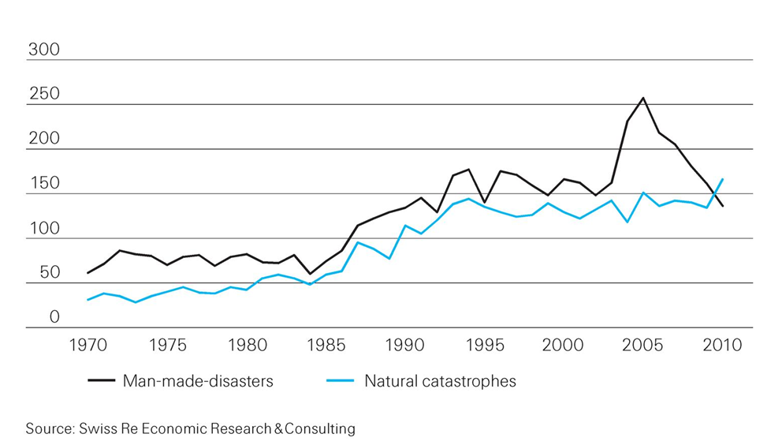
Catastrophic events are on the rise
From less than 100 in 1970 to over 300 in 2010
U.S. Hurricanes
5
Notes:
http://media.swissre.com/documents/sigma1_2011_en.pdf Hurricanes Katrina, Rita, Wilma

Slide 6
IT Strategy: Move up, Get in and Get out
Get in
Competitive
or Leading
BENEFICIARY
“Differentiating”
Beneficiary & Field Facing
Increasing Impact for Beneficiaries
PROGRAM
“Improving Program Delivery”
Increasing Impact for Beneficiaries
OPERATIONAL
“Helping the Organization Run”
Efficient
Donor & HQ
Facing
FOUNDATIONAL
“Keeping the Lights On”
Get out

Slide 7

Conclusion in Three Sentences
IT strategic direction points:
Move the IT agenda up the strategy pyramid
“Get out” of the bottom (of lights-on operations)
“Get in” at the top (program impacting IT)

Slide 8
Getting in: Texting Survivors in Haiti
6M SMS in 7 days
385K SMS/Day received
1.1M early warning SMS
1M Cholera health SMS
800K IVR calls in 1 month
8
Notes:
IFRC and Trilogy partnership: targeted SMS-based communications
6 million SMS sent during 7 days disaster preparedness campaign
385,000 messages received per day in PaP & Artibonite
1.1 million "early warning" SMS ahead of hurricane Tomas storm surges
Cholera: 2.1 million public health SMS sent:*733 IVR info-base; 800,000 calls to IVR in September
Survey potential
Beneficiary at the center of communications

Slide 9
Getting Out: Office365
We are not in the data center business
We need to redeploy people, time and money up-the-pyramid
We need to have impact on 60+ National Societies who have little to no IT
We are a Microsoft-centric shop with many inter-application and platform dependencies
We need a more fluid path from premises to off-premises computing
We are about partnering with those whose business it is to do things that it is not our business to do

Slide 10
The Unsung Benefit of the Cloud
The interesting question about the cloud is not whether it will help you be more efficient or more agile, but will it free up your resources to be more relevant and have more impact.
10

Slide 11
2. INNOVATION IS ABOUT Harvesting

Slide 12
Discover and Harvest
Jerry Sternin, Vietnam and positive deviance
  The value of discovering the exceptions
Traditional approach is more an “assess and build” approach:
  assess the situation, gather requirements, specify the project, build it, test it and deliver it.
  problem is that this approach has a dismal history
The “discover and harvest” approach:
  finding those applications and uses of technology in the far reaches of your organization that are already working.
12
Notes:
See the Fast Company article on Jerry’s work, “Positive Deviant,” by David Dorsey, November 30, 2000; here: http://www.fastcompany.com/magazine/41/sternin.html
Richard Tanner Pascale & Jerry Sternin, “Your Company’s Secret Change Agents,” Harvard Business Review, May, 2005.
“Positive Deviant,” Fast Company.

Slide 13
The best answers, especially if it involves change, need to be from the inside out.
  “Maybe the problem is that you can't import change from the outside in. Instead, you have to find small, successful but "deviant" practices that are already working in the organization and amplify them.” --Sternin
13

Slide 14
What’s Needed?
For leaders to become chief amplifiers.
CIO’s should become adept at finding what’s working around them (Discovery --outside their headquarter walls), can be taken to scale (Harvesting); and then shine the spotlight on it.
14

Slide 15
The Imagine Cup Funnel
400,000
3,000
400
27 Winners
How are you gathering
the good ideas?
15

Slide 16
Discover and Harvest Benefits
It’s already working somewhere; it leapfrogs over getting a new system to work. The pilot has already been run.
Some group has already adopted it; it doesn’t need to be sold.
It’s field-tested. Especially for international NGOs working in challenged rural settings, it works where technology is rare.
16

Slide 17
For Discover and Harvest to Work…
You need to believe in:
Headquarters Humility – that innovations will come from the far country
Good Enough Technology – that 80% solutions get the job done
17

Slide 18


Tech Catalog of Standards & Choices
‘Discover’
‘Harvest’
Application Inventory
Application Catalogue
NS IT Survey - Applications
Scale up
Application Portfolio
Review
850+
Criteria
National Societies
De facto
vendor standards
Application Contest
Application Catalogue is the window for NSs into supported applications
National Societies
18
Notes:
http://www.istockphoto.com/stock-photo-4237972-funnel.php

Slide 19
3. Collaborate or perish

Slide 20
Nonprofits get by with a fifth (or less) of corp. IT costs
5x
18x
4x
Notes:
20

Slide 21
Leveling the NGO - Corp IT Playing Field
21

Slide 22
Key Conclusion
Even if we tripled IT spending, we would still be playing catch-up for just keeping the lights on.
22
Notes:
22

Slide 23
Non Profit IT Departments Can’t Play the Odds
IF
57% of ERP projects don't realize their ROI (Nucleus Research)
66% IT projects fail (Standish Chaos DB)
NGOs spend a 20th what corporations do (Tuck survey)
And we are spending donors’ dollars
THEN
We must find a better way...
23

Slide 24
What else is possible for nonprofits?
Collaborate or Perish
  Shared consulting/support
  Shared web/file server hosting & backup
  Shared fundraising systems guru
  Shared technology procurement
  Shared technology training
The operative word here is Shared
24

Slide 25
The New Collaboration
Who Are You Partnering With?
“Who has expertise I can trust?”
Shared Services & Assessments
Share
and Do
Share
and Do
Share
and Do
SHARED
SPECIALIZATION
JOINT PROJECTS
“What can we build together?”
NRK, Phase 2 Satellites
Increasing Level of Trust
PARTNERING
“How can we work with corporations?”
Cisco, Microsoft, Intel Grants
Do and Share
BASIC INFO SHARING
“What are my peers doing?”
Meetings, Conference Calls
25

Slide 26

NetHope Vision
Connected Together:
To be a catalyst for collaboration in the International NGO community and enable best use of technology for connectivity in the developing parts of the world
Notes:
NGO – Nongovernmental Organization (nonprofit, charity, social sector)

Slide 27























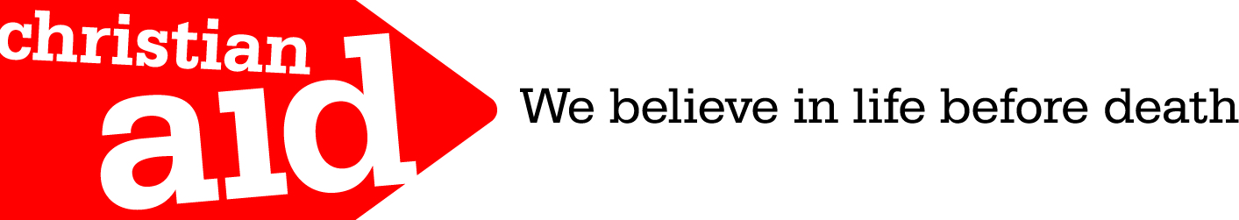







Collaboration: 34 Member NGOs
27

Slide 28
Why Has NetHope Been So Successful with Collaboration?
Trust & Relationship: we know each other well as colleagues, not competitors
Hunger (Scarcity) – IT departments are among the most under-funded areas of nonprofits
Common Need: we are all trying to deliver ICT out to the moist challenged areas of the world in which we work
Value: We deliver member value 10-fold and more over member contributions
Time: ten years of working together
28

Slide 29
In The Future…
You will be known not by what you do, but by who you partner with.
29

Slide 30
Questions to Ask Yourself
Where on the IT Strategy stack are you?
Where can you discover innovation in your organization?
What’s the next level of collaboration you are willing to commit to?

Slide 31
Further Reading
Blogs:
http://eghapp.blogspot.com/
http://granger-happ.blogspot.com/ (Dartmouth)
Web site (see the articles & presentations link) http://www.eghapp.com
Email: ehapp@ifrc.org
Twitter: @ehapp
LinkedIn: http://www.linkedin.com/profile/view?id=1906312
Book: Managing Technology to Meet Your Mission, chap. 11

Slide 32
Questions?

