Slide 1
Crisis Informatics - an Excerpt
Part 2
Edward G. Happ
June 28, 2021

Slide 2
Four Lectures from SI-537+, Fall 2020
Part 1
3. History Of IT In Crisis Response And Major Cases (911, Indonesian Tsunami, Haiti, Tacloban, Syria)
4. A Framework For Understanding The Application Of Technology And Data To Crises
Part 2
16. Crisis And Cultural Context
19. COVID, Crisis Informatics and IT
Can we record this please?
Notes:
From SI-537, F2020, Lecture 3, 4, 12 (part 2); and ILO presentation of March 19, 2020.
From SI-537 Crisis Informatics - Lecture 3 FINALc.pptx, F2020
From SI-537 Crisis Informatics - Lecture 4 FINALb.pptx, F2020
From SI-537 Crisis informatics - Lecture 12 FINAL.pptx, part b, F2020
From my ILO presentation of March 19, 2020, “COVID, Crisis Informatics and IT FINALd.pptx”

Slide 3
Part 1 Conclusions
The most important take-away is that context matters.
    The scope, severity, location and timing determine which technology to apply.
Each audience has its own technology footprint
    Rule #1 is “know thy audience!”

Slide 4
16. Lecture – Crisis And Cultural Context
Notes:
From SI-537 crisis informatics - Lecture 12 FINAL.pptx, F2020

Slide 5
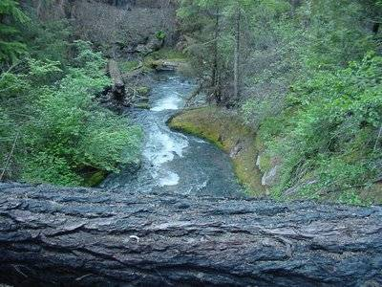
A story from Zaire
This is a story about overcoming obstacles. It is also one about leadership in a crisis.
“The tree the tempest with a crash of wood Throws down in front of us is not to bar
Our passage to our journey's end for good,
But just to ask us who we think we are.”
–Robert Frost
Notes:
A Tree in Zaire, #243
http://www.hpmd.com/hpmd/personal/LTYMstories.nsf/links/243
Robert Frost, “On a Tree Fallen Across the Road,” http://www.americanpoems.com/poets/robertfrost/12119
http://oceanshaman.blogspot.com/2007/11/on-tree-fallen-across-road.html
Inspiring people and engaging their hearts and minds for change is a very difficult thing. Your frustration is well-founded. I cannot argue with your logic. It is well thought-out and rational. But groups of people don't change based on reason. I heard a story at a workshop that I think tells us something about leadership. It also tells us about the heart of strategy.
Four Peace Corps volunteers were making their way in a large Land Rover to a village in what was then Zaire. There was a single dirt road through a forest. A few kilometers from the village they discovered a large tree that had fallen, blocking the road. A villager was on top of the log chopping away with a hand-held axe. Wood chips were flying in every direction, but he was making little progress. The volunteers asked him to step aside. They pulled a cable from the winch in front of the truck and wrapped it around the tree. They tried the winch first, without success. Putting the truck in reverse, with all four wheels engaged, they attempted to drag the tree from the road. The wheels spun in the dirt. They made little progress. Villagers had begun to arrive down the dirt road, from the other side. As the volunteers gave up, restoring the cable to the winch, the villagers gathered around the tree murmuring. The man with the axe resumed his chopping. Off to one side, at the edge of field, the volunteers saw an old man smiling. He walked slowly up to the villagers at the tree and began to sing. The villagers joined him in one of those African songs that rises and falls with a cadence of call and response. As the song rose, the villagers all lifted. The tree moved a few inches. As the song fell, they put the tree down. Again and again, they sang and moved, sang and moved. In less than an hour, the tree was removed from the road. The volunteers got in their Land Rover and drove on to the village, with the people following in the dust.

Slide 6
Question for Today
How do cultural differences impact crisis response?

Slide 7
Riding the Waves of Culture
“I think Trompenaars is correct when he says we will never 'master' anybody else's culture. This means that keeping a beginner's mind - in perpetuity - is a must for successful and less stressful dealings throughout the emerging global village.” –Tom Peters
“Trompenaars' solution: 'We need a certain amount of humility and a sense of humour to discover cultures other than our own - a readiness to enter a room in the dark and stumble over unfamiliar furniture until the pain in our shins reminds us of where things are.’
“I think such a sense of playfulness is on target. My experience says that it's OK to make blunders in other cultures. What is not OK is cultural arrogance. If you come to another's turf with sensitivity and open ears - what the Zen teachers call a 'beginner's mind' - you're halfway home.” –Tom Peters, “Culture and Sore Shins”
Notes:
"Culture and sore shins: Tom Peters On Excellence," Independent, July 9, 1994, https://bit.ly/2QztQNW

Slide 8
Fons Trompenaar’s Types
“The author begins with the 'universalist' v the 'particularist' schism. Universalists (e.g., at the extreme, Americans, Canadians, Australians, Swiss) believe in 'one best way' - a set of rules that applies in any setting. Particularists (Koreans, Chinese, Malaysians, at the other extreme) focus on the peculiar nature of a situation.” [i.e., situational]
“Say you are riding in a car with a close friend who has an accident in which a third party is injured. You are the only witness, and he asks you to falsely testify about his driving speed. Universalists won't lie for him. Particularists will.”
--Tom Peters
Notes:
IBID, http://www.independent.co.uk/news/business/culture-and-sore-shins-tom-peters-on-excellence-1412986.html

Slide 9
Five dimensions of how we relate culturally
See Trompenaars’ app and TED talk in the notes.
versus
Universalism
  rules
Communitarianism
  the group versus
Neutral
  feelings expressed
Diffuse
  range of involvement
Achievement
  how status is accorded
Particularism
  relationships
Individualism
  the individual
Emotional
  feelings expressed
Specific
  range of involvement
Ascription
  how status is accorded
--Fons Trompenaars, Riding the Waves of Culture, p. 29
Notes:
Fons Trompenaars and Charles Hampden-Turner, Riding the Waves Of Culture, Second Edition, 1997, Nicholas Brealey Publishing Limited, London. https://pdfs.semanticscholar.org/baa5/8e86493834d21459cba14437d8900542d666.pdf
See Fons Trompenaar's app “Culture for Business” https://www3.thtconsulting.com/tools/culture-for-business-tool/
and his engaging TED talk on “Riding the Waves of Cultural Change,” https://youtu.be/hmyfjKjcbm0

Slide 10
The Case of Ebola
March 2014 – June 2016
11,315 people died
Notes:
From the complete “Crisis and Cultural Context” lecture, Nov. 20, 2018

Slide 11
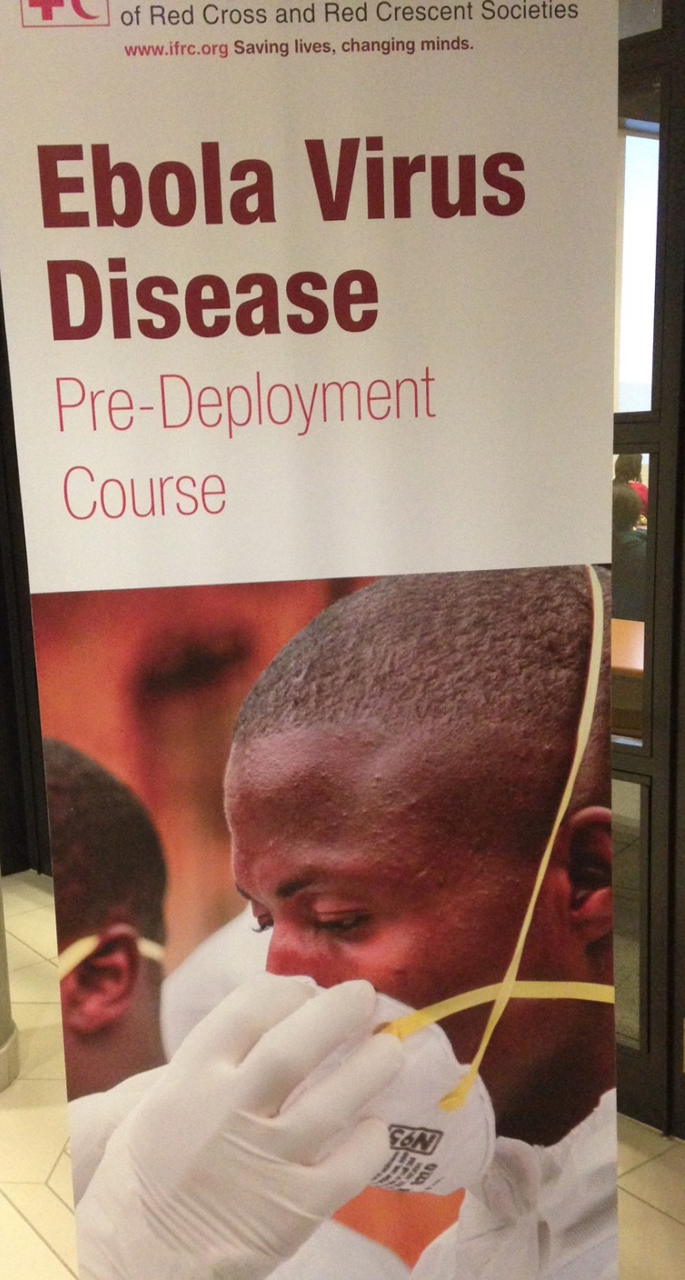
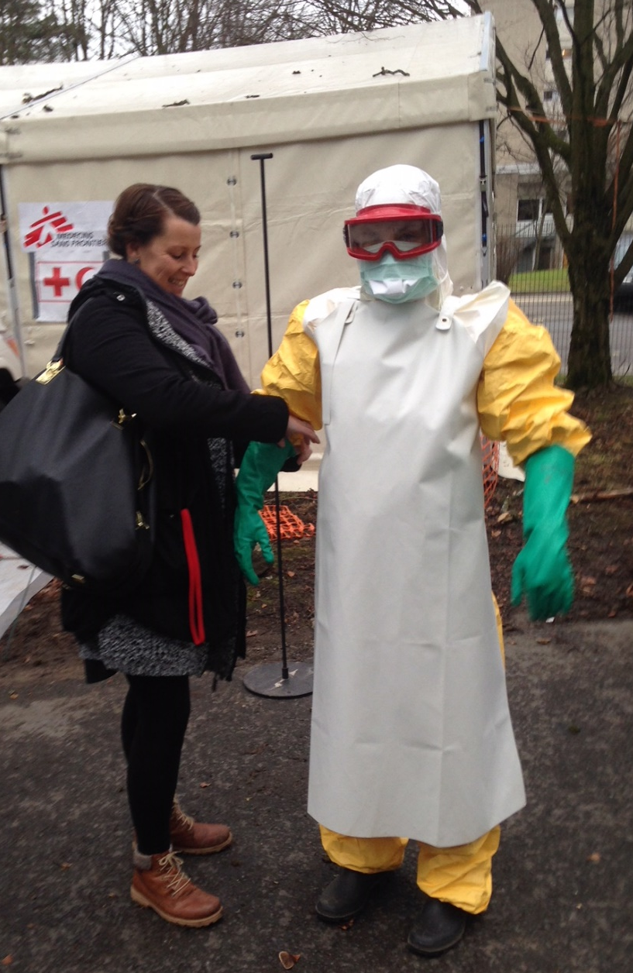
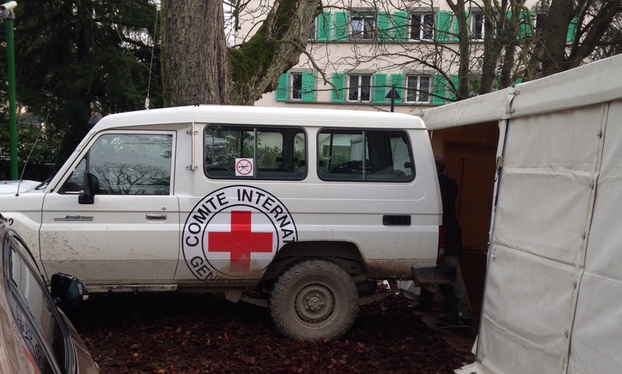
Ebola Training
& the last hug
IFRC Campus,
Dec. 16, 2014 & Jan. 15, 2015
Notes:
Dec. 16, 2014 and Jan. 15, 2015

Slide 12
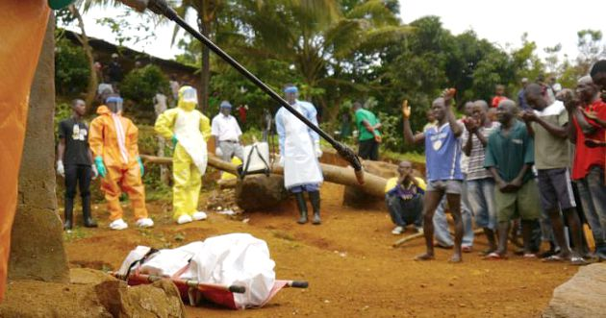
“During this emotional time, traditional burial rituals and practices may need to be modified so that family members can say goodbye to their loved ones without becoming exposed to [Ebola]. Providing the opportunity for a safe yet dignified burial is an opportunity to respect cultures and traditions and provides comfort to those left behind.” --WHO, “Safe and dignified burials”
“…in Freetown, neighbours and family praying over body of man who died of Ebola in community.” --WHO
Notes:
“Safe and dignified burials,” WHO, http://www.who.int/csr/disease/ebola/training/safe-burials/en/

Slide 13
“Scenes of conflict were frequent in Guinea, Sierra Leone, and Liberia—the three countries hardest hit by Ebola—as medical authorities tried to separate the dying and the dead from their communities. Ambulance drivers and burial teams were pelted with stones.
In the worst attack, eight people distributing information about Ebola in Guinea were killed. Villagers often retreated with ill relatives into the forest, where they could hide—and where the deadly virus then quickly spread.
"The problem was that the people handling the intervention only looked at this as a health issue; they did not try to understand the cultural aspects of the epidemic," Anoko says.” –National Geographic, Julienne Anoko, Anthropologist
Notes:
IBID, https://news.nationalgeographic.com/2015/01/150130-ebola-virus-outbreak-epidemic-sierra-leone-funerals/

Slide 14
Science Confronts Culture
“Spirituality runs wide and deep in Sierra Leone, Liberia, and Guinea. The population consists mainly of Christians and Muslims. Christians close the eyelids of the dead, wash and dress them. Muslims wash the dead as well, but wrap them in a white cloth. There are also rituals particular to ethnic groups—such as the Kissi, the Mende, the Sherbro, and the Kona—as well as secret societies.”…
“As death approaches, virus levels peak. Anyone who touches a droplet of sweat, blood, or saliva from someone about to die or just deceased is at high risk of contracting the disease.”
Notes:
IBID, https://news.nationalgeographic.com/2015/01/150130-ebola-virus-outbreak-epidemic-sierra-leone-funerals/

Slide 15
Distrust Thwarts Compromise
"You have to take into account a history in which local people have learned to distrust the government," says Paul Richards, an anthropologist at University College London who has worked in Sierra Leone for 40 years.” …
“He adds, ‘It doesn’t help that outsiders are dressed in astronaut suits.’”
Notes:
IBID, https://news.nationalgeographic.com/2015/01/150130-ebola-virus-outbreak-epidemic-sierra-leone-funerals/
"It’s a situation not unlike that in Ferguson, Missouri, where a legacy of slavery, exploitation, disregard, and abuse leads people to think their own solutions are better than those from the outside.”

Slide 16
Pastors, Imams, Chiefs Stop Rituals
“Abyusuf went to his congregation and explained what he had learned: "I told people, this is not the first plague [recalling a leprosy contagion in ancient times]. You do not need to wash the corpse. You can pray in absentia. The rules are not absolute.”
“Pastors promised their congregations similar forgiveness, and chiefs asked their people to cease all secret society rituals. Meanwhile, humanitarian organizations and the government enacted "safe and dignified burials," during which people could pray briefly for their loved ones, while standing two meters (6.5 feet) from the white body bag.”
Notes:
IBID, https://news.nationalgeographic.com/2015/01/150130-ebola-virus-outbreak-epidemic-sierra-leone-funerals/

Slide 17
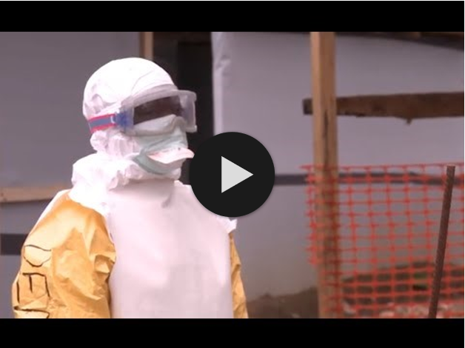
The Case of Ebola and Dignified Burial
https://www.youtube.com/watch?v=jirs9qVq50k (5:11)
Notes:
“WHO: Fighting the Ebola outbreak in Sierra Leone,” Aug 11, 2014, https://www.youtube.com/watch?v=jirs9qVq50k (5:11)
Also see “Meet the Fearless Ebola Hunters of Sierra Leone”, National Geographic, Mar 24, 2015
https://www.youtube.com/watch?v=_HRY3eXjnos (4:14)

Slide 18
Why the Ebola Case?
What was different about this crisis?
    And similar to the current pandemic?
What role did culture play?
What examples of improvising did you see?
Notes:
Sometimes culture trumps science

Slide 19
Cultural Awareness

Slide 20
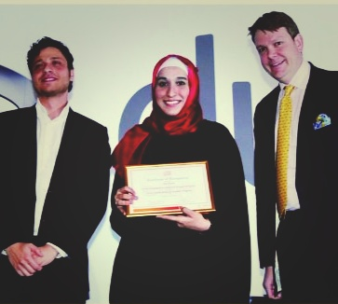
The Handshake
At the Imagine Cup student competition, on the Microsoft campus in Redmond in 2015, I held out my hand without thinking
Heba Nayef, a team member from Dubai said, “we cannot shake hands”
I apologized, realizing I had crossed a cultural boundary
She then showed me an alternative greeting
Notes:
“The Handshake,” #494, http://www.hpmd.com/hpmd/personal/LTYMstories.nsf/links/494

Slide 21
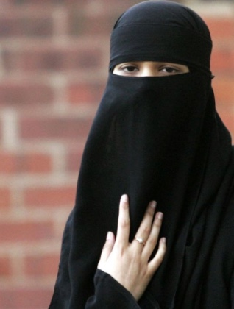
Kevin MacRitchie ran a simulation
to train us for deployment
Cultural Awareness
Majority of refugees are of Muslim faith
Be mindful of different cultures –
  E.g. 9 out of 10 refugees are from Syria, Afghanistan or Iraq
Remember the cultural differences with regards to women
  See next slide

Slide 22
Kevin MacRitchie’s Slide…
Remember – Culture Rules
Things to Do
  Do respect the privacy and protected role of women in Muslims societies
  Men stand when women enter a room
  Do respect the different living “areas” for men and women
Things NOT to Do
  Do not shake hands with a Muslim woman unless she offers her hand first (unless you are a woman)
  Do not flirt, hit on, touch, hug or talk in private with women. IT COULD ENDANGER THEIR SAFETY.
  Do not talk in public to professional Muslim women unless it is business-related.
  Do not engage a woman in conversation unless you have been formally introduced

Slide 23
Conclusion
Culture provides the context for all humanitarian crisis work
You can’t address the crisis without first understanding the context

Slide 24
19. COVID, Crisis Informatics and IT
Notes:
From my ILO presentation of March 19, 2020, “COVID, Crisis Informatics and IT FINALd.pptx”

Slide 25
What is the question for today?
How do humanitarian and IT crises parallel and disrupt each other? The case of COVID-19

Slide 26
Crises - Two Types of Time
Humanitarian Crises
Technology Crises
migration
long
People outage
9/11, Pandemic
long
drought
famine
ebola
Types of Outage
COVID (2020)
Duration
Spanish Flu (1918)
Duration
Fire Scenario
Insurance Threshold
wildfire
software
hurricane
hardware
tsunami
network
earthquake
electrical
short
short
slow
Onset
sudden
slow
Onset
sudden
The time for emergency preparedness follows a similar line
But money spent preparing is the opposite curve

Slide 27
Risk Framework
*Black swan: “an unpredictable or unforeseen event, typically one with extreme consequences.”
COVID-19
high
Black Swans*
The Risk Frontier
(Optimal Insurance Threshold)
Impact
low
low
Likelihood
high
The decision: with scarce resources, which risk would you address first?
Notes:
A black swan is “an unpredictable or unforeseen event, typically one with extreme consequences.” --Oxford Languages

Slide 28
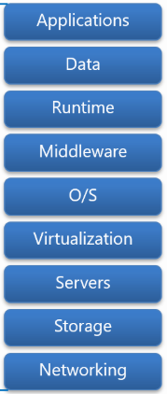
Operating the IT Stack
Key IT Managers questions: Where are my single points of failure? What’s my plan-B? For example, electricity?
You manage* (or you manage those who manage the traditional IT stack)
Security
*A key single point of failure:
you and your people (and your
partners’ people)
Climate (AC)
You also manage*
(the supporting structure)
Electrical
Notes:
https://dachou.github.io/2018/09/28/cloud-service-models.html

Slide 29
COVID & the IT Responsibility Shift
Keep customers running
Keep systems and employees running
With COVID, the internal people become external customers

Slide 30
But, you say, that’s why we have a Business Continuity Plan (BCP)!
If you lose your team, who runs the BCP?
That’s the 9/11 and COVID question.
Except, for COVID, your backup team may also be out.

Slide 31
Your worst case, last resort choice?
Shut down the business.
…or, quarantine your backup team now!

Slide 32

Ripley’s 3-Ds Arc of Disaster Response
Where are you?
Action!
high
Response Level
Decisive Moment
Deliberation
Denial
Low
Start
Time
end

Slide 33
Resiliency and Improv
Improvising is about the “and” –trying, building on it,
adjusting as you go.
“Resilient people … possess three characteristics:
    a staunch acceptance of reality;
    a deep belief, often buttressed by strongly held values, that life is meaningful;
    and an uncanny ability to improvise.
You can bounce back from hardship with just one or two of these qualities, but you will only be truly resilient with all three. These three characteristics hold true for resilient organizations as well.”
–Diane Coutu, “How Resilience Works”, HBR, May 2002
Sound like innovation?

Slide 34
How do you decide? It depends
Openly share health data?
Covid-19
USA
Expedient
Ebola,
Sierra Leone
“HHS Issues Limited Waiver of HIPAA Sanctions Due to Coronavirus”, Mar. 17, 2020
Open Text,
Syria
Action Basis
Emergency
Relief
Development
Programs
Principle
Low
Crisis Urgency
High
Notes:
https://healthitsecurity.com/news/hhs-issues-limited-waiver-of-hipaa-sanctions-due-to-coronavirus

Slide 35
Key Take-aways
You can’t plan for a 100-year event, but you can improvise
Your key single point of failure is losing people
Everyone becomes an external customer
With increased crisis urgency come more expedient decisions

Slide 36
Next steps
Join or create a collaboration group to share best practices. There are at least two operating in the nonprofit space.
Read up on disaster response (e.g. Amanda Ripley’s book).
Experiment and share what works; this is a broader community than our immediate organizations.

Slide 37
Q&A, Discussion

