Slide 1
Crisis Informatics - an Intro
ANIA Great Lakes Chapter Education Series
Edward G. Happ
Executive Fellow Emeritus
April 26, 2023

Slide 2
Agenda
Introductions
What is Crisis Informatics
A Brief History of IT in Crisis Response
A Crisis IT Framework
Q&A

Slide 3
Introductions

Slide 4
Learning Objectives
By the end of the session, learners will be able to…
1) Understand the characteristics of major disasters and the evolution of technology response
2) Recognize the humanitarian side of the large-numbers
3) Introduce basic data sources for understanding context of disasters
4) Introduce & apply a framework for understanding the application of technologies to the scope, severity, context and phases of a crisis and response (course objective #2)
5) Identify and recommend technologies and data relevant to the affected population’s context (course objective #1)

Slide 5
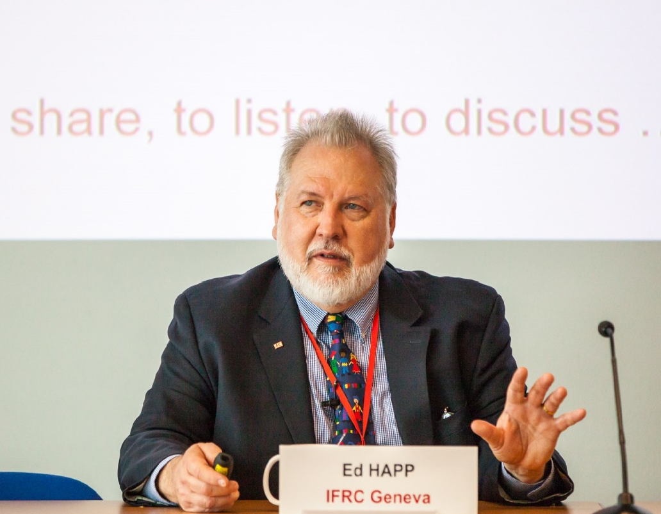
Who I Am…
5 years teaching Crisis Informatics and IT Mgmt
40 years in IT, 38 in IT mgmt
13 years on Wall Street
10 years in mgmt consulting
17 years in NGOs
Former Global CIO at IFRC
Former CIO at STC/US & UK
Co-founder and former Chairman of NetHope.org
More on LinkedIn, Google and www.eghapp.com
Making Connections for Good
– People, Comm’s, Ideas
Connect!
Notes:
When I was 38, I read a comment by Handy saying we could expect to have 5 careers;
For the millennials, US Dept. of Labor estimates you can expect to have 14 jobs…by the time they are 38! (see https://www.youtube.com/watch?v=XrJjfDUzD7M at 02:15)
http://www.amazon.com/The-Age-Unreason-Charles-Handy/dp/0875843018
Charles Handy, http://www.texasventures.us/india/images/leader2_1.jpg …five careers

Slide 6
A Personal Timeline
IFRC
Net Hope+
STC
UMSI
IT Manager, Wall Street
Consulting Partner
Global CIO
Teacher/ Researcher
Writer
ConsutlantAdvisor
Chapter 1
Chapter 2
Chapter 3
Chapter 4
Chapter 5
1991
2000
2017
2022
1977
Today

Slide 7
Crisis Informatics… a 3x3 Summary
The top 3 take-aways for this course are:
A disaster is a disruption; the usual tools don’t apply
Planning and improvisation must coexist
Context matters for culture and technology
Top 3 critical questions I hope you ask of each crisis response:
What’s your a-plan, b-plan and improvising approach?
What are the technology touchpoints of your audience?
How can you break down and organize changing and challenging situations?
Notes:
Drilling down a level, a dozen things I want to get across are:
In a disaster, you can't rely on the infrastructure
Murphy's Law prevails; planning for it is really hard, but necessary
The shift to cash programs depends on the technology backbone
Time compresses in a crisis, and the needs change by the hour
Crisis leadership first means personal grounding, dealing with frustration and high stress
Crisis management is much different than response and development management
Your technology won't match citizen technology; context matters!
Triage is necessary and most difficult [Tony Redmond]; what's the one most important thing?
Decisions must be made with incomplete data
Backup of backup is necessary
In times of rapid change, agility and improvisation are king
Personal preparedness is the foundation for community preparedness

Slide 8
What is Crisis Informatics?

Slide 9
“Crisis informatics is a multidisciplinary field combining computing and social science knowledge of disasters; its central tenet is that people use personal information and communication technology to respond to disaster in creative ways to cope with uncertainty.”
-- Leysia Palen and Kenneth M. Anderson
Notes:
Paylen and Anderson, “Crisis informatics--New data for extraordinary times,” Science, 15 JULY 2016 • VOL 353 ISSUE 6296
Published by AAAS, downloaded from http://science.sciencemag.org/ on August 24, 2020
https://www.science.org/doi/10.1126/science.aag2579

Slide 10
Components of Crisis Informatics
Actors
Networks
Devices
Software
Data
Citizens Social Media
Volunteers Social Media
Govt’s
Agencies
Historical Info
Crisis Event
Crisis Response
Research Modeling
UN/NGO
Systems
Logistics
Comm’s
PR/Web
DSS
FR/DMS
HR/Rosters
Corp. CSR
Notes:
UN Foundation and HHI, “Disaster Relief 2.0” 2011, p. 19
https://hhi.harvard.edu/publications/disaster-relief-20-future-information-sharing-humanitarian-emergencies

Slide 11
3. Lecture – A Brief History of IT in Crisis Response
Notes:
From SI-537 Crisis Informatics - Lecture 3 FINALc.pptx, F2020

Slide 12
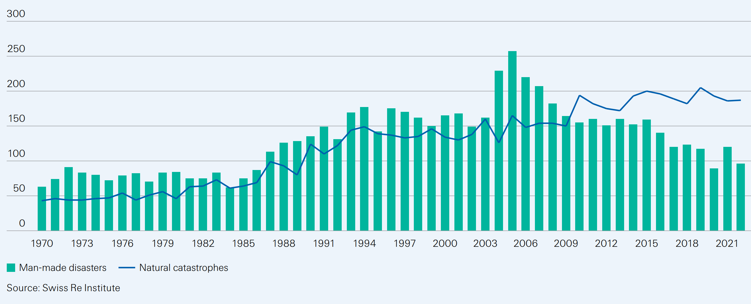
Number of Disasters* Continue to Rise
*Natural disaster trend is up, as “man-made” disasters decline (1970- 2022)
Notes:
Swiss Re, “Sigma” report, No. 1, Mar. 30, 2023, p. 27,
https://www.swissre.com/institute/research/sigma-research/sigma-2023-01.html

Slide 13
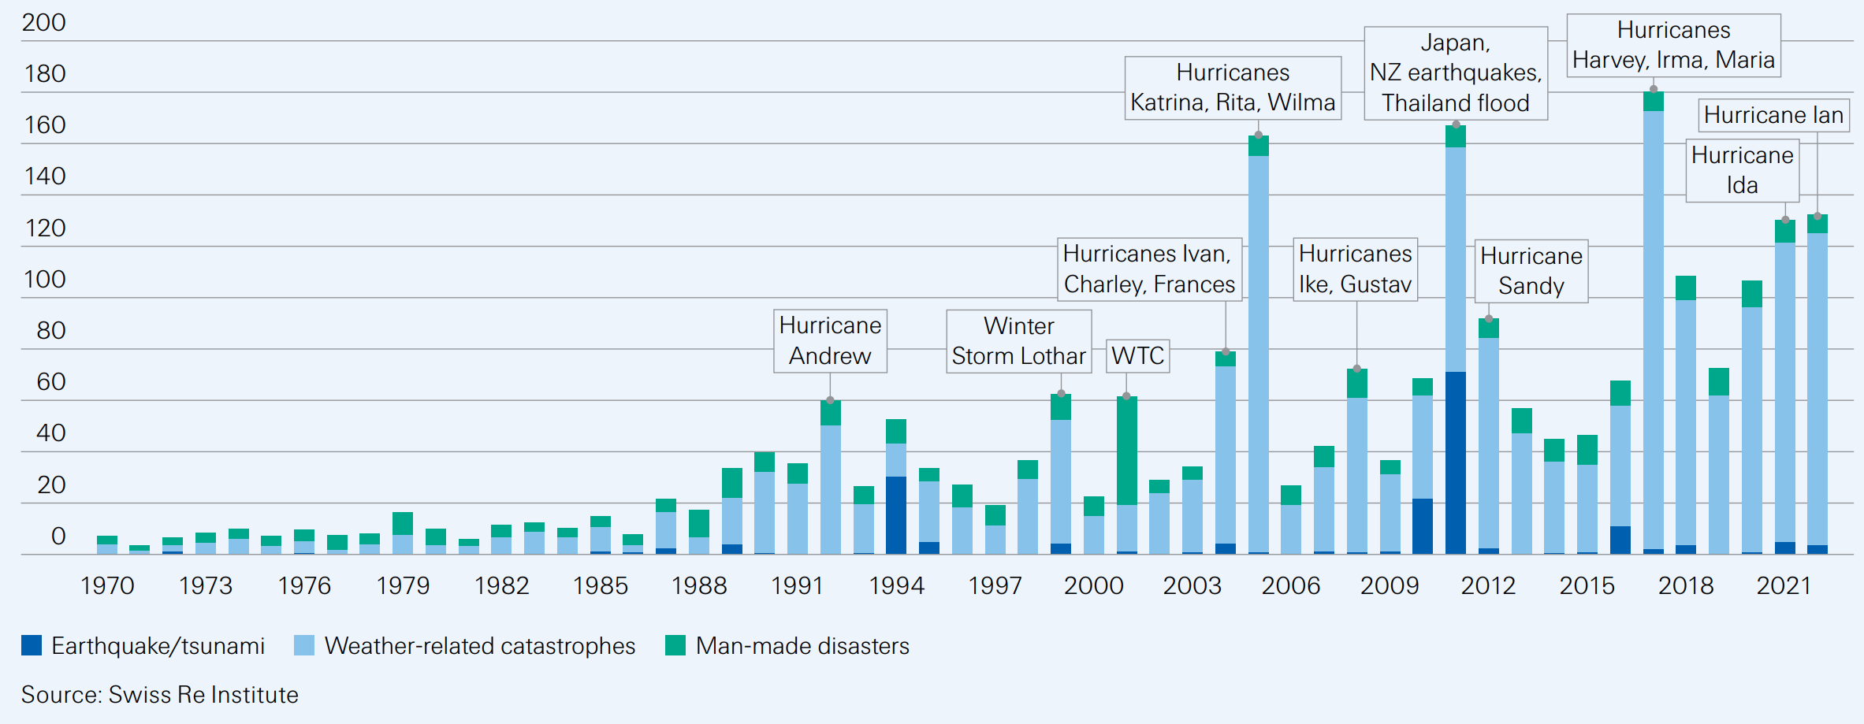
The Cost of Disasters is Rising ($B)
Notes:
Swiss Re, “Sigma” report, No. 1, Mar. 30, 2023, p. 28, https://www.swissre.com/institute/research/sigma-research/sigma-2023-01.html

Slide 14
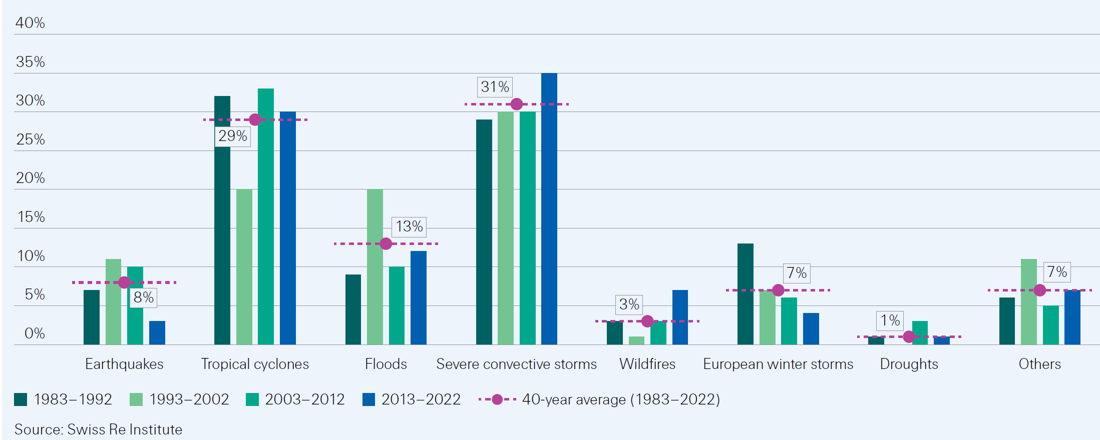
Share of insured losses by peril type by decade
Climate related disasters rose most in the last decade
Notes:
Swiss Re, “Sigma” report, No. 1, Mar. 30, 2021, p. 8, https://www.swissre.com/institute/research/sigma-research/sigma-2021-01.html
Convective storm = severe thunderstorm.

Slide 15
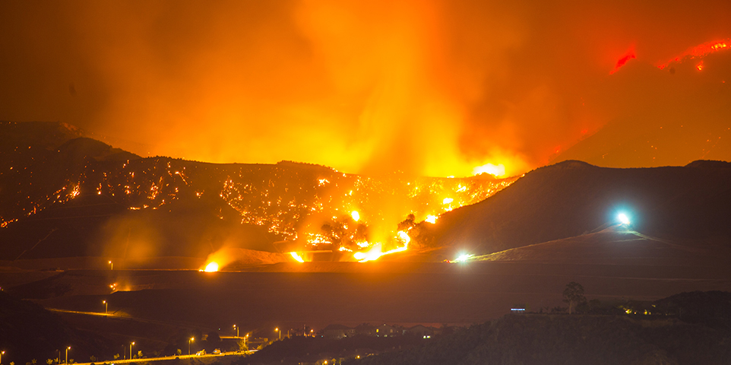
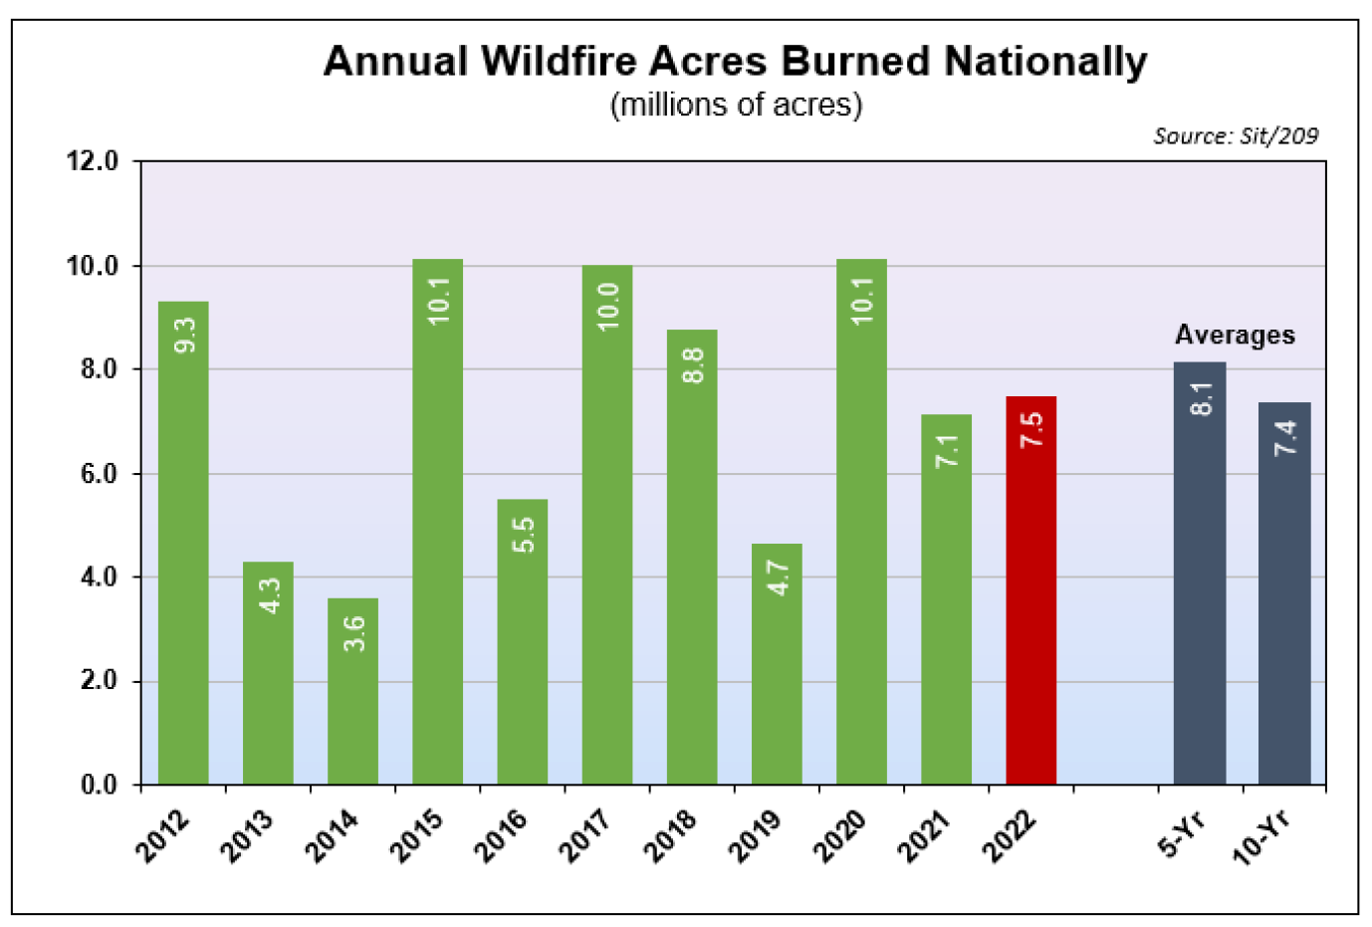
7.5M USA acres burned in 2022
Notes:
https://www.predictiveservices.nifc.gov/intelligence/2022_statssumm/annual_report_2022.pdf
Photo credit: https://www.iii.org/fact-statistic/facts-statistics-wildfires
https://www.nifc.gov/fireInfo/nfn.htm

Slide 16
Catastrophes

Slide 17
Factors of Crisis
Mild
Moderate
Severe
Catastrophic
Severity of Crisis
Personal
Commun-ity
Organiza-tion
Regional
Interna-tional
Scope of Crisis
LDC
Developing
Developed
Context of Crisis

Slide 18
Indonesia, Dec. 26, 2004
Indian Ocean Earthquake and Tsunami
280,000 deaths*
Date | Time (UTC) | Place | Lat. | Long. | Fatalities | Magni-tude | Comments
Dec. 26, 2004 | 00:58 | Off the west coast of northern Sumatra, Indonesia see 2004 Indian Ocean earthquake and tsunami | 3.316 | 95.854 | 230,000~ 300,000 | 9.1 | M_{w} (USGS) Centred 250 km SSE of Banda Aceh, Sumatra, Indonesia, at a depth of 30 km. Most damage took place in Indonesia.
*Wikipedia list of 21st century earthquakes
Notes:
https://en.wikipedia.org/wiki/List_of_21st-century_earthquakes

Slide 19
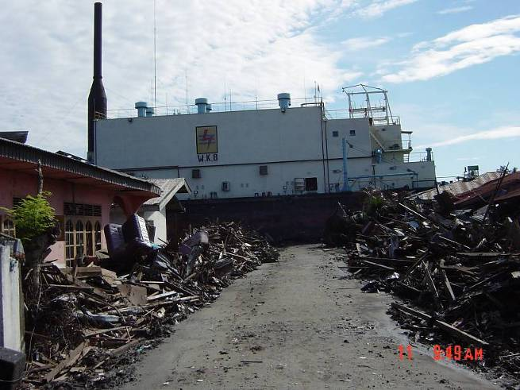
What is this large object?
a very large ship 5 miles inland in the middle of the road
Banda Aceh, Indonesia 2004
Notes:
Photo by Rui Lopes, Save the Children, 2004

Slide 20
Haiti, Jan. 12, 2010
Earthquake
160,000+ deaths
Date | Time (UTC) | Place | Lat. | Long. | Fatalities | Magnitude | Comments
Jan. 12, 2010 | 21:53 | Haiti region see 2010 Haiti earthquake | 18.443 | -72.571 | 160,000~ 316,000 | 7.0 | M_{w} (USGS) Centred 25 km WSW of PORT–AU–PRINCE, Haiti, at a depth of 13 km.
Notes:
https://en.wikipedia.org/wiki/List_of_21st-century_earthquakes

Slide 21
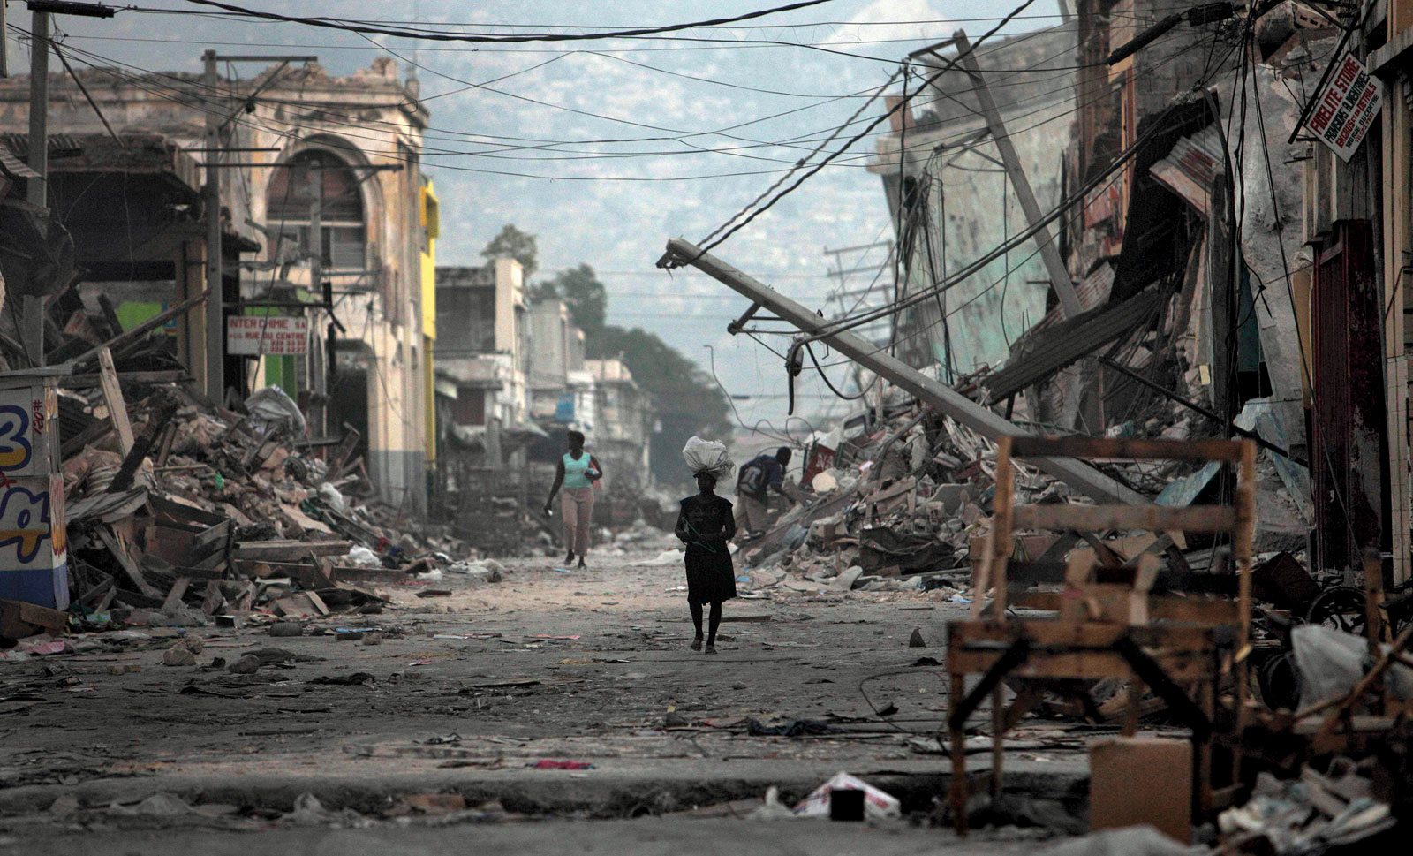
2010 Haiti Earthquake Damage
Notes:
Photo credit: https://www.britannica.com/event/2010-Haiti-earthquake

Slide 22
Three ICT Things Different in Haiyan DR
Telco networks recovered before NGO VSATs were set up
BYOT extended to relief workers
ICT Collaboration worked
22

Slide 23
Syrian Civil War
15 March 2011 – present
(12 years)
14m = more than 50% are refugees!
Total killed:
384,000-586,100 (Mar. 2020 SOHR estimate)
470,000 (Feb. 2016 SCPR estimate)
164,298 (Sep. 2018, VDC database estimate)
Over 7,600,000 internally displaced (2017 UNHCR estimate)
Over 6,253,784 refugees (Jul 2019 registered by UNHCR)
Population before the war: about 21 million
Notes:
https://en.wikipedia.org/wiki/Casualties_of_the_Syrian_Civil_War
https://en.wikipedia.org/wiki/Refugees_of_the_Syrian_Civil_War
https://data2.unhcr.org/en/situations/syria
Refugees of the Syrian Civil War - Total population:5,440,749 refugees (registered, December 2017)^{[1]}
6,130,000–6,320,000 refugees (based on UN estimate, March 2016)^{[2]}
“U.N.: Nearly half of Syria’s population uprooted by civil war,” Aug. 29, 2014
https://www.washingtonpost.com/news/morning-mix/wp/2014/08/29/
http://www.unhcr.org/53ff76c99.htmlu-n-nearly-half-of-syrias-population-uprooted-by-civil-war/?utm_term=.f52e19664feb

Slide 24
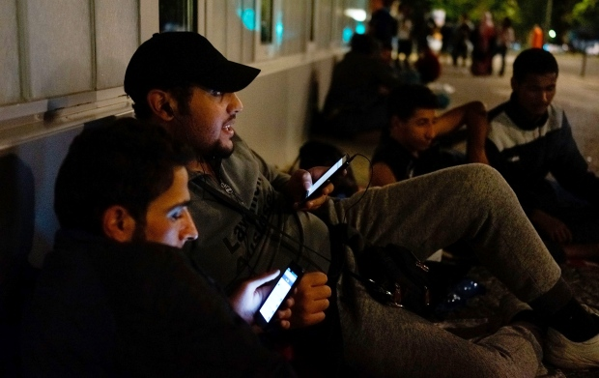
Syrian Refugees – Sep. 2015
Information to survive
“Refugees from Syria use smartphones to connect with relatives back home as they wait outside a government office in Berlin last month.” --Carsten Koall/Getty
Notes:
Zach Dubinsky, “For Syrian refugees, smartphones are a lifeline — not a toy”, CBC News, Posted: Sep 12, 2015,
http://www.cbc.ca/news/world/for-syrian-refugees-smartphones-are-a-lifeline-not-a-toy-1.3221349

Slide 25
Three ICT Things Different in Syrian DR
Beneficiaries led in technology (73% of youth have smartphones)*
Top questions were about information (next slide)
Lack of coordination among receiving countries (getting better)
*Maitland and Xu study of Za’atari Refugee Camp, Jan., 2015
25
Notes:
Note that this is the percent of phone users, not percent of youth.
https://www.researchgate.net/publication/315307842_A_Social_Informatics_Analysis_of_Refugee_Mobile_Phone_Use_A_Case_Study_of_Zaaatari_Syrian_Refugee_Camp
“a total of 151 out the 207 reporting at least one model, or 73% of reported phone are smartphones. “, p. 7

Slide 26
Top Questions of Refugees in Greece
Where am I?
Do you have WiFi?
Where can I buy food and water?
Where can I breastfeed my baby?
Where is the bus to Germany?
Can I take a taxi?
How do I register?
Why am I being fingerprinted?
How long must I stay here before I can leave?
Where can I change money?
--Tyler Jump (IRC), Huffington Post, 29-Oct-2015
26
Notes:
http://www.huffingtonpost.com/tyler-jump/common-questions-refugees-ask-when-arrive-europe_b_8400118.html

Slide 27
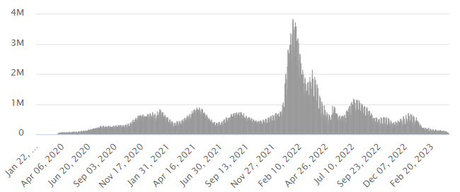
The COVID Pandemic
Worldometer Data As of April 11, 2023
Cases: 685,010,070
Deaths: 6,837,940
Recovered: 657,829,534
7-Day Moving Avg of New Cases 2020-2023
The peak was Feb.
of last year
Notes:
https://www.worldometers.info/coronavirus/
https://www.worldometers.info/coronavirus/#countries

Slide 28
Which country had the greatest number of COVID deaths?
The US,
1,123,836 COVID deaths in US
per JHU as of 3/10/23
Not China, not an emerging country,
the USA!
Notes:
https://coronavirus.jhu.edu/data/new-cases

Slide 29
To put that in perspective
1,123,836 deaths would be like losing the entire populations of some of Michigan’s largest cities:
Detroit
Grand Rapids
Ann Arbor
Dearborn
Lansing
In total!
Notes:
https://coronavirus.jhu.edu/data/new-cases

Slide 30




New York City
During Lockdown
Clockwise:
Subway car
Chinatown
Grand Central
5th Avenue

Slide 31
Why the facts and photos?
“Statistics don’t bleed; it is the detail which counts” --Koestler
Data alone does not bleed.
…With deference to Arthur Koestler
Notes:
“Arthur Koestler, in an oft-quoted comment of 1944, said that ‘a dog run over by a car upsets our emotional balance and digestion; 3,000,000 Jews killed in Poland cause but a moderate uneasiness. Statistcs don’t bleed; it is the detail which counts. We are unable to embrace the total process with our awareness, we can only focus on little lumps of reality.’”

Slide 32
"Developing countries suffer the greatest costs when a disaster hits – more than 95 percent of all deaths caused by disasters occur in developing countries, and losses due to natural disasters are 20 times greater (as a percentage of GDP) in developing countries than in industrialized countries.”
–Wikipedia, World Bank
Notes:
See http://en.wikipedia.org/wiki/Disaster
Also see http://www.worldbank.org/en/topic/disasterriskmanagement/overview

Slide 33
Disaster Risk vs. Vulnerability
Do more disasters hit more vulnerable countries?
Disaster Risk Score
Notes:
See Excel pivot table in: “Vulnerability versus Disaster Risk v3.xlsx” ; from the data in the previous slide sources

Slide 34
?
Arrows indicate key shifts
Notes:
See “Disaster Response - ICT Factors v18.xlsx”

Slide 35
A Few Conclusions
Crisis Informatics is…
Information about crises (data, photos/videos, stories)
Information to be better prepared for crises (disaster preparedness and resiliency)
Information to make better decisions during crises (management)

Slide 36
4. Lecture - A Crisis IT Framework
Notes:
From SI-537 Crisis Informatics - Lecture 4 FINALb.pptx, F2020

Slide 37
Question for Today
How can we make better decisions about technology used in crises by applying a framework that takes full account of the current situation?
An objective from our syllabus:
Apply a framework for understanding the application of technologies to the scope, severity, context and phases of a crisis and response

Slide 38
1. Severity – levels of emergency

Slide 39
Looking at Crisis and Resilience as a Continuum of Factors
Mild
Moderate
Severe
Catastrophic
Severity of Crisis
Personal
Commun-ity
Organiza-tion
Regional
Interna-tional
Scope of Crisis
LDC
Developing
Developed
Context of Crisis

Slide 40
Complex Emergencies
“The designation of an L3 emergency, in consultation with the IASC* Principals, will be issued by the Emergency Relief Coordinator (ERC), on the basis of an analysis of 5 criteria: scale, complexity, urgency, capacity, and reputational risk.” --IASC System-Wide Emergency Activation, p.1
* IASC = Inter-Agency Standing Committee (UN operational agencies plus some large Int’l Org’s (IOs) like IFRC and ICRC)
Notes:
IASC = INTER-AGENCY STANDING COMMITTEE
Report is here: https://reliefweb.int/sites/reliefweb.int/files/resources/IASC%20System-Wide%20Activation.pdf p. 1

Slide 41
WFP Emergency Levels
World Food Programme (WFP) Emergency Response Classifications …according to a three-level scale:
Level 1 Response: Emergency operations within the response capabilities of the relevant WFP Country Office (CO), with routine support from Regional Bureau (RB).
Level 2 Response: Emergency Response operations requiring regional augmentation of country-level response capability.
Level 3 Response: Emergency Response operations requiring mobilization of WFP global response capabilities in support of the relevant CO(s) and/or RB, i.e. a Corporate Response.
--WFP Emergency Response Classifications, p.1
Notes:
WFP Emergency Response Classifications, p.1
http://documents.wfp.org/stellent/groups/public/documents/resources/wfp264770.pdf

Slide 42
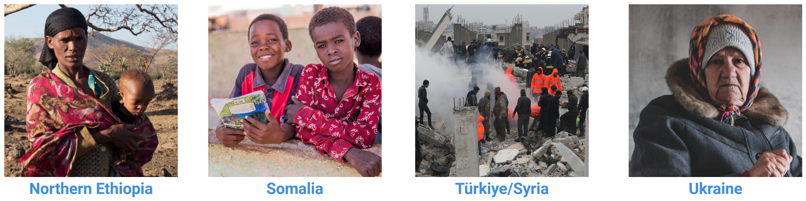
Current OCHA Level 3 Emergencies
IDP & Drought
Poverty & Instability
Earthquake
Conflict
https://www.unocha.org/where-we-work/current-emergencies
As of Apr. 2023
OCHA = UN Office for the Coordination of Humanitarian Affairs
Notes:
https://www.unocha.org/where-we-work/current-emergencies

Slide 43
2. Scope –
A Personal Earthquake Story

Slide 44
Looking at Crisis and Resilience as a Continuum of Factors
Mild
Moderate
Severe
Catastrophic
Severity of Crisis
Personal
Commun-ity
Organiza-tion
Regional
Interna-tional
Scope of Crisis
LDC
Developing
Developed
Context of Crisis

Slide 45
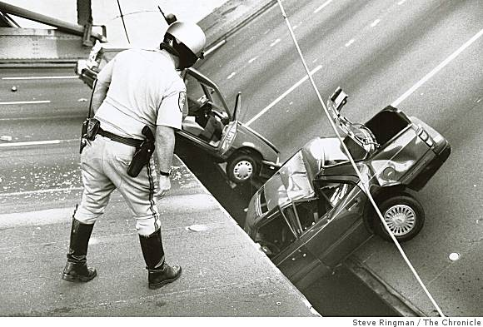
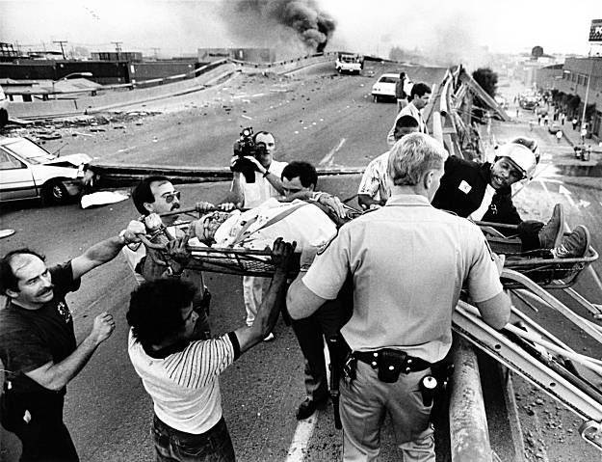
October 17, 1989
San Francisco, 5:04 pm
Loma Prieta 7.1
earthquake
45
Notes:
Photos: http://jellyjules.com/?p=2656
http://en.wikipedia.org/wiki/1989_Loma_Prieta_earthquake
LTYM #480, “Loma Prieta” http://www.hpmd.com/hpmd/personal/LTYMstories.nsf/links/480

Slide 46
3. Context – Where The Crisis Occurs

Slide 47
Looking at Crisis and Resilience as a Continuum of Factors
Mild
Moderate
Severe
Catastrophic
Severity of Crisis
Personal
Commun-ity
Organiza-tion
Regional
Interna-tional
Scope of Crisis
LDC
Developing
Developed
Context of Crisis

Slide 48
Crisis Context
It matters where you are in the world
1. LDC – 47 Least Developed Countries, like Haiti.
      Least Developed Countries (LDC) meet three criteria:
  Poverty – based on a three-year average estimate of GNI per capita for the period 2016-2018, based on the World Bank Atlas method (under $1,025 for inclusion, above $ 1,230 for graduation)
  Human resource weakness – Human Assets Index (HAI) based on indicators of: (a) nutrition: percentage of population undernourished; (b) health: mortality rate for children aged five years or under; (c) education: the gross secondary school enrolment ratio; and (d) adult literacy rate.
  Economic vulnerability – Economic Vulnerability Index (EVI) based on indicators of: (a) population size; (b) remoteness; (c) merchandise export concentration; (d) share of agriculture, forestry and fisheries; (e) share of population in low elevated coastal zones; (f) instability of exports of goods and services; (g) victims of natural disasters; and (h) instability of agricultural production. – UN Criteria
Notes:
http://unohrlls.org/about-ldcs/criteria-for-ldcs/
https://en.wikipedia.org/wiki/Least_Developed_Countries

Slide 49
4. Time – The Phases of Disaster Response

Slide 50
Phases of Disaster Response
Preparedness
First Response
Scaling up
Transition
Learning
Stage 0
Stage 4
Stage 1
Stage 3
Stage 2
50

Slide 51

Putting it together in a Framework
Scope
Context
Severity
Time
Notes:
How big, how bad, where and when
http://ecx.images-amazon.com/images/I/51ILWP8TZqL.jpg
Time: from hours to years, DR to transitional to development

Slide 52
Conclusions?
The most important take-away is that context matters.
    The scope, severity, location and timing determine which technology to apply.
Each audience has its own technology footprint
    Rule #1 is “know thy audience!”

Slide 53
Next steps
Join or create a collaboration group to share best practices. There are at least two operating in the nonprofit space.
Read up on disaster response (e.g. Amanda Ripley’s book).
Experiment and share what works; this is a broader community than our immediate organizations.
See the rest of the course on YouTube, here: https://www.youtube.com/playlist?list=PLbBJLViN2UszgHfeUfPYGq7w__G6r0eLR
And the book project, here: https://docs.google.com/document/d/12ULKaMl4-MD8rYOSADHhmWfSTllc2uv5PBOah5UoM8w/edit?usp=sharing

Slide 54
Q&A, Discussion

Slide 56
Appendix

Slide 57
Philippines – Haiyan Cyclone, Nov. 2013
Cyclone
6,300 deaths
Rank^{[15]} | Storm | Dates of impact | Deaths
2 | Haiyan/Yolanda 2013 | 2013, November 7–8 | 6,300^{[16]}
*2nd deadliest cyclone in Philippines history
Notes:
https://en.wikipedia.org/wiki/Typhoons_in_the_Philippines

Slide 58
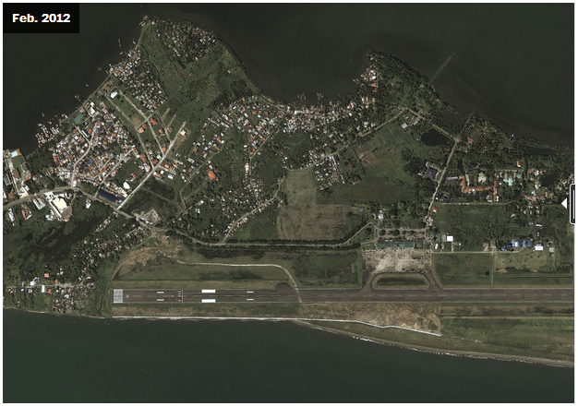
Tacloban Airport Before
58
Notes:
http://www.washingtonpost.com/blogs/worldviews/wp/2013/11/15/8-maps-that-explain-why-typhoon-haiyan-hit-the-philippines-so-hard/

Slide 59
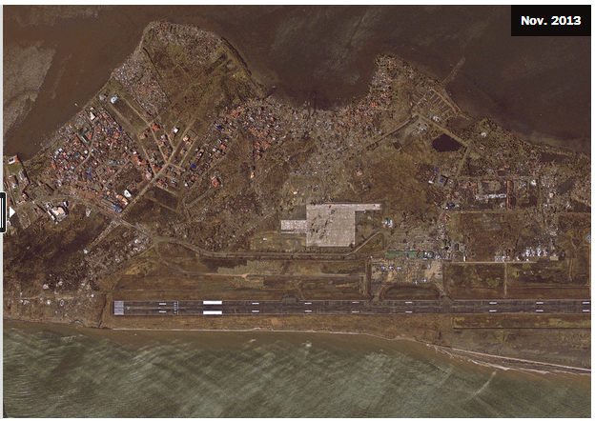
Tacloban Airport After
59
Notes:
http://www.washingtonpost.com/blogs/worldviews/wp/2013/11/15/8-maps-that-explain-why-typhoon-haiyan-hit-the-philippines-so-hard/

Slide 60
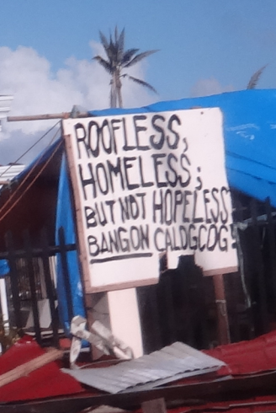
RC Philippines Response – Jan. 2014
By the Numbers:
16 million people affected
6,201 deaths reported
4 million people displaced
1.14 million houses damaged
Source: NDRRMC, 14 Jan. 2014
60
Notes:
IFRC: Philippines Typhoon Haiyan, FACT SitRep 20, 29 January 2014, pg. 1

Slide 61
Flows of Data to Crises Response
UN NGOs
1.0 Data volume
Flows of Data to Crises Response
“Disaster Relief 2.0”,
UN Foundation report, March 2011
Notes:
UN Foundation and HHI, “Disaster Relief 2.0” 2011, p. 19
https://hhi.harvard.edu/publications/disaster-relief-20-future-information-sharing-humanitarian-emergencies

Slide 62
Data Overload
Volunteers
Techs
UN NGOs
Beneficiary- Citizens
1.0 Data volume
2.0 Data volume
Flows of Data to Crises Response
“Disaster Relief 2.0”,
UN Foundation report, March 2011

