Slide 1

Collaboration, Crisis and Scarcity
The Tuck School of Business at Dartmouth
Hanover, NH
February 16, 2012
Edward G. Happ
Chairman
Global CIO, International Red Cross/Red Crescent

Slide 2
A Brief Introduction
13 Years on Wall Street
10 Years in management consulting
12 years in NGOs
Former CIO at STC/US & UK
Co-founder and Chairman of NetHope.org
More at www.eghapp.com
Connect with me via LinkedIn

Slide 3
I’d like to do four things today
Introduce NetHope and our model of collaboration
Offer some thoughts on the future of collaboration
Think out loud about the value and role of scarcity
Apply this to Disaster Response

Slide 4
NetHope Intro

Slide 5
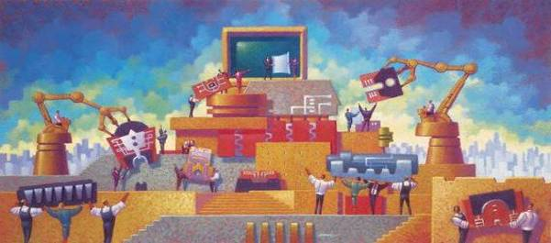
NetHope Vision
Connected Together, Changing the World
To be a catalyst for collaboration in the International NGO community and enable best use of technology for connectivity in the developing parts of the world

Slide 6
Two Hypotheses - 2001
We had to be able to solve the “last mile” problem (connectivity) faster, cheaper, better if we did it together
We would be a much more interesting partner to the technology companies on whom we depend, if we came as a group rather than the one-off, hat-in-hand organizations we have been.

Slide 7































Collaboration: 34 Member NGOs
7

Slide 8
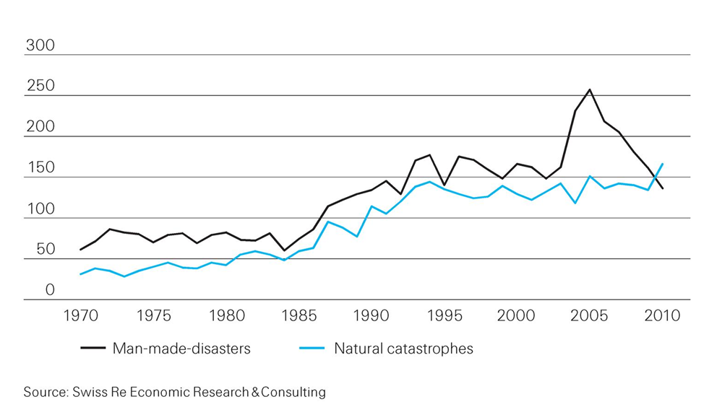
Catastrophic events are on the rise
From less than 100 in 1970 to over 300 in 2010
8
Notes:
http://media.swissre.com/documents/sigma1_2011_en.pdf Hurricanes Katrina, Rita, Wilma

Slide 9
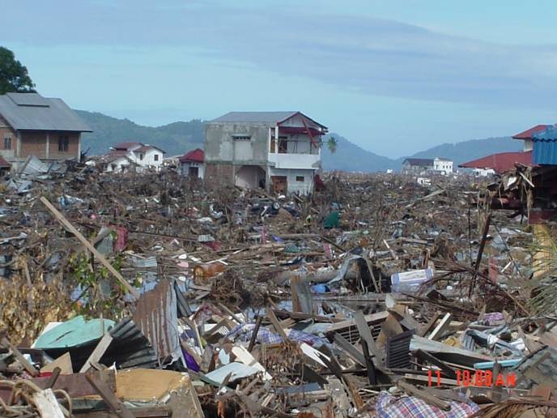
Banda Aceh – Ground Zero – 26 Dec 04
Notes:
9

Slide 10
Stages of a Disaster
Stage 1: Within hours of disaster striking
  First relief workers arrive on the ground.
  Survey and assess damage, transmit pictures, security information, relief material and personnel requirements to Head Offices.
  Agencies decide how deeply involved they will be with relief efforts.
  Example: CRS in sectarian fighting in eastern Congo
  This is the Highly Individual, Highly Mobile ICT stage

Slide 11
Stages of a Disaster (cont.)
Stage 2: Within two weeks of disaster striking
  Teams begin to arrive on the scene as risk of disease and malnutrition escalates.
  Requirements are continuous monitoring of disaster, assessment of victim needs, management of relief material deployment between and across aid agencies, personnel security, application and reporting of donated funds, uploading of case studies, pictures and relief reports.
  Example: Relief International in Bam, Iran earthquake
  Small Group, Highly Mobile/Temporary ICT stage

Slide 12
Stages of a Disaster (cont.)
Stage 3 – From one-six months following a disaster striking to multi-year.
  Agencies provide resources for building reconstruction, counseling, family reunification, food distribution, water purification, etc.
  Agencies become part of the community over a long period of time.
  Example: Actionaid in tsunami relief in southern India
  Large Group - Permanent ICT stage

Slide 13
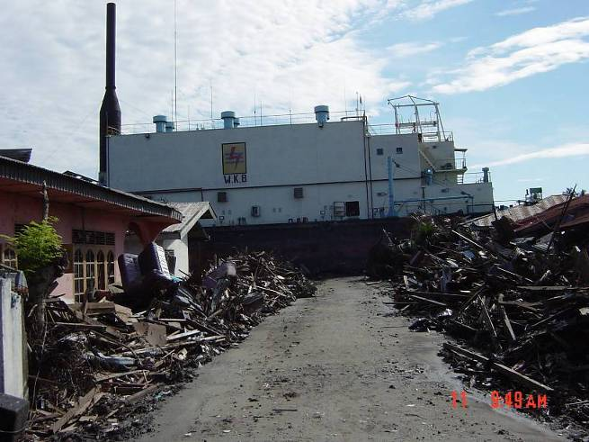
What is this large object?
a very large ship 5 miles inland in the middle of the road

Slide 14
NetHope Value Proposition –
Top 5 for Members
  Why NGOs want to be members:
    Increase Staff – NetHope’s virtual team and PM’s extend NGO IT departments
    Share Knowledge/Gain consulting and access – advice through members and partners estimated at $75K per year (500% ROI)
    Realize Economies of scale – grants, purchasing
    Greater impact thru leverage of ICT, building local networking expertise, eliminating duplication of effort and resources
    Present Unified face to donors and funding organizations

Slide 15
NetHope Value Proposition –
Top 5 for Corporate Partners
Why corporations work with NetHope?
  Broader impact: reaching greater number of beneficiaries thru single point of focus
  Better philanthropy leverage: Lower cost of admin thru single point of focus
  Work through NGO CIOs: leveraging the IT heads of largest international nonprofits who have the on-the-ground reach and experience
  Lower risk thru collaborations; better deployment of grants; members help each other implement and execute
  Support the model of NGO collaboration, leverage technology for capacity building

Slide 16
Why has NetHope been successful with collaboration?
Trust & Relationship: we know each other well as colleagues, not competitors
Hunger (Scarcity) – IT departments are among the most under-funded areas of nonprofits
Common Need: we are all trying to deliver ICT out to the most challenged areas of the world in which we work
Value: We deliver member value 10-fold+ over member contributions
Time: ten years of working together
16

Slide 17
An Evolving Strategy

Slide 18
NetHope Strategic Direction - 2002
Prime
Members
Domain
The Horizontal
Frontier
1
NetHope began in quadrant 1, for example providing connectivity to members
Beneficiaries
2
The Horizontal Frontier
3
2
Customer
3
NetHope’s supports and enables through technology but does not provide programs to the beneficiary since this is the members’ role
The Vertical
Frontier
Primary
NetHope
Domain
(e.g. Phase I VSATs)
Members
4
The Vertical Frontier
4
1
Vertical
(e.g. program sectors)
Horizontal
(e.g. tools & platforms)
Strategic Thrust

Slide 19
NetHope Strategic Direction - 2008
With NetHope’s extension of impact to the beneficiary,
it is important to define how NetHope complements member NGOs
Prime
Members
Domain
New NetHope
growth area
(e.g. VNK)
1
NetHope began in quadrant 1, for example providing connectivity to members
Beneficiaries
Primary growth area for NetHope leveraging strength in quadrant 1
2
3
2
Customer
3
NetHope’s supports and enables through technology but does not provide programs to the beneficiary since this is the members’ role
Secondary
NetHope Domain
(e.g. ICT Skill
Building,
Shared Services)
Primary
NetHope
Domain
(e.g. Phase I VSATs)
Members
4
Secondary growth area for NetHope
4
1
Vertical
(e.g. program sectors)
Horizontal
(e.g. tools & platforms)
Strategic Thrust

Slide 20
NetHope Strategic Direction - 2011
Prime Members
Domain
NetHope
growth area
(e.g. ICT4D)
1
NetHope began in quadrant 1, for example providing connectivity to members
3
Beneficiaries
New
NetHope
growth area
(e.g. NH Academy)
Primary growth area for NetHope leveraging strength in quadrant 1
2
2
Customer
3
NetHope’s supports and enables through technology but does not provide programs to the beneficiary since this is the members’ role
NetHope
Domain
(e.g.
Shared Services)
Primary
NetHope
Domain
(e.g. Phase II VSATs)
Members
4
Secondary growth area for NetHope
4
1
Vertical
(e.g. program sectors)
Horizontal
(e.g. tools & platforms)
Strategic Thrust

Slide 21
NetHope Strategic Direction – 2014?
Prime Members
Domain
NetHope
Domain
(e.g. ICT4D)
1
NetHope began in quadrant 1, for example providing connectivity to members
3
Beneficiaries
NetHope
growth area
(e.g. NH Academy)
Primary growth area for NetHope leveraging strength in quadrant 1
2
2
Customer
3
NetHope’s supports and enables through technology but does not provide programs to the beneficiary since this is the members’ role
NetHope
Domain
(e.g.
Shared Services)
NetHope
Domain
(e.g. Phase II
VSATs)
Loss
or Fulfillment
of Infrastructure
Foundation?
Members
1
4
Secondary growth area for NetHope
4
Vertical
(e.g. program sectors)
Horizontal
(e.g. tools & platforms)
Strategic Thrust

Slide 22
NetHope Values – Guiding Principles
Technology Matters
  NGO Effectiveness depends on technology and capacity building
Benefiting all benefits one
  Benefiting one also Benefits All
Learn through collaboration
  Learn by doing together
Build for the Field
  IT solutions are deployed solutions
Bias for action
  The need for speed, especially for emergencies
Trust above all else
  Trust comes through open dialog and working together over time

Slide 23
The Innovation Mutual Fund
I4 Health - MedCheck, a NetHope/Accenture initiative for battling the counterfeit drug trade.
I4 Microfinance - Mobile Banking pilot between NetHope, Accion and Microsoft, using Microsoft’s OneApp and PDAs/cell phones for Loan Approvals and Credit Scoring
I4 Education - eLearning and ICT Program for secondary schools with the Tanzanian government, NetHope Members, Accenture and others to reach 1.5M secondary school children.
I4 Geographic Information Systems - A hydrology/ water dataset sharing project in East Africa and a Disaster Preparedness pilot with partner ESRI.
23

Slide 24
The Future of Collaboration

Slide 25
The Context
The Apollo 13 story was featured in the 1995 film with Tom Hanks and Kevin Bacon. The incredible events that unfolded in April 1970 gripped the nation and the world. On April 13, 56 hours into the mission, an oxygen tank in the service module that contained the astronauts’ support systems exploded. What followed was a remarkable story of collaboration between the astronauts and mission control in Houston. While the world watched, they were able to bring a damaged spacecraft back to earth safely …
Notes:
The NASA account of the accident is here: http://nssdc.gsfc.nasa.gov/planetary/lunar/ap13acc.html

Slide 26
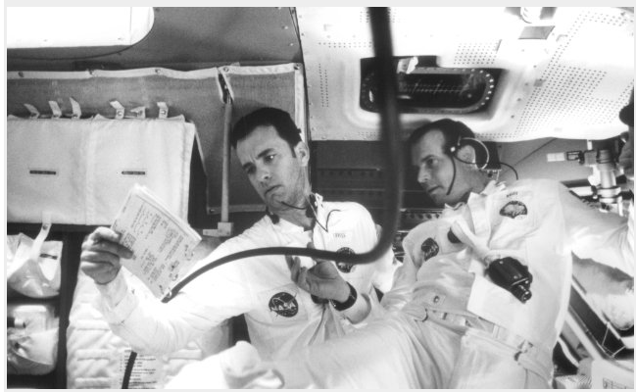
The Movie Clip…
watch for the collaboration
http://www.youtube.com/watch?v=5giXXW_UdaM
Notes:
http://www.youtube.com/watch?v=5giXXW_UdaM
Photo: http://www.imdb.com/media/rm1413254656/tt0112384

Slide 27
The Elements of a Collaboration
First, there was a shared burning need—there was a clear and present problem that had to be solved.
Second, there was scarcity—only a few resources were available.
Third, there was a strong social desire to band together as a team and solve the problem.
Notes:
These three factors: need, scarcity and social desire are the glue that makes collaboration work.
Yet it is the valued of scarcity that is perhaps the most powerful.

Slide 28
The New Collaboration
Who Are You Partnering With?
“Who has expertise I can trust?”
Shared Services & Assessments
Share
and Do
Share
and Do
Share
and Do
SHARED
SPECIALIZATION
JOINT PROJECTS
“What can we build together?”
NRK, Phase 2 Satellites
Increasing Level of Trust
PARTNERING
“How can we work with corporations?”
Cisco, Microsoft, Intel Grants
Do and Share
BASIC INFO SHARING
“What are my peers doing?”
Meetings, Conference Calls

Slide 29
The paradox of plenty and scarcity

Slide 30
More is Better
Apple app store: over 100,000 apps
Android app store: 50,000 apps
How to get 50 really useful humanitarian applications?
Increase the size of the funnel

Slide 31
The Imagine Cup Funnel
400,000
3,000
400
27 Winners
How are you gathering
the good ideas?
31

Slide 32
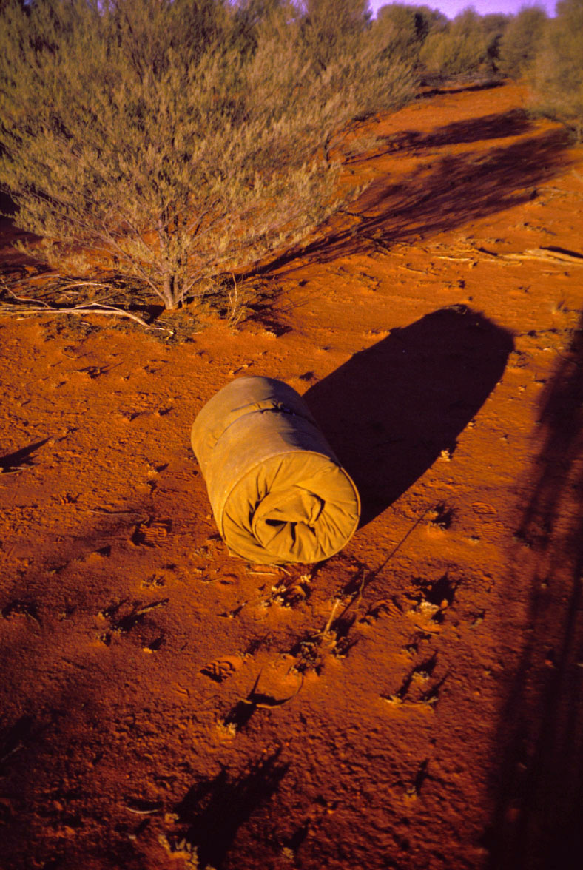
Story on the
Value of Scarcity
Paul Pholeros, Architect,
Professor and Director
of Healthabitat…
A Class in the Australian
Outback
Building “muscle memory”

Slide 33
The Problem: NGOs invest a fifth of corp. IT
5x
18x
4x
Notes:
33
33

Slide 34
Closing the Productivity Gap: A New Calculus
A back of the envelop calculation for taking a $5M IT
department in a $200M NGO to $23M
Charity Factor
Collaboration Factor
56%
Gap Remains
Notes:
A fictitious $200M NGO; 1,700 users

Slide 35
Leveling the NGO - Corp IT Playing Field

Slide 36
Non Profit IT Departments Can’t Play the Odds
IF
57% of ERP projects don't realize their ROI (Nucleus Research)
66% IT projects fail (Standish Chaos DB)
NGOs spend a 20th what corporations do (Tuck survey)
And we are spending donors’ dollars
THEN
We must find a better way...
36
Notes:
36

Slide 37
Key Conclusion: we can’t do it alone
Even if we tripled IT spending, we will still be playing catch-up for just keeping the lights on.
Notes:
37

Slide 38
What else is possible for nonprofits?
Collaborate or Perish
  Shared consulting/support
  Shared web/file server hosting & backup
  Shared fundraising systems guru
  Shared technology procurement
  Shared technology training
  The operative word here is Shared
38

Slide 39


Application Catalog of Standards & Choices
‘Discover’
‘Harvest’
Application Inventory
Application Catalogue
NS IT Survey - Applications
Scale up
Application Portfolio
Review
500+
Criteria
National Societies
De facto
vendor standards
Application Contest
Application Catalogue is the window for NSs into supported applications
National Societies
Notes:
http://www.istockphoto.com/stock-photo-4237972-funnel.php

Slide 40
Anatomy of
Disaster Response

Slide 41
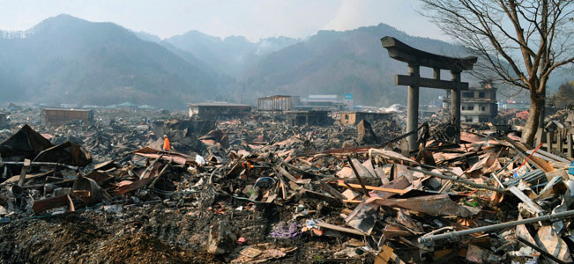
Japan Tsunami Aftermath – 14 Mar 11
A destroyed landscape in Otsuchi village,
Iwate Prefecture in northern Japan” -- Reuters/Kyodo
41
Notes:
http://news.yahoo.com/s/ap/ap_on_bi_ge/as_japan_earthquake_nuclear_crisis

Slide 42
Stages of a Disaster Response
Stage 0: Preparedness
  Example: Typhoon preparedness in Bangladesh
  This is the best investment (4:1)
Stage 1: Within hours of disaster striking
  Example: CRS in sectarian fighting in eastern Congo
  This is the Highly Individual, Highly Mobile ICT stage
Stage 2: Within two weeks of disaster striking
  Example: Relief International in Bam, Iran earthquake
  Small Group, Highly Mobile/Temporary ICT stage
Stage 3 – From one-six months following a disaster striking to multi-year.
  Large Group - Permanent ICT stage
Stage 4 – Learning
  Example: NetHope members in Pakistan earthquake response
  Don’t waste mistakes
42
Notes:
Bangladesh cyclone: 3,000 fatalities in 2007 versus 138 000 in 1991 and 500,000 in 1970
Factor of 50-100 reduction due to advance evacuation of 3.2M people and stockpiles of relief supplies, i.e. disaster preparedness! (see http://fe4.news.re3.yahoo.com/s/time/20071119/wl_time/howbangladeshsurvivedthecyclone )

Slide 43
Stages of a Disaster Response
Preparedness
First Response
Scaling up
Transition
Learning
Stage 0
Stage 4
Stage 1
Stage 3
Stage 2

Slide 44
Bangladesh Cyclone Fatalities
Preparedness
Works
44
Notes:
Bangladesh cyclone: 3,000 fatalities in 2007 versus 138 000 in 1991 and 500,000 in 1970
Factor of 50-100 reduction due to advance evacuation of 3.2M people and stockpiles of relief supplies, i.e. disaster preparedness! (see http://fe4.news.re3.yahoo.com/s/time/20071119/wl_time/howbangladeshsurvivedthecyclone )

Slide 45
Changing Priorities By Program Type
For emergency response, time and volume are king;
for development, cost and quality reign
Ranking factors 1-4, 1=highest
45
Notes:
For emergency response, time and volume are king; for development, cost and cost reign

Slide 46
An NGO Supply Chain
Beneficiary engagement
Assessment
Country – Sub-Office
Reporting
Plan
Procure
Ship
Warehouse
Ship
Ben. Track
For development, procurement is competitive; for emergency response, procurement is pre-determined and agile
Beneficiary tracking is key in the NGO supply chain; commercial SCM applications lack this
Beneficiary engagement is increasing in the supply chain
46
Notes:
For development, operational budget planning happens first; competitive bids are < 3 days due to relationships with suppliers; so often the same process for ER

Slide 47
Crisis Needs?
First: is my family OK?
Second: can I get food, water, shelter?
Third: can we communicate? (Voice / Data)
47
Notes:
47

Slide 48
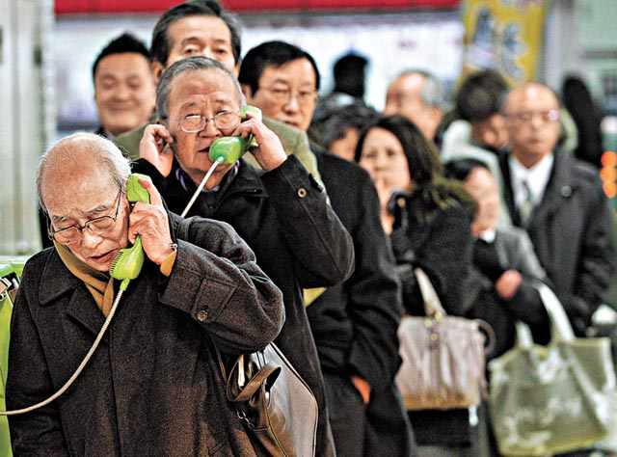
People need to know their loved ones are safe
“People need Information as much as water, food,
medicine or shelter.
Information can save lives, livelihoods and resources.
Information bestows power.” –World Disasters Report 2005
48
Notes:
http://voices.washingtonpost.com/blog-post/tsuna.JPG

Slide 49
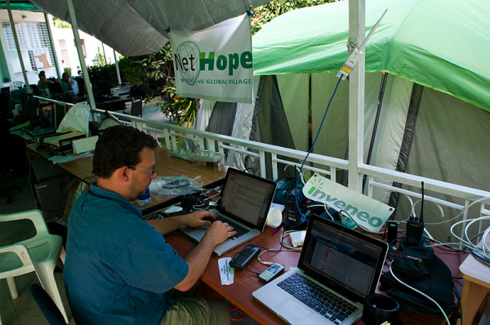
Shared Wi-Fi Network in Haiti
Mark Summer configuring networks at NetHope/Inveneo tent city
49
Notes:
http://www.inveneo.org/?q=haiti-links-grow

Slide 50
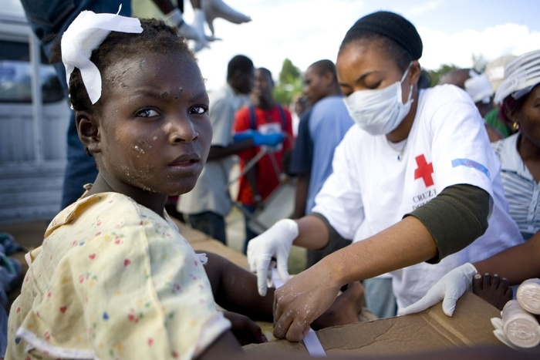
Haiti – 19 Jan 10
Notes:
http://www.ifrc.org/en/news-and-media/photo-galleries/2010/haitiearthquake-januaryI-2010/

Slide 51
Three Take-aways
NetHope collaboration is built on scarcity
Nonprofits must collaborate or perish
The urgency of crisis can drive collaboration

Slide 52
Further Reading
Blogs:
http://eghapp.blogspot.com/
http://granger-happ.blogspot.com/ (Dartmouth)
Web site (see the articles & presentations link) http://www.eghapp.com
Email: ehapp@ifrc.org
Twitter: @ehapp
LinkedIn: http://www.linkedin.com/profile/view?id=1906312
Book: Managing Technology to Meet Your Mission, chap. 11

Slide 53
Questions?

Slide 55
Appendix

Slide 56
NGO IT Strategy: Moving the Agenda Up the Pyramid
Get in
Competitive
or Leading
BENEFICIARY
“Differentiating”
Beneficiary & Field Facing
Increasing Impact for Beneficiaries
PROGRAM
“Improving Program Delivery”
OPERATIONAL
“Helping the Organization Run”
Efficient
Donor & HQ
Facing
FOUNDATIONAL
“Keeping the Lights On”
Get out

Slide 57
What are the key questions?
What is fundamental in disaster relief?
What is fundamental in long-term development?
Is technology a benefit to communities in crisis?
Can SCM be a competitive advantage for nonprofits?
What is commodity and what is value-added for a non-profit?
Notes:
What’s fundamental in ER: deployed food, water, shelter
In development: sustainability

Slide 58
Questions for NetHope Members
What are the back-to-basics and embrace-the-future opportunities?
Where on the IT stack are you?
Where can you value scarcity to drive innovation
What’s the next level of collaboration you are willing to commit to?
What are you ready to “share and do” rather than “do and share?”

Slide 59
Consider Mercy Corps
“Many of Mercy Corps’ field offices are located in austere environments with limited local IT support. In order to improve shared services within these offices, we adopted a server appliance strategy with two stretch goals: 100% reliability and 0% administration.”
That’s zero% administration!
They also follow the 80/5 Rule for network hardware: “80% of the functionality at 5% of the cost”
  Note the order of magnitude here: that’s 95% less for a “good enough” 80% solution.
59
Notes:
Quotes from Peter Dickenson, CIO at Mercy Corps, in an email of 5/27/08

Slide 60
Interesting relationship between connectivity & poverty
U.S. Census Bureau
and Telegeography
Global Bandwidth
report

Slide 61
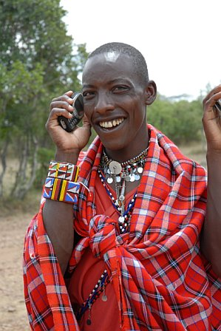
For the rest
of the world,
this is the Internet
61
Notes:
Masai Warrior at Ikelani Using Cell Phone, Jupiter research Blog, Julie Ask, October 06, 2006; http://weblogs.jupiterresearch.com/analysts/ask/archives/007174.html

Slide 62
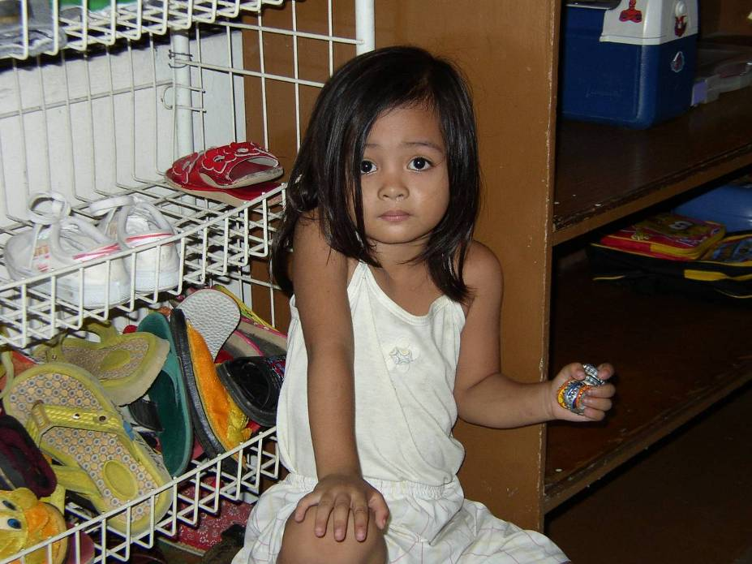

Slide 63
Bottle-caps
Simple, basic toys are good enough
She brought her toys with her to the center
She had already adopted these toys as hers
Now change the word
“toys” → “technologies”
63

