Slide 1

The Coming Wave of Disruptive Innovation for Nonprofits
July 14, 2010
Edward G. Happ
Global CIO, IFRC
Chairman, NetHope

Slide 2
Three Take-aways
Disruptions fly under the radar screen of requirements
Strategy means we need to look in new directions
Anticipating disruptions and embracing them as opportunities requires partnering and experiments
The Power of Collaboration

Slide 3
Good Enough Technology
“Generally, disruptive technologies underperform established products in mainstream markets. But they have other features that a few fringe (and generally new) customers value. Products based on disruptive technologies are typically cheaper, simpler, smaller, and frequently, more convenient to use.”—Clay Christensen
Notes:
Clayton M Christensen, The Innovator’s Dilemma, p. xviii, emphasis added.

Slide 4
Disruptive Technologies are Not New

Slide 5

The 1927 Fridge
Notes:
http://www.adclassix.com/a3/27frigidairerefrigerator.htm

Slide 6

Cell phones started as “good enough”
Notes:
Verizon 2004 Ad Campaign, http://beingamydietrich.files.wordpress.com/2009/04/verizon.jpg

Slide 7

So did the PC
Notes:
http://dl.maximumpc.com/galleries/25oldpcs/IBM_PC_01_full.jpg

Slide 8
Disintermediation
Let’s play a game….
Notes:
The music industry value chain

Slide 9

Some Strategic Context

Slide 10
What’s the single most important strategic question?

Slide 11
What’s my destination?

Slide 12
NGO IT Strategy: Moving the Agenda Up the Pyramid
Competitive
or Leading
BENEFICIARY
“Differentiating”
Beneficiary & Field Facing
PROGRAM
“Improving Program Delivery”
Increasing Impact for Beneficiaries
OPERATIONAL
“Helping the Organization Run”
Efficient
Donor & HQ
Facing
FOUNDATIONAL
“Keeping the Lights On”

Slide 13
The Problem: NGOs invest a fifth of corp. IT
5x
18x
4x
Notes:
13
13

Slide 14
Non Profit IT Departments Can’t Play the Odds
IF
57% of ERP projects don't realize their ROI (Nucleus Research)
66% IT projects fail (Standish Chaos DB)
NGOs spend a 20th what corporations do (Tuck survey)
And we are spending donors’ dollars
THEN
We must find a better way...
Notes:
14

Slide 15
Key Conclusion: we can’t do it alone
Even if we tripled IT spending, we will still be playing catch-up for just keeping the lights on.
And…
Notes:
15

Slide 16
Keeping the Lights-On is Irrelevant
It’s more a commodity each day
“We can't get close to what Google and Amazon can do in their data centers”
–Peter Cochrane

Slide 17
We Need to Push the Pyramid at Both Ends
Get in
Competitive
or Leading
BENEFICIARY
“Differentiating”
Beneficiary & Field Facing
Increasing Impact for Beneficiaries
PROGRAM
“Improving Program Delivery”
OPERATIONAL
“Helping the Organization Run”
Efficient
Donor & HQ
Facing
FOUNDATIONAL
“Keeping the Lights On”
Get out

Slide 18

Advice from a Hockey Legend
“I skate to where the puck is going to be,
not where it has been.” --Wayne Gretzky
18

Slide 19
Looking to the Future

Slide 20
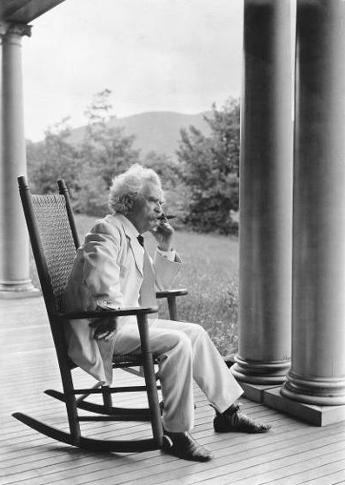
It’s More about Practices than Forecasts
"The art of prophecy is very difficult-- especially with respect to the future." --Mark Twain

Slide 21
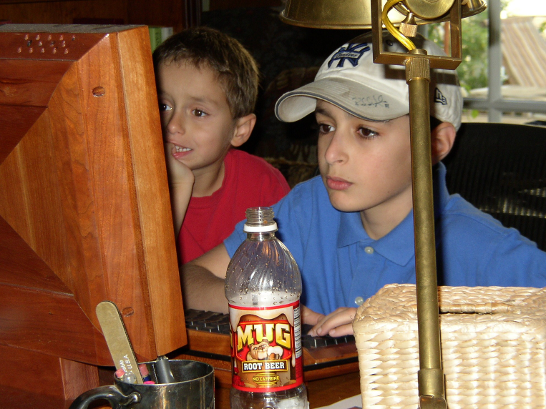
Who is Your Leading Indicator?
21

Slide 22
Who are you spending time with?
“If you’re a CIO, you need to spend a lot of time out on the fringes of the Web because that’s where the innovation’s taking place. You need to spend a lot of time with people under 25 years old.”
–Gary Hamel
Notes:
Gary Hamel interview, CIO Magazine, November 15, 2007, p. 50-55.

Slide 23
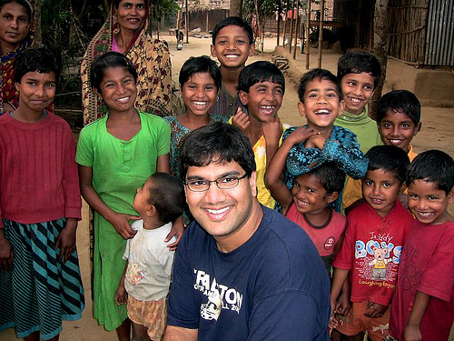
The Uncultured Project
Notes:
http://savetheworldblog.files.wordpress.com/2009/10/2606613587_44ea042f60.jpg
http://uncultured.com/

Slide 24
Turning 3 things upside down
Bottoms-up KM (Gmail case, Guru connecting)
Emerging countries leading (design for other 90%)
Children as forecasters (the technology is conversation, the safe conversation—like driving)

Slide 25
Some Potential Disruptive Themes
In-country corporations and the rise of CSR - supply-chain savvy corporations inviting NGOs to join their relief efforts
Beneficiary driven relief - The beneficiary kiosk – beneficiaries ordering relief supplies
Survivor assessments – survivors as sources for assessment and demand data (Ushahidi)
Renegade partners – in-country partners who decide to go it alone
Direct funders – direct connections to people and projects (Kiva, Uncultured)

Slide 26

The Sometimes Connected Internet
Internet Village Motoman Network
Notes:
http://www.developingtelecoms.com/content/view/687/59/
Internet Village Motoman “Already, innovative ICT projects in Cambodia have helped connect remote rural schools to the internet,” said Tony Bates. “With NGN technology things can only get better.”
Cambodia was picking itself up and could show the way to several developing nations. Mr Bates went on to cite the example of a First Mile Solutions project called “Internet Village Motoman”, which used new ICT to provide internet access for 15 solar-powered village schools, telemedicine clinics, and the governor’s office in a remote province of Cambodia - using five Honda motorcycles.
The project worked by equipping new schools in the villages with solar panels on the roof to provide sufficient energy to run a computer for six hours and providing an e-mail link via a motorcycle delivery system.
Early every morning, five Honda motorcycles leave the hub in the provincial capital of Banlung, where a satellite dish donated by Shin Satellite links the provincial hospital and a special skills school to the Internet for telemedicine and computer training.
The motorcycle drivers, equipped with a small box and antenna at the rear of their vehicle that downloads and delivers e-mail through a wi-fi (wireless) card, begin the day by collecting the e-mail from the hub's dish, which takes just a few seconds.
Then, as they pass each school and one health centre, they transmit the messages they have downloaded and retrieve any outgoing mail queued in the school or health centre computer, also equipped with a similar book-sized transmission box. They then go on to the next school. At the end of the day they return to the hub to transmit all the collected e-mail to the Internet for any point on the globe.
“This is an example of technology changing the quality of life, it is testament to the power of engineering.” While the telecoms industry is “not inventing technology for technology’s sake, we respond to consumer demand across the broadest possible consumer base.”
TDS helped to highlight the fact that developing nations are now a major part of that consumer base, and have now become the primary focus of the telecommunication industry’s attention, particularly with regards to NGN technology, this also being the conclusion expressed elsewhere in this review, of Fernando Lagraña, Executive Manager of ITU Telecom World.
“The industry has the potential of benefiting the developing world in ways we hadn’t even deemed possible a few years ago,” he said. “We must ensure that the future of the industry is shaped by the needs of the least developed and developing world.”

Slide 27
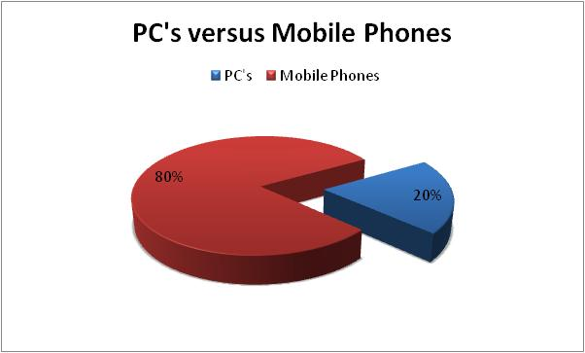
What’s your software platform?

Slide 28
Peters Law of Proximity
The amount of innovation is directly proportional to the distance from headquarters.

Slide 29
The New Collaboration
Who Are You Partnering With?
“Who has expertise I can trust?”
Shared Services & Assessments
SHARED
SPECIALIZATION
JOINT PROJECTS
“What can we build together?”
NRK, Phase 2 Satellites
Increasing Level of Trust
PARTNERING
“How can we work with corporations?”
Cisco, Microsoft, Intel Grants
BASIC INFO SHARING
“What are my peers doing?”
Meetings, Conference Calls

Slide 30
The Innovation Mutual Fund
I4 Health - MedCheck, a NetHope/Accenture initiative for battling the counterfeit drug trade.
I4 Microfinance - Mobile Banking pilot between NetHope, Accion and Microsoft, using Microsoft’s OneApp and PDAs/cell phones for Loan Approvals and Credit Scoring
I4 Education - eLearning and ICT Program for secondary schools with the Tanzanian government, NetHope Members, Accenture and others to reach 1.5M secondary school children.
I4 Geographic Information Systems - A hydrology/ water dataset sharing project in East Africa and a Disaster Preparedness pilot with partner ESRI.

Slide 31
Toward Relevant IT – A Manifesto
Mission-Moving Projects. Technology matters. We believe ICT can move missions, which is the most strategic application of ICT to which we can aspire
Good Enough Applications. Small is beautiful, faster to change, and fit for purpose
Shared Services. Sharing resources stretches and enhances what we do as individual organizations.
Lights-Out Infrastructure. To get in to mission moving app’s, we need to get out of basic IT operations. We need to shift the IT agenda from "lights-on" technology to “impact” technology.
Increased Experiments. Vary like mad. Pilot, prototype, trials. Partner to pilot: share the risks..

Slide 32
Six questions for Nonprofit Leaders
What new programs (that directly serve beneficiaries) have you helped engender that would not have been possible without the new use of technology?
What have you done to help close the "productivity gap" in the way your nonprofit delivers programs and operates as an organization?
How have you helped bridge the divide that will be caused by disruptive innovations in the nonprofit space?
For relief organizations: How have you helped disaster response be 50% faster with 50% greater impact?
How have you helped your organization attract and retain knowledge workers (and IT professionals) in the face of crisis of the baby boom generation retirement wave?
What are you doing to move commodity functions out of your organization and contribute time, dollars and support to the truly value-added functions of your agency?

Slide 33
A Fundamental Law of Disruption
If you don’t answer these questions
Someone else will

Slide 34
Three Take-aways
Disruptions fly under the radar screen of requirements
Strategy means we need to look in new directions
Anticipating disruptions and embracing them as opportunities requires partnering and experiments
The Power of Collaboration

Slide 35

For the rest of the world, this is the Internet
35
Notes:
Masai Warrior at Ikelani Using Cell Phone, Jupiter research Blog, Julie Ask, October 06, 2006; http://weblogs.jupiterresearch.com/analysts/ask/archives/007174.html

Slide 36
Further Reading
Blogs:
http://eghapp.blogspot.com/
http://granger-happ.blogspot.com/ (Dartmouth Fellowship)
Web site (see the articles & presentations link) http://www.fairfieldreview.org/hpmd/EGHprofile.nsf
Email: ehapp@ifrc.org
Twitter: @ehapp
And the book:
Managing Technology to Meet Your Mission, chap. 11.

Slide 37
Questions?

Slide 38
Appendices

Slide 39
Coming Wave of Disruptive Innovation for NGOs
Many Industries in the for-profit world have experienced wrenching change due to the disruptive innovation that technology can bring, Traditional value-chains have been broken by “good enough” technology that call into question the common assumptions of quality and the usual way of doing things. Think about how the music industry, or the newspaper industry has changed over the past decade. We can expect disruptive innovations to impact NGOs in the coming years as well. Nonprofits have not experienced this in significant ways to date, however, the signs are on the horizon.

Slide 40
Some Strategic Questions
How are you balancing innovation and Infrastructure?
What’s the technology future versus technology past?
How will you invest enough but not too much?
How will you meet near-term business needs while building for the long term?
Will you ensure convergence rather than divergence of technology?
From where will disruptive Innovations for NGOs come?
How can we better partner and collaborate to embrace innovations?
How have you helped your organization attract and retain knowledge workers and IT professionals?

