Slide 1

Strategy, Consulting and NetHope
SI-345
October 15, 2020
Edward Happ,
Executive Fellow
NetHope Leadership Fellow

Slide 2
Agenda for the class
5:00-5:10 Introductions (0:10 min's)
5:10-6:00 Lecture – Strategy, Consulting & NetHope (0:50 min's)

Slide 3
Intros

Slide 4
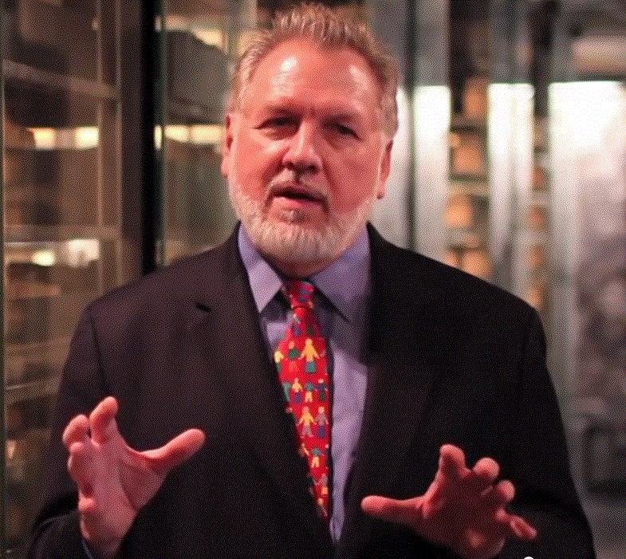
Who I Am…
40 years in IT, 38 in IT mgmt
13 Years on Wall Street
10 Years in management consulting
17 years in NGOs
Former Global CIO at IFRC
Former CIO at STC/US & UK
Co-founder and former Chairman of NetHope.org
More on LinkedIn, Google and www.eghapp.com
Connect!
Making Connections for Good
– People, Comm’s, Ideas
Notes:
When I was 38, I read a comment by Handy saying we could expect to have 5 careers;
For the millennials, US Dept. of Labor estimates you can expect to have 14 jobs…by the time they are 38! (see https://www.youtube.com/watch?v=XrJjfDUzD7M at 02:15)
http://www.amazon.com/The-Age-Unreason-Charles-Handy/dp/0875843018
Charles Handy, http://www.texasventures.us/india/images/leader2_1.jpg …five careers

Slide 5
A Personal Timeline
IFRC
Net Hope+
STC
UMSI
IT Manager, Wall Street
Consulting Partner
Global CIO
Teacher/ Researcher
Writer
Oenophile
Chapter 1
Chapter 2
Chapter 3
Chapter 4
Chapter 5
1977
1991
2000
2017
Today
20??

Slide 6
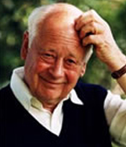
Why all these chapters?
When I was 38, I read a comment by Charles Handy saying we could expect to have 5 careers in our lifetime
So I started thinking in terms of 5 chapters to my career. I’m in chapter 4 now.
For most of you, the US Dept. of Labor estimates you can expect to have 14 jobs… by the time you are 38! *
*see https://www.youtube.com/watch?v=XrJjfDUzD7M at 02:15
Notes:
(see https://www.youtube.com/watch?v=XrJjfDUzD7M at 02:15)
http://www.amazon.com/The-Age-Unreason-Charles-Handy/dp/0875843018
Charles Handy, http://www.texasventures.us/india/images/leader2_1.jpg …five careers

Slide 7
Lecture – The NetHope Chapter

Slide 8
I’d like to reflect on 5 Perspectives
Founder
Member
Governor (Chairman)
Strategist
Historian
Adviser
As a consultant, you may want to interview people in these NetHope roles.
I can offer you the bias of 5 in 1. Caveat Emptor!

Slide 9
I’d also like to look at 3 intersections
External factors
Internal factors
Crisis factors

Slide 10
Consulting 101…the matrix
Now I may be tempted to take 6 perspectives and 3 factors and create a 3x6 matrix of topics
In fact, you cannot graduate a business program without at least mastering the 2x2 matrix
But we don’t have the time to cover 18 topics
And it would mean violating an important law of consulting, namely
Do all the homework, but present only the bottom line
I will now violate the rule

Slide 11
The 3x3 Method

Slide 12
3x3 Summaries and Consulting
For my course, each set of readings to be summarized with 2 slides:
  3 take-aways
  3 critical questions
  20-point font
  Think tweets
Notes:
See my blog post: http://eghapp.blogspot.com/2011/07/finding-bottom-line.html

Slide 13
Why?
The importance of finding the bottom line.
When you present to a senior management team, “please be brief! It's not that senior managers have short attention spans; they need to get to the bottom line and make a decision. Your job is to help them do that.”
--From my blog post, “Working Backwards,”
https://eghapp.blogspot.com/2018/08/working-backwards.html
--Also see my “Finding the bottom line,” http://eghapp.blogspot.com/2011/07/finding-bottom-line.html

Slide 14
NetHope 3x3
Takeaways
  Context matters: there are internal and external factors to consider; there are changes and common threads
  For a nonprofit, donors are the market
  Embracing the paradoxes: most challenges are continua that beg balancing

Slide 15
NetHope 3x3
Critical Questions
  Which matters more, inheritance (history) or new challenges (disruptions & change)?
  How can an organization that is formed by and serves its members also be a nonprofit in its own right?
  Does Jim Collins metaphor of clock-builders and time-tellers hold true for NetHope?
Applying the NGO principle of sustainable programs
Notes:
https://www.jimcollins.com/concepts/clock-building-not-time-telling.html

Slide 16
“Leading as a charismatic visionary—a “genius with a thousand helpers”—is time telling; shaping a culture that can thrive far beyond any single leader is clock building. Searching for a single great idea on which to build success is time telling; building an organization that can generate many great ideas over a long period of time is clock building. Enduring greatness requires clock building.” --Jim Collins

Slide 17
Perspectives

Slide 18
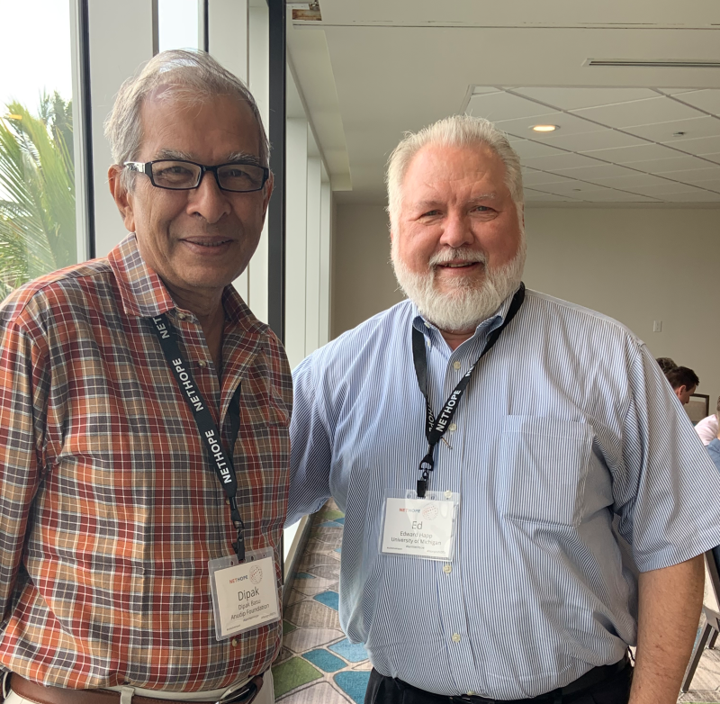
Founder
Actually, co-founder
Isaacson reminds us that most IT innovations are not solo acts (2014)
Dipak Basu & Ed Happ, 26th NetHope Summit
Notes:
Walter Isaacson, The Innovators, 2014

Slide 19
Founded with two compelling hypotheses
If NetHope began with the observation that most international non-profit IT leaders are trying to solve the last kilometer problem, taking IT out to the most challenged areas and situations in which humanitarians work,
We can solve the last mile problem faster, cheaper, better if we do it together
We will be a stronger partner with tech company supporters if we come as a group
Collaborate & Aggregate

Slide 20
Members have increased 8-fold in 20 years
That’s an 11.9% CAGR
Conclusion in the title
IFRC
2007
STC
2001
Consultant tip: show the big numbers and a simple stat.

Slide 21
The key question for international NGO IT leaders: How can you afford not to be a part of this group?

Slide 22
Incorporation & 501(c)3 Status
We were founded in 2001 with Save the Children (STC) as the incorporator/legal assurer
We incorporated in Sep. 2004 and completed the asset transfer from STC Dec. 2006
In Feb. 2006, we received our US nonprofit 501(c)3 status.
These legal events are important because they establish governance, liability, tax exemption and tax-deducible donations

Slide 23
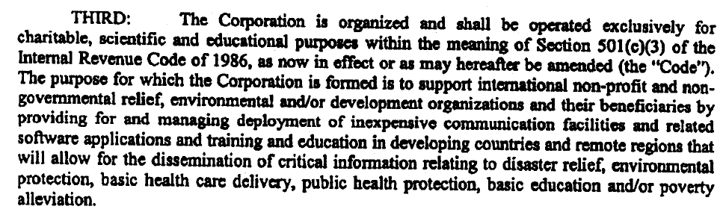
Here’s the key statement …
In our 501(c)3 application, we needed to state our charitable purpose (see below). It can’t be based on the members charitable purpose, being a member's association, or a buying consortium.
This limits the meaning of membership organization.
We must have a charitable purpose to society that merits not having to pay taxes to that society.
From the 501(c)3 application and Certificate of Incorporation
Notes:
COI signed on 9/22/04 by Carolyn Miles, STC
501(c)3 application approved on 2/2/06

Slide 24
The Charitable Program Activities
“Three ways we have implemented these [Charitable Programs] are the TAG SharePoint knowledgebase, the Deals and Discounts program, and the NetHope Chapters. Note that this application does not specify a strategic intent or focus, rather leaving the programs to be developed as similar to ICT knowledge sharing, communications infrastructure, and collaborating of best practices. However, the emphasis is clearly on sharing communications and education/knowledge. It is precisely the educational component that was deemed “most charitable” by our counsel at the time.” –NetHope Strategy Refresh – An Historical View, 2013

Slide 25
From the Tuck/Dartmouth Case
“The strategy had to address both sustainable funding mechanisms and a clear direction for business activities. Should NetHope be a”
  Technology funding hub?
  Software services provider?
  Equipment innovator?
  Procurement service?
  Industry association focused on networking and education?
  Thought leader?
  –Tuck/Dartmouth, 2007, p. 15
#5 appears to have worked out in practice, if not design.

Slide 26
Q&A Pause

Slide 27
Strategy Impact Factors
Notes:
Key external factors:
Cisco Fellowship Program
Incorporation and 501(c3) status
Major disasters: Tsunami (2004) Haiti (2010)
Key Internal factors:
Change from ED-Fellows to CEO (2006)
Change in CEOs (2013)

Slide 28
A NetHope Timeline
Cisco Fellowship program driver
Bull Market
Dotcom
Crash
Great Recession
Reduced NGO funding
Incubator
Governance
Transitions
Strategic
Chapter 1
Chapter 2
Chapter 3
Chapter 4
2001
2006
2013
2014
2017
2018
Today
An external, economic viewpoint
Notes:
Dot-com bubble, 1994 to 2000
Dot-com crash, March 11, 2000, to October 9, 2004

Slide 29
A NetHope Timeline
4th Chair
3rd CEO
1st ED
2nd Chair
3rd Chair
2nd ED
2nd CEO
1st Chair
1st CEO
Incubator
Governance
Transitions
Strategic
Chapter 1
Chapter 2
Chapter 3
Chapter 4
2001
2006
2013
2014
2017
2018
Today
An internal, leadership viewpoint

Slide 30
Three CEOs in 14 Years
Represent three focal points of the organization:
  Fundraising
  Strategy
  Member care
The challenge of balance and history

Slide 31
A NetHope Timeline
Five Programs
5-year Strategy I
CDN center
5-year Strategy II
Accenture growth
Business Plan
Shared Svcs
Tuck case
Strategy history
Accenture options
Theory of Change
Incubator
Governance
Transitions
Strategic
Chapter 1
Chapter 2
Chapter 3
Chapter 4
2001
2006
2013
2014
2017
2018
Today
An internal strategy viewpoint
and consultant strategy viewpoint

Slide 32
A NetHope Timeline
West Africa Ebola
Hurricane Dorian
Haiti earthquake
Nepal earthquake
Hurricane Maria
Bam, Iran earthquake
Philippines typhoon
Indonesia tsunami
Incubator
Governance
Transitions
Strategic
Chapter 1
Chapter 2
Chapter 3
Chapter 4
2001
2006
2013
2014
2017
2018
Today
Major external disaster response
Notes:
NetHope responded to the earthquake in Bam, Iran in Dec. 2003,
the great Indonesia earthquake and tsunami in Dec. 2004.
Pakistan earthquake in Oct. 2005

Slide 33
Key Questions
Would NetHope have been launched without the Cisco Fellowship program that was launched in response to the dot-com bubble burst?
If NetHope only served its members, would it have been eligible for nonprofit status?
If NetHope did not strive to also meet donor needs, would it survive?
A consultant is challenged to sort the signal from the noise

Slide 34
Note the trade-offs, especially #2

Slide 35
Most Recent Strategy (2019)

Slide 36
Reimagining the Path to Greater Impact
Lauren Woodman
2019 NetHope Global Summit

Slide 37
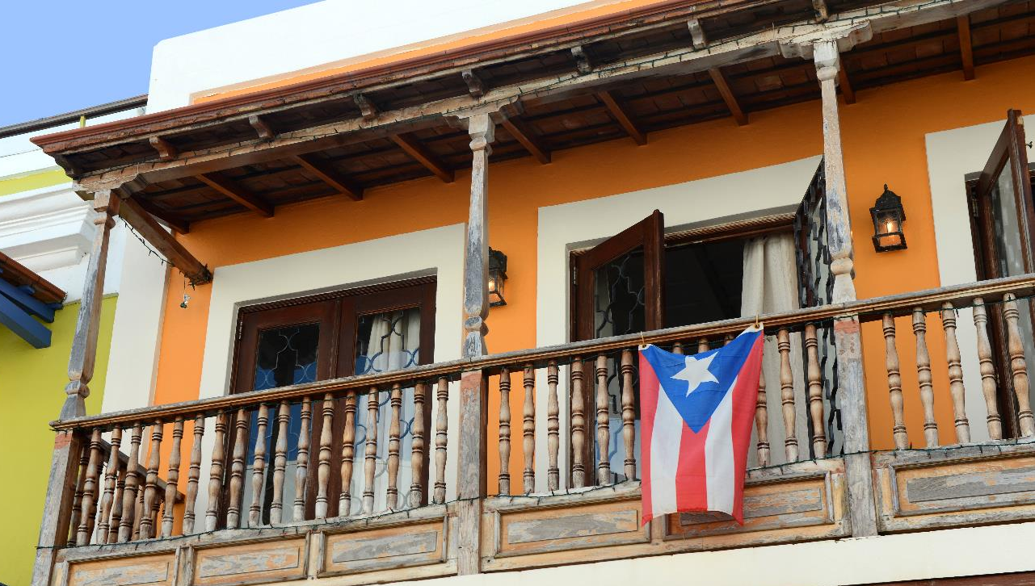
Welcome
2019 NetHope
Global Summit

Slide 38
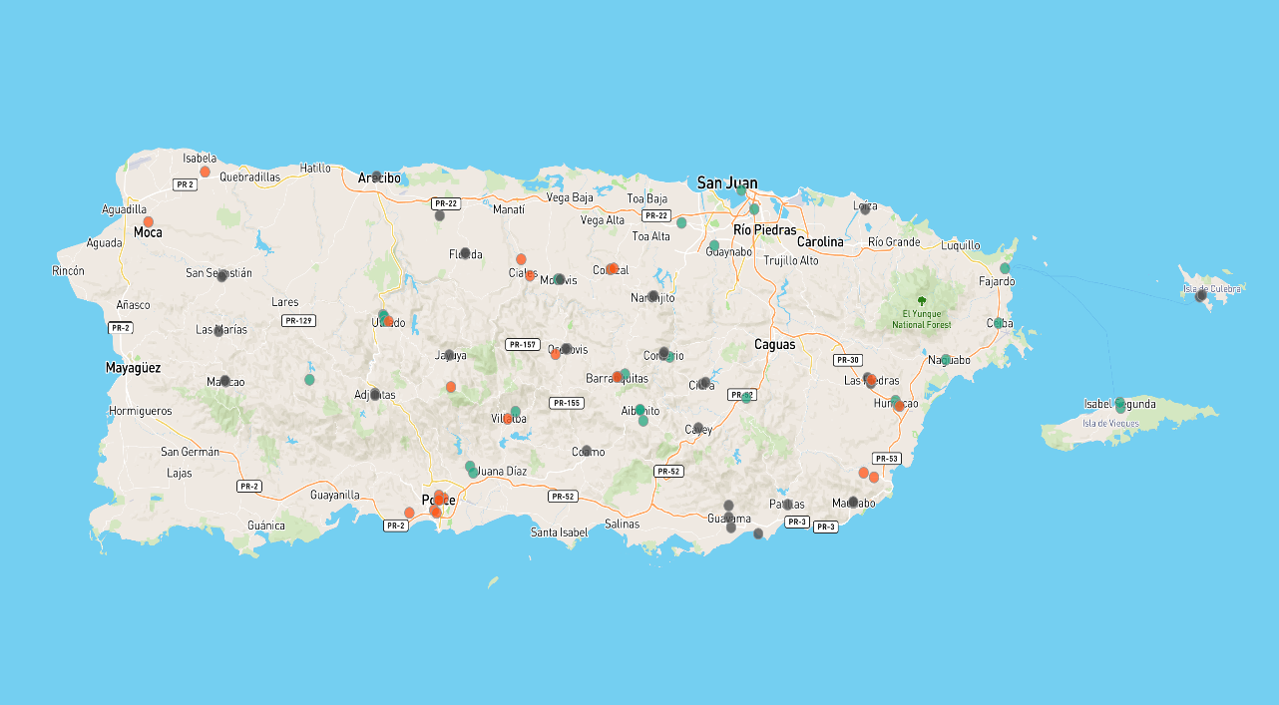


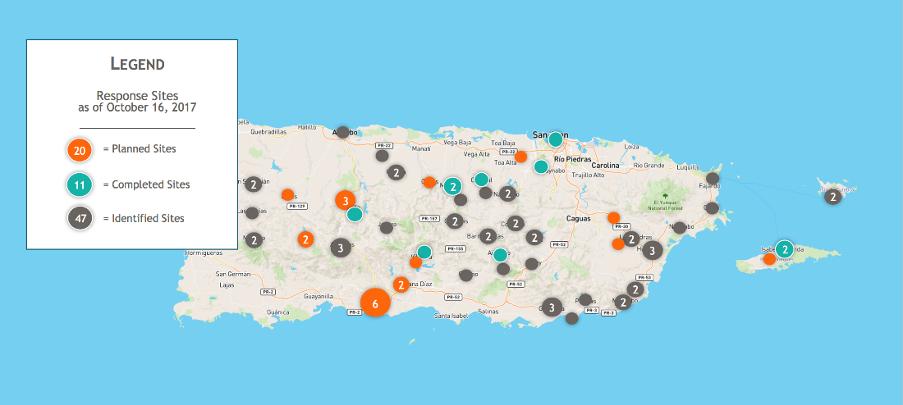
NH Response
NetHope Response in Puerto Rico
Legend
Response Sites
as of October 30, 2017
23
= Planned Sites
31
= Completed Sites
2
2
39
= Identified Sites
2
2
2
3
2
2
2
2
2
2
3
2
2
2
2
6
3
2
Notes:
Thanks to Cisco, Facebook, The Patterson Foundation, Microsoft – 99 sites. 39 provided public wifi. More than a million and a half Puerto Ricans benefitted from Information as Aid .

Slide 39


Our Mission
NetHope empowers committed organizations to change the world through the power of technology.
Notes:
During the drafting of the strategic plan in 2014-2015, this mission was carefully constructed. “Committed” organizations reflects the NetHope expectation that all members contribute to the collective good.

Slide 40
NetHope Values (2013)
Technology matters
    We are at the intersection of technology and nonprofit work
    We advocate and interpret ICT benefits for the sector
Benefitting all benefits one
    Our brand of partnering means shifting from a ‘do then share’ to a ‘share then do’ mentality
    larger organizations: take a leadership position on collaboration
Learning through collaboration
    Ready, fire, aim… fire, aim, fire aim, fire aim
Build for the field
    Cultivate headquarters humility
    Expect the pyramid to flip… discover and harvest
Bias for action
    When times are uncertain, smart organizations “vary like mad”
    Pilots and prototypes and agility as core competencies
Trust above all else
    Value the faith and integrity we have with each other
Notes:
These next two are my slides from a decade ago

Slide 41
NetHope’s Model of Building Collaboration
“Who has expertise I can trust?
Shared Assessments, Services II
Shared
Specialization
Joint Projects
“What can we build together?”
NRK, Phase 2 Satellites
Increasing Levels of Trust
Partnering
“How can we work with corporations?”
Cisco, Microsoft, Intel Grants
Basic Info Sharing
“What are my peers doing?”
Meetings, Conference Calls

Slide 42
NetHope
Strategic Plan
October 2019

Slide 43
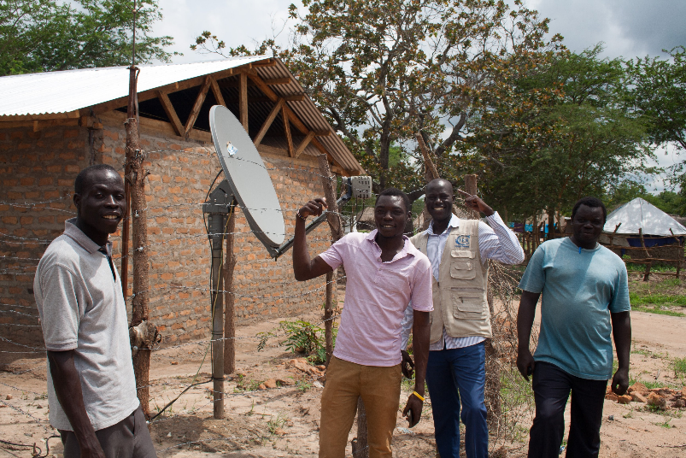
How We Deliver on Our Mission
Connect
Build the Right Foundation
Reimagine Aid
Connectivity
Infrastructure
Power Solutions
Notes:
Build the right fundamentals
Demand Aggregation
Connectivity & Infrastructure

Slide 44

How We Deliver on Our Mission
Enable
Collective Impact Programs
Emergency Response
Refugees & IDPs
Health/Education/Livelihoods
Environment/Conservation
Notes:
Work

Slide 45
How We Deliver on Our Mission
Transform
Reimagine Aid
Reimagine Aid
Business Enablement
Capacity Building
Technology & Operating Standards
Sector Benchmarks

Slide 46
NetHope Value
Sector Transformation
Enable
Collective Impact
Generalization/Widespread Adoption
Reimagined Approach
Transform
Reimagine Aid
Advance
The Sector
Connect
The Right Foundation
Notes:
LM: Is this a slide to mostly talk from? Not sure it will be that helpful as a slide to read. The last slide had the value proposition. This now says NetHope Value: Improving our world, together. I’m wondering if there will be confusion about which is the actual value proposition. NH: Improving our world, together is the distilled value proposition.
LW: removed the “value prop” from the prior slide. The prior slide we decided during one of the Committee calls that we needed to explain the difference of a value prop vs. tagline or motto or mission or whatever. Does removing from the prior slide help? NOTE: The prior slide will NOT be in the member version presented at the Member Call on 10-1-19.
FW: I see it as different perspective of the same thing i.e. value proposition.
AA&NH: This as it’s placed will require explanation/decoding. Not intended to be linear. A simplified path to indicate a process. Drop is confusing. Ripple effect?
LW: yes, ripple effect. And no, it’s not fully intended to be linear – but for our organizations that were not born digital, it *is* the typical path that they follow…..i wonder if we can address that in commentary – it’s also why the color coding (which is tagged to the colors we use in the program explanation) is gradient, and not sharp edges…..does that help or no?

Slide 47

How We Deliver on Our Mission
Advance the Sector
Connect
Enable
Transform
Build the Right Foundation
Drive Collective Impact
Reimagine Aid
Collaborative Field Programs:
Emergency Response
Refugees & Internally Displaced People
Health/Welfare/Education/Livelihoods
Environment/Conservation
Connectivity
Infrastructure
Power Solutions
Business Enablement
Capacity Building
Technology & Operating Standards
Sector Benchmarks
Working Groups / Issue Groups / Charters
Notes:
FWL Is “livelihood” missing from Enable? DONE
NH: I think Advance the Sector should run along the bottom as foundational. It buttresses, powers our work.
LW: Per Advance – Board had it at the top, and I think it would cause more trouble that it’s worth to change. I also see it somewhat differently – i.e., that we get the right to advance the sector because of the work we do. We don’t pontificate and then prove; we prove and then share.

Slide 48
NetHope Strategic Plan Comparisons
A return to connect-ivity roots
Combines education & consulting
Where did conven-ing go?
A PC form of advocacy?
[1] 2015 NetHope Strategic Plan Draft, Jan. 2015, p. 3
[2] 2019 Summit - Reimagining the Path to Greater Impact, Oct. 2019, p. 33

Slide 49
Common Threads
Bill Brindley’s five C’s:
Collaboration
Connectivity
Contribution (back to the members and community)
Customers (beneficiaries?)
Catalyst (for enabling IT in NGOs)
To where would you match Lauren's focus themes?
Notes:
Farmer & Johnson, “NetHope—Collaborating for the Future of Relief and Development”, 2007, pp. 9-10

Slide 50























































NetHope 59 Members
Plus 3 logos added after 2019 Summit vote

Slide 51
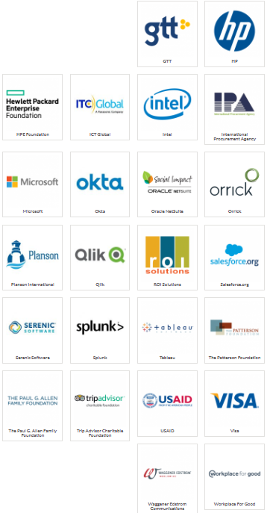
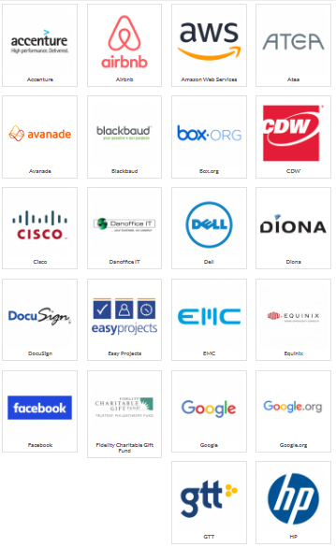
NetHope 46+ Supporters
Notes:
https://nethope.org/our-partners/all-partners/

Slide 52
Consulting with NetHope
Why would I make a good consultant with NetHope?
  Short learning curve
  360-degree understanding of the context
  Able to embrace the ambiguity
Why would I make a bad consultant?
  Personally invested in the outcome
  Questionable dispassionate analysis
  I’d have to live with the recommendations

Slide 53

Open Discussion, Q&A

Slide 54
Consulting Questions to Debate
Would you recommend that the new CEO adopt the 2019 strategy or develop a new one?
Given the pandemic is causing significant across-the-board budget cuts at NGOs, travel, training, conferences & membership costs are the first to go. What would you recommend for NetHope to retain members?
What seems to be repeating patterns at NetHope? If past is prologue, what can the new CEO expect?
If programs are the bread-and-butter products of NGOs, and the pandemic is constraining most program delivery, what program shifts would you recommend that is consistent with NetHope’s history?
Turnover is over 70% in 2020 at NetHope. What would you recommend the CEO do to stem the bleeding? Should they?

