Slide 1



The Tech Leadership Academy is made possible by generous funding from Microsoft Community Affairs
These materials are available under the Creative Commons Attribution-NonCommercial 3.0 License.

Slide 2
Turning the Pyramid Upside Down
The Impact and Future of Technology in Nonprofits
Edward G. Happ
Global CIO, IFRC
Chairman, NetHope
September 7, 2011

Slide 3
A Brief Introduction
13 Years on Wall Street
10 Years in management consulting
11 years in NGOs
Former CIO at STC/US & UK
Co-founder and Chairman of NetHope.org
More on LinkedIn, Google and www.eghapp.com

Slide 4
Session 1:
Future of IT in Nonprofits
Recognize the role of technology in moving missions forward
Use pyramid framework to strategically understand different roles of technology in organizations
Learn where to look for future trends before they disrupt you
Use the “discover and harvest approach” to discover and amplify pockets of innovation
4

Slide 5

I. Some Strategic Context

Slide 6

Parable of the Rocks
6
Notes:
http://www.flickr.com/photos/weeping-willow/2852177218/

Slide 7
What’s the single most important strategic question?

Slide 8
What’s my destination?

Slide 9
Moving the IT Agenda Up the Pyramid
Technology
Leadership
Academy
Competitive
or Leading
BENEFICIARY
“Differentiating”
Beneficiary & Field Facing
Increasing Impact for Beneficiaries
PROGRAM
“Improving Program Delivery”
Increasing Impact for Beneficiaries
OPERATIONAL
“Helping the Organization Run”
Efficient
Donor & HQ
Facing
FOUNDATIONAL
“Keeping the Lights On”
9

Slide 10
Technology is a Key to Building Capacity
More Effective Impact
At Greater Scale
Effective, Efficient, Scalable Programs
Hiring
Training
Partnering
Advocacy
Tools
Processes
Standards
Systems Impact
Funding Support

Slide 11
The Problem: NGOs invest a fifth of corp. IT
5x
18x
4x
Notes:
11
11

Slide 12
Closing the Productivity Gap: A New Calculus
A back of the envelop calculation for taking a $5M IT
department in a $200M NGO to $23M
Charity Factor
Collaboration Factor
56%
Gap Remains
Notes:
A fictitious $200M NGO; 1,700 users

Slide 13
Leveling the NGO - Corp IT Playing Field

Slide 14
Non Profit IT Departments Can’t Play the Odds
IF
57% of ERP projects don't realize their ROI (Nucleus Research)
66% IT projects fail (Standish Chaos DB)
NGOs spend a 20th what corporations do (Tuck survey)
And we are spending donors’ dollars
THEN
We must find a better way...
14
Notes:
14

Slide 15
Key Conclusion: we can’t do it alone
Even if we tripled IT spending, we will still be playing catch-up for just keeping the lights on.
And…
Notes:
15

Slide 16
Keeping the Lights-On is Irrelevant!
It’s more a commodity each day; consider that:
“We can't get close to what Google and Amazon can do in their data centers” –Peter Cochrane
Why then are we in the data center business?

Slide 17
We Need to Push the Pyramid at Both Ends
Get in
Competitive
or Leading
BENEFICIARY
“Differentiating”
Beneficiary & Field Facing
PROGRAM
“Improving Program Delivery”
Increasing Impact for Beneficiaries
OPERATIONAL
“Helping the Organization Run”
Efficient
Donor & HQ
Facing
FOUNDATIONAL
“Keeping the Lights On”
Get out

Slide 18
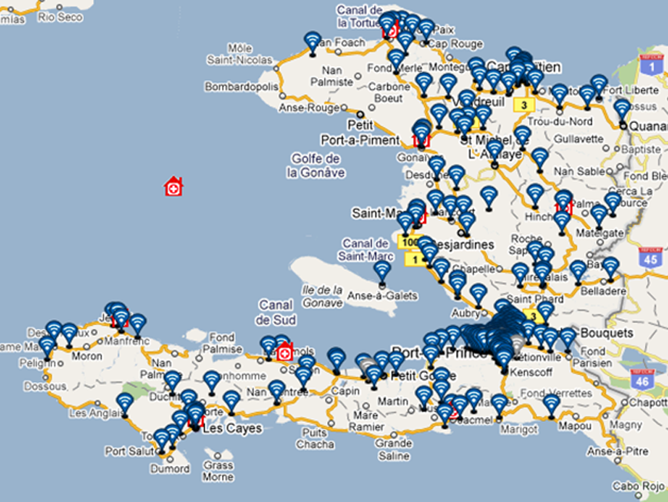
IFRC – Trilogy
TERA Application
Notes:
TERA = TRILOGY EMERGENCY RESPONSE APPLICATION
See http://www.ifrc.org/en/news-and-media/news-stories/americas/haiti/haiti-red-cross-takes-to-the-airwaves/

Slide 19
Texting Survivors in Haiti
6M SMS in 7 days
385K SMS/Day received
1.1M early warning SMS
1M Cholera health SMS
800K IVR calls in 1 month
Notes:
IFRC and Trilogy partnership: targeted SMS-based communications
6 million SMS sent during 7 days disaster preparedness campaign
385,000 messages received per day in PaP & Artibonite
1.1 million "early warning" SMS ahead of hurricane Tomas storm surges
Cholera: 2.1 million public health SMS sent:*733 IVR info-base; 800,000 calls to IVR in September
Survey potential
Beneficiary at the center of communications

Slide 20
Getting Out: BPOS/Office365
We are not in the data center business
We need to redeploy people, time and money up-the-pyramid
We need to have impact on 60+ National Societies who have little to no IT
We are a Microsoft-centric shop with many inter-application and platform dependencies
We need a more fluid path from premises to off-premises computing
We are about partnering with those whose business it is to do things that it is not our business to do

Slide 21
IFRC - The IT Portfolio for the Next 5 Years
21

Slide 22
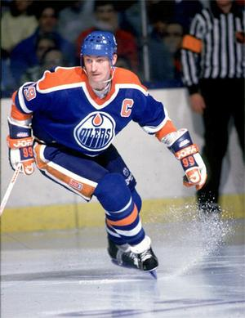
Advice from a Hockey Legend
“I skate to where the puck is going to be,
not where it has been.” --Wayne Gretzky

Slide 23
II. Looking to the Future – Part 1

Slide 24
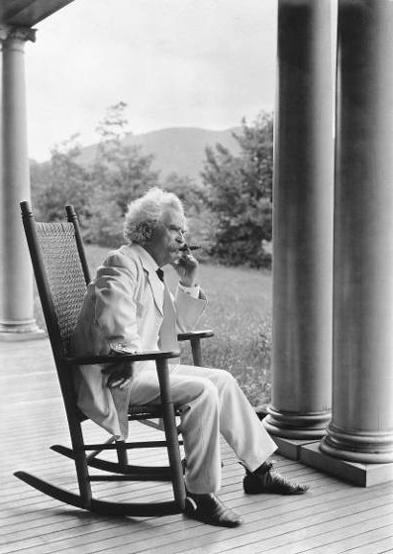
It’s More about Practices than Forecasts
"The art of prophecy is very difficult-- especially with respect to the future." --Mark Twain
24

Slide 25
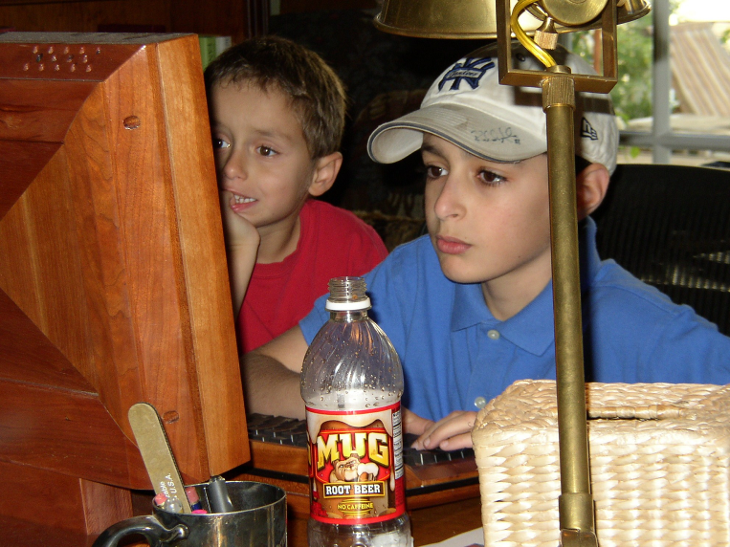
Who is Your Leading Indicator?
25

Slide 26
Who are you spending time with?
“If you’re a CIO, you need to spend a lot of time out on the fringes of the Web because that’s where the innovation’s taking place. You need to spend a lot of time with people under 25 years old.”
–Gary Hamel
Notes:
Gary Hamel interview, CIO Magazine, November 15, 2007, p. 50-55.

Slide 27
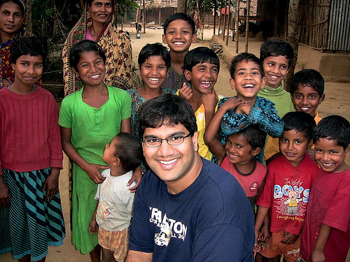
The Uncultured Project
2.2 M Views
27
Notes:
http://savetheworldblog.files.wordpress.com/2009/10/2606613587_44ea042f60.jpg
See Shawn Ahmed’s YouTube site, here: http://uncultured.com/

Slide 28
Turning 3 things upside down
Bottoms-up KM (Gmail case, Guru connecting)
Emerging countries leading (design for other 90%)
Children as forecasters (the technology is the conversation, the safe conversation—like driving)

Slide 29
Some Potential Disruptive Themes
In-country corporations and the rise of CSR - supply-chain savvy corporations inviting NGOs to join their relief efforts
Beneficiary driven relief - The beneficiary kiosk – beneficiaries ordering relief supplies
Survivor assessments – survivors as sources for assessment and demand data (Ushahidi)
Renegade partners – in-country partners who decide to go it alone
Direct funders – direct connections to people and projects (Kiva, Uncultured)

Slide 30
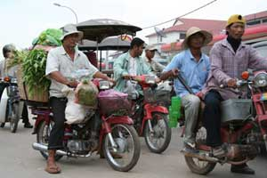
The Sometimes Connected Internet
Internet Village Motoman Network
Notes:
http://www.developingtelecoms.com/content/view/687/59/
Internet Village Motoman “Already, innovative ICT projects in Cambodia have helped connect remote rural schools to the internet,” said Tony Bates. “With NGN technology things can only get better.”
Cambodia was picking itself up and could show the way to several developing nations. Mr Bates went on to cite the example of a First Mile Solutions project called “Internet Village Motoman”, which used new ICT to provide internet access for 15 solar-powered village schools, telemedicine clinics, and the governor’s office in a remote province of Cambodia - using five Honda motorcycles.
The project worked by equipping new schools in the villages with solar panels on the roof to provide sufficient energy to run a computer for six hours and providing an e-mail link via a motorcycle delivery system.
Early every morning, five Honda motorcycles leave the hub in the provincial capital of Banlung, where a satellite dish donated by Shin Satellite links the provincial hospital and a special skills school to the Internet for telemedicine and computer training.
The motorcycle drivers, equipped with a small box and antenna at the rear of their vehicle that downloads and delivers e-mail through a wi-fi (wireless) card, begin the day by collecting the e-mail from the hub's dish, which takes just a few seconds.
Then, as they pass each school and one health centre, they transmit the messages they have downloaded and retrieve any outgoing mail queued in the school or health centre computer, also equipped with a similar book-sized transmission box. They then go on to the next school. At the end of the day they return to the hub to transmit all the collected e-mail to the Internet for any point on the globe.
“This is an example of technology changing the quality of life, it is testament to the power of engineering.” While the telecoms industry is “not inventing technology for technology’s sake, we respond to consumer demand across the broadest possible consumer base.”
TDS helped to highlight the fact that developing nations are now a major part of that consumer base, and have now become the primary focus of the telecommunication industry’s attention, particularly with regards to NGN technology, this also being the conclusion expressed elsewhere in this review, of Fernando Lagraña, Executive Manager of ITU Telecom World.
“The industry has the potential of benefiting the developing world in ways we hadn’t even deemed possible a few years ago,” he said. “We must ensure that the future of the industry is shaped by the needs of the least developed and developing world.”

Slide 31
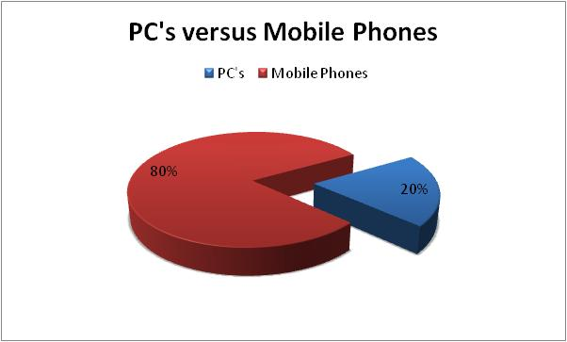
What’s your software platform?
31

Slide 32
Peters Law of Proximity
The amount of innovation is directly proportional to the distance from headquarters.

Slide 33
What’s our far country?
The Field!
33

Slide 34



















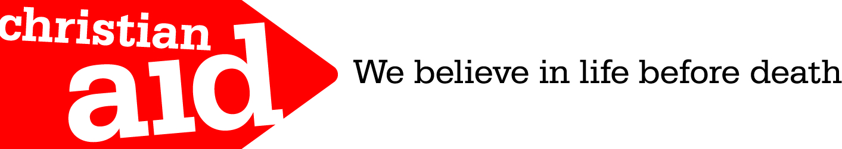









The NetHope Collaboration: 33 Member NGOs

Slide 35
The New Collaboration
Who Are You Partnering With?
“Who has expertise I can trust?”
Shared Services & Assessments
SHARED
SPECIALIZATION
JOINT PROJECTS
“What can we build together?”
NRK, Phase 2 Satellites
Increasing Level of Trust
PARTNERING
“How can we work with corporations?”
Cisco, Microsoft, Intel Grants
BASIC INFO SHARING
“What are my peers doing?”
Meetings, Conference Calls

Slide 36
Why NetHope Works?
We have…
  History: NetHope has been at it for almost 10 years: building trust since 2001
  Hunger: NGO IT are beggars – don’t underestimate value of under-funding
  Humility: extending trust to centers of excellence in other members
  Partnering: corporate partners buy-in to the leverage of collaboration and having impact with technology

Slide 37
The Innovation Mutual Fund
I4 Health - MedCheck, a NetHope/Accenture initiative for battling the counterfeit drug trade.
I4 Microfinance - Mobile Banking pilot between NetHope, Accion and Microsoft, using Microsoft’s OneApp and PDAs/cell phones for Loan Approvals and Credit Scoring
I4 Education - eLearning and ICT Program for secondary schools with the Tanzanian government, NetHope Members, Accenture and others to reach 1.5M secondary school children.
I4 Geographic Information Systems - A hydrology/ water dataset sharing project in East Africa and a Disaster Preparedness pilot with partner ESRI.
37

Slide 38
Toward Relevant IT – A Manifesto
Mission-Moving Projects. Technology matters. We believe ICT can move missions, which is the most strategic application of ICT to which we can aspire
Good Enough Applications. Small is beautiful, faster to change, and fit for purpose
Shared Services. Sharing resources stretches and enhances what we do as individual organizations.
Lights-Out Infrastructure. To get in to mission moving app’s, we need to get out of basic IT operations. We need to shift the IT agenda from "lights-on" technology to “impact” technology.
Increased Experiments. Vary like mad. Pilot, prototype, trials. Partner to pilot: share the risks..
38

Slide 39
Six questions for Nonprofit Leaders
What new programs (that directly serve beneficiaries) have you helped engender that would not have been possible without the new use of technology?
What have you done to help close the "productivity gap" in the way your nonprofit delivers programs and operates as an organization?
How have you helped bridge the divide that will be caused by disruptive innovations in the nonprofit space?
For relief organizations: How have you helped disaster response be 50% faster with 50% greater impact?
How have you helped your organization attract and retain knowledge workers (and IT professionals) in the face of crisis of the baby boom generation retirement wave?
What are you doing to move commodity functions out of your organization and contribute time, dollars and support to the truly value-added functions of your agency?

Slide 40
A Fundamental Law of Disruption
If you don’t answer these questions
Someone else will

Slide 41
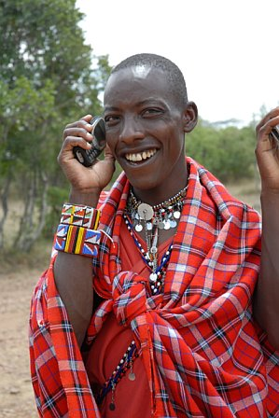
For the rest
of the world,
this is the Internet
41
Notes:
Masai Warrior at Ikelani Using Cell Phone, Jupiter research Blog, Julie Ask, October 06, 2006; http://weblogs.jupiterresearch.com/analysts/ask/archives/007174.html

Slide 42
III. Looking to the Future – Part 2

Slide 43
A metaphor to ponder
What was Picasso up to?...

Slide 44
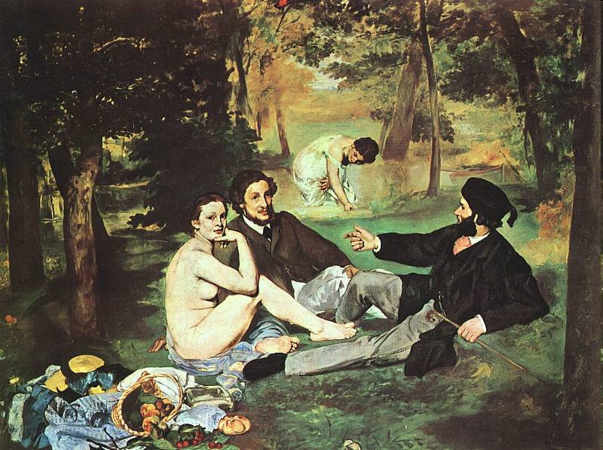
Manet’s Luncheon on the Grass, 1863
Notes:
http://www.artlex.com/ArtLex/r/images/Luncheon%20on%20the%20Grass.jpg

Slide 45
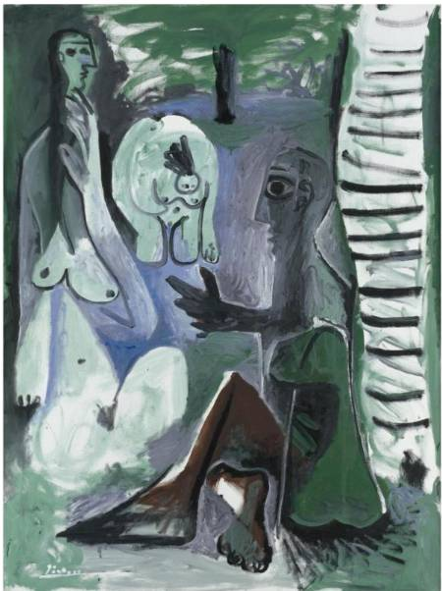
Picasso’s
Luncheon on the Grass (after Manet), 1961
Notes:
http://picasso.tamu.edu/picasso/WorksInfo?CatID=OPP.61:218
Also see: http://www.arthistoryclub.com/art_history/Pablo_Picasso

Slide 46
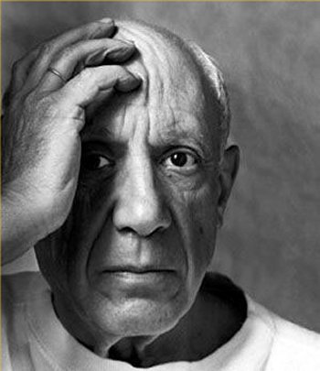
Picasso on technology?
Three take-aways:
Dialog with the past
Change the focus for the future
Embrace uncertainty
Notes:
http://www.myclassiclyrics.com/artist_biographies/Pablo_Picasso_Biography.htm

Slide 47

Everything Old is New
IT Pendulum between the Extremes
Left Brain (60s, 90s)
Centralized
Standardized
Generalized
Rationale
Autocratic
Big is Better
In-source
Tight
Right Brain (70s, 80s)
Decentralized
Customized
Specialized
Creative
Democratized
Small is Beautiful
Outsource
Loose
The next wave?
Notes:
http://www.biologycorner.com/worksheets/pendulum.html

Slide 48
IV. Discover and Harvest

Slide 49

Parable of Crossing the Street
49
Notes:
http://www.flickr.com/photos/islandspice/290682376/sizes/o/in/photostream/
“The traffic in Cairo is, by western standards, insane. There are few traffic lights in the city, and no one pays any attention to them. The painted lines on the street and highways are at best guidelines; if four cars can fit in three lanes, they do. One evening in Cairo we parked near the edge of the old city and walked to dinner. At the first main street, we experienced the drivers of Egypt, up close and personal. How were we ever going to cross this street? My New York instincts were to look for a gap in the traffic, and run for it. But there were no gaps.
Though I was the boss, Farouk took charge. "Hold my hands," he said, "follow my lead, and don't look!" It was a strange experience, a throw-back to early childhood, grabbing Dad's hand before crossing the street; depending on him to get us safely across. "Go now," he said, taking five steps forward and stopping, then five more. Cars were swerving around us like a river around three rocks. "Hold on," he admonished, "do what I say; now go." In a dance I did not understand, he guided across the sea of chaos, to the other side.
When we caught our breath, and heart rates slowed down, I asked him how he got us across. In New York, we would have been killed. But these were Cairo rules. "When you step out," he said, "the drivers must take responsibility not to hit you." "...but you need to know when to step out," he added.
This story was a lesson I'll never forget, precisely because I needed to forget. I had to put aside my experience and preconceived notions of how to cross a busy street, and trust someone else to guide me through their country's rules. Letting others lead you and teach you is part of becoming a good leader. It is especially true of learning about other cultures--we will never get it as well as those who have it in their blood. This also applies to our areas of expertise. Sometimes we need to let others teach us.” --http://www.hpmd.com/hpmd/personal/LTYMstories.nsf/links/289

Slide 50
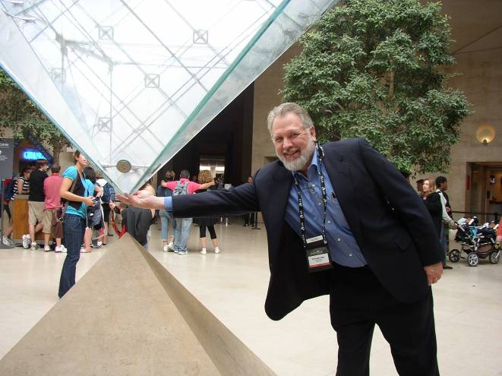
For The Da Vinci Code Fans

Slide 51
Where should we look for innovation and ideas?
Children, Students,
Emerging Countries
1. Citizen-facing
Field Tech’s, Field Workers, Partners
2. Field-facing
Corporations
Increasing Distance from HQ
3. Donor-facing
HQ
4. Supporting
Inverting the pyramid

Slide 52
Discover and Harvest
Jerry Sternin and “bright spots”
  The case of Vietnam malnutrition
  The value of discovering the exceptions
Traditional approach is more an “assess and build” approach:
  assess the situation, gather requirements, specify the project, build it, test it and deliver it.
  problem is that this approach has a dismal history
The “discover and harvest” approach:
  finding those applications and uses of technology in the far reaches of your organization that are already working.
Notes:
See the Fast Company article on Jerry’s work, “Positive Deviant,” by David Dorsey, November 30, 2000; here: http://www.fastcompany.com/magazine/41/sternin.html
Richard Tanner Pascale & Jerry Sternin, “Your Company’s Secret Change Agents,” Harvard Business Review, May, 2005.
“Positive Deviant,” Fast Company.

Slide 53
As Jerry would say “somewhere in your organization, groups of people are already doing things differently and better. To create lasting change, find these areas of positive deviance and fan the flames.”

Slide 54
Discover and Harvest has a number of benefits
It’s already working somewhere; it leapfrogs over getting a new system to work. The pilot has already been run.
Some group has already adopted it; it doesn’t need to be sold.
It’s field-tested. Especially for international NGOs working in challenged rural settings, it works where technology is rare.

Slide 55
Why Don’t We See More D&H Approaches?
It requires headquarters humility
It means accepting “good enough” solutions.
55

Slide 56

Seven International Nonprofits Agreed on a “Good Enough” Approach to M&E in Emergency Response
56

Slide 57
The best answers, especially if it involves change, need to be from the inside out.
  “Maybe the problem is that you can't import change from the outside in. Instead, you have to find small, successful but "deviant" practices that are already working in the organization and amplify them.” --Sternin
57

Slide 58
What’s Needed?
For leaders to become chief amplifiers.
CIO’s should become adept at finding what’s working around them (Discovery --outside their headquarter walls), can be taken to scale (Harvesting); and then shine the spotlight on it.

Slide 59
The Imagine Cup Funnel
400,000
3,000
400
27 Winners
How are you gathering
the good ideas?

Slide 60
How to take a “discover and harvest” approach
Run a contest for people to submit their applications and uses of technology
Include everybody: Field-workers, volunteers, donors, supporters, youth
Recognize and reward them (it doesn’t need to be a cash award.)
Put their name on the application. Most people take pride in what they do and want to be recognized for what they achieve.

Slide 61


A Tech Catalog of Standards & Choices - “crossing the street”
‘Discover’
‘Harvest’
15 NSs cross the digital divide
NS IT Survey - Applications
Application Inventory
Application Catalogue
Scale up
Application Portfolio
Review
500+
Criteria
National Societies
De facto
vendor standards
Application Contest
Application Catalogue is the window for NSs into supported applications
National Societies
61
Notes:
http://www.istockphoto.com/stock-photo-4237972-funnel.php

Slide 62
Bottoms-up Knowledge Management
“There is no shelf” –Clay Shirkey
  The triumph of folksonomies
  And deep-indexing
Finding the person rather than the content
  Connecting the front-line
  What’s the de facto social network?
The need for tech to learn from what I do
  The problem of managing email
  The case of the email sabbatical
  All this technology is supposed to make my job easier, right?

Slide 63
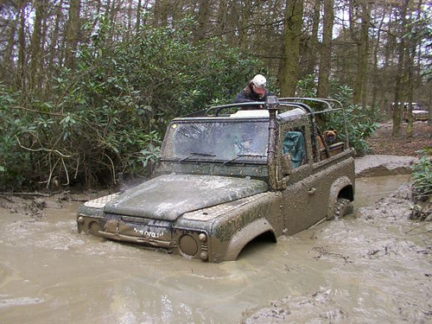
Stuck?
63
Notes:
http://farm3.static.flickr.com/2405/2116956923_98b45103fb.jpg

Slide 64
Moral of the Story
We cannot get the capacity gains we need in NGOs without working together more and sharing commodity resources
We cannot go it alone!
Think Collaborations, partnerships, co-ops

Slide 65
Things you can do if you’re small
Get Out:
Get the hardware and software free or near free (Techsoup, corporate donations off-lease, etc.)
Get seats in training classes from partners (e.g., corps, larger organizations)
Form a cooperative for basic things like support
Get Out:
Develop a strategy and plan with an informal board of IT advisors
Form a cooperative for experiments like I4D
Move Up:
Connect with beneficiaries through their phones (see MobileActive.org)
65

Slide 66
Session 1:
Future of IT in Nonprofits
Recognize the role of technology in moving missions forward
Use pyramid framework to strategically understand different roles of technology in organizations
Learn where to look for future trends before they disrupt you
Use the “discover and harvest approach” to discover and amplify pockets of innovation
66

Slide 67
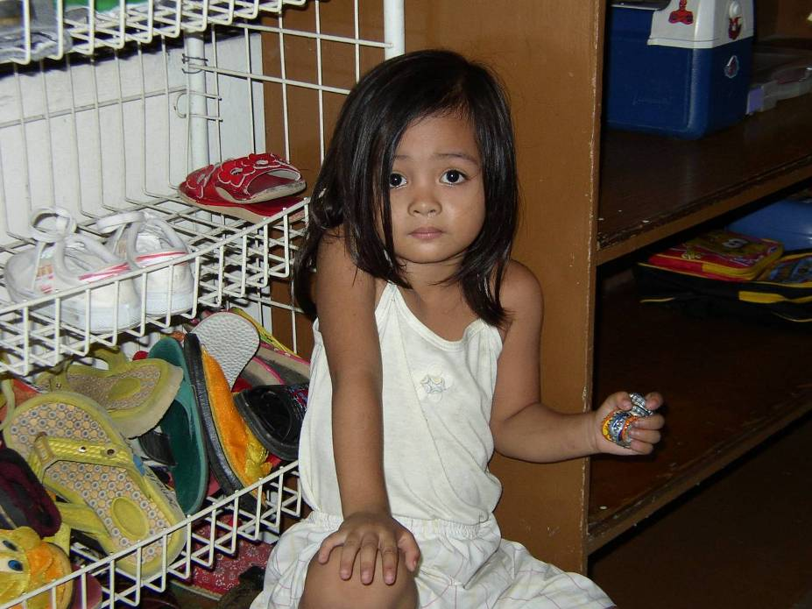

Slide 68
Bottle-caps
Simple, basic toys are good enough
She brought her toys with her to the center
She had already adopted these toys as hers
Now change the word
“toys” to
“technologies”

Slide 69
Further Reading
Blogs:
http://eghapp.blogspot.com/
http://granger-happ.blogspot.com/ (Dartmouth Fellowship)
Web site (see the articles & presentations link) http://www.eghapp.com
Email: ehapp@ifrc.org
Twitter: @ehapp
And the book:
Managing Technology to Meet Your Mission, chap. 11.

Slide 70
Questions?
70

Slide 71
APPENDIX

Slide 72
Key Questions We Cannot Yet Answer In Nonprofits
How can we seamlessly operate disconnected?
How do we co-operate with technology partners? (i.e., shared services)
How can we deliver programs in new ways with technology? (changing the delivery model)
What is the portfolio of basic phone-based applications that works in the field?
What is the portfolio of bite-sized operating applications that works in an underfunded HQ business model?

Slide 73
A Triad of IT Drivers
Metcalf’s Law
the network effect is exponential
Nielsen’s Law
high-end user's connection speed grows by 50% per year
Moore’s Law
CPUs double
every 18 months

Slide 74
One Final Word
Before you make your bets: when there is rapid change and uncertainty, smart organizations vary like mad*. Run pilots, experiments and test ideas. Throw away what doesn’t work. Take to scale that which succeeds.
* See Jim Collins, Built to Last, Harper Collins, 1995, pp. 146-47.
74

Slide 75
NetHope Values – Guiding Principles
Technology (ICT) Matters
  NGO Missions depend on effective technology & capacity building
Benefiting all benefits one
  Benefiting one also Benefits All
Learn through collaboration
  Learn by doing
Build for the Field
  IT solutions are deployed solutions
Bias for action
  The need for speed, especially for emergencies
Trust above all else
  Trust comes through open dialog and working together over time
75

Slide 76
A Summary Strategy in Ten Questions
From where have we come?
Who are we?
What do we do?
Why do we do it?
Where we are going?
How will we get there?
What will it cost and how long will it take?
What are the existing resources? (What is the capacity we have to get there?)
What investment is required to close the gap?
What’s the impact on departments?

Slide 77
Connecting the Dots
What does the NGO Data Center
of the future look like?

Slide 79

Who will pull your chain?
The Market?
Donors?
Your Boss?
or
You?

Slide 80
Conclusion?
Change is not an option
Change is a must

