Slide 1
IBM Open Development for Disaster Response
Communication Networks, the Changing Landscape
Edward G. Happ
Global CIO, IFRC
June 2015

Slide 2
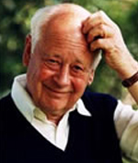
A Brief Introduction
3 careers: Wall Street, management consulting, NGOs
Current Global CIO at IFRC
Former CIO of Save the Children
Co-founder and former Chairman of NetHope.org
More on LinkedIn, Google and www.eghapp.com
Connect!
2
Notes:
When I was 38, I read a comment by Handy saying we could expect to have 5 careers; for the millennials, they can expect to have 14 jobs…by the time they are 38! (see https://www.youtube.com/watch?v=XrJjfDUzD7M at 02:15)
http://www.amazon.com/The-Age-Unreason-Charles-Handy/dp/0875843018
Charles Handy, http://www.texasventures.us/india/images/leader2_1.jpg …five careers

Slide 3
Disasters Losses Continue to Rise (1970-2014)
3
Notes:
http://www.swissre.com/sigma/

Slide 4
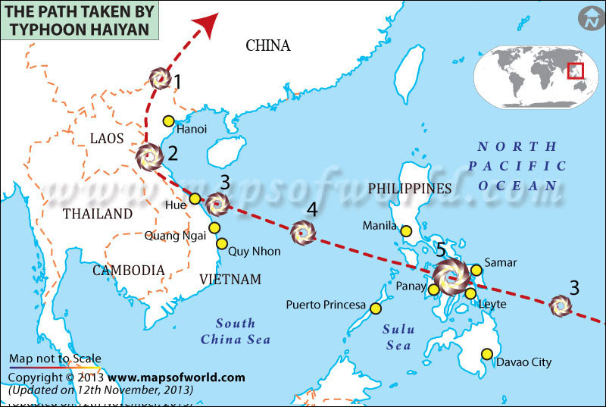
We continue to learn: recent example, typhoon Haiyan
4
Notes:
http://www.washingtonpost.com/blogs/worldviews/wp/2013/11/15/8-maps-that-explain-why-typhoon-haiyan-hit-the-philippines-so-hard/

Slide 5
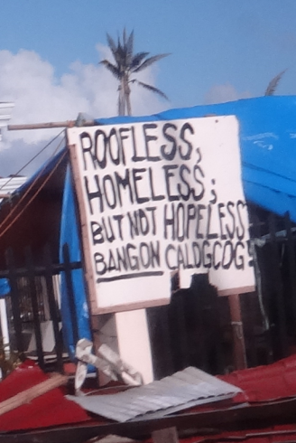
RC Philippines Response - details
By the Numbers:
16 million people affected
6,201 deaths reported
4 million people displaced
1.14 million houses damaged
Source: NDRRMC, 14 Jan. 2014
5
Notes:
IFRC: Philippines Typhoon Haiyan, FACT SitRep 20, 29 January 2014, pg. 1

Slide 6
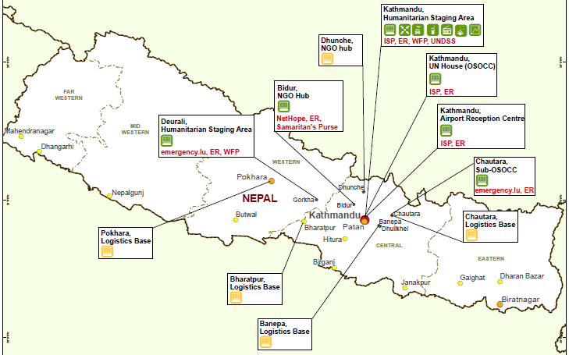
ETC Services in Nepal (08-May-15)
Notes:
http://ictemergency.wfp.org/web/ictepr/countries-nepal

Slide 7
Disaster Response is Changing…
Preparedness
First Response
Scaling up
Transition
Learning
Stage 0
Citizens
Beneficiaries
Volunteers
Stage 4
Stage 1
Stage 3
Stage 2
7

Slide 8
What We Learned in Haiyan DR
Technology use is changing…
Telco networks recovered before NGO VSATs were set up
  Telco DRP is part of our DRP
BYOT extended to relief workers
  “Just give me an IP address”
ICT Collaboration worked
  NetHope members and UN ETC were in synch

Slide 9
Changing Priorities By Program Type
For emergency response, time and volume are king;
for development, cost and quality reign
Ranking factors 1-4, 1=highest
9
Notes:
For emergency response, time and volume are king; for development, cost and cost reign

Slide 10
An NGO Supply Chain
Beneficiary engagement
Assessment
Country – Sub-Office
Reporting
Plan
Procure
Ship
Warehouse
Ship
Ben. Track
For development, procurement is competitive; for emergency response, procurement is pre-determined and agile
Beneficiary tracking is key in the NGO supply chain; commercial SCM applications lack this
Beneficiary engagement is increasing in the supply chain
10
Notes:
For development, operational budget planning happens first; competitive bids are < 3 days due to relationships with suppliers; so often the same process for ER

Slide 11
Crisis Needs?
First: is my family OK?
Second: can I get food, water, shelter?
Third: can we communicate? (Voice/Data)
11
Notes:
11

Slide 12
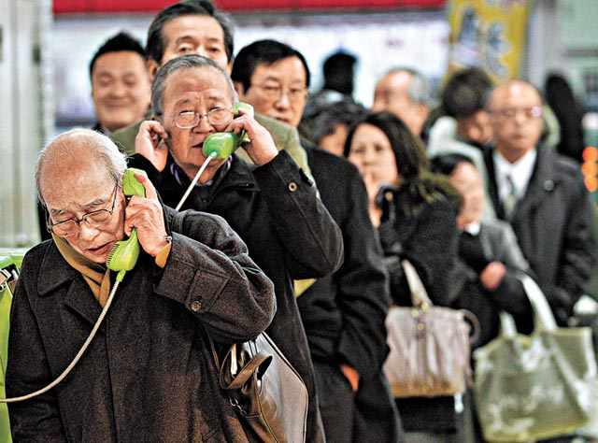
People need to know their loved ones are safe
“People need Information as much as water, food,
medicine or shelter.
Information can save lives, livelihoods and resources.
Information bestows power.” –World Disasters Report 2005
12
Notes:
http://voices.washingtonpost.com/blog-post/tsuna.JPG

Slide 13
Major Disasters Over Past Decade - ICT Factors

Slide 14

2013 World Disasters Report
A mere six per cent in low-income countries have access to the Internet, compared to a massive 76 per cent in high-income countries.
Welcome to the digital divide.
--IFRC, World Disasters Report, October 2013
  95% of first responders are local people
Notes:
https://www.ifrc.org/publications-and-reports/world-disasters-report/world-disasters-report-2013/

Slide 15
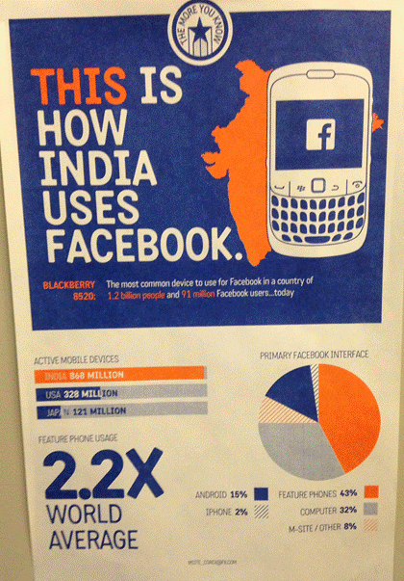
Poster seen
At Facebook
Feature phones account for 43% of Facebook usage in India.
Only 17% access via smartphone
Feature phone usage is 2.2x the world’s mobile phone average

Slide 16
Four Take-aways…
The value of speed
The value of local
The value of good-enough (feature phones)
The value of improvising (ready, fire, aim)
16

Slide 17
Unsolved Problems-projects
Here are 5 problems for which we do not have a robust solution:
“Find the guru” enterprise search to find the expertise network
Simple feature phone development platform for encouraging vulnerable population creativity
Mesh nets that work easily for feature phone users
Auto porting of content apps from smart to feature phones
A sharable tech catalog on network solutions: an apps store for vulnerable populations

Slide 18

Questions?

Slide 19
Further Reading
Blogs:
http://eghapp.blogspot.com/ (Current)
http://granger-happ.blogspot.com/ (Dartmouth Sabbatical)
Web site (see the articles & presentations link) http://www.eghapp.com
Email: ehapp@ifrc.org
Twitter: @ehapp
LinkedIn: http://www.linkedin.com/profile/view?id=1906312
Books: Managing Technology to Meet Your Mission, chap. 11
  We are Better Together, http://collaboration-book-project.blogspot.com/

Slide 21
Agenda – Deep Dive Session
5 mins: Welcome – Diane Melley – introduce topic and external SME
20-30 mins: SME presentation – it will be helpful if you have slides
  Share additional details on your background – IBMers are interested in who you are.
  Share your experiences pertaining to the topic; include actual scenarios, and your observations about the greatest needs and challenges, the highest potential for improvement.
  The more concrete, the better.
5-10 mins: Comments from an IBM SME on the related technology, given your remarks
10-15 mins: Q&A from IBMers, submitted via the web conference, moderated by Rebecca
5 mins before end: Closing remarks from Diane

Slide 22
Bangladesh Cyclone Fatalities
Preparedness
Works!
22
Notes:
Bangladesh cyclone: 3,000 fatalities in 2007 versus 138 000 in 1991 and 500,000 in 1970
Factor of 50-100 reduction due to advance evacuation of 3.2M people and stockpiles of relief supplies, i.e. disaster preparedness! (see http://fe4.news.re3.yahoo.com/s/time/20071119/wl_time/howbangladeshsurvivedthecyclone )

Slide 23
Six Lessons
What we can learn from disaster relief …
  Fast/Agile: people need attention immediately; cut the red tape
  Improvising: Apollo 13: make do, get in done, opportunity to shine, all hands on deck
  Resourceful/Satisficing: good enough is good enough
  Collaboration: No soloists; no redundancy
  Preparing is not executing: Planning is preparedness, not execution
  Values: Humanitarian focus on care, trust, and humility
23
Notes:
Satisficing: deciding on and pursuing a course of action that will satisfy the minimum requirements necessary to achieve a particular goal.

