Slide 1
Crisis and Resilience some working definitions
Edward G. Happ
ICT4D Confab
24 Feb. 2017

Slide 2
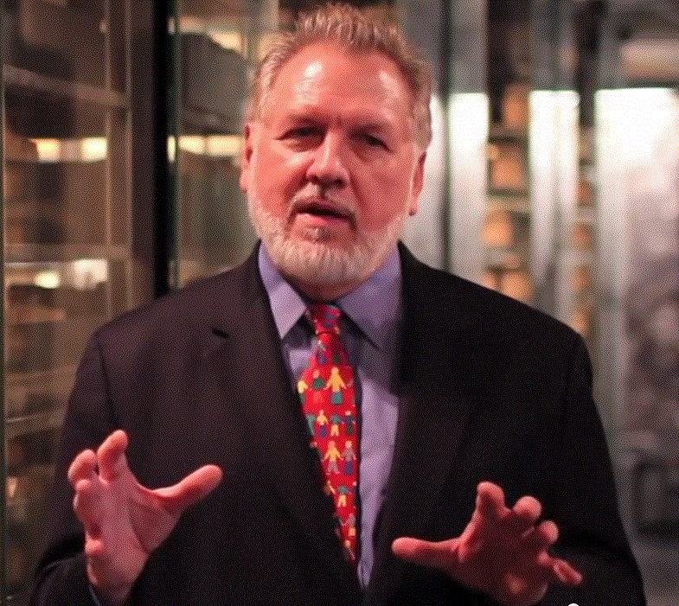
A Brief Introduction
13 Years on Wall Street
10 Years in management consulting
17 years in NGOs
Former Global CIO at IFRC
Former CIO at STC/US & UK
Co-founder and former Chairman of NetHope.org
More on LinkedIn, Google and www.eghapp.com
Connect!
Notes:
When I was 38, I read a comment by Handy saying we could expect to have 5 careers; for the millennials, they can expect to have 14 jobs…by the time they are 38! (see https://www.youtube.com/watch?v=XrJjfDUzD7M at 02:15)
http://www.amazon.com/The-Age-Unreason-Charles-Handy/dp/0875843018
Charles Handy, http://www.texasventures.us/india/images/leader2_1.jpg …five careers

Slide 3
Crisis

Slide 4
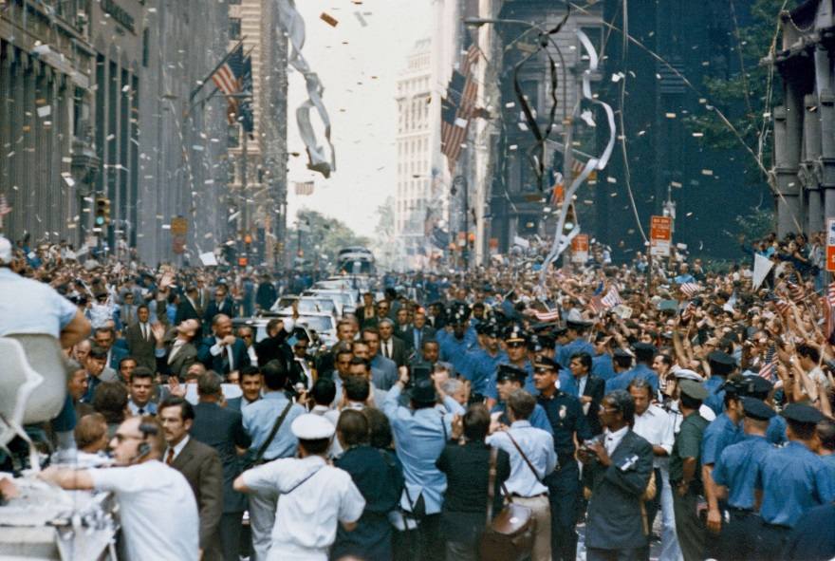
A Story…
About the 1984 Olympics tickertape parade
in downtown NYC…
“…what was meant to be an unalloyed celebration was frozen for a terrible half hour of panic and confusion when part of a sidewalk scaffold on lower Broadway collapsed, injuring about 100 spectators as they awaited the athletes.“ –NY Times, August 16, 1984
Notes:
… the construction roof collapsing on Carolyn and me on Broadway as we awaited seeing Marylou Retton. Handling personal crisis.
TICKER TAPE AND CHEERS GREET OLYMPIC MEDALISTS
By DAVID W. DUNLAP
NY Times, Published: August 16, 1984
http://www.nytimes.com/1984/08/16/nyregion/ticker-tape-and-cheers-greet-olympic-medalists.html
“…what was meant to be an unalloyed celebration was frozen for a terrible half hour of panic and confusion when part of a sidewalk scaffold on lower Broadway collapsed, injuring about 100 spectators as they awaited the athletes."
"Pure patriotism was not the only sentiment coming from the crowd. By their shouts and signs, it was clear that the first among equals in New York's affection was Mary Lou Retton, the winner of four individual medals - one gold - and a gold team medal in gymnastics.“
Note that the photo is for the Apollo 11 parade, August 1969 https://en.wikipedia.org/wiki/List_of_ticker-tape_parades_in_New_York_City

Slide 5
Crisis – a definition
crisis
[krahy-sis]
noun, plural crises [krahy-seez] (Show IPA)
a stage in a sequence of events at which the trend of all future events, especially for better or for worse, is determined; turning point.
a condition of instability or danger, as in social, economic, political, or international affairs, leading to a decisive change.
a dramatic emotional or circumstantial upheaval in a person's life.
Medicine/Medical. a. the point in the course of a serious disease at which a decisive change occurs, leading either to recovery or to death. b. the change itself.
the point in a play or story at which hostile elements are most tensely opposed to each other.

Slide 6
Semantic Change…
“Originally, crisis denoted ‘the turning point for better or worse in an acute disease or fever.’ Now it most commonly means ‘a difficult or dangerous situation that needs serious attention’” -- Merriam Webster

Slide 7
In short
A crisis is a shock to the system, whether personal, economic, political or a natural disaster

Slide 8

Crisis misunderstood
“In the Chinese language, the word "crisis" is composed of two characters, one representing danger and the other, opportunity.” –JFK, April 1959
…while wei means danger, “Mair says that the jī element of wēijī is semantically neutral and better understood as "incipient moment…” Benjamin Zimmer, March 2007
or in short, a “dawning danger”
Notes:
Benjamin Zimmer, “Crisis = danger + opportunity: The plot thickens,” March 27, 2007

Slide 9
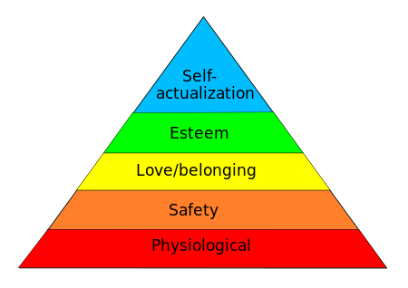
An implied definition from Maslow’s Hierarchy of Needs
Crisis
Development
A crisis is the absence of need fulfilment beyond safety and physiological
Notes:
https://en.wikipedia.org/wiki/Maslow%27s_hierarchy_of_needs

Slide 10
Crisis Needs
1) Is my family OK?
2) Can I get food, water, shelter?
3) Can we communicate? (Voice/Data)
Notes:
10

Slide 11
Crisis Management Changes Things
Notes:
Work\2017\Crisis Management Matrix v1.xlsx

Slide 12
Resilience

Slide 13
Resilience – A Definition
resilience
or resiliency
[ri-zil-yuh ns, -zil-ee-uh ns]
noun
the power or ability to return to the original form, position, etc., after being bent, compressed, or stretched; elasticity.
ability to recover readily from illness, depression, adversity, or the like; buoyancy.
Origin of resilience
1620-30; < Latin resili (ēns), present participle of resilīre to spring back, rebound (see resilient ) + -ence
Notes:
http://www.dictionary.com/browse/resilience

Slide 14
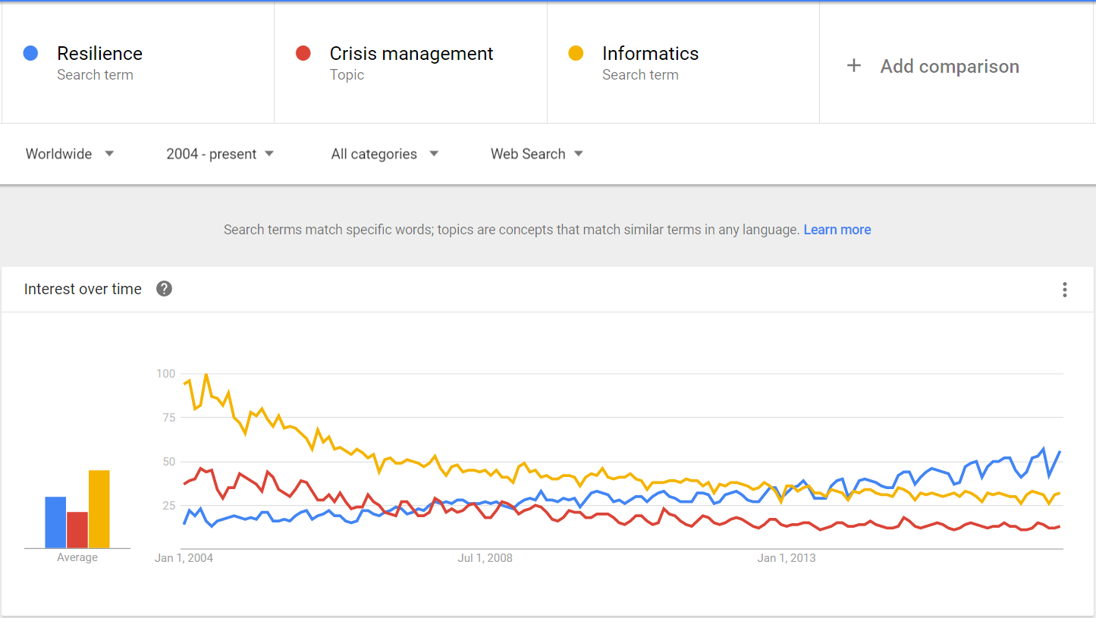
Some trends, courtesy of Google
Notes:
https://www.google.com/trends/explore?date=all&q=resilience,informatics,%2Fm%2F01yz51

Slide 15
The Red Cross/Red Crescent…
“The IFRC defines resilience as, “the ability of individuals, communities, organizations or countries exposed to disasters, crises and underlying vulnerabilities to anticipate, prepare for, reduce the impact of, cope with and recover from the effects of shocks and stresses without compromising their long-term prospects.”
--IFRC Framework for Community Resilience, 2014, p. 6
Notes:
http://www.ifrc.org/Global/Documents/Secretariat/201501/1284000-Framework%20for%20Community%20Resilience-EN-LR.pdf

Slide 16
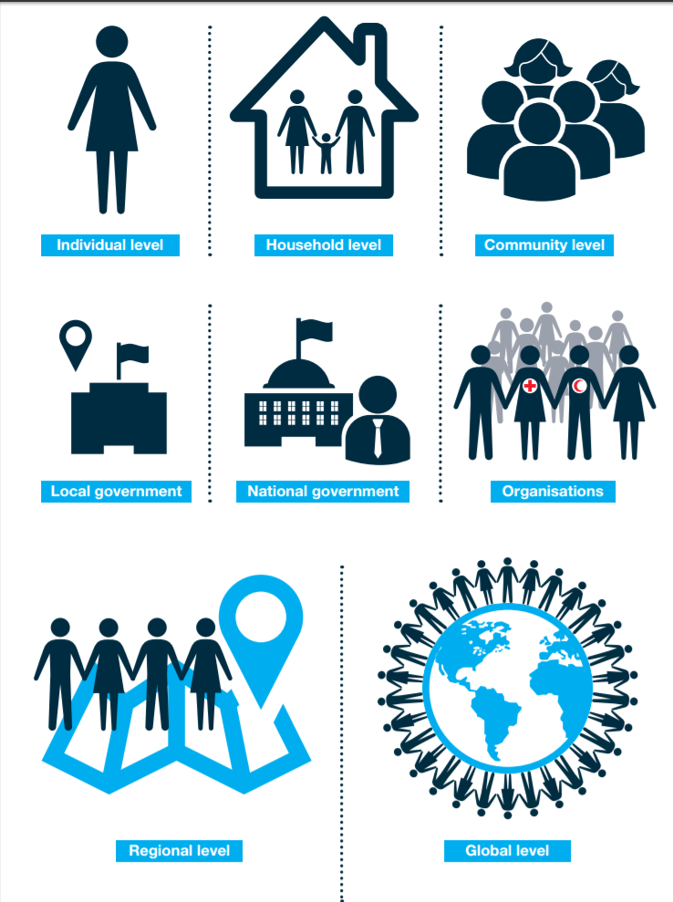
Resilience at Multiple Levels
Individual level
Household level
Community level
Local government
National government
Organizations such as National Societies including their branches and volunteers
Regional and global levels

Slide 17
Crisis Informatics –
A Preview

Slide 18
We propose to look at crisis and resilience as a continuum
Individual
Organizational
Community/ Regional
International

Slide 19

IT and Crisis – a Framework
Scope
Time
Severity
Notes:
http://ecx.images-amazon.com/images/I/51ILWP8TZqL.jpg

Slide 20
IT and Crisis – a Framework
Sample disasters
Scope vs. Severity | Mild | Moderate | Severe | Catastrophic
Individual | Finals? | Lost in wilderness hike | House burns down | Incapacitating car accident
Organizational | Short-term network outage | Payroll system failure | Denver Airport Baggage System | 911 (Cantor Fitzgerald)
Community/ Regional | One-day taxi strike | Blizzard of '78 | Hurricane Katrina, Sandy | Haiti Earthquake
International | Seasonal Flu | 2016 US Elections? | Syrian Refugees | WWII

Slide 21
IT and Crisis – a Framework
Technology Overlay
Scope vs. Severity | Mild | Moderate | Severe | Catastrophic
Individual | ebooks | GPS | First Aid app; Airbnb | ??
Organizational | 4G/LTE | Manual system | Pull the plug; cut your losses | BCP geographic diversity; cloud systems and data
Community/ Regional | Uber | Facebook warnings | IPAWS - Integrated Public Alert and Warning System | Help Me apps??
International | Flu shot, travel masks | Canada | Smartphone info-flow; Whatsapp, etc. | ??

Slide 22
IT and Crisis – Time & Shifts
time is another dimension to the framework
Ranking factors 1-4, 1=highest
Emergency Response, Transition, and Development phases
22
Notes:
Changing Priorities by Program Type v3.xls

Slide 23
Timeline of a Disaster Response
Stage 0: Preparedness
  Example: Typhoon preparedness in Bangladesh
  This is the best investment (5:1)
Stage 1: Within hours of disaster striking
  Example: CRS in sectarian fighting in eastern Congo
  This is the Highly Individual, Highly Mobile ICT stage
Stage 2: Within two weeks of disaster striking
  Example: Relief International in Bam, Iran earthquake
  Small Group, Highly Mobile/Temporary ICT stage
Stage 3 – From one-six months following a disaster striking to multi-year.
  Large Group - Permanent ICT stage
Stage 4 – Learning
  Example: NetHope members in Pakistan earthquake response
  Don’t waste mistakes
23
Notes:
Bangladesh cyclone: 3,000 fatalities in 2007 versus 138 000 in 1991 and 500,000 in 1970
Factor of 50-100 reduction due to advance evacuation of 3.2M people and stockpiles of relief supplies, i.e. disaster preparedness! (see http://fe4.news.re3.yahoo.com/s/time/20071119/wl_time/howbangladeshsurvivedthecyclone )

Slide 24
Phases of a Disaster Response
Preparedness
First Response
Scaling up
Transition
Learning
Stage 0
Stage 4
Stage 1
Stage 3
Stage 2
24

Slide 25
Some questions
Are the low/high technology solutions fit-for-purpose?
Are these solutions in search of a problem?
What other examples come to mind?
Do the cultural and infrastructure contexts matter?

Slide 26
IT and Crisis – Questions and Factors
How many? -> Scope
How much? -> Severity
When? -> DR Phase
Where?-> geo-political context

Slide 27
Questions For You…

Slide 28
For the Crisis Informatics Course…
What types of crises are more interesting?
What types of crisis response would you want to be involved in?
How many of you have experienced personal crises? What types?
What are your coping strategies? How have you stayed resilient?
What mix of projects, discussions, lectures and small group work feels right?
What is the right mix of reading: cases, stories, texts, articles?
How should the grading be structured?
What would you need to know and be able to do for you to feel this course was a success?
What one thing would make you want take this course?
How would you market this course to your peers?

Slide 29
The ACCI
A Student Advisory Committee for Crisis Informatics (ACCI) is being created.
This ad hoc committee of students will help to create the syllabus for this new course.
The ACCI will begin small group meetings (initially weekly, then as needed)
And start a wiki to develop relevant materials.
Prospective members should express their interest to Ed Happ ehapp@umich.edu
--Terms of Reference, “ACCI,” February, 2017

Slide 30
Further Reading
Blogs:
http://eghapp.blogspot.com/ (Current)
http://granger-happ.blogspot.com/ (Dartmouth Sabbatical)
Web site (see the articles & presentations link) http://www.eghapp.com
Email: ehapp@ifrc.org
Twitter: @ehapp
LinkedIn: http://www.linkedin.com/profile/view?id=1906312
Books: Managing Technology to Meet Your Mission, chap. 11
  We are Better Together, http://collaboration-book-project.blogspot.com/

Slide 31
Notes:
https://www.si.umich.edu/

