Slide 1
IT Leadership Insights and NGO Work
Edward G. Happ
Executive Fellow, UMSI
Korean Red Cross, Wonju, S. Korea
July 30, 2019

Slide 2
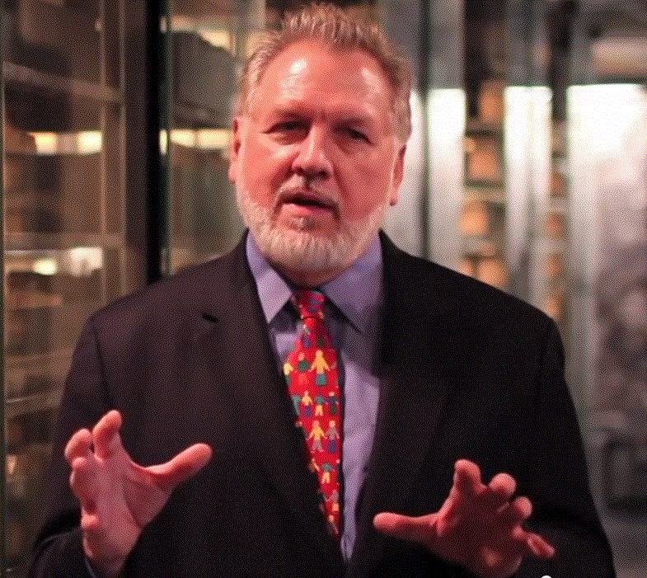
Who I Am…
40 years in IT, 38 in IT mgmt
13 Years on Wall Street
10 Years in management consulting
17 years in NGOs
2 Years Exec. Fellow at UM
Former Global CIO at IFRC
Former CIO at STC/US & UK
Co-founder and former Chairman of NetHope.org
More on LinkedIn, Google and www.eghapp.com
Connect!
Making Connections for Good
– People, Comm’s, Ideas
Notes:
When I was 38, I read a comment by Handy saying we could expect to have 5 careers;
For the millennials, US Dept. of Labor estimates you can expect to have 14 jobs…by the time they are 38! (see https://www.youtube.com/watch?v=XrJjfDUzD7M at 02:15)
http://www.amazon.com/The-Age-Unreason-Charles-Handy/dp/0875843018
Charles Handy, http://www.texasventures.us/india/images/leader2_1.jpg …five careers

Slide 3
The Request
“I would like to talk about your experience in IT + humanitarian activities and how to be a good leader in RedCross.” —Minyoung Choi
This is an audience need… leadership 101!

Slide 4
Quick Audience Poll
  How many of you work in IT?
  How many use IT in your work?
  How many have worked in a corporation before your current job?
  How many plan to go back to school, whether in a university or via online courses?

Slide 5
What is the question for today?
If you aspire to be a (better) IT leader in an NGO,
What do you need to know?

Slide 6
Tentative Agenda
Handling Ambiguity
Personal Journey
Future Research

Slide 7
1. A Personal Journey

Slide 8
A Personal Timeline
IFRC
Net Hope+
STC
UMSI
IT Manager, Wall Street
Consulting Partner
Global CIO
Teacher/ Researcher
Writer
Oenophile
Chapter 1
Chapter 2
Chapter 3
Chapter 4
Chapter 5
1977
1991
2000
2017
Today
20??

Slide 9
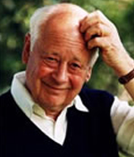
Why all these chapters?
When I was 38, I read a comment by Charles Handy saying we could expect to have 5 careers in our lifetime
So I started thinking in terms of 5 chapters to my career. I’m in chapter 4 now.
For my students, the US Dept. of Labor estimates they can expect to have 14 jobs… by the time they are 38! *
*see https://www.youtube.com/watch?v=XrJjfDUzD7M at 02:15
Notes:
(see https://www.youtube.com/watch?v=XrJjfDUzD7M at 02:15)
http://www.amazon.com/The-Age-Unreason-Charles-Handy/dp/0875843018
Charles Handy, http://www.texasventures.us/india/images/leader2_1.jpg …five careers

Slide 10
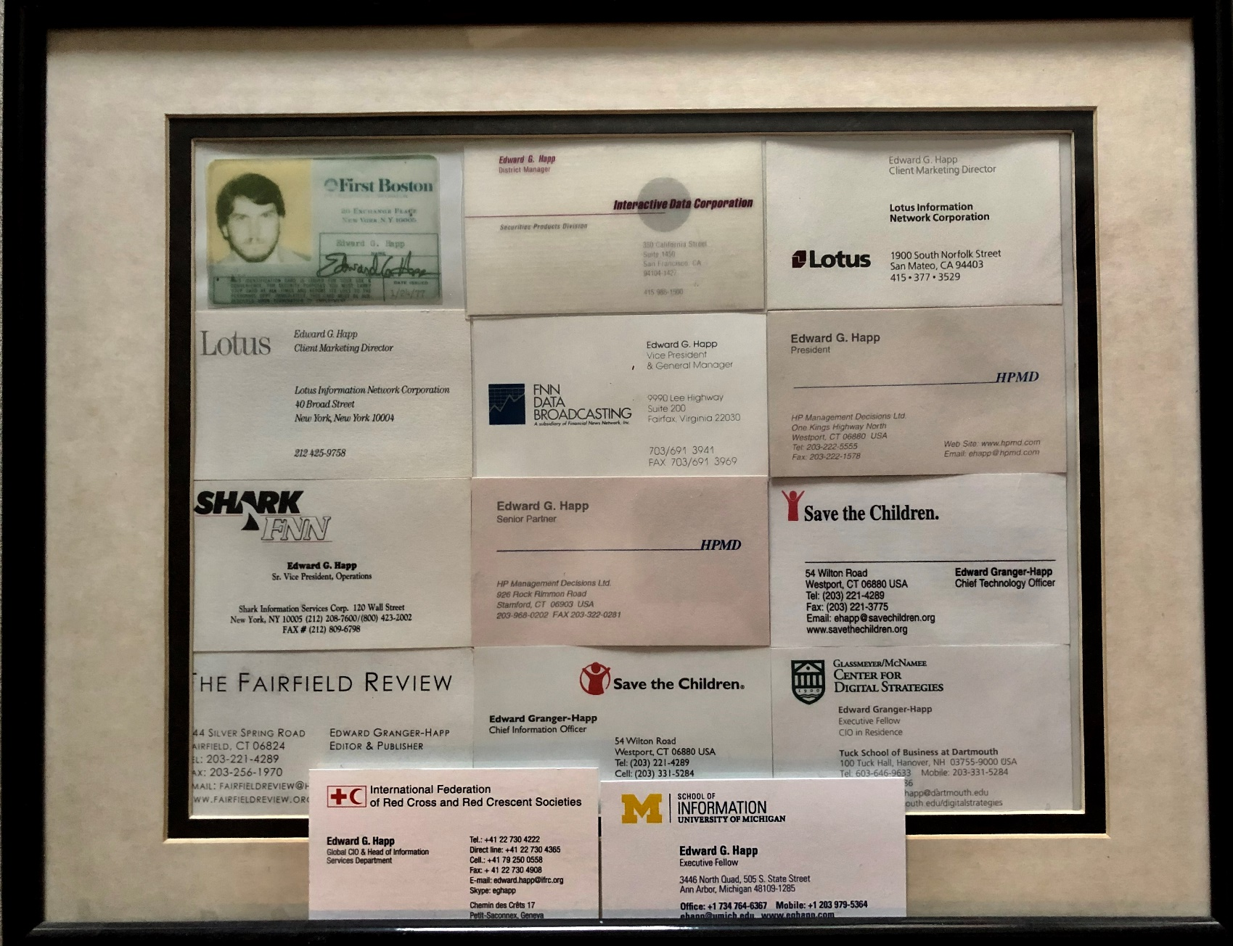
4 Chapters, 14 Roles…
So maybe I’m a Millennial in disguise?

Slide 11
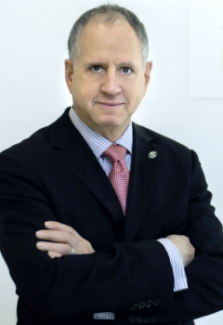
Advice from a Wall Street customer
Then CEO of a Wall St. data provider and director at Outward Bound (an NGO)
When I told him I was joining Save the Children, he said “I give you about a year.”
Why?
“You’ll be too frustrated with the pace of decision-making”
He was right about the frustration, but wrong about the year
I end up working 17 years at NGOs and still volunteer!
Notes:
Ken Marlin, Telesphere CEO, ~1998

Slide 12
Why & how did I get into nonprofit work?
When will your agenda shift?
I had run a small consulting business for 10 years advising companies on their IT plans and projects
I missed being part of a team that saw projects thru to their end
I had just turned 48 years old and my agenda was shifting from success to significance
It was time for a change
I saw an ad in The NY Times that Save the Children, HQ near my home, was looking to hire their first CIO
This would combine my technology, business and charitable interests
I asked my friends and colleagues who knew about nonprofit work; they all said “you have to do this!”
I believed in the mission; the work here mattered!

Slide 13

Advice from an NGO executive
VP of HR at a leading international NGO.
I asked, “You could be VP of any corporation and earn 3x the money; why are you here?”
He answered, “What I tell people about this job: you are working at a place where you are highly valued for what you bring, and where each day you can have impact that matters, globally”
The mission matters
Notes:
LTYM #169
“What I tell people about Save: working at a place where you are highly valued for what you bring, and where each day you can have impact that matters, globally (Rod Davis' story.)
Or http://www.hpmd.com/hpmd/personal/LTYMstories.nsf/links/nnn

Slide 14

Advice from an NGO COO
COO (#2) at a leading international child-focused NGO.
She sent around a poster that I hung in my office so I would see it every day
The poster said, “If you’re not serving a child, you’re serving someone who is.”
In IT we help people get their jobs done

Slide 15
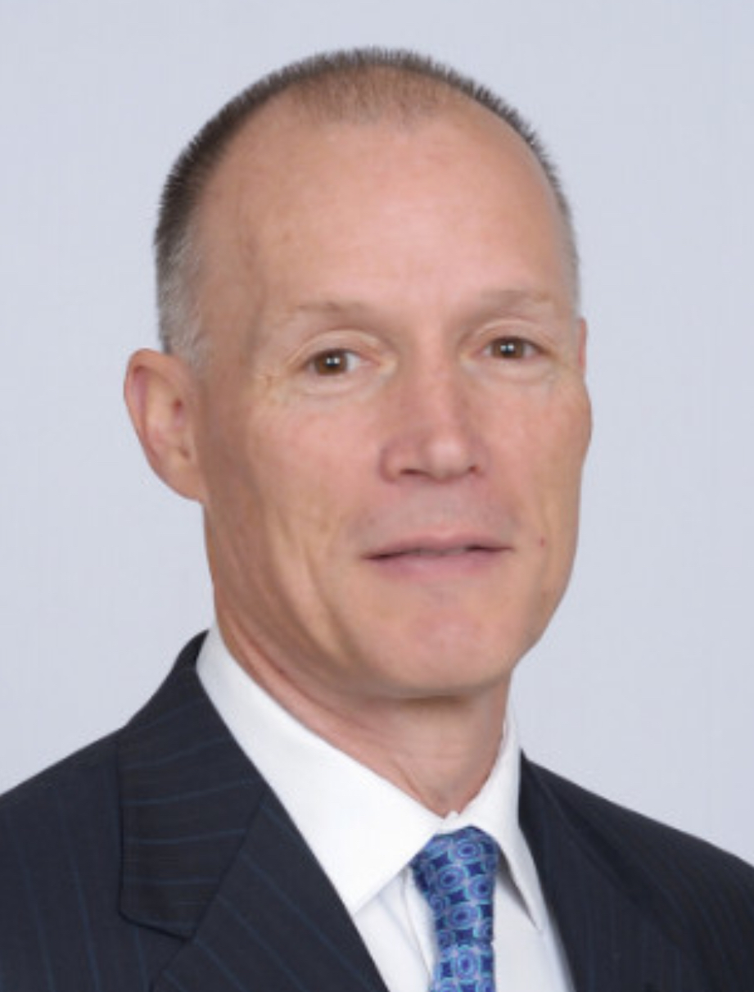
Advice from an NGO CIO
CIO at a leading international NGO.
I asked, “What’s your driver for IT?”
He answered, “When we make good decisions in IT, more kids get fed.”
The mission matters
IT has a “mission-moving” motivation
Notes:
LTYM #57
http://www.hpmd.com/hpmd/personal/LTYMstories.nsf/links/057

Slide 16

The Scream
CIO’s first public board meeting.
Many life-time donors invited and were sitting in front row.
Presentation to board on smart decision he made to cancel a large, failing IT project
80-year donor raised her hand and asked how much had been spent on this project?
1.9 million dollars, he answered, and turned to screen to continue
Interrupted by a shriek and wail from this octogenarian. "You've just spent my entire lifetime of donations on a mistake!“
He was stunned; audience fell silent as the distraught donor was escorted from room.
He resolved to always think about IT projects in terms of donor-years and donor-lifetimes
Notes:
Photo credit: https://www.scarletmarketeer.com/my-blog-the-scarlet-letter
LTYM #278

Slide 17
Letters To a Young Manager (LTYM)
Why should leaders tell stories? They are retold.
I started keeping track of stories like “The Scream” in 2005 after hearing Steve Denning talk about the power of narrative leadership at a NetHope Summit.
I now have a database of over 500 stories, each illustrating an issue about managing IT (or most any organization)
Each is wrapped in a letter to two first-time supervisors in response to a question he or she asked asked, hence “Letters To a Young Manager”.
See http://www.hpmd.com/hpmd/personal/LTYMstories.nsf/vwBook
Or http://www.hpmd.com/hpmd/personal/LTYMstories.nsf/links/nnn where “nnn” = the letter story number.

Slide 18
2. Handling Ambiguity - An Intro

Slide 19
What is Ambiguity?
Think Options!
Ambiguity: “the quality of being open to more than one interpretation; inexactness” —Google
Ambiguous: “capable of being understood in two or more possible senses or ways; an ambiguous smile; an ambiguous term; a deliberately ambiguous reply” –Merriam Webster

Slide 20

Professor Moreno
Q1: How can you tell if the dough is mixed well?
“Close your eyes and touch the dough. Think of [something beautiful] and touch the dough. You will know when it’s ready.”
Q2: How do you know when the dough is thin enough?
“You can see the grain of the table through it”
“For most dishes, you need to taste and adjust, taste and adjust.
But for pastry you must follow the recipe.”
Notes:
LTYM #488

Slide 21
Most of business (including technology) is about making pasta, not pastry
…in other words, handling ambiguity

Slide 22

What about the crisis immersion lab?
The immersion lab we run on the first day of SI-537 is inherently ambiguous
It requires improvising: having a process to figure out what to do next
Do you mean we have to plan for the unplanned?
Exactly!
To read more about the crisis immersion lab, see the “ACM Interactions” article:
http://interactions.acm.org/archive/view/may-june-2018/the-connectivity-lab-umsi

Slide 23
Why is it important to be able to handle ambiguity?
Everyone in leadership expects you to be able to handle ambiguous situations and projects
It’s an opportunity to prove your value-add
It shows you can break down a problem and propose options for decision-making

Slide 24
The Amazon Interview Case
A question was posted on Quora.com by a developer who had failed the Amazon on-site interview.
They asked Quora readers for advice about what to do next
One of the responders was Matt Kellner, a software engineer from the Seattle area, who previously worked for Amazon and has been on both sides of the interview table.
He notes that the line of questioning where an interviewee “locked up” is typical at tech companies. It’s deliberately ambiguous. It creates a mini-crisis to see how the applicant handles it.
Bottom line: companies are looking for candidates who can handle ambiguity. It’s not only for solving open-ended problems internal to the organization; often customers do not know exactly what they want and are not particularly adept at providing focused requirements. In fact, one could argue that in the realm of customers, whether internal or external, perfect requirements don’t exist. So handling ambiguity is fundamental to tech-related work.
Notes:
See The Amazon Interview Case.pdf

Slide 25
Amazon Interview Case (cont.)
The 3x3 Summary
Take-aways
Modern tech interviews create a mini crisis to see how candidates handle ambiguity
Many candidates freeze up
The successful ones ask clarifying questions and talk about the thought process they would follow
Questions
If there are no perfect requirements, how can you solve customer problems?
Should you admit to a customer (or interviewer) that there is not a clear way forward?
Is this an opportunity to talk about options and their pros/cons?

Slide 26
Some relevant quotes
Options Again!
“The character of human life, like the character of the human condition, like the character of all life, is "ambiguity": the inseparable mixture of good and evil, the true and false, the creative and destructive forces-both individual and social.” --Paul Tillich
“Take advantage of the ambiguity in the world. Look at something and think what else it might be.” --Roger von Oech

Slide 27
This duality is reflected in our work with alternate disaster plans: the importance of having an a-plan, b-plan in preparing for crisis, and in thinking through options in our project challenges…
there is no one answer when it comes to crisis…
it depends on the context

Slide 28
Disasters are by their very nature ambiguous.
The normal course of things,
even our best laid plans,
are derailed.
Disaster response is about handling ambiguity.

Slide 29
How can we deal with ambiguity?
Techniques from the Apollo 13 Case
Clarify the problem and the options
Gain a better understanding of the context
Use the tools we’ve learned to break down crises
    Situation awareness & context >> have & don’t have - inventory
    Assumptions and approach >>know & don’t know
    Break it down, get it organized, build an MVP (Apollo 13 filter) >> the task
    Keeping the end goal in mind >> bottom line!
    A- and B-plans >> options!
    Decision trees >> decision-making
    Roles >> incident commander & backup

Slide 30
2b. An Example From My Experience at the Red Cross

Slide 31
The Case of the EOC
Sound ambiguous?
SG returns from trip to UNICEF, where he got a tour of their Emergency Operations Center (an EOC)
His assignment: build us an EOC fast, like the UNICEF one
Problem: no specs, no use cases, weak comparison
Break it down: how much time, how much budget?
Spend what you need to. Show me something in <90 days.
Meeting with USG of Disaster Management:
    When crisis occurs, what are the top questions you need to answer?...
    What are the details for this EVENT? (Are we matching size of response to size of disaster?)
    What are the ASSETS and resources we can bring to bear?
    What PROGRESS and decisions are being made?
    How are we INFORMING others?

Slide 32
The Case of the EOC (cont.)
Senior Management agreed to a two track approach:
Track one – Develop EOC prototype using existing data sources and setup EOC room in HQ (An MVP demo in 90 days)
Track two – a needs analysis and consultative study process to clarify the specific purpose, business processes and options for establishing an EOC and related Emergency Operations Centre Network servicing National Societies and the Secretariat locally, regionally and globally (An analysis and plan in parallel in 6 mo’s; implementation to follow.)

Slide 33
The Case of the EOC (cont.)
Form a small cross-functional team of our best people
While we were working out a design to answer the USG’s top questions, we saw two opportunities:
Reorient and standardize our data collection in the field into feeds that can readily be used for analytics and decision support
Develop a virtual EOC that can run anywhere on a laptop or tablet
We delivered our MVP demo in exactly 90 days and built the opportunity into Track Two.

Slide 34
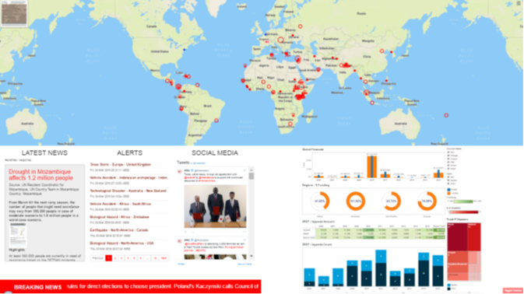
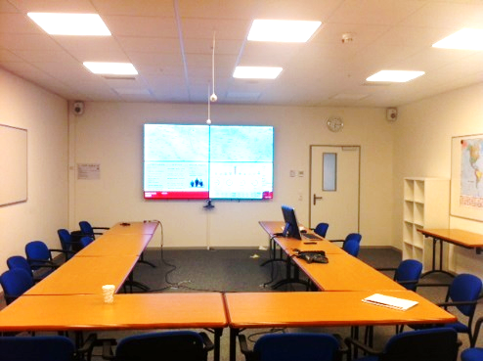
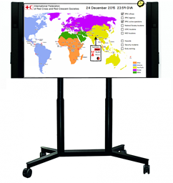

Track One Deliverables
Prototype Web Application
EOC Room
Mobile Touchscreen
EOC web application with interactive map, country & operations info, news alerts, and global financial dashboard.
EOC will act as a daily information coordination place to help operational team to answer to a disaster
Interactive display of EOC application available for small groups to view and discuss around the IFRC office. E.g. Front desk / reception area, SG office, etc.

Slide 35
2c.Ambiguity – Concluding Question

Slide 36
Where do you want to be?
A scripted, recipe approach?
A creative, freedom of expression approach?

Slide 37
In Conclusion:
Use Crisis Informatics Building Blocks
Situation awareness & context
Assumptions and approach
Break it down, get it organized, build an MVP (Apollo 13 filter)
Keeping the end goal in mind
A- and B-plans - options
Decision trees
Organize roles

Slide 38
3. Leadership and the Future

Slide 39
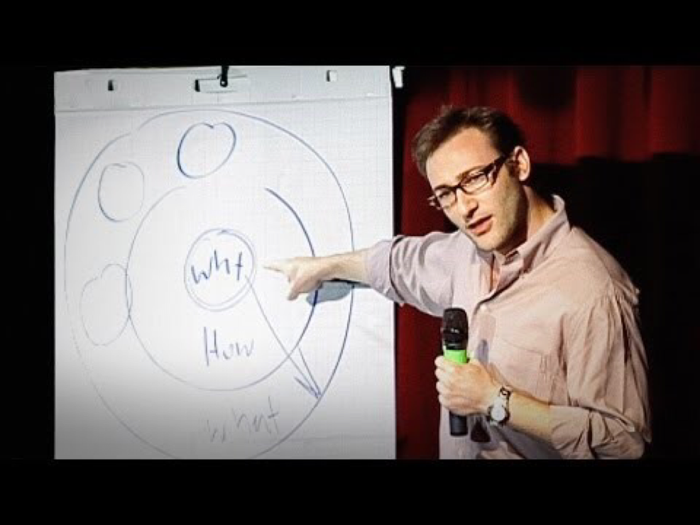
The Key Question for the IT Leader
Not WHAT
Or HOW
But WHY
What is the Why of NGO IT?
To move the IT agenda to be more mission moving IT...

Slide 40
An NGO IT Strategy Approach
Get in
Competitive
or Leading
BENEFICIARY
“Differentiating”
Increasing Impact for Beneficiaries
PROGRAM
“Improving Program Delivery”
Increasing Mission Impact
Move up
OPERATIONAL
“Helping the Organization Run”
Efficient
FOUNDATIONAL
“Keeping the Lights On”
Get out

Slide 41
Why Study Leadership and Management?
Some of you will attain the highest IT Management Position (currently the CIO)
All of you will lead a project
All of you will work with people in IT
All of you will work for a manager
All of you will practice influence management

Slide 42
3b. Future Trends - Aspects of Data Science

Slide 43
Data 1.0, 2.0, 3.0++
Data 1.0 – In your organization you gather a lot of data, and don’t do a lot with that data. People work on their projects/programs and the information is around the donor or grant. You do not share data very well, and mostly what you use is a spreadsheet – like Excel.
Data 2.0 – In your organization, there is data easily shared between teams. You can see budgets and where people are w/re to the projects/programs they are working on. Data is shared broadly through tools and BI.
Data 3.0++ – In your organization, you are very agile – you have extensive networks and use your data well, but also use external data. You make decisions and changes based on what is working and what isn’t working and you are able to do so real-time. You receive beneficiary data to make your organization better. You can start using this data to feed into machine learning/AI.
Notes:
Data Skills Workshop v5.pptx

Slide 44

The New UMSI Online Degree Program

Slide 45
The Why?
“The demand for data scientists has grown dramatically in the past decade and it will continue to grow far beyond our capacity to accommodate students in a traditional classroom setting.” –Dean Thomas A. Finholt
“Universities are not graduating data analysts fast enough for 10x growth by 2020” –Cindi Howson, Gartner VP
“…by 2018 the number of data science jobs in the United States alone will exceed 490,000, but there will be fewer than 200,000 available data scientists to fill these positions. Globally, demand for data scientists is projected to exceed supply by more than 50 percent by 2018.” –Amy Gershkoff, TechCrunch
Notes:
Quote from Cindi Howson is from the Gartner CIO Conference in Toronto, June 2017.
https://techcrunch.com/2015/12/31/how-to-stem-the-global-shortage-of-data-scientists/

Slide 46
The Net Forecast?
The NGO – Corporate analytics gap will widen
The skills deficit will be in more areas than first forecast
Across all sectors, the demand will drive a democratization of data analytics
  As we all became financial analysts with spreadsheets in the 1980’s so with DS in the 2020’s
The demand for the “soft” consultative skills will rise (the DS analysts as end-user coach)
AI will play an increasing role in bridging the gap

Slide 47
My Three NGO-Focus Initiatives; planning for future means running experiments
The Crisis Immersion Lab
  Simulations for Crisis Informatics Class and NGOs
  Portable AR/VR version to be tested this next semester
The Data4Good Center
  Data sets for NGO research
  Started with 17 years of NGO IT surveys and 18 months of refugee Internet data
  Next is AI analysis of 20 years of NGO narrative reports for themes, trends and unexpected correlations
The NetHope - UMSI Internship Program
  MSI students, NetHope members and tech co’s work on an NGO IT project for the summer
  Looking to grow next year from initial pilot

Slide 48
3c. Applying the RC Fundamental Principles

Slide 49
ICTs and the Fundamental Principles
“The Fundamental Principles of the Red Cross Red Crescent Movement provide a rich set of guidelines for discussing how information and communications technologies (ICTs) can be employed with humanitarian aims, and in particular the protection and benefit of vulnerable people.” --E. Happ & J. Mortimer, “ICTs and the Fundamental Principles” Oct. 2014
Notes:
E. Happ & J. Mortimer, “ICTs and the Fundamental Principles” Oct. 9, 2014, The fundamental principles and ICTs v3_1.docx
See more at: http://www.ifrc.org/who-we-are/vision-and-mission/the-seven-fundamental-principles

Slide 50
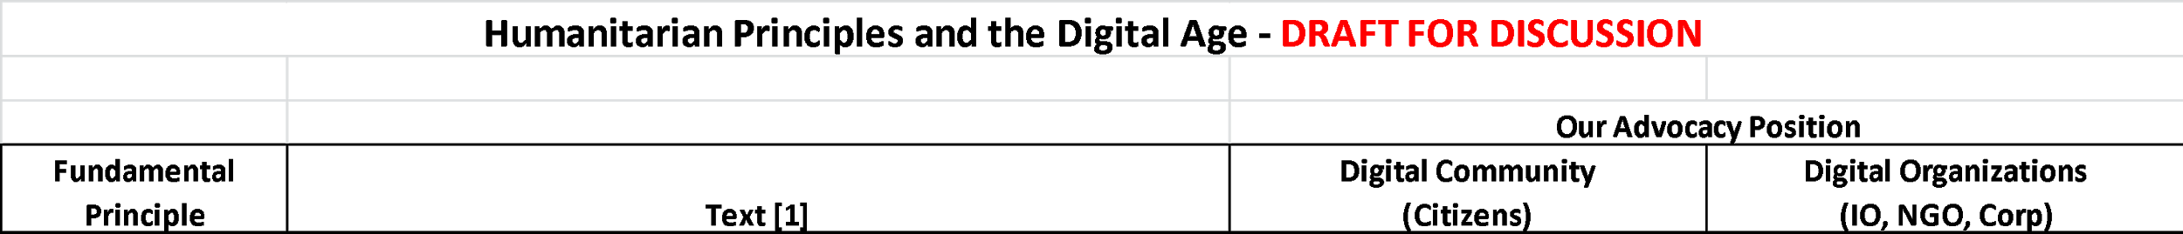
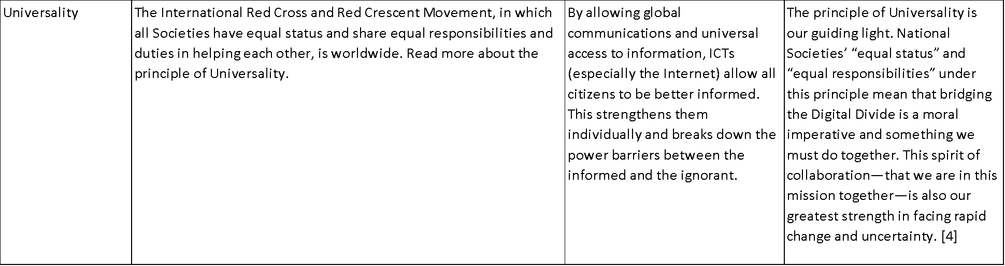
Digital Citizens and Organizations – two perspectives
See the paper
The principle of Universality is our guiding light. …under this principle means that bridging the Digital Divide is a moral imperative
E. Happ, “Humanitarian Principles and the Digital Age,” Dec. 14, 2014
Notes:
Work\2014\Humanitarian Principles and the Digital Age v4.xlsx ver. 5 update on 4/17/16

Slide 51

Questions?

Slide 53
Appendix

Slide 54
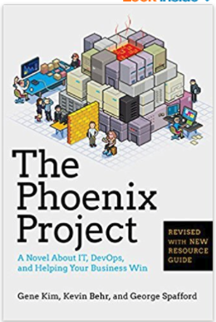
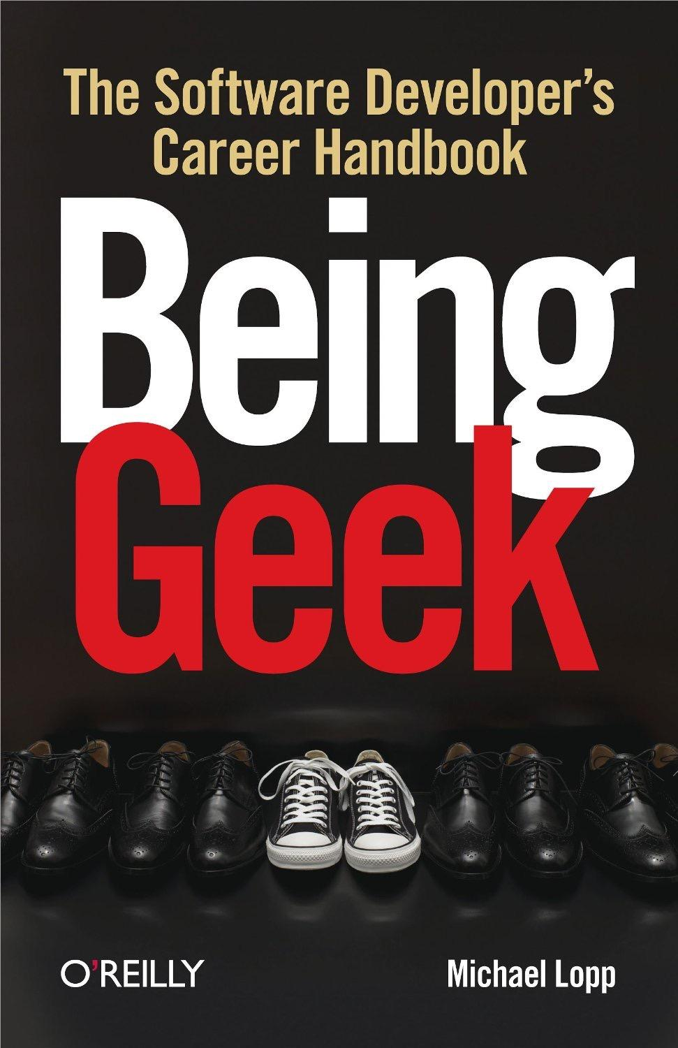
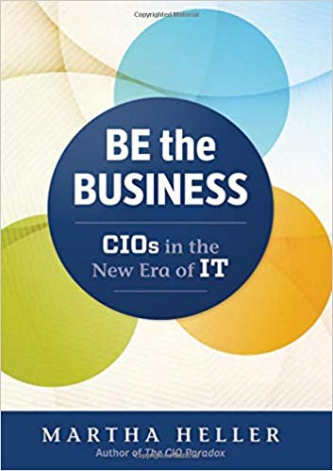
Primary Texts
For It Leadership & Management Course
Notes:
Gene Kim, Kevin Behr and George Spafford, The Phoenix Project: A novel about IT, DevOps, and helping your business win, IT Revolution Press, 2013
Michael Lopp, Being Geek: The software developer's career handbook, O'Reilly, 1st edition, 2010
Martha Heller, Be the Business: CIOs in the New Era of IT Hardcover, Routledge; 1st edition, 2017

Slide 55
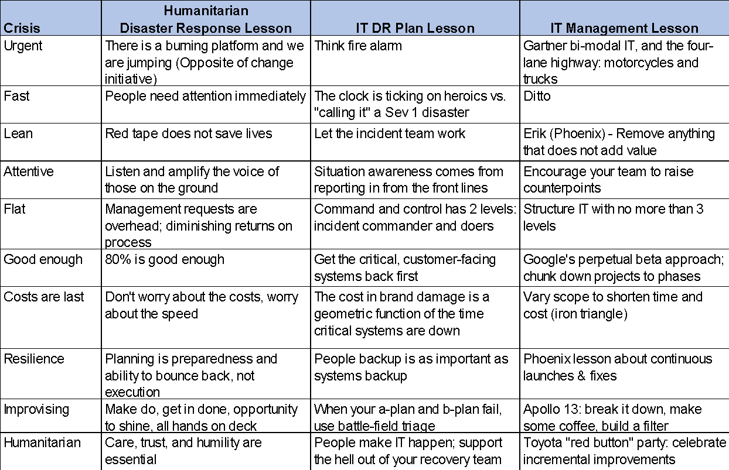
Crisis as an IT Paradigm (see handout)
Notes:
Crisis as an IT Paradigm v2.xlsx

Slide 56
3x3 Summaries
What: Each reading to be summarized with 2 slides:
  3 take-aways
  3 questions
  20 point font
Why: Finding the bottom line
    See my blog post: http://eghapp.blogspot.com/2011/07/finding-bottom-line.html
Notes:
See my blog post: http://eghapp.blogspot.com/2011/07/finding-bottom-line.html

Slide 57
Leadership and Management
"Management is doing things right. Leadership is doing the right things."
–Peter Drucker
Notes:
From the course catalog description

Slide 58

Why Are We Here?
CEO posed this question to MBA students at Harvard:
Why are you here?
After a pause, he said, “To make revenue grow!”
I would change the answer for NGOs: “To make our mission grow!”

