Slide 1
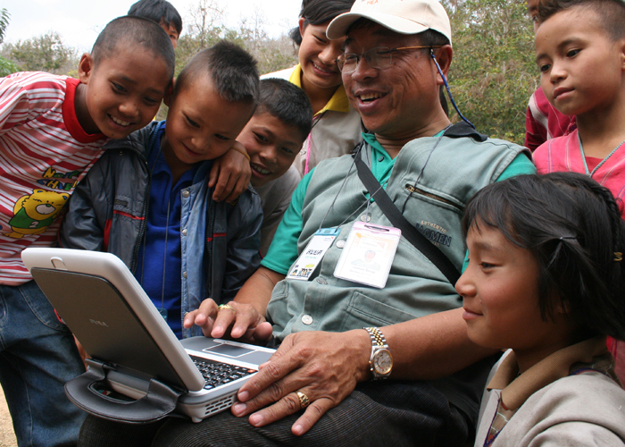
NetHope Chairman’s Report
Edward G. Happ, November 8, 2011

Slide 2
What’s My Goal?
I’d like to do 3 things today:
  Remind us of our roots and branches (as historian)
  Challenge us to do more and do better in our second decade (as strategist)
  Spark our imagination about collaboration (as storyteller)
If I stimulate your imagination and make you uncomfortable with some poke-in-the-eye questions, then I’ve done my job.

Slide 3
A Look Back & Look Forward
Founding Hypotheses
  Connecting, Collaborating and Partnering are still at our core
An Evolving Strategy
  Our strategy has gotten more complex; so have the drivers
Six Questions
  We’ve done well; we can do better
Next Challenges
  More “mission moving”, more empowering, more sustainable
The Future of Collaboration
  Amplify the need, value the scarcity, build on the social desire
Notes:
My job is to remind us of our origins, our stories and to ask some poke-in-the-eye questions; if I stimulate your imagination and make you uncomfortable, then I’ve done my job. I’d like to do 3 things: (a) Remind us of our roots and branches (as unofficial historian) (b)
Challenge us to do more and do better in our second decade, and (c) Spark our imagination about collaboration

Slide 4
Two Hypotheses

Slide 5
Two Hypotheses - 2001
We had to be able to solve the “last mile” problem (connectivity) faster, cheaper, better if we did it together.
We would be a much more interesting partner to the technology companies on whom we depend, if we came as a group rather than the one-off, hat-in-hat organizations we had been.

Slide 6
An Evolving Strategy

Slide 7
NetHope Strategic Direction - 2002
Prime
Members
Domain
The Horizontal
Frontier
1
NetHope began in quadrant 1, for example providing connectivity to members
Beneficiaries
2
The Horizontal Frontier
3
2
Customer
3
NetHope’s supports and enables through technology but does not provide programs to the beneficiary since this is the members’ role
The Vertical
Frontier
Primary
NetHope
Domain
(e.g. Phase I VSATs)
Members
4
The Vertical Frontier
4
1
Vertical
(e.g. program sectors)
Horizontal
(e.g. tools & platforms)
Strategic Thrust

Slide 8
NetHope Strategic Direction - 2008
With NetHope’s extension of impact to the beneficiary,
it is important to define how NetHope complements member NGOs
Prime
Members
Domain
New NetHope
growth area
(e.g. VNK)
1
NetHope began in quadrant 1, for example providing connectivity to members
Beneficiaries
Primary growth area for NetHope leveraging strength in quadrant 1
2
3
2
Customer
3
NetHope’s supports and enables through technology but does not provide programs to the beneficiary since this is the members’ role
Secondary
NetHope Domain
(e.g. ICT Skill Building,
Shared Services)
Primary
NetHope
Domain
(e.g. Phase I VSATs)
Members
4
Secondary growth area for NetHope
4
1
Vertical
(e.g. program sectors)
Horizontal
(e.g. tools & platforms)
Strategic Thrust

Slide 9
NetHope Strategic Direction - 2011
Prime Members
Domain
NetHope
growth area
(e.g. ICT4D)
1
NetHope began in quadrant 1, for example providing connectivity to members
3
Beneficiaries
New
NetHope
growth area
(e.g. NH Academy)
Primary growth area for NetHope leveraging strength in quadrant 1
2
2
Customer
3
NetHope’s supports and enables through technology but does not provide programs to the beneficiary since this is the members’ role
NetHope
Domain
(e.g.
Shared Services)
Primary
NetHope
Domain
(e.g. Phase II VSATs)
Members
4
Secondary growth area for NetHope
4
1
Vertical
(e.g. program sectors)
Horizontal
(e.g. tools & platforms)
Strategic Thrust

Slide 10
NetHope Strategic Direction – 2014?
Prime Members
Domain
NetHope
Domain
(e.g. ICT4D)
1
NetHope began in quadrant 1, for example providing connectivity to members
3
Beneficiaries
NetHope
growth area
(e.g. NH Academy)
Primary growth area for NetHope leveraging strength in quadrant 1
2
2
Customer
3
NetHope’s supports and enables through technology but does not provide programs to the beneficiary since this is the members’ role
NetHope
Domain
(e.g.
Shared Services)
NetHope
Domain
(e.g. Phase II
VSATs)
Loss or Fulfillment
of Infrastructure
Foundation?
Members
1
4
Secondary growth area for NetHope
4
Vertical
(e.g. program sectors)
Horizontal
(e.g. tools & platforms)
Strategic Thrust

Slide 11
Six Questions

Slide 12
Six questions for Nonprofit Leaders
What new programs (that directly serve beneficiaries) have we helped engender that would not have been possible without the new use of technology?
What have we done to help close the "productivity gap" in the way our nonprofit delivers programs and operates as an organization?
How have we helped bridge the disruptive divide that will be caused by disruptive innovations in the nonprofit space?

Slide 13
Six questions for Nonprofit Leaders
For relief organizations: How have we helped disaster response be 50% faster with 50% greater impact?
How have we helped our organizations attract and retain knowledge workers (and IT professionals) in the face of crisis of the baby boom generation retirement wave?
What are we doing to move commodity functions out of our organizations and contribute time, dollars and support to the truly value-added functions of our agencies?

Slide 14
A Strawman NGO Report Card
New beneficiary impact programs B+
Close the NGO "productivity gap" A-
Bridge the disruptive divide C+
50% faster disaster response B-
Attract new consumer-workers C
Move commodity functions out C+
Notes:
Examples:
NetHope Academy, TERA system –both in Haiti
Growth in IT use and application (855 at IFRC)
Back office Cloud (ServiceNow?)
NetHope – Inveneo Wifi in Haiti (Day 8)
Consumerization of tech in new generation (NH social media use is good)
Get out of data center business (server-less NGO projects - Ashoka)

Slide 15
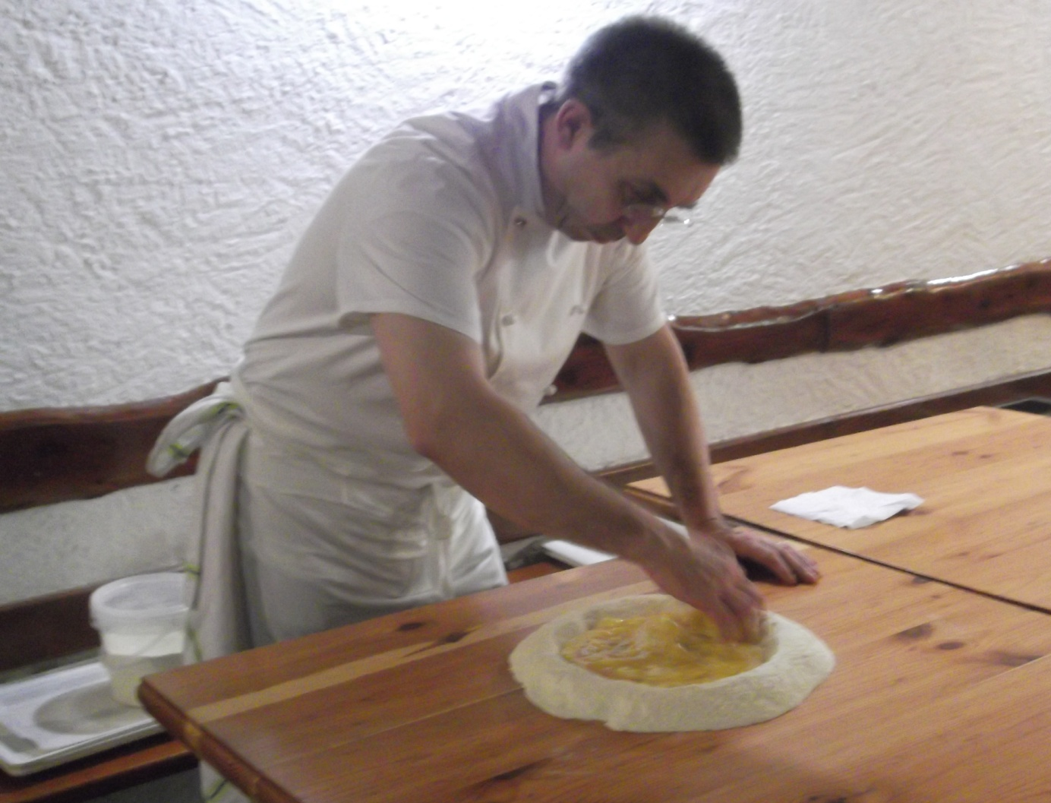
Professor Moreno
“Not Perfetto! Everything can be good;
but it can also be better.”

Slide 16
Which means …
As we look out the next ten years,
The Best is Yet to Come!

Slide 17
Next Challenges

Slide 18
Board Accomplishments - 2011
Welcomed two new Board members
Commissioned Task Force to make recommendations on Board Succession at the 2011 Annual Meeting
Increased Nominating Committee transparency and action to ensure continuity
Improve member voting to best practice
Executed a long-term CEO contract to ensure solid foundation for the future

Slide 19
Challenges for the Board - 2012
Succession plan implementation for the Board
Management succession plan to present to the Board and Members to support NetHope’s next decade of growth [CEO]
Review the need for further Bylaws reform [Task Force]
Capacity building for and growth of the senior management team [CEO]
Board commitment and fundraising leadership, with increasing funding diversity

Slide 20
The Next Ten Years - 2010
Delivering the
“Relevant IT Manifesto”
2. Empowering others in emerging countries
3. Become a leading economically
Self-sustaining organization
4. End the NGO Digital Divide
Notes:
Delivering the “Relevant IT Manifesto” (see http://eghapp.blogspot.com/2011/07/relevant-it-manifesto.html)
mission-moving projects such as I4D,
“good enough” applications such as smaller, fit-for-purpose applications,
“lights-out” infrastructure such as cloud computing and shared services
Empowering others in emerging countries
gain the skills to support their own social-benefit technology.
Share technology knowledge locally (NetHope’s charitable purpose)
move from a provider of technology to an enabler of communities
working ourselves out of some jobs: a goal of charitable organizations
Become a leading economical self-sustaining organization in our sector
shift from dependence on the generosity of our partners to more services that fuel our programs
balancing member-serving activities with member-services that come at a cost, and potentially compete with vendors
applying alternative economic models
End the NGO Digital Divide

Slide 21
The Future of Collaboration

Slide 22
The Context
The Apollo 13 story was featured in the 1995 film with Tom Hanks and Kevin Bacon. The incredible events that unfolded in April 1970 gripped the nation and the world. On April 13, 56 hours into the mission, an oxygen tank in the service module that contained the astronauts’ support systems exploded. What followed was a remarkable story of collaboration between the astronauts and mission control in Houston. While the world watched, they were able to bring a damaged spacecraft back to earth safely …
Notes:
The NASA account of the accident is here: http://nssdc.gsfc.nasa.gov/planetary/lunar/ap13acc.html

Slide 23
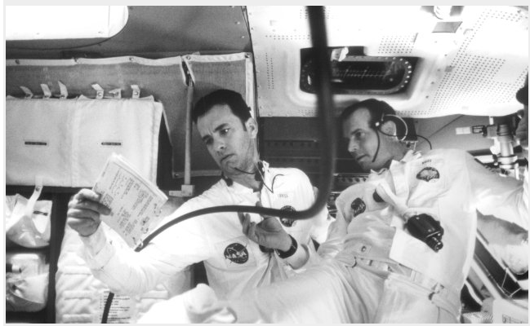
The Movie Clip…
watch for the collaboration
http://www.youtube.com/watch?v=5giXXW_UdaM
Notes:
http://www.youtube.com/watch?v=5giXXW_UdaM
Photo: http://www.imdb.com/media/rm1413254656/tt0112384

Slide 24
The Elements of a Collaboration
First, there was a shared burning need—there was a clear and present problem that had to be solved.
Second, there was scarcity—only a few resources were available.
Third, there was a strong social desire to band together as a team and solve the problem.
Notes:
These three factors: need, scarcity and social desire are the glue that makes collaboration work.
Yet it is the valued of scarcity that is perhaps the most powerful.

Slide 25
The New Collaboration
Who Are You Partnering With?
“Who has expertise I can trust?”
Shared Services & Assessments
Share
and Do
Share
and Do
Share
and Do
SHARED
SPECIALIZATION
JOINT PROJECTS
“What can we build together?”
NRK, Phase 2 Satellites
Increasing Level of Trust
PARTNERING
“How can we work with corporations?”
Cisco, Microsoft, Intel Grants
Do and Share
BASIC INFO SHARING
“What are my peers doing?”
Meetings, Conference Calls

Slide 26
Questions to Ask Yourself
What are the back-to-basics and embrace-the-future opportunities?
Where on the IT stack are you?
Where can you value scarcity to drive innovation
What’s the next level of collaboration you are willing to commit to?
What are you ready to “share and do” rather than “do and share?”

Slide 27
Questions?

