Slide 1
NetHope Center for the Digital Nonprofit and the Masters in Data Science
Edward G. Happ
November 1, 2018

Slide 2
Objectives
Introduce the NetHope Center for the Digital Nonprofit and its expectation for data skills
Overlay the UMSI MADS curriculum and roles NGO departments may play
Understand the intersections, gaps and drivers for change

Slide 3
Key Question:
Will the Data Science graduates in April 2020 help meet the NGO needs to become digital enterprises?

Slide 4
The Center for the Digital Nonprofit
(with thanks to Lauren Woodman, CEO and Jim Daniell, CIO)

Slide 5
What is It?
The Center for the Digital Nonprofit is unique in its approach, bringing together stakeholders from nonprofit organizations and the technology sector to work collaboratively.
Founded by NetHope, The Center builds on a 16-year history of trusted cross-sector partnerships. The Center welcomes active participation from committed organizations eager to tackle – and solve – big problems.
Representing more than 50 of the world’s largest humanitarian, development, and conservation organizations, the nonprofit members of The Center work in over 180 countries and represent $23 billion in annual international aid. The Center’s 50 technology partners bring the value of over $676+ billion of technology R&D and the creative ideas of more than 1 million employees.
Notes:
https://nethope.org/center-for-the-digital-nonprofit/

Slide 6
The Why?
Notes:
2018.06 NetHope Fellows Briefing.pdf

Slide 7
The Solution
Combine the on-the-ground experience of global nonprofits with the expertise of the technology sector to create, adopt, and scale innovative solutions.
Notes:
2018.06 NetHope Fellows Briefing.pdf

Slide 8
CDN Key Projects
Notes:
2018.06 NetHope Fellows Briefing.pdf

Slide 9
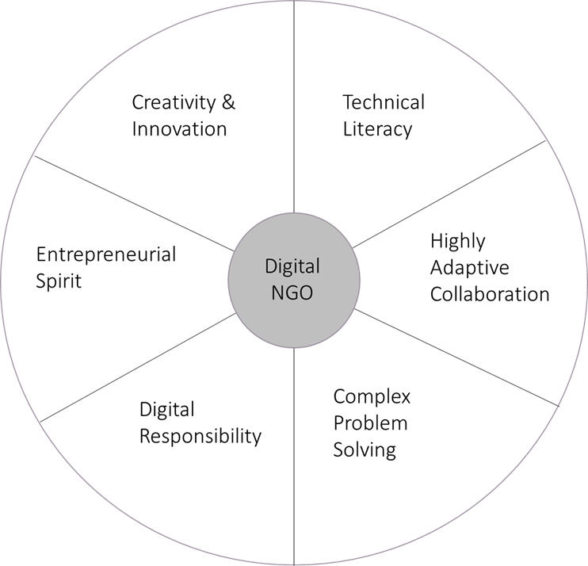

Skills Framework for the Digital NGO
Notes:
2018.06 NetHope Fellows Briefing.pdf

Slide 10
Notes:
2018.06 NetHope Fellows Briefing.pdf

Slide 11







Digital Nonprofit Skills™ within the Framework
The Digital Nonprofit Skills ™ (DNS) is an aggregate of six categories that shape the Digital Skills Framework: Technical Literacy, Highly-Adaptive Collaboration, Complex Problem-Solving, Social Responsibility, Entrepreneurial Spirit and Creativity & Innovation
Highly Adaptive
Technical Literacy
Collaboration
Do people seamlessly work across boundaries?
Digital Responsibility
Foundational category, responsibly and effectively understand and use technology tools to access, manage, evaluate, create and communicate information
Tech Literacy
Does the org have the foundational skills to transform?
The ability to manage personal information in a safe manner, build a positive online reputation and weigh the benefits and risks of online transfer of information across sites.
Complex Problem-Solving
Is the org solving
complex problems in
an agile manner?
Highly Adaptive Collaboration
Entrepreneurial Spirit
People seamlessly work together across cultural, social and language barriers, sharing ideas, while adapting to a changing environment in order to accomplish a common goal.
Creativity & Innovation
Does everyone contribute to new risk-taking ideas?
It’s an attitude and approach to thinking that actively seeks out change, rather than waiting to adapt to change. It’s a feeling of ownership in the solution.
Digital Responsibility
Are people keeping information
safe?
Complex Problem-Solving
Entrepreneurial Spirit
Does the org challenge old
ways of
working?
Creativity & Innovation
The ability to use research, analytics, rapid prototyping and feedback in an agile work environment to achieve the best solution possible.
The ability to think creatively about something new, or already exists with the inclusion of different thinkers willing to take risks on new ideas to generate greater impact
Notes:
This is what to print

Slide 12
The DNA Defines Four Type of Nonprofits
Notes:
2018.06 NetHope Fellows Briefing.pdf

Slide 13
Digital Threshold and Digital Transformation
Digital Threshold:
the point at which
digital
transformation
Begins
Digital
Transformation:
the theoretical “average” path to becoming a digital
NGO
Notes:
2018.06 NetHope Fellows Briefing.pdf

Slide 14
DNA Results (as of June 2018)
DNA
Respondents
30 national nonprofit organizations
>$20b in annual aid
Notes:
2018.06 NetHope Fellows Briefing.pdf

Slide 15
Notes:
2018.06 NetHope Fellows Briefing.pdf

Slide 16
Data 1.0, 2.0, 3.0++
Definitions:
Data 1.0 – In your organization you gather a lot of data, and don’t do a lot with that data. People work on their projects/programs and the information is around the donor or grant. You do not share data very well, and mostly what you use is a spreadsheet – like Excel.
Data 2.0 – In your organization, there is data easily shared between teams. You can see budgets and where people are w/re to the projects/programs they are working on. Data is shared broadly through tools and BI.
Data 3.0++ – In your organization, you are very agile – you have extensive networks and use your data well, but also use external data. You make decisions and changes based on what is working and what isn’t working and you are able to do so real-time. You receive beneficiary data to make your organization better. You can start using this data to feed into machine learning/AI.
Notes:
Data Skills Workshop v5.pptx

Slide 17
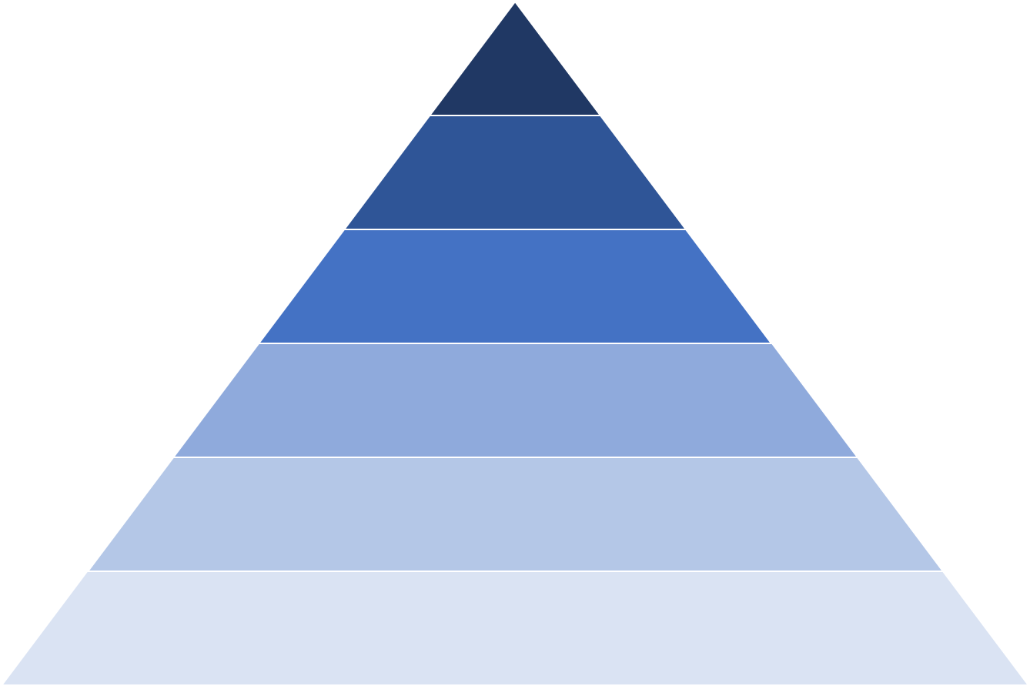
Hierarchy of Data Evolution
As an organization becomes more evolved with their data, they move from gathering and storing data, to using it for benchmarking and comparison, to predicting the future.
AI/Deep Learning
AB testing, experimentation, simple ML algorithms
Learn/Optimize
Analytics, metrics, segments, aggregates, features, training data
Aggregate/Label
Without better data collection, analytics don’t add value
Cleaning, anomaly, detection, prep
Explore/Transform
Reliable data flow, infrastructure, pipelines, ETL, structured and unstructured data storage
Move/Store
Instrumentation, logging, sensors, external data, user-generated content
Collect
Notes:
As an organization becomes more evolved with their data, they move from gathering and storing data, to using it for benchmarking and comparison, to predicting the future.
Data Skills Workshop v5.pptx

Slide 18
Heat Map – Sample-only
Circle areas of highest risk
 | Sr. Leaders | Program | Fundraising | HR | Finance | IT
Hierarchy of Data Skills
(in order of complexity)
Data Production & Hygiene
Data Security & Storage
Spreadsheet Tools
Data Visualization
Data Analytics
Agile
Experimentation
AI |  |  | ??
Deep Learning
Few skills | Some skills | Many skills
Notes:
Data Skills Workshop v5.pptx

Slide 19
The MADS Degree

Slide 20

The New UMSI Online Degree Program

Slide 21
The Why?
“The demand for data scientists has grown dramatically in the past decade and it will continue to grow far beyond our capacity to accommodate students in a traditional classroom setting.” -- Dean Thomas A. Finholt.
“Universities are not graduating data analysts fast enough for 10x growth by 2020,” –Cindi Howson, Gartner VP
“…by 2018 the number of data science jobs in the United States alone will exceed 490,000, but there will be fewer than 200,000 available data scientists to fill these positions. Globally, demand for data scientists is projected to exceed supply by more than 50 percent by 2018.” --Amy Gershkoff, TechCrunch
Notes:
Quote from Cindi Howson is from the Gartner CIO Conference in Toronto, June 2017.
https://techcrunch.com/2015/12/31/how-to-stem-the-global-shortage-of-data-scientists/

Slide 22
The MADS Degree has Six Areas of Mastery
Data Science Core
Computational Methods
Exploring and Communicating Data
Analytic Techniques
Data Science Application Areas
Capstone Courses

Slide 23
Intersections and Gaps

Slide 24
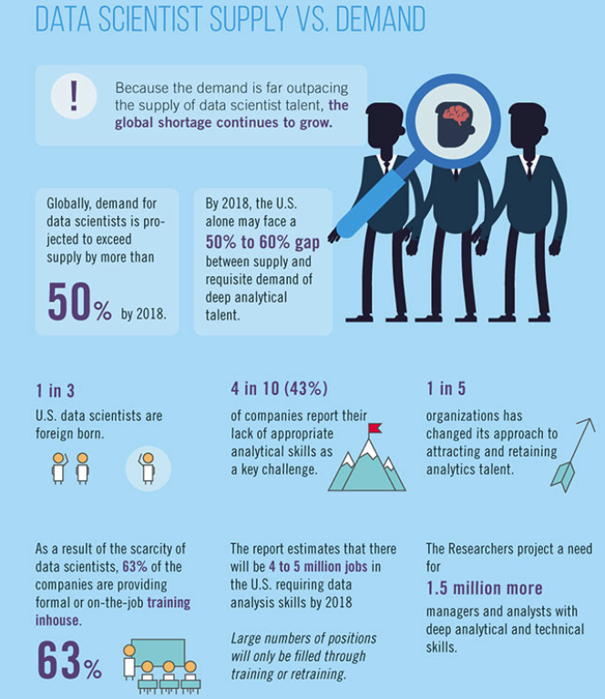
Globally, demand for data scientists is
projected to exceed
supply by more than 50% …this year!
Infographic developed by
University of California, Riverside, for Inside Big Data, Aug. 2018
Notes:
https://insidebigdata.com/2018/08/19/infographic-data-scientist-shortage/
https://www.forbes.com/sites/gilpress/2015/04/30/the-supply-and-demand-of-data-scientists-what-the-surveys-say/#34328ab76b90

Slide 25
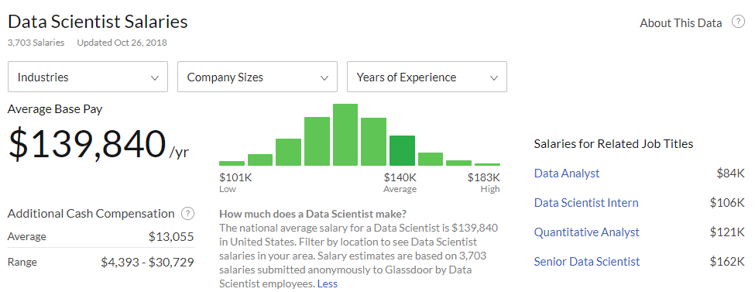
DS Salaries are beyond NGO Means
2.6X
“The average salary for "ngo" ranges from approximately $33,146 per year for Communications Intern to $88,885 per year for Associate Director.” Average is $54,615 --Indeed.com
Notes:
https://www.glassdoor.com/Salaries/data-scientist-salary-SRCH_KO0,14.htm
https://www.indeed.com/salaries/Ngo-Salaries

Slide 26
The red topics are potential gaps not represented in the other
Notes:
NetHope vs. MADS in 9 vs. 30 topics
NetHope Summit\UMSI MADS Curriculum.xlsx

Slide 27
Zone of new end-user DS tools
New NGO role
Opportunities for more “black box” tools
Opportunities for Exec DS program
Notes:
Spring 2020 is the first graduation of the MADS program

Slide 28
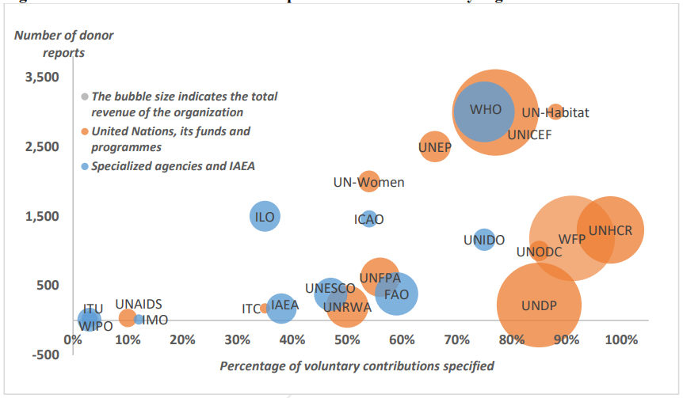
Applying DS to Growing Reports Volume?
Mostly public / grant reports on program results
Of 24 UN Org’s, avg. annual reports is 1,019
--UN Joint Inspection Unit report, 2017, p. 5, 30
Notes:
https://www.unjiu.org/sites/www.unjiu.org/files/jiu_rep_2017_7_english.pdf

Slide 29
Cultural Obstacles
An increase in data analytics means an increase in internal accountability.
    Are we ready for the radical measurement of everything that a comprehensive digital enterprise implies?
    Are we ready to evaluate one program versus another based on the data?
    Are we ready to pivot accountability frameworks to delivering for citizen-beneficiaries to delivering effective operations?
Comprehensive data analytics looks for the patterns and trends across an organizations work and market
    Are we ready to put aside the banner of "uniqueness" as a defense against comparative analytics?
Being an evidence-based organization goes beyond gathering evidence
    Analytics has the potential of pushing us to “stop this” and “start that”, making the hard service delivery decisions

Slide 30
The Net Forecast?
The NGO – Corporate analytics gap will widen
The skills deficit will be in more areas than first forecast
Across all sectors, the demand will drive a democratization of data analytics
  As we all became financial analysts with spreadsheets in the 1980’s so with DS in the 2020’s
The demand for the “soft” consultative skills will rise (the DS analysts as end-user coach)
AI will play an increasing role in bridging the gap

Slide 31
Questions to think about
    If data scientists are being priced out of the NGO market, what are some alternatives?
    Are we ready for the cultural changes required for being data-driven? (e.g., radical measurement of everything, comparative program analytics, inward facing accountability)
    Who in the organization needs to have deep understanding of DS and who needs conversational understanding?
    As the tools move toward a democratization of DS, will we be ready to pivot to DS experts as consultants rather than ivory tower crunchers? (i.e., will the soft skills matter more than the math/tech skills?)
    Based on medium-sized UN org data, NetHope members produce (in aggregate) over 5,000 narrative reports per year. What are some ways these can become big data sets?
    What are some ways that AI can fill some of these gaps? (watch the IBM Watson ads on YouTube and ask what this suggests for NGOs)

Slide 32
Next Steps, Q&A

Slide 34
The Center for the Digital Nonprofit
Notes:
2018.06 NetHope Fellows Briefing.pdf

Slide 35
IDEA / D3
Notes:
2018.06 NetHope Fellows Briefing.pdf

Slide 36
Notes:
2018.06 NetHope Fellows Briefing.pdf

Slide 37
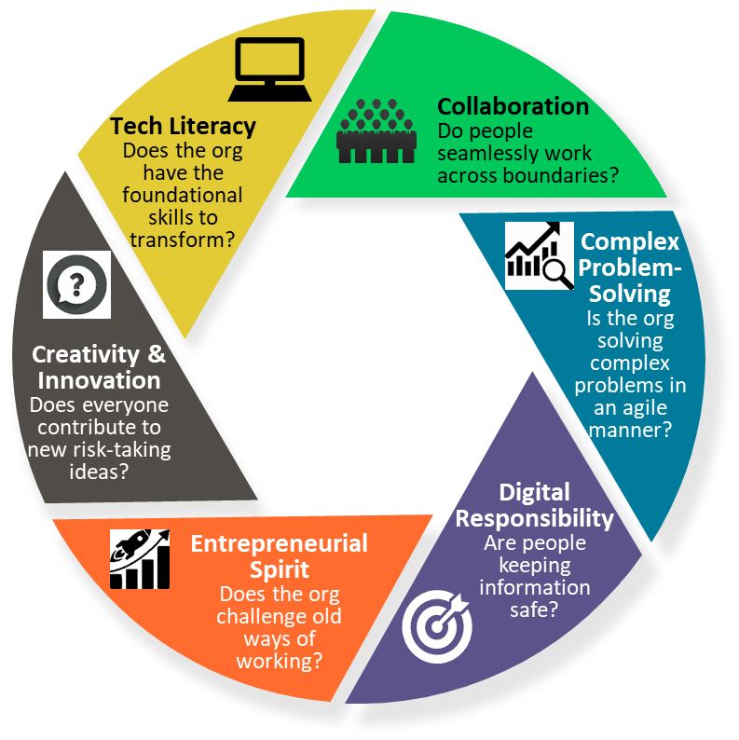
Digital Skills Framework for the Nonprofit
Ed – Option B
Notes:
Tying data to almost the entire DSFW

Slide 38
Digital Skills Framework for the Nonprofit
Ed – Option C
Builds a foundation of skills
  Tech Literacy
  Adaptive Collaboration
  Complex Problem-Solving
  Digital Responsibility
  Entrepreneurial Spirit
  Creativity & Innovation
Enables peer-to-peer learning
Adaptable for the modern worker
Notes:
Modified from Data Skills Workshop v5.pptx
Tying data to almost the entire DSFW

Slide 39
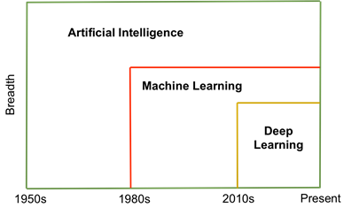
Data Skill (in order) | Definition
Data Production & Hygiene | Data production is the day-today information collected to run a business or organization. Data hygiene is the process of ensuring that data is clean data.
Data Security & Storage | Data security means protecting data, such as a database, from destructive forces and from the unwanted actions of unauthorized users. Data storage is the safeguarding of data in a secure manner.
Spreadsheet Tools | A spreadsheet is an interactive computer application for organization, analysis and storage of data in tabular form. Spreadsheets are developed as computerized simulations of paper accounting worksheets. The program operates on data entered in cells of a table. Microsoft Excel and Google Spreadsheets are examples of tools.
Data Visualization | The visual representation of information or data in the form of a chart, diagram, picture, etc..
Data Analytics | Analysis of data is a process of inspecting, cleaning, transforming, and modeling data with the goal of discovering useful information, suggesting conclusions, and supporting decision-making
Agile | Agile development refers to a development methodology based on iterative development, where requirements and solutions evolve through collaboration between self-organizing cross-functional teams. For many organizations, it is a way of working and responding quickly to new information.
Experimentation | An experiment is a procedure carried out to support, refute, or validate a hypothesis. Experiments provide insight into cause-and-effect by demonstrating what outcome occurs when a particular factor is manipulated. Experiments vary greatly in goal and scale, but always rely on repeatable procedure and logical analysis of the results.
AI | AI, or artificial intelligence is a sub-field of computer science. Its goal is to enable the development of computers that are able to do things normally done by people -- in particular, things associated with people acting intelligently.
Deep Learning | Deep learning is a set of techniques for training neural networks with many layers. It's a subfield of machine learning, which considers other models of data besides neural networks
NetHope Definitions

Slide 40
UMSI Curriculum
DSC: Data Science Core (3 credits)
Course DSC.1: Introduction to Applied Data Science
Introduction to Applied Data Science provides an overview of the field of data science and its applications. This includes the technical, theoretical, societal, and pragmatic aspects of the field, and how the field intersects with different domains.
Course DSC.2: Data Science Ethics
Data Science Ethics provides an introduction to the ethical questions involved when working with data in the workplace. Topics will include: privacy, data security, bias/fairness issues in data, and algorithmic transparency.
Course DSC.3: Contextual Inquiry
Contextual inquiry is a process data scientists can use to understand opportunities for the use of advanced data analytics. It involves interviewing people about how decisions are currently made and exploring how they could be made differently. Students will also learn how to identify key stakeholders in a project and identify technical and organizational contingencies that could interfere with progress on a project.
CM Computational Methods (5 credits)
Course CM.1: SQL and Databases
The SQL and Databases course provides an introduction to structure data and databases for data scientists. The focus is on the theory and mechanics of manipulating data, and students will gain comprehensive skills in creating databases (e.g. using the Data Definition Language, DDL) and retrieving and manipulating data (e.g. the Data Manipulation Language, DML). Some introductory relational theory will be introduced to ground these skills in a larger framework.

Slide 41
UMSI Curriculum (cont.)
Course CM.2: Advanced SQL and Databases (prereq: CM.1)
Advanced SQL and Databases introduces typical database architectures which data scientists use to the students. In particular, data cubes, star and snowflake schemas, online transaction processing, and data warehousing topics will be covered. In addition, more advanced database mechanics, such as transactions, window functions, and user-defined functions will be covered.
Course CM.3: Data Manipulation
This course provides hands on skills in data manipulation and cleaning. Students will learn to work with modern data cleaning frameworks (e.g. python pandas), and how to handle data which is real-world and messy. At the end of this course students will be able to clean and validate moderately large datasets and prepare them for further processing.
Course CM.4: Big Data I: Efficient data processing (prereq: CM.3)
Sometimes data cleaning and manipulation computations take too long to complete. Students will learn to conduct performance profiling in order to identify which parts of a computation are at fault. They will also learn techniques for improving performance, including making sure data is accessed in memory rather than from disk, and converting quadratic time processes to linear time processes.
Course CM.5: Big Data II: Scalable data processing (prereq: CM.3)
This course continues the exploration of how to make computations complete quickly. It focuses on techniques of parallelization, conducting computations on different fragments of data simultaneously on multiple machines. Students will learn the Apache Spark framework and corresponding pyspark libraries. They will learn about the spark resilient distributed datasets (RDD) mechanisms, and the underlying functional methods which can be applied based on this framework. This course will further demonstrate the benefits of running large SQL queries on distributed architectures.

Slide 42
UMSI Curriculum (cont.)
Comm: Exploring and Communicating Data (5 credits)
Course Comm.1: Basic Data Visualization (prereq: DSC.2, CM.3)
In Basic Data Visualization, students will learn the fundamentals of visualization, including theory related to human perception and storytelling. Students will learn how to create different kinds of core visualizations (charts and graphs such as boxplots, histograms, bar charts, scatter plots and radar plots), and how to add interactivity to these visualizations for deeper engagement.
Course Comm.2: Exploratory Data Analysis (prereq: DSC.2, CM.3, Comm.1)
A critical step in working with a dataset is understanding both its global characteristics as well as local variation in specific variables, in order to simplify and increase the accuracy of further analysis, suggest specific hypotheses to test, or identify the need for additional data gathering or processing. The Exploratory Data Analysis course will teach students how to approach a new dataset to summarize global statistics and trends, to identify and interpret outliers, noise, patterns, and to find underlying factors or clusters within data (typically with visualization methods).
Course Comm.3: Persuasive Communication
Data scientists need to communicate the results of their investigations to project stakeholders. That includes explaining what was done, interpreting the results and arguing for how they should be used to change future decisions and actions. Students will learn techniques for presenting persuasively.
Course Comm.4: Advanced Data Visualization (prereq: Comm.1)
Advanced Data Visualization will focus on issues related to the building of data science dashboards. These issues includes human perception and understanding in dashboards, as well as technical topics in the linking of data within dashboards together to enable EDA. This course will build on the basic data visualization course by introducing new frameworks and techniques for dashboard creation, and will result in a real-world dashboard visualization project appropriate for a learner portfolio.

Slide 43
UMSI Curriculum (cont.)
Course Comm.5: Presenting Uncertainty (prereq: Comm.1, AT.1)
It is important for data scientists to convey the appropriate level of confidence in their results. Many analytic techniques represent uncertainty as probability distributions. Bayesian techniques treat information as something that updates probability distributions. Students will learn how to interpret these probability distributions and present them in ways that people with little statistical training can understand.
AT: Analytic Techniques (11 credits)
Course AT.1: Math Methods for Data Science
In this course, students will learn mathematical notations and techniques used in the analytic techniques. This includes matrix reduction, eigenvectors, and optimization techniques of gradient descent.
Course AT.2: Data Mining I (prereq: DSC.2, AT.1)
In Data Mining I, students will learn the basic representations of three typical types of real world data (e.g., Item sets, matrices, and sequences data) and computational algorithms and tools to extract patterns from these data that can either be used to characterize a data set or be used as features for downstream machine learning tasks.
Course AT.3: Data Mining II: Feature extraction from: (prereq: AT.2)
In Data Mining II, students will learn the basic representations of additional types of real world data (e.g., time series, spatial data, and streams) and computational algorithms and tools to extract patterns from these datatics that can either be used to characterize a data set or be used as features for downstream machine learning tasks.

Slide 44
UMSI Curriculum (cont.)
Course AT.4: Supervised Learning (prereq: DSC.2, AT.1)
The Supervised Learning course will teach students how to train, evaluate, and select effective predictive models for regression and classification, which estimate their models based on labelled examples. The course will cover key machine learning concepts such as overfitting and regularization, methods for correctly preprocessing input data, a variety of widely-used prediction models, metrics for evaluating prediction quality, and how to choose the right method and model-fitting parameters for a given supervised learning task.
Course AT.5: Unsupervised Learning (prereq: DSC.2, AT.1)
In the Unsupervised Learning course, students will learn basic concepts and approaches for finding and extracting useful structure from data when labelled examples are not available. Results from these unsupervised learning methods are useful for a wide variety of data science tasks: from creating interpretable visual summaries of datasets, to deriving effective new features for later supervised learning tasks. Methods covered will include different approaches to dimensionality reduction, manifold learning, k-means and agglomerative clustering, and density estimation.
Course AT.6: Deep Learning (prereq: AT.4)
In Deep Learning, students will learn the basic concepts, models, and tools of deep learning. The course will cover the most popular neural network architectures (e.g., CNN, RNN, LSTM) and practical application scenarios of using these models to solve various real world problems.
Course AT.7: Machine Learning Pipelines (prereq: AT.4, AT.3)
In Machine Learning Pipelines, students will learn how to orchestrate machine learning workflows together into larger production pipelines. This includes automation of the data acquisition and cleaning stages, updating of models based on new data, validation techniques, and providing web-based API endpoints for the consumption of the output of models by third party services (e.g. visualizations and dashboards).

Slide 45
UMSI Curriculum (cont.)
Course AT.8: Causal Inference (prereq: DSC.2, AT.1)
Causal Inference introduces students to analytic techniques that infer, from observational data, that a treatment leads to an outcome. Techniques include propensity score matching and instrumental variables. At the end of this course, students will be able to identify when an analyst has incorrectly inferred causation from mere correlation and apply techniques to increase confidence in a causal interpretation.
Course AT.9: Network analysis (prereq: AT.1, DSC.2, CM.4, CM.3)
Network Analysis introduces the basic concepts and metrics of network and graph data, characteristics of real world social networks and information networks, and tools to describe, visualize, and analyze large-scale networks. Students will also learn how information is diffused in everyday social networks.
Course AT.10: Natural Language Processing (prereq: DSC.2, AT.1, CM.3)
Natural Language Processing introduces how to use machine learning techniques to understand, annotate, and generate the language we see in everyday situations. It will cover methods and tools to process and discover knowledge from text data and how to apply these tools to different kinds of text and real world problems (such as sentiment/opinion analysis).
Course AT.11: Experiment Design & Analysis (prereq: AT.1, CM.1)
Randomized controlled experiments offer a way to make strong causal claims. This course will introduce students to common designs for experiments, starting with a simple A/B test. At the end of the course, students will be able to select an appropriate experiment design and, through simulation, determine an appropriate sample size.

Slide 46
UMSI Curriculum (cont.)
APP: Data Science Application Areas (2 credits required)
Course APP.1: Information Retrieval (prereq: AT.1, DSC.2, CM.4, CM.3)
Information Retrieval will introduce the basic concepts, algorithms, and tools to build a search engine for large-scale text collections and various practical issues related to commercial search engines like Google and Bing (such as query log analysis).
Course APP.2: Social Media Analytics (prereq: DSC.2, COMM.1, COMM.2, CM.3, AT.9).
Social Media Analytics explores the kinds of data streams produced by users of social media systems, and the kinds of analyses typically performed on them. The data streams include post contents (text, images, audio, and video), metadata including reactions, shares, and ratings by other users, and usage data (e.g, views, clicks, dwell time). Social media platform owners conduct analyses in order to improve their services and sell ads. Marketers conduct analyses in order to understand consumer reactions to products and brands, and to optimize ad campaigns. Social scientists, the media, and others use social media analytics to understand social relations and social trends. At the end of this course, students will be prepared to conduct a capstone project using social media data.
Course APP.3: Learning analytics (prereq: DSC.2, COMM.1, COMM.2, CM.3, AT.8).
Learning Analytics explores how analytics and data science are being used by educational researchers to understand learning processes and outcomes. Topics students will explore include predictive models for student success, dashboards of learner activities, and behavioral interventions based on learner traces. Learners will explore how learning theories (e.g. social constructivism) are conceptualized from the lens of a data scientist, and be able to apply data science techniques to specific kinds of learning data.

Slide 47
UMSI Curriculum (cont.)
CAP: Capstone Courses
Course CAP.1A,B: Capstone I (2 credits)
In Capstone I, students will apply the skills they have gained in a larger project. This capstone will be scaffolded, and include elements of the preceding courses (e.g. data manipulation, visualization, and communication), and will be an important part of the learners portfolio. Students will be provided with an unprocessed dataset and directed to perform various manipulations of it to produce a clean dataset for analysis and the results of exploratory data analysis.
Course CAP.2A,B: Capstone II: (2 credits)
In Capstone II, students will synthesize and apply the data science analytic techniques they have gained in a larger project. This capstone will focus on core data science methods, and will demonstrate the application of analytic techniques, such as supervised and unsupervised learning. The capstone will provide learners with some freedom in choosing their domain of interest. Students work with a real-world dataset.
Course CAP.3A,B,C: Capstone III: (3 credits; prereq: courses 5.x)
Capstone III is based on the domain specific courses (e.g. information retrieval, social media analytics, and learning analytics) which the students have taken in the last semester of study. Building on those topics, students will be expected to apply the breadth of the data science pipeline, from contextual inquiry through data manipulation, machine learning, and data presentation. This capstone is open ended, and acts as a signature project for the students, and the core of their learner portfolio.

