Slide 1
Engaging with new technologies and innovation
15th October 20
Edward G. Happ, Global CIO & Head of ISD

Slide 2
Thesis
New technologies are developing faster than we can keep up with them. And the barriers to entry are low to non-existent for the average person to build a collection of personal tools and applications. Teams take their own technology initiative and so-called “shadow IT” mushrooms. At the same time, organizations continue to grow and mature, especially in new economies, with their technology portfolios to “run the business” getting ever more complex and data more intertwined. What’s an IT leader to do? We will explore these two threads of growth and the paradox of embracing them.

Slide 3
STRATEGIC CONTEXT

Slide 4
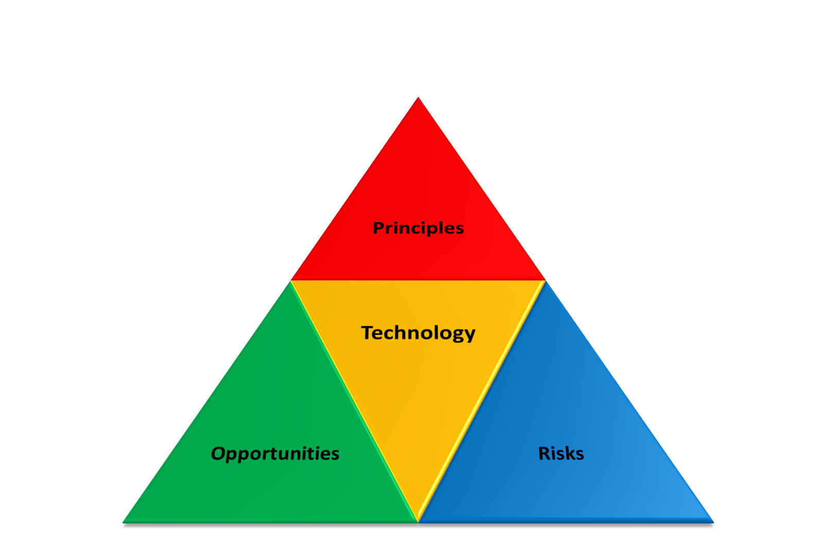
Three themes for technology, innovation and humanitarian action

Slide 5
Technology and our Vision
New technology is an opportunity to do more and reach further, key aim of Strategy 2020.
  Allows us to work more efficiently and productively.
  Can provide means of communicating more directly with vulnerable people.
  Means to engage and mobilize Youth and Volunteers.
  Can lead to more ecologically sensitive, “greener” organization.
Technology is also a risk that we must recognize and advocate for the protection of vulnerable people.
  Technology is unevenly distributed in world and risks exacerbating divide between richer & poor communities. We have a moral obligation to Bridge the Digital Divide.
  Technology can also put people at risk when their information is not protected.
  When used in unprincipled ways, it can also dehumanize fundamental human connections.
  Can also disrupt humanitarian work when systems on which we depend fail.

Slide 6
Technology and our Vision (cont.)
Technology in humanitarian action and vulnerable communities must be principled technology.
  Essential that we continue to be guided by the fundamental principles as we apply technology.
  Principles make effective humanitarian action possible in challenging situations.
  We are in the unique position to advocate and ensure humanitarian principles are part of the agenda to bring technologies to all people in the world.

Slide 7
IT Strategy Context
Get in
Competitive
or Leading
BENEFICIARY
“Differentiating”
Beneficiary & Field Facing
Increasing Impact for Beneficiaries
PROGRAM
“Improving Program Delivery”
Increasing Impact for Beneficiaries
Move up
OPERATIONAL
“Helping the Organization Run”
Efficient
Donor & HQ
Facing
FOUNDATIONAL
“Keeping the Lights On”
Get out

Slide 8
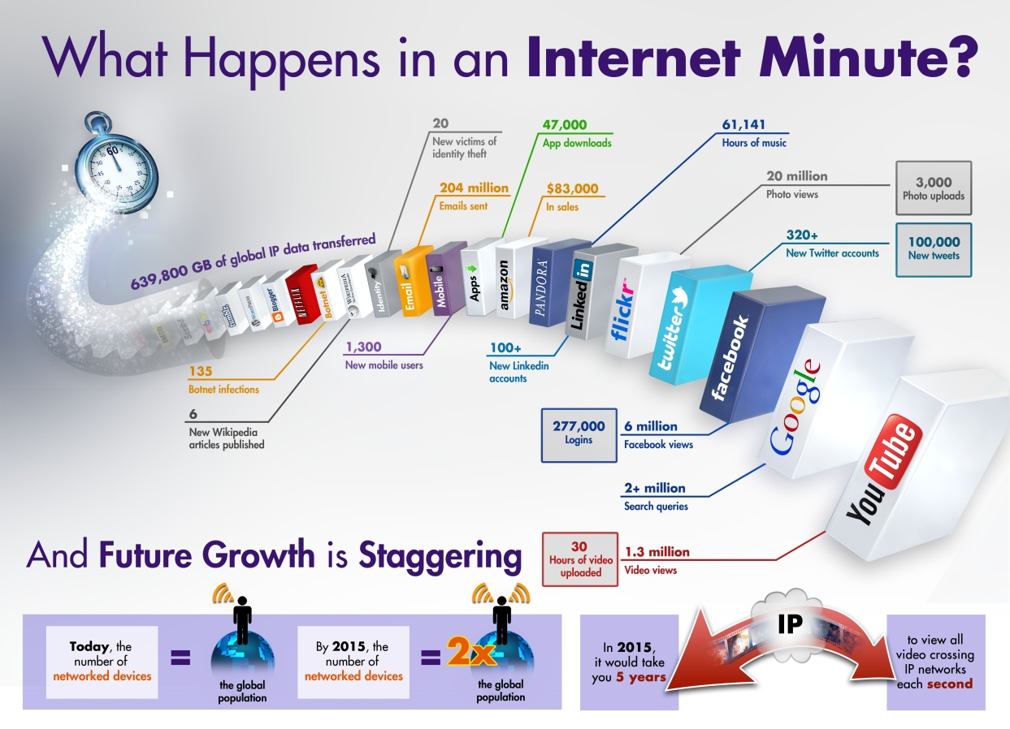
Notes:
License Some rights reserved by IntelFreePress http://www.flickr.com/photos/intelfreepress/6780720740/sizes/o/in/photostream/

Slide 9
Innovation at the margins
Historical IT – all
components provided
User Devices
Network
Enterprise apps
Data
User apps
Local innovation is more likely
and sustainable at the outer
layers of IT delivery
Current Era – Users bring
their own devices and apps
Future Era – Users bring
their own networks
Standard core – it is unlikely
users will have or should have their own Finance, HR, Supply Chain, and Legal
applications and data
External crowd-sourced data is
pushing the internal data paradigm

Slide 10
Shadow IT
Shadow IT can be described as the IT work done outside the IT department’s budget and knowledge.
Represents an estimated 23% of the IT application work done at IFRC at an estimated cost of over 600,000 CHF per year and growing
There are over 35 innovation initiatives happening across the IFRC locations
Notes:
http://searchcloudcomputing.techtarget.com/definition/shadow-IT-shadow-information-technology
Assuming 3 applications created per Zones/Delegations plus GVA departments, yields 18 apps versus a portfolio of 60 apps in GVA-ISD. 23% of the 3M ISD Project Budget is 690K CHF.

Slide 11
Yin and Yang of Shadow IT
On the one hand “Shadow IT is considered by many an important source for innovation and such systems may turn out to be prototypes for future approved IT solutions” and
On the other hand Shadow IT is a risk “... Shadow IT solutions are not often in line with the organization's requirements for control, documentation, security, reliability, etc.”
Notes:
Wikipedia entry on “Shadow IT”, here: http://en.wikipedia.org/wiki/Shadow_IT . Also compare the Economist article, “IT’s Arab spring”, Oct. 8, 2011, here: http://www.economist.com/node/21531112

Slide 12
OPPORTUNITIES

Slide 13
Three Types of Innovation*
Empowering (or disruptive) innovation – “transmutes complicated and costly products available to a few into simpler, cheaper products accessible to many” “creating new markets and wreaking havoc within industries” (e.g., Ford Model T car)
Sustaining innovation – “replaces old models with new products that often incorporate new technology and novel design features.” “making things incrementally bigger, more powerful, and more efficient” (ex. Toyota Prius)
Efficiency innovation – “makes existing products more proficiently” (ex. Lean production)
Only disruptive innovations create new jobs
*Clay Christensen, Davos interview, January 2013
Notes:
See http://www.davidkhurst.com/clayton-christensen-at-davos-an-ecological-perspective/
and http://www.wired.com/business/2013/02/mf-clayton-christensen-wants-to-transform-capitalism/all/

Slide 14
What are we trying to optimize?
Thinking outside the box; engage the creativity of our people
Investing small amounts for big returns
Delivering new program/services that demonstrate impact and scale
In short, engaging our creativity to maximize supply and minimize constraints

Slide 15
Models of Innovation
Traditional, top-down innovation
Discovery innovation, an inverted model
Disruptive Innovation, Clay Christensen model
The R&D lab, corporate model
Controlled experiments, the Dartmouth model
Crowdsource ideagoria, the Tapscott model

Slide 16


Application Catalog of
Standards & Choices
Discover
Harvest
NS IT Survey - Applications
Scale up
Application Portfolio
Review
900+
Application Catalogue
Criteria
De facto
vendor standards
Application Contest
Application Catalogue is the
window for NSs into supported applications
16
Notes:
http://www.istockphoto.com/stock-photo-4237972-funnel.php

Slide 17
Recommendation
Combining the Discover and Harvest model (option 2) with Controlled Experiments (option 5) may be best suited for a nonprofit organization budget and culture
      Use a project review panel, pilots and contests to create an ecosystem for innovation to take root, flourish and scale
      Disciplined experimenting to take projects to Pilot -> Scale -> Mainstream, with try-learn-do investment levels
Create an innovation fund to get started
  Allocate an initial budget of 1.5M CHF and evaluate after one year (See the IT Think paper for details)

Slide 18
A Project Review Panel for Continuous Innovation Harvesting
Many
Ideas
A Few Successful
Mainstream Programs
20 Small Pilots
(20K each)
5 Scale up
(100K each)
2 Mainstream
(300K each)
6 month’s
24 month’s
36 month’s
Notes:
http://www.istockphoto.com/stock-photo-4237972-funnel.php

Slide 19
RISKS AND MITIGATIONS

Slide 20
ISD Management Risks
Risk # | Risk Description | Key Mitigation Points
77 | Disruptive innovations in technology cause IFRC to fall further behind competitors. Includes digital program development (ICT4D), direct connections with beneficiaries, and digital fundraising direct to local NGOs. | Continued membership in leading edge organizations like NetHope, ICSC and university research. Create a discretionary innovation fund to encourage leading-edge projects.
76 | Lack of insight into IT spending across all offices and grants means inability to identify redundancies in IT costs and track Shadow IT. | Needs to be part of Chart of Accounts reform (Angela Eaton working on this).
74 | Cancelation of the DMDS project due to funding issues will impact how IFRC does business. HLS and Logic are very old systems, procurement not standardized across departments and zones. | Procurement and inventory should be under Unrestricted budget. Allocate part of the project budget to finalize phase 1 of the project.
73 | Management time required for restricted projects limits capacity (DMDS, Post2015 MDG). | Management continues to triage the non-IT funded projects. Test case proposal to charge back PM efforts to department (e.g. Health).
72 | Risk of lack of RM fundraising puts projects in jeopardy (DMDS, Digital Divide). | Allocate more budget to the DD initiative (e.g DFID), fund Tech Advisory Unit, and need to maintain DD as an RM priority.
71 | Risk of not being able to sustain increase in annual maintenance due to cloud pay-per-use model & portfolio growth, which differs from the traditional model of buying software. | Some projects have been put on hold per Finance. Studying impact and plan to meet with finance to discuss financial impact of projects (maintenance, depreciation) and how to absorb the increase.
62 | Growth in project portfolio continuing | Delays in projects have been addressed with project management. Now need to reconsider increasing project and core budget to solve growing project demand & innovation needs.

Slide 21
Defined classification of Information to understand security impact
Information category & non-exhaustive list of examples | Estimated % of information | Operational impact and financial loss of the unauthorized disclosure, alteration, or destruction of information
Highly restricted . Examples: Vulnerable populations highly sensitive data with individual names; Sensitive disciplinary process information; Fraud/corruption investigations; Highly confidential audit reports | Between 1-2% | Severe
Restricted. Examples: Personally Identifiable Information (PII) on staff or beneficiaries (e.g. name, passport number) Beneficiary data with individual names Personnel files and work history data | Between 3-4% | Significant
Internal (default category until information is classified). Examples: Beneficiary data without individual names; Internal communications Internal policies, procedures and standards | Up to 95% | Limited or none
Public (deliberately made public). Examples: External press releases and publications; Financial statements after release; Appeal documents |  | None expected

Slide 22
Some questions for local applications
How do we move local applications to regional & global stage?
How is it sustainable? Is funding is in place to scale and survive developer and sponsor turnover.
How is it maintainable? Does it have technology architecture, standards, integration to work in IFRC IT ecosystem?
How is it supportable? Is the training and service plan to support users in place before growing the base of users?
The Global/NS potential and sharing needs to be built into the design from the beginning, not at the end of a project
Also time and costs for applications need to be locally affordable, not centrally, …consistent with NS capacity building model.

Slide 23
CONCLUSION

Slide 24
In Short…
We need to use Federation resources effectively and that includes technology and ISD
ISD’s responsibility is to deliver IT value to the whole secretariat and beyond (convening the RCRC IT market of sharing)
Zones can contribute to this by developing local applications in such a way that we can use them more widely
  And avoid divergence by developing applications in isolation
  Avoiding applications that duplicate, undermine or complicate work which is being carried out elsewhere
  Championing data standards for consistency
This takes consultation

Slide 25
What to do to turn Shadow IT into Impact IT?
Consult with IT Department (ISD)
    We want to build bridges, not obstacles
Consult with ITSG (the IFRC IT governance arm)
    For projects over 50K, see the TOR
Use the IT Project Methodology developed with Accenture
Route consulting projects with IT components to ISD for review (an HR, Legal ask)
Use the Technology Catalogue (who has already done something like I want to do?)
Use commercial off-the-shelf (COTS) solutions
    Avoid large custom projects with high TCO

Slide 26
How do we motivate sharing ideas with ISD?
Where is the “magnet” for innovation?
  The Technology Catalogue: recognizing pride in authorship
How to we keep this positive and fun?
  The applications contest
How do we better understand the risks?
  Continue to develop the case studies
  Educate staff on the “checklist”
ISD needs to be a trusted advisor and
ISD needs to protect the organization

Slide 27
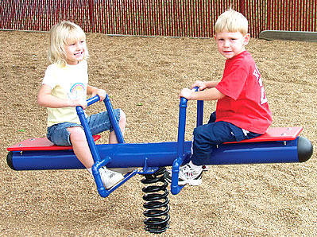
ISD in Balance
The Future-Strategic
The Present-Operational

Slide 28

Questions?

