Slide 1

Technology Leadership in Chaotic Times:
What we can learn from crisis
July 13, 2010
Edward G. Happ
Global CIO, IFRC
Chairman, NetHope

Slide 2
Three Take-aways
IT Strategy at an NGO is about capacity building and moving the agenda up the strategy pyramid to mission-moving applications
NGOs cannot follow in the footsteps of corporations; we need to stand on their shoulders
To succeed we need to partner and experiment

Slide 3
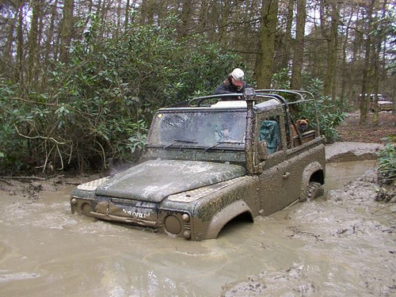
Stuck!
Notes:
http://farm3.static.flickr.com/2405/2116956923_98b45103fb.jpg

Slide 4
Moral of the Story
We cannot get the capacity gains we need in NGOs without working together more and sharing commodity resources
We cannot go it alone!

Slide 5
The value of IT?

Slide 6
Interesting Times
Save the Children (US)
  Canceled raises (2 years)
  10%+ HQ staff cuts; early retirement packages
CARE (Atlanta)
  ~70 staff laid off, including ~60 people in HQ
  Salary Cuts: executive by 10%; other staff by 4%
World Vision (US)
  50 staff laid off ~ 5 % US workforce; Eliminated 25 vacant positions
  Reducing benefits (retirement match down 50%; co-pays up)
  Freezing salaries/Canceling raises
Ford, Kellogg, RWJ Foundations
  Offering buyouts to 30-50% staff
  Closing offices and cutting travel
Museums and Art Orgs
  Layoffs; furloughs; and program scale-back/elimination

Slide 7
IT Departments Have Been Hit Hard
US NGOs with mandated cuts: 79%
Average cut from IT Budget: 24%
--US NGO-CIO Cost Cutting Survey, April 2009

Slide 8

Why is it that technology is too often "the music program of the nonprofit industry, the first to get cut and the last to be reinstated"?
-- Holly Ross, ED, NTEN

Slide 9

A parable
He CUT COSTS
Notes:
http://www.costumesupercenter.com/csc_inc/images/items/343x432/193003.jpg

Slide 10
A Question to Ponder
What if we got so good at cutting IT costs we had nothing left to move our mission forward?

Slide 11

Some Strategic Context

Slide 12
What’s the single most important strategic question?

Slide 13
What’s my destination?

Slide 14
NGO IT Strategy: Moving the Agenda Up the Pyramid
Competitive
or Leading
BENEFICIARY
“Differentiating”
Beneficiary & Field Facing
PROGRAM
“Improving Program Delivery”
Increasing Impact for Beneficiaries
OPERATIONAL
“Helping the Organization Run”
Efficient
Donor & HQ
Facing
FOUNDATIONAL
“Keeping the Lights On”

Slide 15
Technology is a Key to Building Capacity
More Effective Impact
At Greater Scale
Effective, Efficient, Scalable Programs
Hiring
Training
Partnering
Advocacy
Tools
Processes
Standards
Systems Impact
Funding Support
The Power of Collaboration

Slide 16
The Problem: NGOs invest a fifth of corp. IT
5x
18x
4x
Notes:
16
16

Slide 17
Closing the Productivity Gap: A New Calculus
A back of the envelop calculation for taking a $5M IT
department in a $200M NGO to $23M
Charity Factor
Collaboration Factor
56%
Gap Remains
Notes:
A fictitious $200M NGO; 1,700 users

Slide 18
Leveling the NGO - Corp IT Playing Field

Slide 19
Non Profit IT Departments Can’t Play the Odds
IF
57% of ERP projects don't realize their ROI (Nucleus Research)
66% IT projects fail (Standish Chaos DB)
NGOs spend a 20th what corporations do (Tuck survey)
And we are spending donors’ dollars
THEN
We must find a better way...
Notes:
19

Slide 20
Key Conclusion: we can’t do it alone
Even if we tripled IT spending, we will still be playing catch-up for just keeping the lights on.
And…
Notes:
20

Slide 21
Keeping the Lights-On is Irrelevant
It’s more a commodity each day
“We can't get close to what Google and Amazon can do in their data centers” –Peter Cochrane

Slide 22
We Need to Push the Pyramid at Both Ends
Get in
Competitive
or Leading
BENEFICIARY
“Differentiating”
Beneficiary & Field Facing
Increasing Impact for Beneficiaries
PROGRAM
“Improving Program Delivery”
OPERATIONAL
“Helping the Organization Run”
Efficient
Donor & HQ
Facing
FOUNDATIONAL
“Keeping the Lights On”
Get out

Slide 23
Bottom line?
What if we got so good at cutting IT costs we had nothing left to move our mission forward?
We would perish as irrelevant IT

Slide 24
Turning the Question Upside down
What would it take to be the
most relevant
IT departments we can be?

Slide 25
Nonprofits as a Leadership Case

Slide 26
What Don’t Nonprofits Do Well?
Death by consensus – participation paralysis: the strategic plan case
Quality over reach – the Asia Area day-care case
Accountability – the irony and loss of the university model
Metrics – reporting on input rather than impact

Slide 27
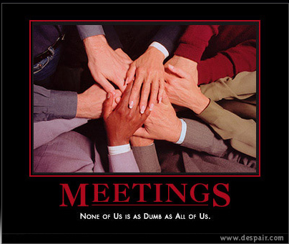
Death by Consensus
Notes:
The Monitoring & Evaluation (M&E) roundtable: no deadline meant a few nonprofits org’s laid our a 5-year project plan for measurement!
No deadline, no single, senior owner.
Image: http://despair.com/meetings.html

Slide 28
What Do Nonprofits Do Well?
Missions that matter
Engage employees hearts and minds
Collaboration rather than competition
Work-life balance –self directed rather than fewer hours
Pragmatic, “good enough” approach to services
We have engaging stories to tell and images to show

Slide 29
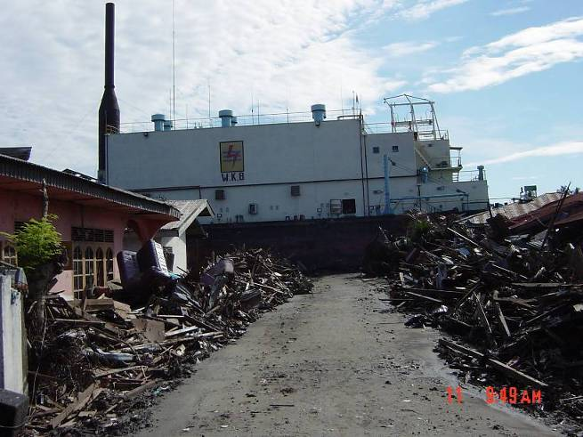
What is this large object?
a very large ship 5 miles inland in the middle of the road

Slide 30
Cisco Fellowship Program Take-Aways
Learn how to manage in chaotic times
  disaster response
How to manage with fewer resources
Influence and relationship management
  how to be the “glue”
Collaborate by example
Gaining a long-term rather than quarterly view
“Fellows became more holistic in their thinking” – Tae Yoo, VP

Slide 31
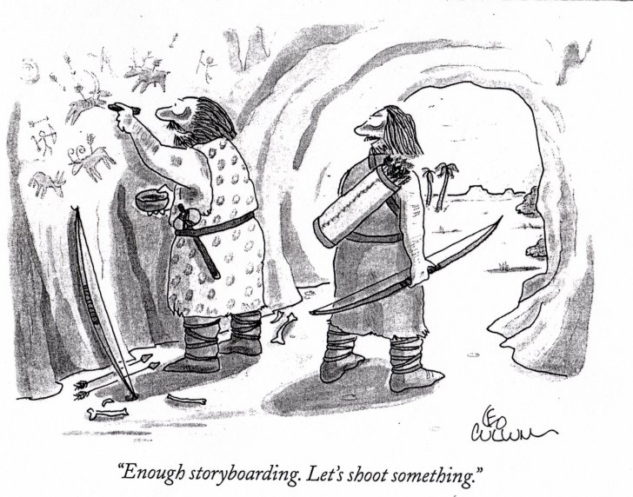
A Bias for Action

Slide 32

Advice from a Hockey Legend
“I skate to where the puck is going to be,
not where it has been.” --Wayne Gretzky
32

Slide 33
Looking to the Future

Slide 34
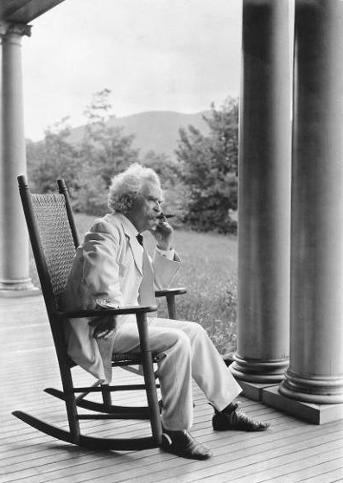
It’s More about Practices than Forecasts
"The art of prophecy is very difficult-- especially with respect to the future." --Mark Twain

Slide 35
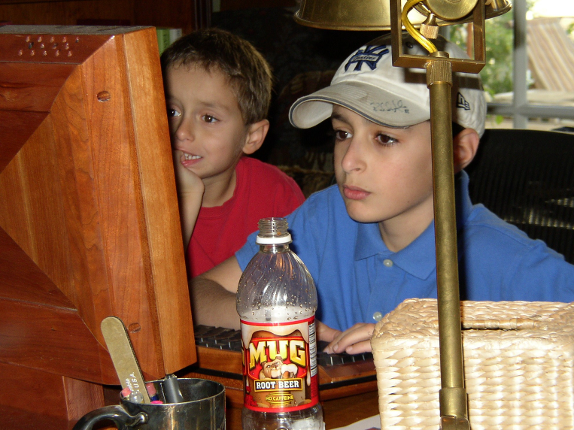
Who is Your Leading Indicator?
35

Slide 36
Who are you spending time with?
“If you’re a CIO, you need to spend a lot of time out on the fringes of the Web because that’s where the innovation’s taking place. You need to spend a lot of time with people under 25 years old.”
–Gary Hamel
Notes:
Gary Hamel interview, CIO Magazine, November 15, 2007, p. 50-55.

Slide 37
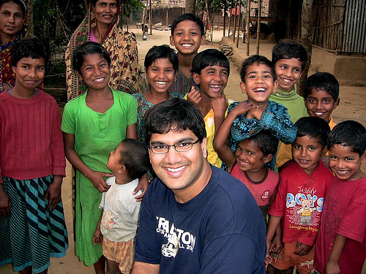
The Uncultured Project
Notes:
http://savetheworldblog.files.wordpress.com/2009/10/2606613587_44ea042f60.jpg
http://uncultured.com/

Slide 38
Turning 3 things upside down
Bottoms-up KM (Gmail case, Guru connecting)
Emerging countries leading (design for other 90%)
Children as forecasters (the technology is conversation, the safe conversation—like driving)

Slide 39
The New Collaboration
Who Are You Partnering With?
“Who has expertise I can trust?
Shared
Specialization
Joint Projects
“What can we build together?”
Increasing Level of Trust
Increasing Level of Trust
Partnering
“How can we work with corporations?”
Basic Info Sharing
“What are my peers doing?”
The Power of Collaboration

Slide 40
The Innovation Mutual Fund
I4 Health - MedCheck, a NetHope/Accenture initiative for battling the counterfeit drug trade.
I4 Microfinance - Mobile Banking pilot between NetHope, Accion and Microsoft, using Microsoft’s OneApp and PDAs/cell phones for Loan Approvals and Credit Scoring
I4 Education - eLearning and ICT Program for secondary schools with the Tanzanian government, NetHope Members, Accenture and others to reach 1.5M secondary school children.
I4 Geographic Information Systems - A hydrology/ water dataset sharing project in East Africa and a Disaster Preparedness pilot with partner ESRI.

Slide 41
Toward Relevant IT – A Manifesto
Mission-Moving Projects. Technology matters. We believe ICT can move missions, which is the most strategic application of ICT to which we can aspire
Good Enough Applications. Small is beautiful, faster to change, and fit for purpose
Shared Services. Sharing resources stretches and enhances what we do as individual organizations.
Lights-Out Infrastructure. To get in to mission moving app’s, we need to get out of basic IT operations. We need to shift the IT agenda from "lights-on" technology to “impact” technology.
Increased Experiments. Vary like mad. Pilot, prototype, trials. Partner to pilot: share the risks..

Slide 42
Six questions for Nonprofit Leaders
What new programs (that directly serve beneficiaries) have you helped engender that would not have been possible without the new use of technology?
What have you done to help close the "productivity gap" in the way your nonprofit delivers programs and operates as an organization?
How have you helped bridge the divide that will be caused by disruptive innovations in the nonprofit space?
For relief organizations: How have you helped disaster response be 50% faster with 50% greater impact?
How have you helped your organization attract and retain knowledge workers (and IT professionals) in the face of crisis of the baby boom generation retirement wave?
What are you doing to move commodity functions out of your organization and contribute time, dollars and support to the truly value-added functions of your agency?

Slide 43
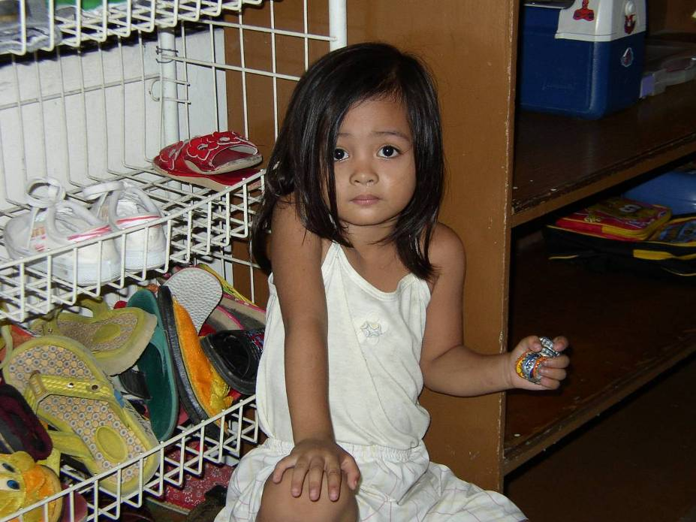

Slide 44
One Final Word
Before you make your bets: when there is rapid change and uncertainty, smart organizations vary like mad*. Run pilots, experiments and test ideas. Throw away what doesn’t work. Take to scale that which succeeds.
* See Jim Collins, Built to Last, Harper Collins, 1995, pp. 146-47.

Slide 45
Three Take-aways
IT Strategy at an NGO is about capacity building and moving the agenda up the strategy pyramid to mission-moving applications
NGOs cannot follow in the footsteps of corporations; we need to stand on their shoulders
To succeed we need to partner and experiment
The Power of Collaboration

Slide 46
Further Reading
Blogs:
http://eghapp.blogspot.com/
http://granger-happ.blogspot.com/ (Dartmouth Fellowship)
Web site (see the articles & presentations link) http://www.fairfieldreview.org/hpmd/EGHprofile.nsf
Email: ehapp@ifrc.org
Twitter: @ehapp
And the book:
Managing Technology to Meet Your Mission, chap. 11.

Slide 47
Questions? ehapp@ifrc.org

Slide 48
Appendices

Slide 49
NetHope Chairman's Report - excerpt
NetHope Summit in Nairobi, Kenya
March 15, 2010
Ed Granger-Happ

Slide 50
We can be creatively fast

Slide 51
Haiti
Some quotes:
“We pulled gear from manufacturers in 48 hours”
“Having CHF host us was critical”
“Equipment that was already in-country (e.g. VSATs) made big difference”
“An earthquake is different… need to set up when it’s safe”
“Creating a solution from scratch takes time”
“We got lucky”

Slide 52
Changing Priorities By Program Type
Ranking factors 1-4, 1=highest
For emergency response, time and volume are king;
for longer-term development, cost and quality reign
Notes:
For emergency response, time and volume are king; for development, cost and cost reign

Slide 53
NetHope Values – Guiding Principles
Technology (ICT) Matters
  NGO Missions depend on effective technology & capacity building
Benefiting all benefits one
  Benefiting one also Benefits All
Learn through collaboration
  Learn by doing
Build for the Field
  IT solutions are deployed solutions
Bias for action
  The need for speed, especially for emergencies
Trust above all else
  Trust comes through open dialog and working together over time

Slide 54
NetHope Values – Guiding Principles
Technology (ICT) Matters
  NGO Missions depend on effective technology & capacity building
Benefiting all benefits one
  Benefiting one also Benefits All
Learn through collaboration
  Learn by doing
Build for the Field
  IT solutions are deployed solutions
Bias for action
  The need for speed, especially for emergencies
Trust above all else
  Trust comes through open dialog and working together over time

Slide 55
We believe in building for the Field
Field workers delivering our organizations’ programs are our primary clients
Our IT solutions must work in the most remote and challenging parts of the world.
Field workers are our most important teachers and critics.
We seek to deliver technology that improves program design, delivery and field impact
We demonstrate measurable results

Slide 56

Seven International Nonprofits Agreed on a “Good Enough” Approach to M&E in Emergency Response

Slide 57
Further Reading
Blogs:
http://eghapp.blogspot.com/
http://granger-happ.blogspot.com/ (Dartmouth Fellowship)
Web site: http://www.fairfieldreview.org/hpmd/EGHprofile.nsf
Email: ehapp@nethope.org
Twitter: @ehapp
And the book:
Managing Technology to Meet Your Mission, chap. 11.

Slide 58
Questions?

Slide 59
Leadership in Chaotic Times
Poverty is growing at a faster rate than population. Donations continue to grow but it’s not enough to turn around the problem. We need new ways for addressing the issues. New partnerships and greater collaboration among NGOs, governments, corporations and citizens is needed. The N-Generation is increasingly interested in combining business and social impact, changing the nature of corporate social responsibility. We also need a greater use of technology to build capacity by orders of magnitude and deliver programs in new ways. This means freeing technology in our organizations from “lights-on” operational infrastructure that dominate our current time and budgets to more “mission-moving” uses of technology. This points us back to partnerships and shared services to free the creative energies of our organizations. We must collaborate or perish as irrelevant.

