Slide 1
The Digital Revolution
Edward G. Happ
Global CIO, IFRC
Chairman, NetHope
April 2012

Slide 2
A Brief Introduction
13 Years on Wall Street
10 Years in management consulting
12 years in NGOs
Global CIO at IFRC in Geneva
Former CIO at STC/US & UK
Co-founder and Chairman of NetHope.org
Publications at www.eghapp.com
Connect with me via LinkedIn

Slide 3
The Digital Revolution
We have all participated in the digital revolution, whether it's through the rise of on-line fundraising, social media and ever new devices. Our donors and employees have been at the center of the change.
The lessons of Haiti and the Arab Spring are that the next wave of the digital revolution for our work as NGOs is centered on the beneficiary, volunteer and citizen.
Let’s discuss key strategic questions surrounding these changes.
3

Slide 4

Technology Gives Voice and Ampifies
“The Internet is not a virtual world inhabited by avatars. It is a means of communication that offers people in the physical world a method to organize, act, and promote ideas and awareness. The Internet was going to change politics in Egypt...” –Wael Ghonim,
Facebook Revolutionary
Notes:
Revolution 2.0, " p. 51; http://www.nytimes.com/2012/02/19/books/review/how-an-egyptian-revolution-began-on-facebook.html?_r=1&nl=books&emc=booksupdateema4&pagewanted=print

Slide 5
What Are Some Key Questions?
How will we lead and respond to the rise of the digital beneficiary?
What does our strategic digital portfolio look like and how will it change?
What are the signs and weak signals of disruptive innovation that technology is posing for our work?
What are our radical collaboration opportunities to have more digital impact?
5

Slide 6
The Rise of the Digital Beneficiary
6

Slide 7
Who Are Our Digital Customers?
BENEFICIARY
Zone of Greatest
Digital Impact
FIELD
Programs
Increasing Impact for Beneficiaries
Increasing Impact for Beneficiaries
DONORS
HQ
Zone of Greatest
Digital Investment
7

Slide 8
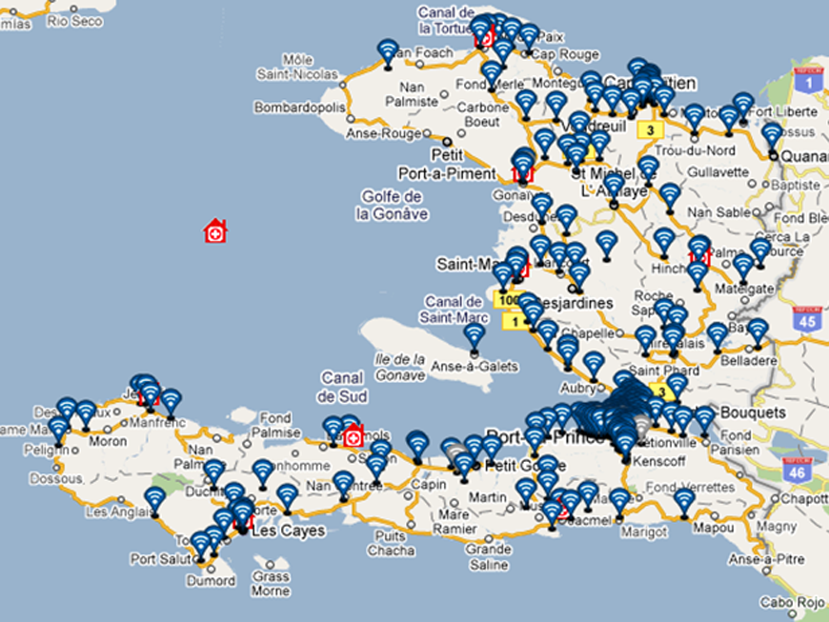
IFRC – Trilogy
TERA Application
Notes:
TERA = TRILOGY EMERGENCY RESPONSE APPLICATION
See http://www.ifrc.org/en/news-and-media/news-stories/americas/haiti/haiti-red-cross-takes-to-the-airwaves/

Slide 9
Texting Survivors in Haiti
6M SMS in 7 days
385K SMS/Day received
1.1M early warning SMS
1M Cholera health SMS
800K IVR calls in 1 month
Notes:
IFRC and Trilogy partnership: targeted SMS-based communications
6 million SMS sent during 7 days disaster preparedness campaign
385,000 messages received per day in PaP & Artibonite
1.1 million "early warning" SMS ahead of hurricane Tomas storm surges
Cholera: 2.1 million public health SMS sent:*733 IVR info-base; 800,000 calls to IVR in September
Survey potential
Beneficiary at the center of communications

Slide 10

Mobile Devices are exploding
>
Mobile devices people on earth
Dec 2012
31
“By the end of 2012, the number of mobile-connected devices
will exceed the number of people on earth…”
--Cisco Forecast, February 14, 2012
Notes:
“By the end of 2012, the number of mobile-connected devices will exceed the number of people on earth, and by 2016 there will be 1.4 mobile devices per capita. There will be over 10 billion mobile-connected devices in 2016, …exceeding the world's population at that time (7.3 billion).” --Cisco Forecast, February 14, 2012
http://www.cisco.com/en/US/solutions/collateral/ns341/ns525/ns537/ns705/ns827/white_paper_c11-520862.html

Slide 11
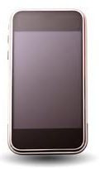
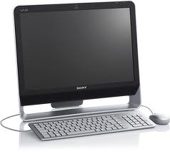
What’s your software platform?
80%
20%
Cisco forecasts of 7 billion phones by end 2012, 10 billion by 2016

Slide 12
The Strategic Digital Portfolio
12

Slide 13
Moving the IT Agenda Up the Pyramid
Competitive
or Leading
BENEFICIARY
“Differentiating”
Beneficiary & Field Facing
Increasing Impact for Beneficiaries
PROGRAM
“Improving Program Delivery”
Increasing Impact for Beneficiaries
OPERATIONAL
“Helping the Organization Run”
Efficient
Donor & HQ
Facing
FOUNDATIONAL
“Keeping the Lights On”
13

Slide 14
The technology budget is counter to the strategic impact
Zone of Greatest
Digital Impact
BENEFICIARY
FIELD
Programs
BENEFICIARY
“Differentiating”
PROGRAM
“Improving Program Delivery”
DONORS
OPERATIONAL
“Helping the Organization Run”
HQ
FOUNDATIONAL
“Keeping the Lights On”
IT Customers
IT Budget

Slide 15
Survey to 330 Nonprofit IT Leaders, April 2012

Slide 16
IFRC - The IT Portfolio for the Next 5 Years
Notes:
See “ISD Projects - Budget and Ratings - 5 year forecast v55e.xlsx” for the pie chart data

Slide 17
Disruptive Innovation
17

Slide 18
“A disruptive innovation is an innovation that helps create a new market and value network, and eventually goes on to disrupt an existing market and value network”
18
Notes:
http://en.wikipedia.org/wiki/Disruptive_innovation

Slide 19
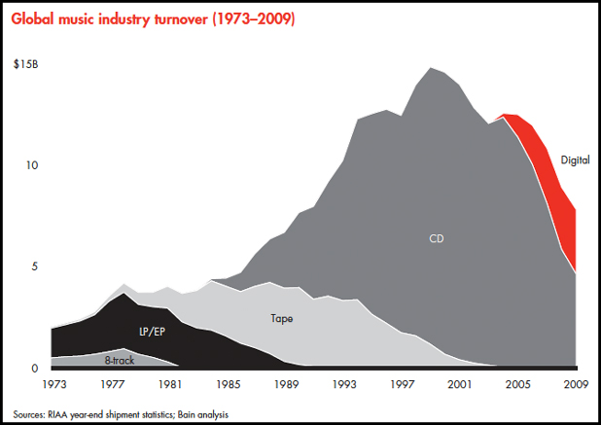
Disruptive Innovation and the Music Industry
Notes:
http://www.businessinsider.com/these-charts-explain-the-real-death-of-the-music-industry-2011-2

Slide 20
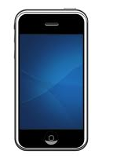

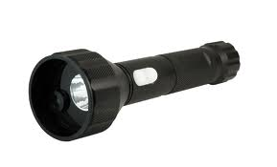
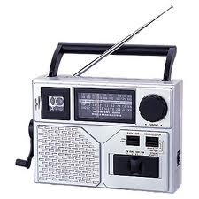

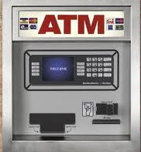
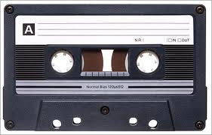
Cell Phones as Disruptive Technology
Travel agent
From Jonathan Boutelle, Co-Founder and CTO of Slideshare
20
Notes:
See Jonathan Boutelle’s (Co-Founder and CTO of Slideshare) Blog at http://www.jonathanboutelle.com/cell-phone-as-disruptive-innovation , SEPTEMBER 20, 2005

Slide 21
Some Potential Disruptive Themes?
In-country corporations and the rise of CSR
Beneficiary-driven programs
Survivor assessments
Renegade partners
Direct funders
Government and Military-driven programs
Social entrepreneurs

Slide 22
Radical Collaboration
22

Slide 23
Radical Collaboration
“Collaboration around the edges must move to the core. We need to build to share, buy to share, and harvest what’s been done by someone else.
For IT, radical collaboration is about having a technology need met by another organization’s IT department. In the future, NGO IT departments will be known not by the costs they save or the value they create, but by the partners they keep.”
–Collaborate or Perish, manuscript, p. 41

Slide 24
Peters Law of Proximity
The amount of innovation is directly proportional to the distance from headquarters.
What’s our far country?
The Field!

Slide 25


Application Catalog of
Standards & Choices
Discover
Harvest
NS IT Survey - Applications
Scale up
Application Portfolio
Review
850+
Application Catalogue
Criteria
De facto
vendor standards
Application Contest
Application Catalogue is the
window for NSs into supported applications
25
Notes:
http://www.istockphoto.com/stock-photo-4237972-funnel.php

Slide 26
Barriers to Collaboration
Not Invented Here (NIH) – not willing to accept ideas/solutions for outside
Hoarding – not willing to share ideas/solutions with others
Search obstacles – not able to easily find info of gurus
Transfer problems – not able to transfer complex knowledge from one group to another
Motivational Problems
Ability problems
--Morten T. Hansen, Collaboration, Harvard, 2009, Chap. 3

Slide 27
NetHope’s New Collaboration
Who Are You Partnering With?
“Who has expertise I can trust?”
Shared Services & Assessments
Share
and Do
Share
and Do
Share
and Do
SHARED
SPECIALIZATION
JOINT PROJECTS
“What can we build together?”
NRK, Phase 2 Satellites
Increasing Level of Trust
PARTNERING
“How can we work with corporations?”
Cisco, Microsoft, Intel Grants
Do and Share
BASIC INFO SHARING
“What are my peers doing?”
Meetings, Conference Calls

Slide 28
Conclusions?
28

Slide 29
What Are Some Key Questions?
How will we lead and respond to the rise of the digital beneficiary?
What does our strategic digital portfolio look like and how will it change?
What are the signs and weak signals of disruptive innovation that technology is posing for our work?
What are our radical collaboration opportunities to have more digital impact?
29

Slide 30
A Fundamental Law of Disruption
If you don’t answer these questions
Someone else will

Slide 31
Next steps?
Debate – truth comes out of the dialogue (a Socratic principle)
Develop a proposal for a joint approach to IT in time for the Global Perspectives meeting (31 October-02 November 2012 – and NetHope CIOs can help)
Partner with other NGOs (join NetHope, CIO4Good or NTEN)

