Slide 1
The Future of Technology in the Social Sector
Get Informed & Get Involved
Edward G. Happ
December 3, 2012

Slide 2
A Brief Introduction
13 Years on Wall Street
10 Years in management consulting
12 years in NGOs
Global CIO at IFRC in Geneva
Former CIO at STC/US & UK
Co-founder and Chairman of NetHope.org
Publications at www.eghapp.com
Connect with me via LinkedIn

Slide 3
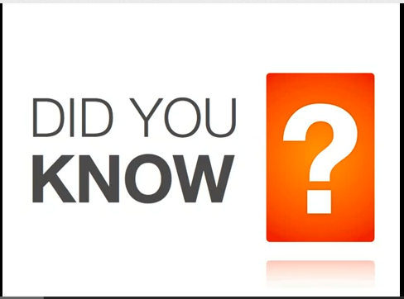
“Did You Know?”
V6.0 …2012
http://www.youtube.com/watch?v=XVQ1ULfQawk
3
Notes:
http://www.youtube.com/watch?v=XVQ1ULfQawk (0:00 - 4:22)

Slide 4

A Super Nova of Multiple Dimensions
Connected users
Info.
Apps
Notes:
http://www.williamsclass.com/EighthScienceWork/StellarEvolution.htm

Slide 5
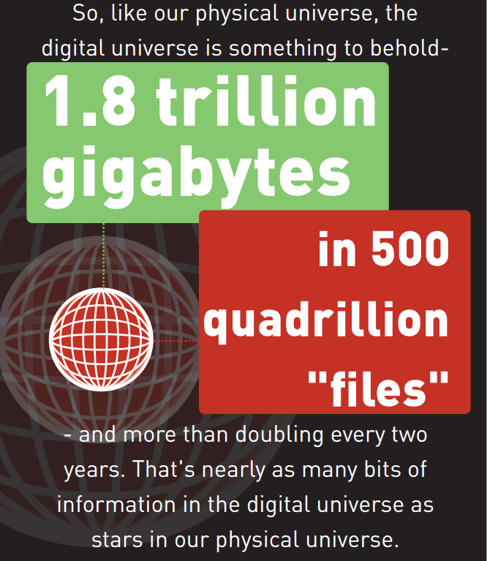
EMC – IDC Digital Universe Study, June 2011
40 exabytes (4.0 x 10¹⁹)
of new info in 2012
5
Notes:
http://www.emc.com/leadership/programs/digital-universe.htm
http://www.emc.com/collateral/about/news/idc-emc-digital-universe-2011-infographic.pdf

Slide 6
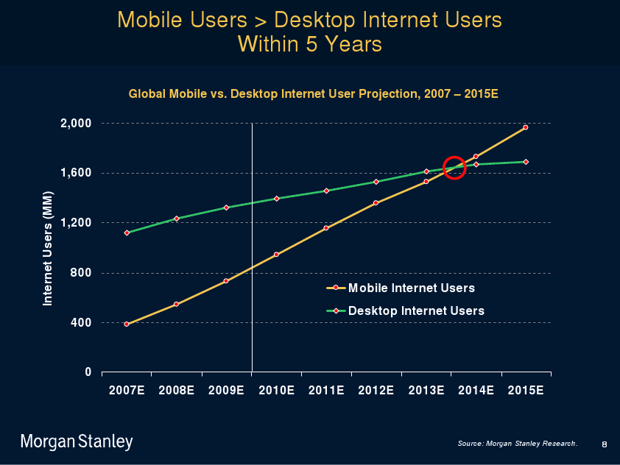
Explosion of connected users
Mary Meeker, Gigaom, April 2012
6
Notes:
http://gigaom.com/2010/04/12/mary-meeker-mobile-internet-will-soon-overtake-fixed-internet/

Slide 7
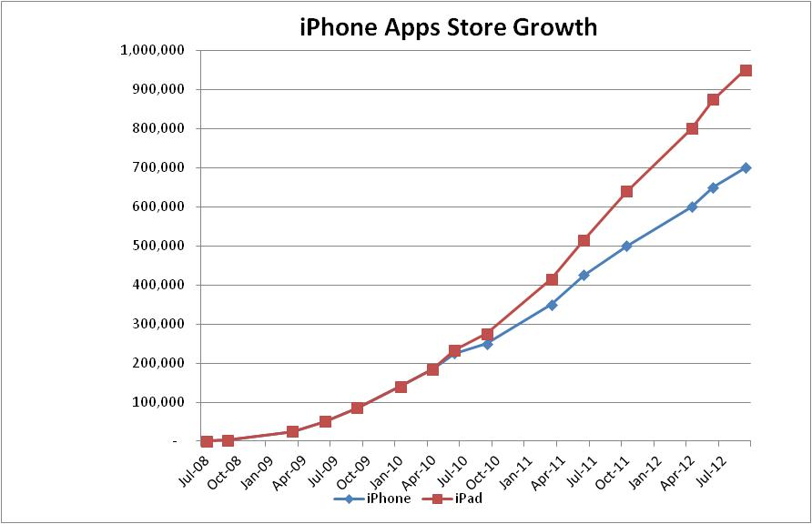
Explosion of mobile applications
7
Notes:
From ask.com

Slide 8
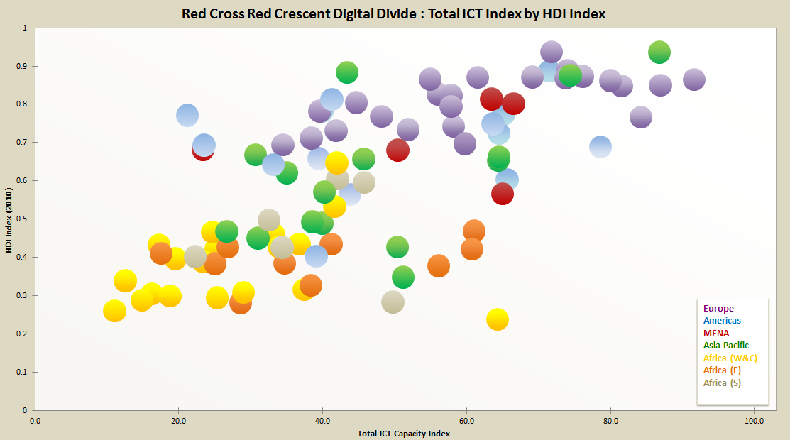
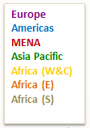
An Internal Digital Divide - RCRC
Lower ICT Index
Higher ICT Index
Human Development Index from the United Nations Development Program’s Human Development Report .
ICT index from a 2011 survey of NS ICT capacity, derived from 18 ICT capacity factors (self reported).
Notes:
Based on responses from 116 National Societies; raise issue of widening gap as all move up the ICT capacity curve.

Slide 9
What does this mean
for
humanitarian work?
?

Slide 10
5 Shifts for Humanitarian Technology
            to mobiles
            to local ER
            to preparedness
            to the beneficiary to collaboration

Slide 11
7 Trends in Development & IT
We will need to reach people where they are, with information they are seeking and with means of communication with which they are familiar
      Think: including a proactive
      mobile ICT strategy
      in development programs
11

Slide 12
7 Trends in Development & IT
The vulnerable will be information partners rather than recipients
      Think : inviting citizens to join our
      information networks
12

Slide 13
7 Trends in Development & IT
Survivors and vulnerable citizens will mobilize into connected advocacy groups faster and with more impact to make their needs known
  Think: advocating with beneficiaries
  and joining their
  information networks
13

Slide 14
7 Trends in Development & IT
The vulnerable will look to procure from us rather than us for them
      Think: inviting survivors into our
      supply chain as partners
14

Slide 15
7 Trends in Development & IT
Information and Communication Technologies for Development (ICT4D) are playing a growing role in NGOs as a means for delivering programs far beyond internal information about programs
      Think: paying attention and
      partnering with those
      who bring early innovations.
15

Slide 16
7 Trends in Development & IT
Technology corporations will be asking us to join & support their development efforts
      Think: partnering side-by-side
      with corporations
          in the delivery of programs
16

Slide 17
7 Trends in Development & IT
Citizens from the developed world will increasingly connect and partner directly with vulnerable citizens in the emerging world
      Think: partnering with non-traditional
      innovators who delivery
      assistance in more direct
      and connected ways
17

Slide 18

Collaboration: a movie lesson
“Whatever comes out of these gates, we got a better chance of survival if we work together.”
18
Notes:
http://www.youtube.com/watch?v=xXOPAPxZEpk (see 06:07 - 07:12 on this trailer)
Battle of Zama
Why did Carthage win over Rome this time?
There’s value in banding together
http://en.wikipedia.org/wiki/Gladiator_(2000_film)

Slide 19
Appendix

Slide 20
Four potential disruptions
Potential Disruptive Innovations enabled by technology
the renegade in-country partner who links directly with suppliers for emergency relief,
the beneficiary driven relief catalog with beneficiaries placing orders via portable kiosks,
in-country corporations taking the lead on programs and relief efforts in functional areas where they have strengths beyond ours (e.g., supply chain) and inviting us to join them,
donor directed projects in the micro-finance (Kiva) and other areas. How we deliver programs will change, either by us or despite us.
Notes:
From my 24-Aug-2009 Blog: http://eghapp.blogspot.ch/2009/08/peering-over-horizon.html

Slide 21
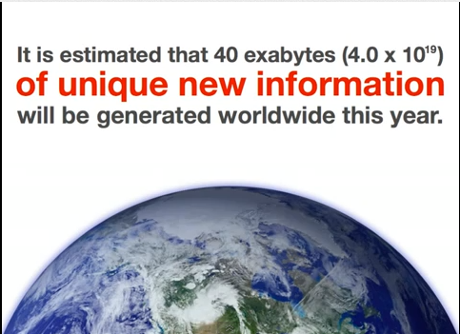
Explosion of Information
Notes:
40 exabytes = 4.0 x 10¹⁹

Slide 22

Explosion of connected users
“By the end of 2012, the number of mobile-connected devices will exceed the number of people on earth, and by 2016 there will be 1.4 mobile devices per capita” (over 10 billion mobile connected devices) --Cisco Visual Network Index Forecast, February 2012
22
Notes:
http://www.cisco.com/en/US/solutions/collateral/ns341/ns525/ns537/ns705/ns827/white_paper_c11-520862.html

