Slide 1
Becoming a Successful Consultant
Ten Things You Need to Know
Edward G. Happ
Executive Fellow, UMSI
February 11, 2019

Slide 2
The Request
“I'm sure the club members would love to hear about your experiences as a consultant and take in any knowledge and advice you can provide.” –William Chen
This is the client’s need… consulting 101!

Slide 3
Quick Audience Poll
  How many of you have consulting experience?
  How many have used consulting in your work or internships?
  How many know someone well who is a consultant?
  How many are in the BSI program? Other programs?
  How many plan to get a masters degree as a next step? In the future?

Slide 4
What is the question for today?
If you aspire to be a consultant,
What do you need to know?

Slide 5
A Personal Timeline
IT Manager, Wall Street
Consulting Partner
Global CIO
Teacher/ Researcher
Writer
Oenophile
Consulting provider >>> Consulting consumer
We are talking about this time
And this time
Chapter 1
Chapter 2
Chapter 3
Chapter 4
Chapter 5
1977
1991
2000
2017
Today
20??

Slide 6
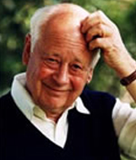
Why all these chapters?
When I was 38, I read a comment by Charles Handy saying we could expect to have 5 careers in our lifetime
So I started thinking in terms of 5 chapters to my career. I’m in chapter 4 now.
For your generation, the US Dept. of Labor estimates you can expect to have 14 jobs… by the time you are 38! *
*see https://www.youtube.com/watch?v=XrJjfDUzD7M at 02:15
Notes:
(see https://www.youtube.com/watch?v=XrJjfDUzD7M at 02:15)
http://www.amazon.com/The-Age-Unreason-Charles-Handy/dp/0875843018
Charles Handy, http://www.texasventures.us/india/images/leader2_1.jpg …five careers

Slide 7
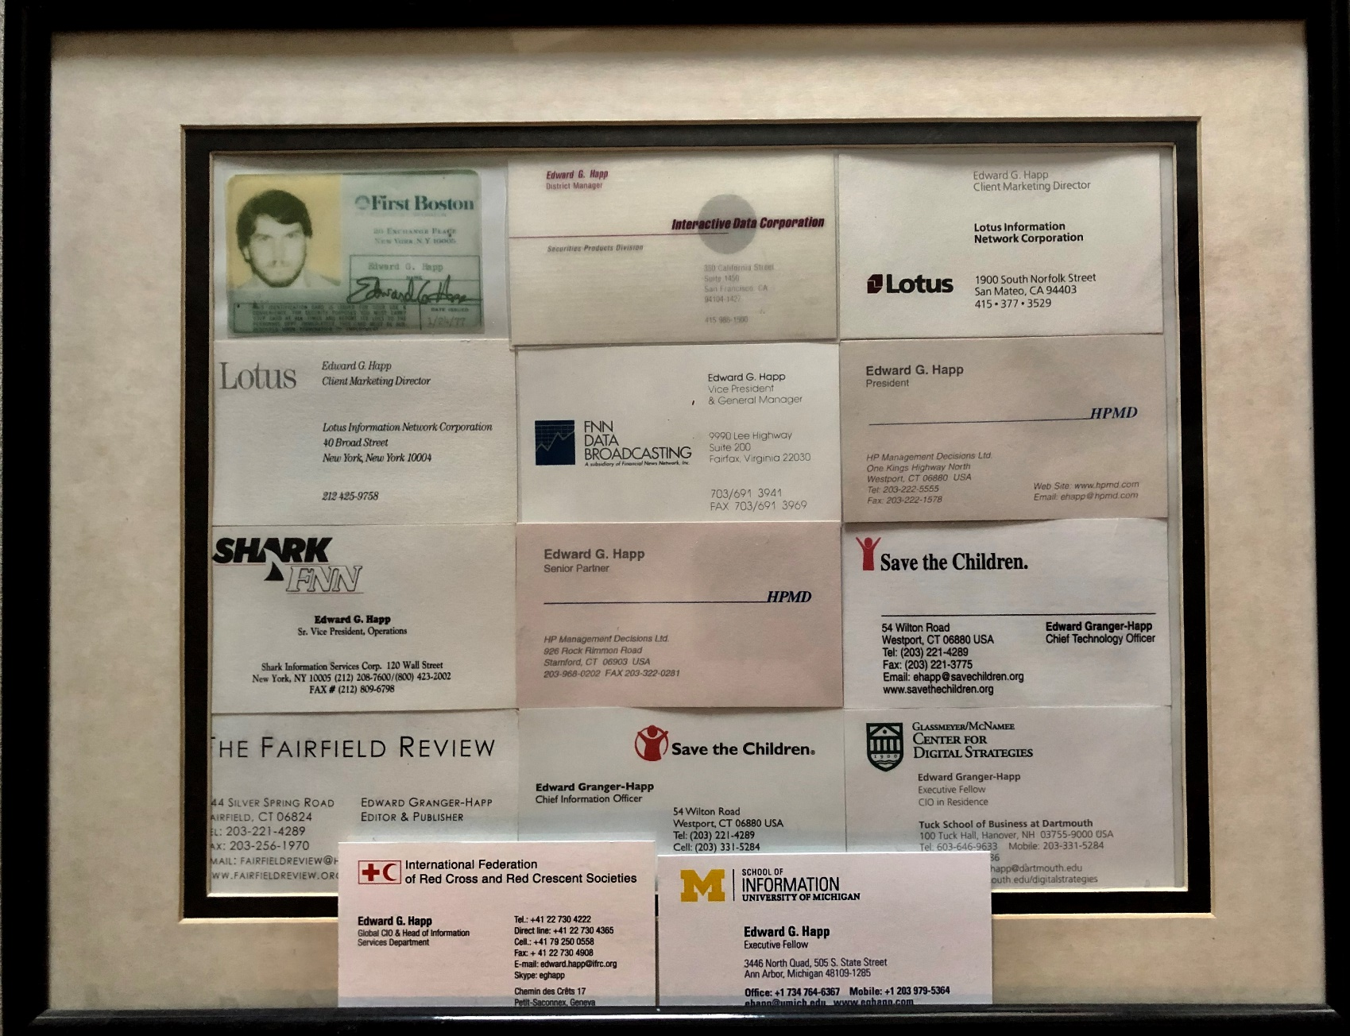
4 Chapters, 14 Roles…
So maybe I’m a Millennial in disguise?

Slide 8
How did I get into consulting?
Also grab the opportunities
Building personal relationships is important …connect!
14 years experience in IT before consulting (learning by doing)
I went thru multiple corporate restructurings and used that as an opportunity to start (and fund) a consulting business
My first customer was my former boss
My brother joined me and we brought on 2 others colleagues
We exited it as the dot.com bubble was peaking in mid-2000
Why? We missed doing rather than recommending; teams rather than solo projects
Over next 17 years I contracted and worked with consultants from Accenture, BCG, McKinsey, PwC, Deloitte, KPMG, Cap Gemini
–I knew what to expect and my standards were high!
Now I am teaching what I learned; not so different from a consultant!
Notes:
See the “The Most Prestigious Consulting Firms In 2015” list, here: https://www.forbes.com/sites/susanadams/2015/09/03/the-most-prestigious-consulting-firms-2/#53daa7257cf0
I worked with 5 of the 10.

Slide 9
Ten Things You Need to Know…
First know yourself
    what motivates you, engages you, makes you come alive?
Your brand (yes brand!)?
    What’s your expertise and your credentials that will justify your fees?
Connections!
    Who will be your references, your warranty? How do you make connections?
Present well!
    How will you market and sell yourself (yes sell!)?
Your audience
    What’s your market? Who are you selling to?

Slide 10
Ten Things You Need to Know…
Many of these are what it takes to run a small business
Paperwork
    What’s your client proposal (doc) and your contract?
Managing Projects
    How will you keep projects on track and report on progress?
Soft skills
    How will you read clients and handle ambiguity?
Legal
    What will be your legal structure, contracts?
Finance
    How will you keep your books & know enough accounting to manage your budget, issue invoices and file your taxes?

Slide 11
If you work for one of the big 10 consulting firms…
First know yourself
Your brand …+ credentials
Connections
Present well
Your audience
Paperwork
Managing Projects
Soft skills
Legal
Finance
Notes:
See the “The Most Prestigious Consulting Firms In 2015” list, here: https://www.forbes.com/sites/susanadams/2015/09/03/the-most-prestigious-consulting-firms-2/#53daa7257cf0
I worked with 5 of the 10.

Slide 12
Well that’s a lot easier!
Yes, the “operator” and “finder” stuff will be handled by the company
But the “grinder” stuff will be a marathon

Slide 13
Would I do it again?
Yes, absolutely.
It is a noble profession to be brought in to solve a problem based on your expertise

Slide 14
To stand out in the job market…
Having hired many professionals over the years, I find that five things are important for standing out among the competition:
Credentials - Beyond the degree, what internships, certificates, part-time jobs, etc. do you have?
Experience - Do you have relevant experience? (especially for nonprofits, volunteering counts; everyone can be a volunteer)
Marketing - Does your cover letter stand out? (I once hired a new graduate, in part based on the boldness and confidence of her letter)
Connections - Who do you know that can refer you? (build and work the personal network)
Soft skills - Can you hold an engaging conversation? (This includes communication, negotiating, handling ambiguity, selling skills, and even psychological sensitivity)
Notes:
http://www.hpmd.com/hpmd/personal/LTYMstories.nsf/links/472

Slide 15
What type of consultant will you be?
Freelance consultancy
Large consultancy
Size
Small/ Boutique
Local consultancy
International consultancy
Geography
Domestic
consultancy
Entrepreneurial
Traditional
Corporate Culture
Internal corporate

Slide 16
Self Discovery
Personal values clarification
Umbrella exercise
Adjectives exercise
Strengthfinders
What’s your brand?
http://www.hpmd.com/hpmd/personal/LTYMstories.nsf/links/472

Slide 17
What’s the main idea?
The top 3 takeaways from this talk:
Consulting takes experience
Consulting is a marathon
Consulting is a noble profession

Slide 18
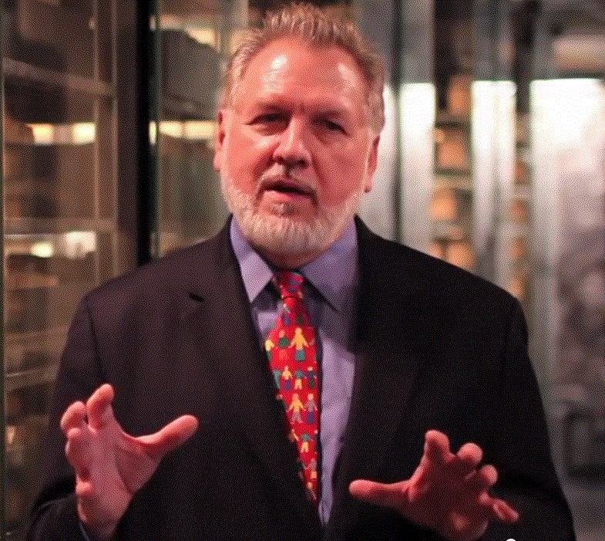
Who I Am…
40 years in IT, 38 in IT mgmt
13 Years on Wall Street
10 Years in management consulting
17 years in NGOs
Former Global CIO at IFRC
Former CIO at STC/US & UK
Co-founder and former Chairman of NetHope.org
More on LinkedIn, Google and www.eghapp.com
Connect!
Making Connections for Good
– People, Comm’s, Ideas
Notes:
When I was 38, I read a comment by Handy saying we could expect to have 5 careers;
For the millennials, US Dept. of Labor estimates you can expect to have 14 jobs…by the time they are 38! (see https://www.youtube.com/watch?v=XrJjfDUzD7M at 02:15)
http://www.amazon.com/The-Age-Unreason-Charles-Handy/dp/0875843018
Charles Handy, http://www.texasventures.us/india/images/leader2_1.jpg …five careers

Slide 19
Q&A, Discussion

