Slide 1
Academic - Practitioner Dialog
Close Encounters
ISCRAM Working Group
Edward G. Happ
May 19, 2019

Slide 2

Parable of Crossing the Street
Visit to Cairo for conference; our host was a manager two levels down in my org
How to cross 6-lane highway to dinner loc?
“Take my hand and don’t look”
“You have to know when to go and when to stop”
This was his country; we needed to follow his lead

Slide 3
Close Encounters

Slide 4
Vantage Points
Four Chapters
For Profit IT
1977-1990
Mgmt Consulting
1990-1999
Non-Profit
CIO
2000-2016
University
Faculty
2017-
Heath
NetHope
CIO Summit
ICT4D Conf
Sternin
Levine
Personal Collaboration Drivers

Slide 5
Six Cases

Slide 6
Case 1: Why Does NetHope Work?
19 year history of NGO IT practitioners collaborating with technology companies
Common desire for do-good impact
NGO scarcity and tech co abundance
NGO shared need to take IT the last mile to have the greatest mission impact
Tech co recognition that NGOs have the on-the-ground presence and experience >> reach
Shared bias for getting things done; we were both pragmatists
The power of aggregation and leverage

Slide 7

Case 1: Why isn’t there more collaboration?
Look at same 6 factors for academic – practitioner (NGO) partnerships
Common desire for do-good impact
NGO scarcity and academic abundance
NGO shared need to take IT the last mile to have the greatest mission impact
Academic recognition that NGOs have the on-the-ground presence and experience
Shared bias for getting things done; we were both pragmatists
The power of aggregation and leverage
? ?
?

Slide 8
Case 2: The Academic & Practitioner Communities: The IFRC CIO Summit
“From ACADEMIA, with Love,” Tina Comes and Bartel Van De Walle, IFRC CIO Summit, June, 2016
Takeaways
  Need to create academic-practitioner partnerships, based on research, consulting and feedback, but requires funding, patience (but no free resources)
  Research can provide data analyses, simulations and models using sample data from different organizations
  Academics feedback cycles are long (avg. 18 months to publish)
Notes:
C:\Users\ehapp\OneDrive - NetHope, Inc\CIO Summit\CIO Summit 2016\Presentations\2016_RCCOI_TC_BvdW_final.pptx

Slide 9
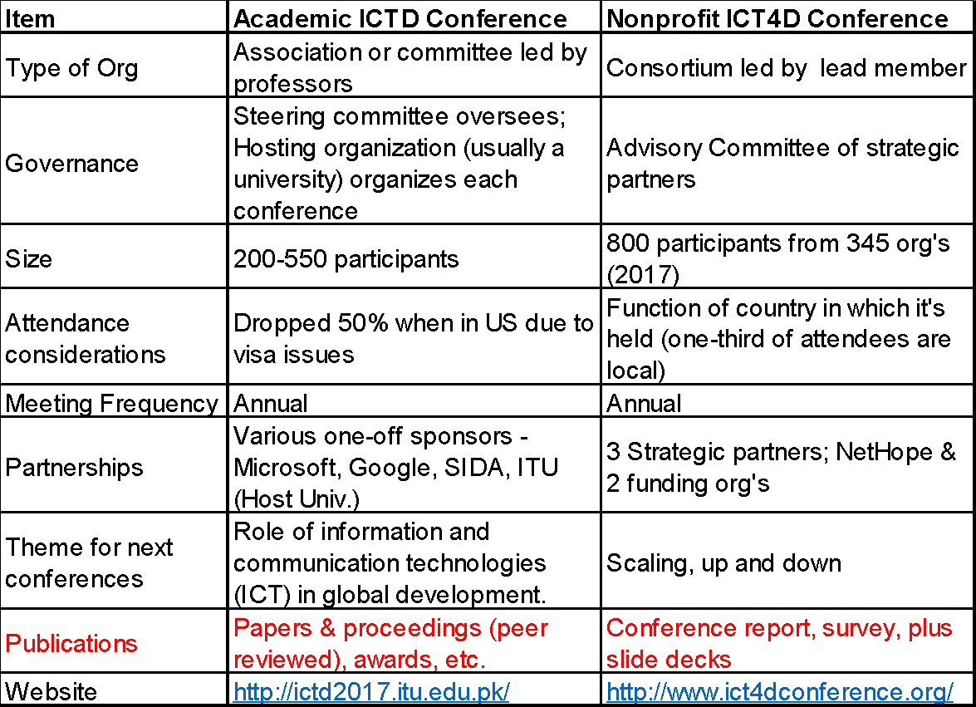
Case 3: Academic & Practitioner Conferences
Notes:
Academic vs Practitioner Confs v2.xlsx

Slide 10
Case 4a: ICT4D Partnerships for Impact
Two key requirements:
good partnerships require trust, often based on strong personal relationships.
they require that each partner gains something through partnership.
--Kentaro Toyama, “Some Things to Think About for the
Workshop on Leveraging NGO, University, and Social Venture ICT4D Partnerships for Impact,” May 11, 2018, ICT4D Conference, Lusaka, Zambia

Slide 11
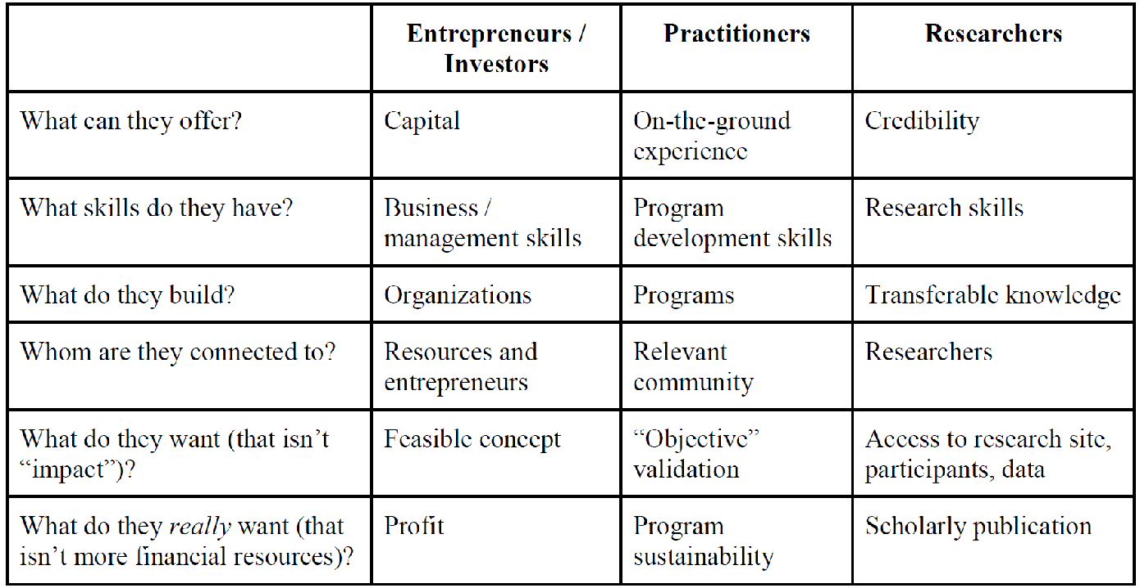
ICT4D Partnerships for Impact (cont.)
“A greatly oversimplified view of what I have experienced, stressing what different groups do best” --Kentaro Toyama

Slide 12
Case 4b: May-2018 ICTD Workshop Outcomes
Common things academics want that practitioners could provide?
Opportunity to test ideas in a real-world environment using network
Access to communities NGOs work with (matching, safeguarding & ethics committees)
Research to have real world impact
Common things practitioners want that academics could provide?
Longitudinal evaluation of project impact/effectiveness
Training & professional development for staff
Support for internal M&E and pre-assessment of projects
Help with longer-term, lower-priority work -> free labor
Summary of research to care about

Slide 13
Case 4c: ICT4D Workshop Results…
Working Groups defined to take two ideas forward:
A strategic university-NGO partnership that is not based on what might be a one-off project and is multi-dimensional with research, etc.
Social impact enterprise to “productize” inventions from academia. First step: identify actors and structure
We also talked about collaborating on a meta-journal…later
And…
Volunteers joined and led the teams
2-3 online meetings in 2018
No actions taken
One group died when leader got additional job
One group could not find common meeting times and is seeking a summer intern to research the question

Slide 14
Case 5: Basic Differences
“Academics are from Mars…” (Levine)
 | Humanitarian Practitioners | Academic Researchers
Timeframe | Days or weeks | Years
Mandate | Help vulnerable people in crisis | Increase knowledge
Funding | Private & Gov’t donors | Private & Gov’t donors
Success Measure | Reports & quantifiable outputs | Quality research publications
Need | Research-proven guidelines | Infrastructure-logistics to conduct crisis research

Slide 15
Case 5: Success Factors (Levine)
Dedicated coordinator between research and operational teams (at HQ and field levels)
Funding to pay for the above plus logistical overhead costs (e.g., space and staff time)
Built into the research grant and paid to the humanitarian org.

Slide 16
Case 6: Interesting ideas partnerships
Jerry Sternin at Save the Children developed positive deviance approach based on child nutrition program Vietnam (HBR, 2000)
Pascale (Oxford) and Sternin wrote an important article (HBR, 2005) applying Sternin’s work to leadership theory
Chip Heath (Stanford) & Dan Heath (Duke) developed this idea further in the “Bright Spots” chapter of Switch (2010)
Notice the practitioner-academic-metapaper progression
And…
“Maybe the problem is that you can’t import change from the outside in. Instead, you have to find small, successful but “deviant” practices that are already working in the organization and amplify them.”—Dorsey on Sternin (Fast Company, 2000)

Slide 17
Convergences and Divergences

Slide 18
Why Collaborate?
What are the benefits?
Practitioner‘s Offer*:
Access and reach
Community knowledge & relationships
Funding (during disaster response)
Program design & operational knowledge (on the ground logistics)
Academics Offer**:
Co-design and development of innovative solutions
Analyses, Simulations, Models addressing specific problems
Knowledge and capacity building environments
Credibility & research skills
* My observations over 20 years
** Tina & Bartel, Kentaro

Slide 19
Where are the intersections?
Both want impact
Both want the application of knowledge
Both recognize the value of working at the community level
Both need funding (from many of the same sources)

Slide 20
What are the obstacles?
Timelines - Disaster Response is now; research and publication process is months
  The research for this disaster won’t help the current program
Investigation methods
  Program design and monitoring + evaluation (M&E) versus testing hypotheses
Diverging time & money valuations
  Volunteer culture versus consulting culture

Slide 21
Conclusions

Slide 22
Why Did the ICT4D WGs Fizzle?
Part-time ownership
Few resources (people, funding)
No driving-force sponsorship
Top-down rather than bottoms-up discovery (positive deviants?)

Slide 23
Some questions to consider
Can we engage practitioners more in knowledge transfers, for research into practice?
Can we get more specific, with a narrower scope to deliver something useful?
Can we engage students more in this work?
Like in Cairo, what do you recommend to get us together across this road?

Slide 25
What can we as academics offer?
My call to action includes the following:
Develop crisis guidelines for academic - practitioner partnerships and test it out on joint projects
Review crisis papers and produce a meta journal of themes and trends for practitioner audiences to read
Find more success stories. Have a group of students and advisors find the bright spots and turn up the volume (ala Sternin)
Create a matching service to connect NGO project needs and research needs, like a VolunteerMatch , Kiva or Projects Direct match donors (of time and money) with humanitarian projects

Slide 26
What’s Next?
Breakout session one:
Problem Identification/Requirements analysis
What are the barriers to collaboration
What are the needs that are not being met
Breakout session two:
Guidelines & Matchmaking priorities
What would be the headlines for a guide to academic - practitioner partnerships during crises?
What would it take to produce an annual journal summarizing our research for themes and trends that can be applied?
What types of cases where we want to turn up the volume?
What are the requirements for a practice-research project matching service that we would want to use?

Slide 27
Breakout 2 Instructions
Part One
Break into four small teams
Each team discusses pros and cons of each of the four questions (the team’s own question may be added), one question per flip chart
Each team votes on one of the questions to focus on (individual dots/post-it exercise – 2 each)
Part Two
With the selected focus question, brainstorm topic headings of content/steps to implement the question
Select top 5 (individual dots/post-it exercise – 5 each)
Report out on top question and top 5 headings

Slide 28
Appendix

Slide 29
Vantage Points
Contexts: [make this a 2D timeline of contexts and key influences
CIO, Save the children, 2000-2009
Global CIO, IFRC, 2010-2016
NetHope Chariman, 2003-2014
UMSI Faculty, 2017-
Cases I looked at:
Sternin and Pascale Positive Deviance, 2000, 2005
Heath Bro’s extension in Switch, 2010
Tina and Bartel, IFRC CIO Summit keynote, June 2016
ICT4D conference 2018, Kentaro et al.
Alan Levine, “Academics are from Mars; Humanitarians are from Venus,” 2016

Slide 30
Notes
Aim at academics
Problems: what practitioners say
What can academics change to better engage with practitioners
What academics can’t change? Their research goals
Timelines are different
How can you achieve research goals and impact humanitarian work.
What kind of partners do you need to make that happen.
Is match-making the goal?
Provocative questions

Slide 31
The Academic & Practitioner Communities
“From ACADEMIA, with Love,” Dr. Tina Comes and Dr. Bartel Van De Walle, IFRC CIO Summit, June, 2016
Questions
  If decision-making is such a complex web, how (& who) can data help?
  Can information about “needs & uncertain trends” translate into better supply chains? Aren’t humanitarian supply chains inherently different?
  If Ebola was a “Big Data disaster” due to a lack of data privacy about mobile phone use, what’s the right balance with urgent data needs for the public good?
Notes:
C:\Users\ehapp\OneDrive - NetHope, Inc\CIO Summit\CIO Summit 2016\Presentations\2016_RCCOI_TC_BvdW_final.pptx

Slide 32
ICTD Workshop - What, When & Where
A half-day day workshop is proposed to bring together NGO practitioners, researchers, and representatives from social ventures to strengthen collaborations around ICT4D solutions.
The workshop will be conducted at the Convention Centre in Lusaka, Zambia after the ICT4D conference
Friday, 11 May 2018, 9am-1pm

Slide 33
ICT4D Workshop - Why?
Abstract: Encouraging Productive Interaction between Practitioners and Researchers
ICT4D research and practice are often disconnected: One prominent aspect of this phenomenon is that the practitioner-focused ICT4D Conference and the academic-focused ICTD conference tend to be siloed with relatively few participants crossing over to the other. In this invitation-only workshop, we bring together practitioners and researchers to identify and brainstorm solutions to the obstacles that impede better interaction between the two groups. Our goal is to arrive at a small number of collaborative projects around which groups of practitioners and researchers would work together.

Slide 34
Discussion Questions
Discussion:
1) How to take nonprofit problems and turn them into research initiatives
2) How to take academic research and have more practical application for practitioners?
3) What do practitioners need or desperately want (and in what form do they need it), that academics are likely able to offer?
4) What do academics need or desperately want (and in what form they need it), that practitioners are likely able to offer.
5) How do we harvest research to have more practical impact?
Desired Outcomes:
1) Participants identify 1 or 2 problems they are working on (or facing)
2) Identify points of intersection on these (current and potential)
3) Narrowing to the top 2-3 we want to work on together in the coming year.

Slide 35
May-2018 ICTD Workshop Outcomes
Exercise 1 - Clarify problems: Impromptu Networking*:
“As a practitioner, what do you need or desperately want that academics might be able to offer?
“As an academic, what do you need or desperately want that practitioners might be able to offer?”
For more than one citation, it is noted in parenthesis.
*Liberating Structures, Impromptu Networking, http://www.liberatingstructures.com/2-impromptu-networking/

Slide 36
May-2018 ICTD Workshop Outcomes
Exercise 2 - Finding the best ideas: 25/10 Crowdsourcing*:
“If you were ten times bolder, what big idea would you recommend? What first step would you take to get started?” Exchange cards 5 times, rate each idea on 1-5 scale, and then sum the scores.
*Liberating Structures, 25/10 Crowdsourcing,
http://www.liberatingstructures.com/12-2510-crowd-sourcing/

Slide 37
What do practitioners want?
It depends on when.
For disasters it’s speed and volume
So a key question is how to do more faster?
For long-term development it’s quality and funding
How to have measurable impact for less cost?

Slide 38

How do you read us?
NGO IT futures presentation at a university in Ohio. I was CIO of an int’l org.
During the Q&A, professor asked, “Do you read any of our work”?
No, but… I read research meta-papers in language of business
Importance of knowing your audience. Are professors writing largely for peers?
As member of UM faculty, I am more aware of pressures both groups face
To connect, need is for more meta-work.

Slide 39
Additional comments from Tina & Bartel
Academics and students are not free resources
Data analyses, simulations and models require cross-organization data
Academics offer (Proposal for Partnership)
  Co-design and development of innovative solutions
  Analyses, Simulations, Models addressing specific problems
  Knowledge and capacity building environments
They Need
  Access and joint deployment mechanisms
  Development of funding lines
  Feedback and an open conversational culture

Slide 40
ICT4D Partnerships for Impact (cont.)
The following questions may inspire some further thinking prior to the working session.
Is there a common language that practitioners and academics can both speak?
If researchers want to control how the data is collected, how can that be less intrusive on practitioner’s work?
Should we clarify what counts as research from each perspective?
How do systems better transfer from academic or entrepreneur development to NGOs?
Are the timeframes of academics, NGOs, entrepreneurs and tech co’s aligned? Is this a fundamental issue?
What kind of investment is required to sustain applications used in programs? What are the costs and who picks of the bill?

Slide 41
May-2018 ICTD Workshop Outcomes
Top 3 Big Ideas that resulted:
Funding Advocacy: A shared global voice/community to demand better approaches from funders, grants and private investors. First step: bring together the disparate global conferences, communities and meetups in each region. Second step: convince DIAL to fund this. (21 points)
Long-term, multidimensional partnering: A strategic university-NGO partnership that is not based on what might be a one-off project and is multi-dimensional with research, and evaluatory, experiential learning, training/professional development and other aspects. First step: Parallel pilot efforts in different dimensions together with planning dialogue (21 points)
Policy Advocacy: Form a global community of practitioners and researchers who work together to affect policy (in governments, multilaterals, foundations). First step: start with a small group of practitioners and researchers who work in one specific domain (e.g. maternal health during pregnancy; small-holder agriculture productivity; etc. (19.5 points)

Slide 42
Case 3b: May-2018 ICTD Workshop Outcomes
Things academics want that practitioners could provide?
Opportunity to test ideas in a real-world environment using network
A partner who is interested in doing policy work
People on the ground with global context and experience
Research to have real world impact
Partnership for external work to do joint proposals -> research skills + access
Invention and innovation
Summary of research to care about
Evaluations
Access to communities we work with (matching, safeguarding & ethics committees)
Dissemination to enable my research to have real-world impact
Access to health workers to test
Networks

Slide 43
My Personal Favorite…
5. Meta-Journal: Journal of academic studies themes for practitioners, published and used by all NGOs. First step: publish a sample “meta” paper. (18 points)

Slide 44
The Challenge
Can we as (mostly) crisis academics do better on partnerships than the ICT4D practitioners?

