Slide 1
Crisis, Connections and Collaboration
All sections to appear here

Slide 2
Crisis, Connections and Collaboration
Edward G. Happ
Global CIO, IFRC
Chairman, NetHope
October 17, 2011

Slide 3
Introductions
pptPlex Section Divider
The slides after this divider will be grouped into a section and given the label you type above. Feel free to move this slide to any position in the deck.

Slide 4
A Brief Introduction
13 Years on Wall Street
10 Years in management consulting
12 years in NGOs
Former CIO at STC/US & UK
Co-founder and Chairman of NetHope.org
More on LinkedIn, Google and www.eghapp.com

Slide 5
Crisis, Connections, Collaborations,
An Outline
Crisis – the world is dangerous place
  Story: Loma Prieta Earthquake
  IFRC by the numbers
  Anatomy of response
  The new information crisis – volume, speed and quality
Connections – more people are connecting to help
  Story: crossing the Street in Cairo
  Survivors are on the team – everyone is a sensor
  Changes in telecommunications – rise of mobiles
  Changes in the crowd – flipping the pyramid
  Changes in the supply chain
Collaboration – working together is not an option
  Story: A tree in Zaire
  The NetHope case – shared services and mutual funds
  More is better (apps catalog) and less is more (value of scarcity)
How you can help
5

Slide 6
Three Take-aways
Crisis – the world stage is getting more challenging
Connections – responding to crisis with technology is becoming more social
Collaboration – working together is not an option, it’s an imperative
6

Slide 7
Crisis
pptPlex Section Divider
The slides after this divider will be grouped into a section and given the label you type above. Feel free to move this slide to any position in the deck.

Slide 8
1. Crisis

Slide 9
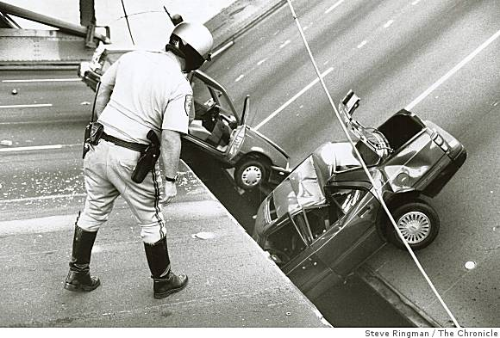
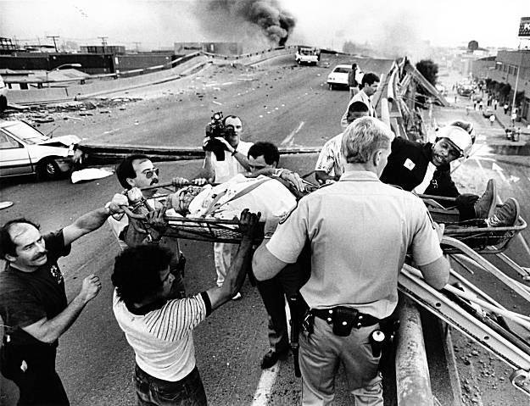
October 17, 1989
San Francisco, 5:04 pm
Loma Prieta earthquake
9
Notes:
Photos: http://jellyjules.com/?p=2656
http://en.wikipedia.org/wiki/1989_Loma_Prieta_earthquake

Slide 10
1989 Loma Prieta earthquake
“The Loma Prieta earthquake, also known as…the World Series Earthquake, was a major earthquake that struck the San Francisco Bay Area of California on October 17, 1989, at 5:04 p.m. local time.
“Caused by a slip along the San Andreas Fault, the quake lasted 10–15 seconds and measured 6.9 on the moment magnitude scale (surface-wave magnitude 7.1)
Killed 63 people throughout northern California, injured 3,757 and left some 3,000-12,000 people homeless.
“occurred during the warm-up practice for the third game of the 1989 World Series, featuring …the Oakland Athletics and the San Francisco Giants. …the first major earthquake in the United States of America to have its initial jolt broadcast live on television. --wikipedia
10
Notes:
http://en.wikipedia.org/wiki/1989_Loma_Prieta_earthquake

Slide 11
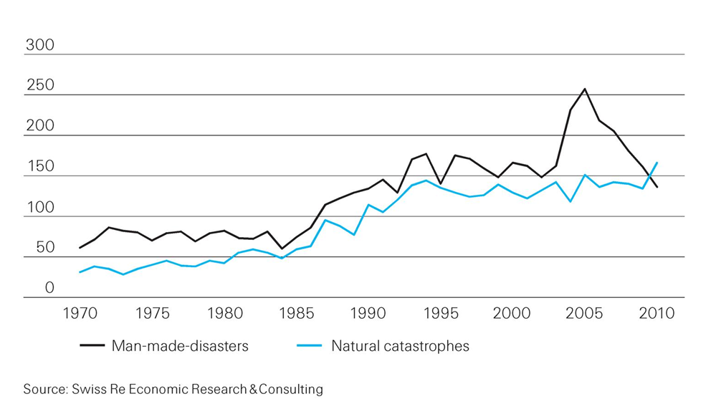
Catastrophic events are on the rise
From less than 100 in 1970 to over 300 in 2010
U.S. Hurricanes
11
Notes:
http://media.swissre.com/documents/sigma1_2011_en.pdf Hurricanes Katrina, Rita, Wilma

Slide 12
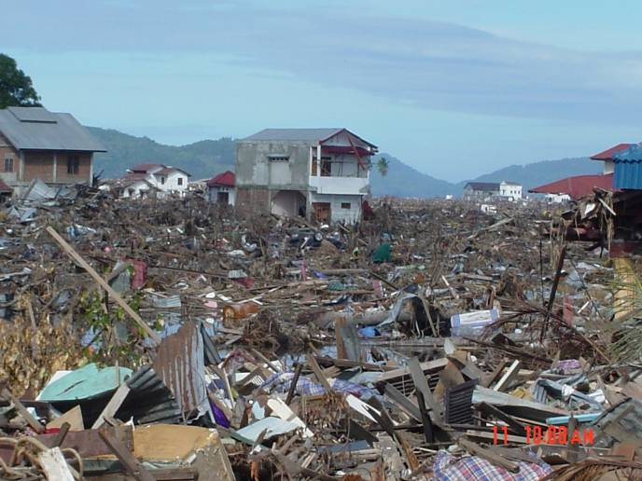
Banda Aceh – Ground Zero 26 Dec 04
Notes:
12

Slide 13
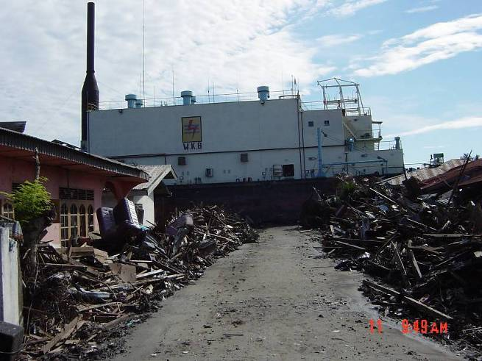
What is this large object?
a very large ship 5 miles inland in the middle of the road

Slide 14
1b) ifrc by the numbers

Slide 15
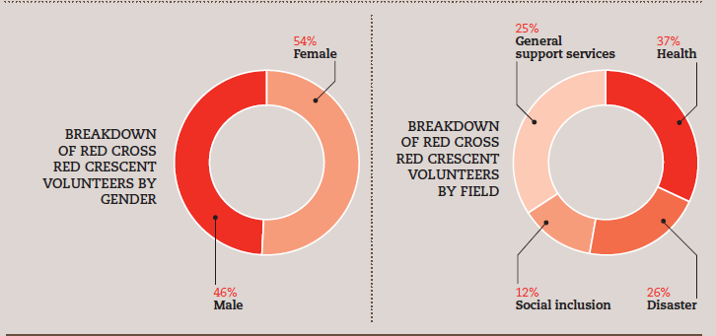
The International Federation of Red Cross and Red Crescent Societies (IFRC) is the world’s largest humanitarian and development network, with volunteers based in 186 National Societies

Slide 16
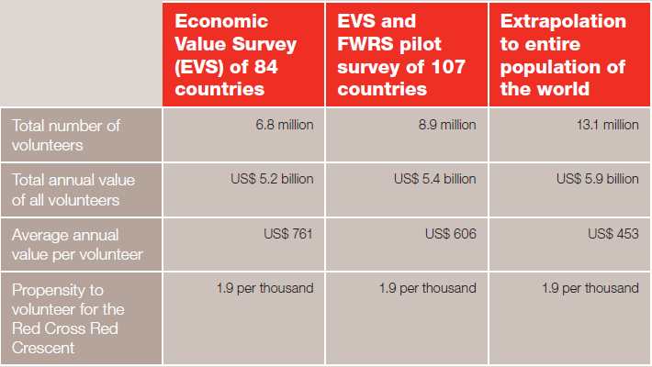
Economic value of volunteers by three sample sets

Slide 17
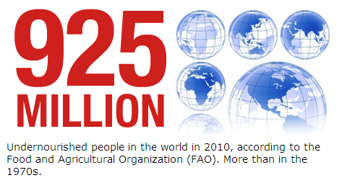
17

Slide 18
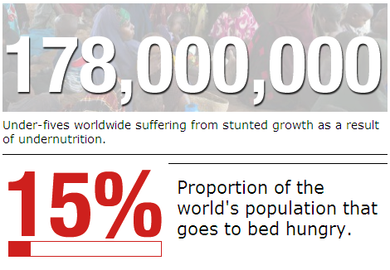
18

Slide 19
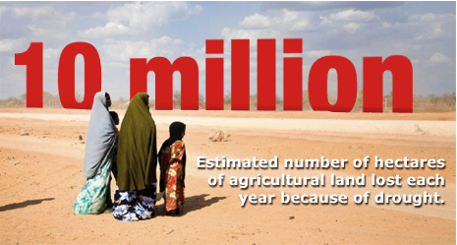
19

Slide 20
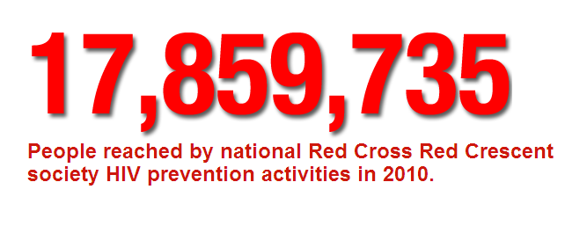
20

Slide 21
1c. Anatomy of response

Slide 22
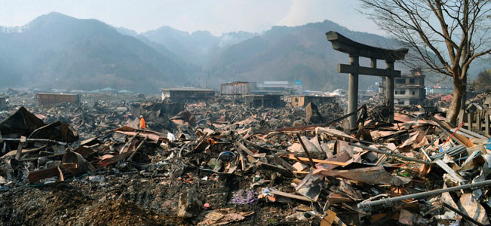
Japan Tsunami Aftermath – 14 Mar 11
A destroyed landscape in Otsuchi village,
Iwate Prefecture in northern Japan” -- Reuters/Kyodo
22
Notes:
http://news.yahoo.com/s/ap/ap_on_bi_ge/as_japan_earthquake_nuclear_crisis

Slide 23
Stages of a Disaster Response
Stage 0: Preparedness
  Example: Typhoon preparedness in Bangladesh
  This is the best investment (4:1)
Stage 1: Within hours of disaster striking
  Example: CRS in sectarian fighting in eastern Congo
  This is the Highly Individual, Highly Mobile ICT stage
Stage 2: Within two weeks of disaster striking
  Example: Relief International in Bam, Iran earthquake
  Small Group, Highly Mobile/Temporary ICT stage
Stage 3 – From one-six months following a disaster striking to multi-year.
  Large Group - Permanent ICT stage
Stage 4 – Learning
  Example: NetHope members in Pakistan earthquake response
  Don’t waste mistakes
23
Notes:
Bangladesh cyclone: 3,000 fatalities in 2007 versus 138 000 in 1991 and 500,000 in 1970
Factor of 50-100 reduction due to advance evacuation of 3.2M people and stockpiles of relief supplies, i.e. disaster preparedness! (see http://fe4.news.re3.yahoo.com/s/time/20071119/wl_time/howbangladeshsurvivedthecyclone )

Slide 24
Bangladesh Cyclone Fatalities
24
Notes:
Bangladesh cyclone: 3,000 fatalities in 2007 versus 138 000 in 1991 and 500,000 in 1970
Factor of 50-100 reduction due to advance evacuation of 3.2M people and stockpiles of relief supplies, i.e. disaster preparedness! (see http://fe4.news.re3.yahoo.com/s/time/20071119/wl_time/howbangladeshsurvivedthecyclone )

Slide 25
Changing Priorities By Program Type
For emergency response, time and volume are king;
for development, cost and quality reign
Ranking factors 1-4, 1=highest
25
Notes:
For emergency response, time and volume are king; for development, cost and cost reign

Slide 26
An NGO Supply Chain
Beneficiary engagement
Assessment
Country – Sub-Office
Reporting
Plan
Procure
Ship
Warehouse
Ship
Ben. Track
For development, procurement is competitive; for emergency response, procurement is pre-determined and agile
Beneficiary tracking is key in the NGO supply chain; commercial SCM applications lack this
Beneficiary engagement is increasing in the supply chain
26
Notes:
For development, operational budget planning happens first; competitive bids are < 3 days due to relationships with suppliers; so often the same process for ER

Slide 27
Crisis Needs?
First: is my family OK?
Second: can I get food, water, shelter?
Third: can we communicate? (Voice / Data)
27
Notes:
27

Slide 28
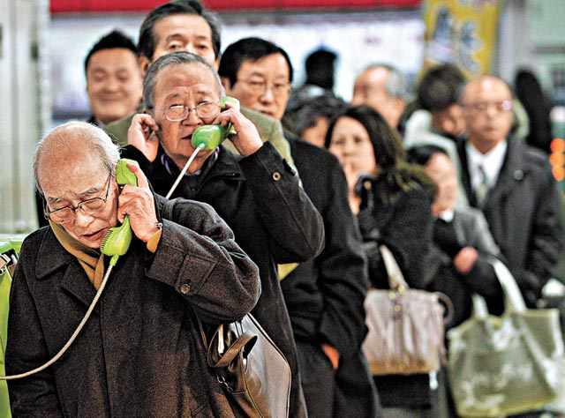
People need to know their loved ones are safe
28
Notes:
http://voices.washingtonpost.com/blog-post/tsuna.JPG

Slide 29
1d. The new information crises

Slide 30
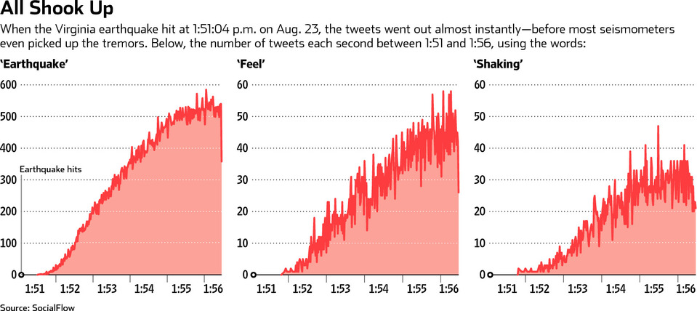
Tweets were faster than the seismometers
30
Notes:
http://online.wsj.com/article/SB10001424052970204138204576598942105167646.html?mod=ITP_review_0#articleTabs%3Darticle%26project%3DEARTHQUAKE_TWEETMAP1109

Slide 31
Flows of Data to Crises Response
UN NGOs
1.0 Data volume
Flows of Data to Crises Response
“Disaster Relief 2.0”,
UN Foundation report, March 2011

Slide 32
Data Overload
Volunteers
Techs
UN NGOs
Beneficiaries
1.0 Data volume
2.0 Data volume
Flows of Data to Crises Response
“Disaster Relief 2.0”,
UN Foundation report, March 2011

Slide 33
The Problem of Unintended Consequences
Higher participation
Untimely decision-making
Increased demand for fast data
More work responding to HQ than for Field
Faster communication with email
Cannot read all the daily email
33

Slide 34
Eight Information Challenges in need of Solutions
Relevance
Is it actionable?
Verification and authentication
Is it true? Is it a hoax?
Duplication
Has this already been dealt with?
Access
Do the most vulnerable have the tools?
34
Notes:
Relevance: Fast information is not the same as actionable information. Hearing about an earthquake on Twitter before it shows up on the website of the US Geological service is interesting, but does not help to prepare the response.
Access: In a first aid course you learn that the person who shouts the loudest is not the one you should necessarily focus on first. The priority is the unconscious person lying next to him. In a similar way we have to ask us whether the people tweeting after a disaster are always the ones who need help most urgently, particularly in a large scale disaster that requires response in a systematic, large scale way and cannot always respond to individual cries for for example shelter or water. People buried under rubble are obviously a different matter.

Slide 35
Information Challenges in need of Solutions (cont.)
Privacy
Is confidentiality respected? Security risks?
Expectations
Are we creating unrealistic expectations?
Impact
Converting Data into Aid delivery?
Proximity
Understanding new proximity dynamics
35
Notes:
Relevance: Fast information is not the same as actionable information. Hearing about an earthquake on Twitter before it shows up on the website of the US Geological service is interesting, but does not help to prepare the response.
Access: In a first aid course you learn that the person who shouts the loudest is not the one you should necessarily focus on first. The priority is the unconscious person lying next to him. In a similar way we have to ask us whether the people tweeting after a disaster are always the ones who need help most urgently, particularly in a large scale disaster that requires response in a systematic, large scale way and cannot always respond to individual cries for for example shelter or water. People buried under rubble are obviously a different matter.

Slide 36
Connections
pptPlex Section Divider
The slides after this divider will be grouped into a section and given the label you type above. Feel free to move this slide to any position in the deck.

Slide 37
2. Connections

Slide 38
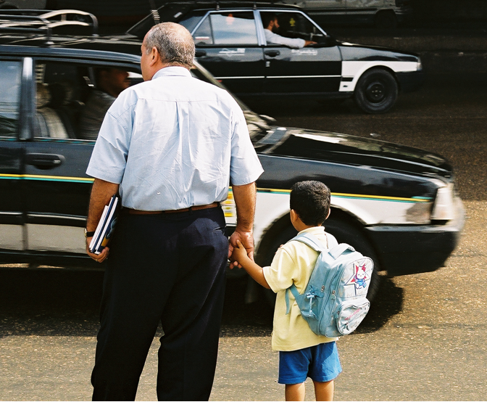
Parable of Crossing the Street
38
Notes:
http://www.flickr.com/photos/islandspice/290682376/sizes/o/in/photostream/
“The traffic in Cairo is, by western standards, insane. There are few traffic lights in the city, and no one pays any attention to them. The painted lines on the street and highways are at best guidelines; if four cars can fit in three lanes, they do. One evening in Cairo we parked near the edge of the old city and walked to dinner. At the first main street, we experienced the drivers of Egypt, up close and personal. How were we ever going to cross this street? My New York instincts were to look for a gap in the traffic, and run for it. But there were no gaps.
Though I was the boss, Farouk took charge. "Hold my hands," he said, "follow my lead, and don't look!" It was a strange experience, a throw-back to early childhood, grabbing Dad's hand before crossing the street; depending on him to get us safely across. "Go now," he said, taking five steps forward and stopping, then five more. Cars were swerving around us like a river around three rocks. "Hold on," he admonished, "do what I say; now go." In a dance I did not understand, he guided across the sea of chaos, to the other side.
When we caught our breath, and heart rates slowed down, I asked him how he got us across. In New York, we would have been killed. But these were Cairo rules. "When you step out," he said, "the drivers must take responsibility not to hit you." "...but you need to know when to step out," he added.
This story was a lesson I'll never forget, precisely because I needed to forget. I had to put aside my experience and preconceived notions of how to cross a busy street, and trust someone else to guide me through their country's rules. Letting others lead you and teach you is part of becoming a good leader. It is especially true of learning about other cultures--we will never get it as well as those who have it in their blood. This also applies to our areas of expertise. Sometimes we need to let others teach us.” --http://www.hpmd.com/hpmd/personal/LTYMstories.nsf/links/289

Slide 39
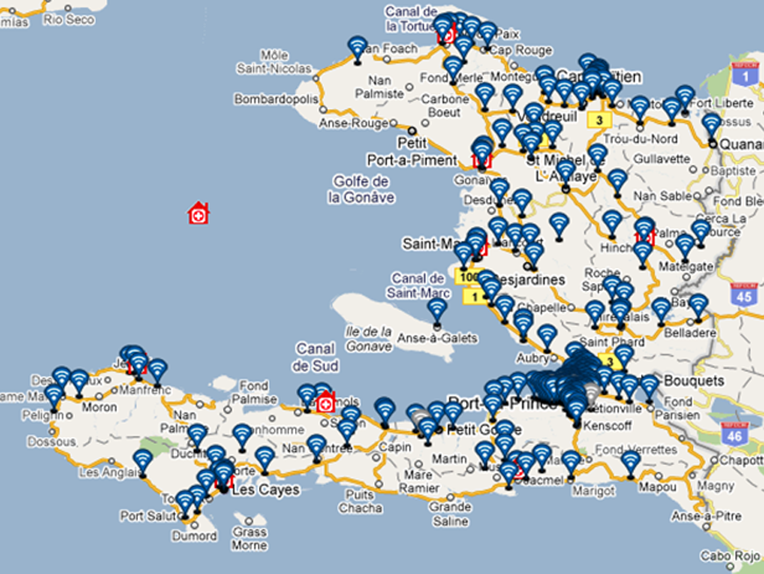
IFRC – Trilogy
TERA Application
Notes:
TERA = TRILOGY EMERGENCY RESPONSE APPLICATION
See http://www.ifrc.org/en/news-and-media/news-stories/americas/haiti/haiti-red-cross-takes-to-the-airwaves/

Slide 40
Texting Survivors in Haiti
6M SMS in 7 days
385K SMS/Day received
1.1M early warning SMS
1M Cholera health SMS
800K IVR calls in 1 month
40
Notes:
IFRC and Trilogy partnership: targeted SMS-based communications
6 million SMS sent during 7 days disaster preparedness campaign
385,000 messages received per day in PaP & Artibonite
1.1 million "early warning" SMS ahead of hurricane Tomas storm surges
Cholera: 2.1 million public health SMS sent:*733 IVR info-base; 800,000 calls to IVR in September
Survey potential
Beneficiary at the center of communications

Slide 41
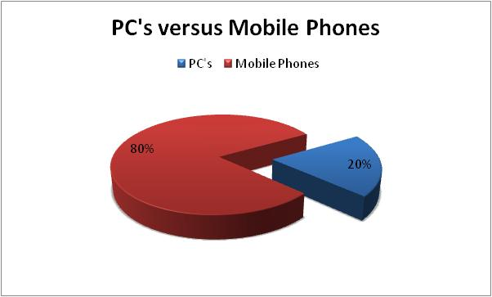
What’s your software platform?
Cell phones sold have passed the 5.5B mark, versus 1.2B PCs
41

Slide 42
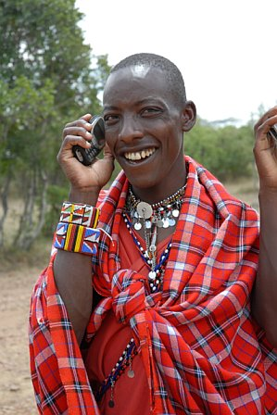
For the rest of the world, this is the Internet
Notes:
Masai Warrior at Ikelani Using Cell Phone, Jupiter research Blog, Julie Ask, October 06, 2006; http://weblogs.jupiterresearch.com/analysts/ask/archives/007174.html

Slide 43
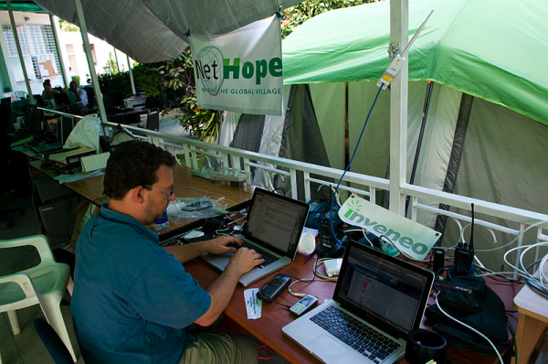
Shared WiFi Network in Haiti
Mark Summer configuring networks at NetHope/Inveneo tent city
43
Notes:
http://www.inveneo.org/?q=haiti-links-grow

Slide 44
Collaboration
pptPlex Section Divider
The slides after this divider will be grouped into a section and given the label you type above. Feel free to move this slide to any position in the deck.

Slide 45
3. collaboration

Slide 46
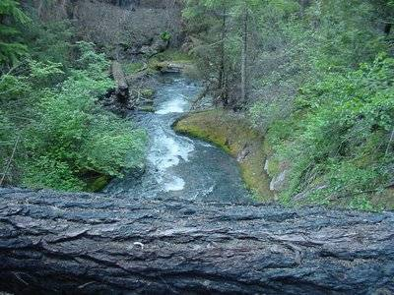
A Tree in Zaire
“The tree the tempest with a crash of wood / Throws down in front of us is not to bar / Our passage to our journey's end for good, / But just to ask us who we think we are.”
–Robert Frost
46
Notes:
Robert Frost, “On a Tree Fallen Across the Road,” http://www.americanpoems.com/poets/robertfrost/12119
http://oceanshaman.blogspot.com/2007/11/on-tree-fallen-across-road.html

Slide 47
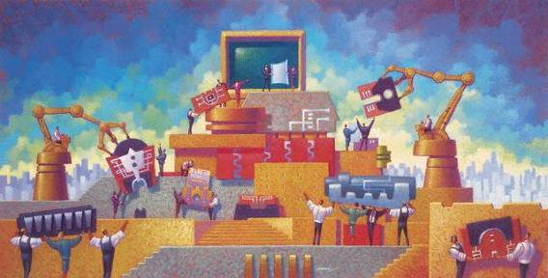
NetHope Vision
Connected Together:
To be a catalyst for collaboration in the International NGO community and enable best use of technology for connectivity in the developing parts of the world
Notes:
NGO – Nongovernmental Organization (nonprofit, charity, social sector)

Slide 48































Collaboration: 34 Member NGOs
48

Slide 49
NetHope Values – Guiding Principles
Technology Matters
  NGO Effectiveness depends on technology and capacity building
Benefiting all benefits one
  Benefiting one also Benefits All
Learn through collaboration
  Learn by doing together
Build for the Field
  IT solutions are deployed solutions
Bias for action
  The need for speed, especially for emergencies
Trust above all else
  Trust comes through open dialog and working together over time

Slide 50
The Innovation Mutual Fund
I4 Health - MedCheck, a NetHope/Accenture initiative for battling the counterfeit drug trade.
I4 Microfinance - Mobile Banking pilot between NetHope, Accion and Microsoft, using Microsoft’s OneApp and PDAs/cell phones for Loan Approvals and Credit Scoring
I4 Education - eLearning and ICT Program for secondary schools with the Tanzanian government, NetHope Members, Accenture and others to reach 1.5M secondary school children.
I4 Geographic Information Systems - A hydrology/ water dataset sharing project in East Africa and a Disaster Preparedness pilot with partner ESRI.
50

Slide 51
Why Has NetHope Been So Successful with Collaboration?
Trust: we know each other well as colleagues, not competitors
Hunger – IT departments are among the most under-funded areas of nonprofits
Common Need: we are all trying to deliver ICT out to the moist challenged areas of the world in which we work
Value: We deliver member value 10-fold and more over member contributions
Time: ten years of working together
51

Slide 52
Discover and Harvest
pptPlex Section Divider
The slides after this divider will be grouped into a section and given the label you type above. Feel free to move this slide to any position in the deck.

Slide 53
INNOVATION IS ABOUT Harvesting

Slide 54
Discover and Harvest
Jerry Sternin, Vietnam and positive deviance
  The value of discovering the exceptions
Traditional approach is more an “assess and build” approach:
  assess the situation, gather requirements, specify the project, build it, test it and deliver it.
  problem is that this approach has a dismal history
The “discover and harvest” approach:
  finding those applications and uses of technology in the far reaches of your organization that are already working.
54
Notes:
See the Fast Company article on Jerry’s work, “Positive Deviant,” by David Dorsey, November 30, 2000; here: http://www.fastcompany.com/magazine/41/sternin.html
Richard Tanner Pascale & Jerry Sternin, “Your Company’s Secret Change Agents,” Harvard Business Review, May, 2005.
“Positive Deviant,” Fast Company.

Slide 55
Discover and Harvest Benefits
It’s already working somewhere; it leapfrogs over getting a new system to work. The pilot has already been run.
Some group has already adopted it; it doesn’t need to be sold.
It’s field-tested. Especially for international NGOs working in challenged rural settings, it works where technology is rare.
55

Slide 56
For Discover and Harvest to Work…
You need to believe in:
Headquarters Humility – that innovations will come from the far country
Good Enough Technology – that 80% solutions get the job done
56

Slide 57


Tech Catalog of Standards & Choices
‘Discover’
‘Harvest’
Application Inventory
Application Catalogue
NS IT Survey - Applications
Scale up
Application Portfolio
Review
500+
Criteria
National Societies
De facto
vendor standards
Application Contest
Application Catalogue is the window for NSs into supported applications
National Societies
Notes:
http://www.istockphoto.com/stock-photo-4237972-funnel.php

Slide 58
Plenty and Scarcity
pptPlex Section Divider
The slides after this divider will be grouped into a section and given the label you type above. Feel free to move this slide to any position in the deck.

Slide 59
The paradox of plenty and scarcity

Slide 60
More is Better
Apple app store: over a hundred thousand apps
Android app store: fifty thousand
How to get 50 really useful humanitarian applications?
Increase the size of the funnel

Slide 61
The Imagine Cup Funnel
400,000
3,000
400
27 Winners
How are you gathering
the good ideas?
61

Slide 62
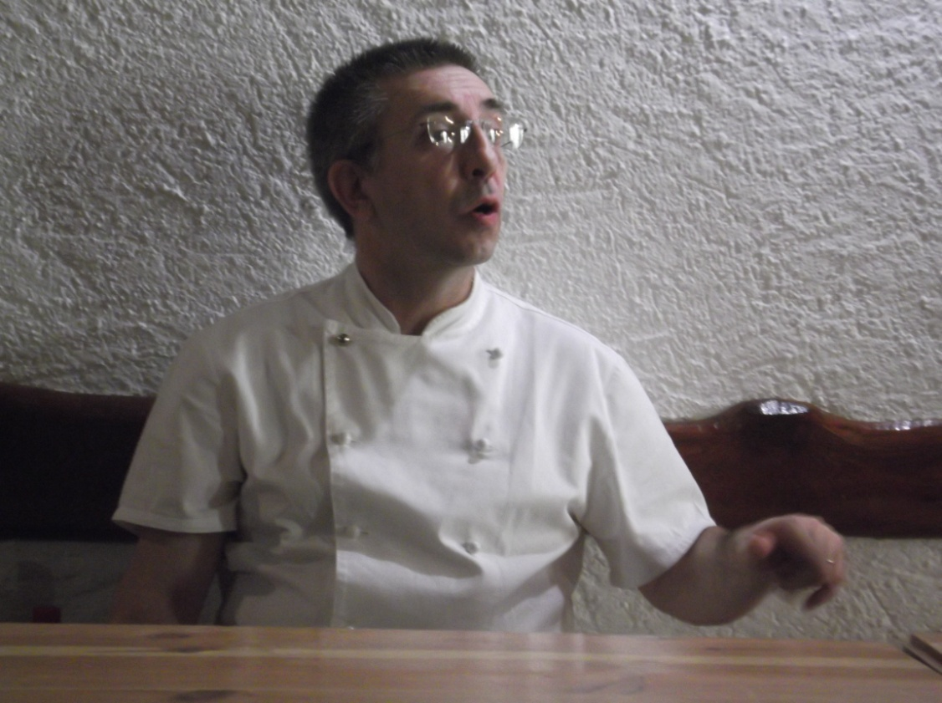
Philosopher Chef Moreno
“Usually when you follow your instinct, the first thing you do is the right thing. With too much technology, you lose touch with that instinct.”
62

Slide 63
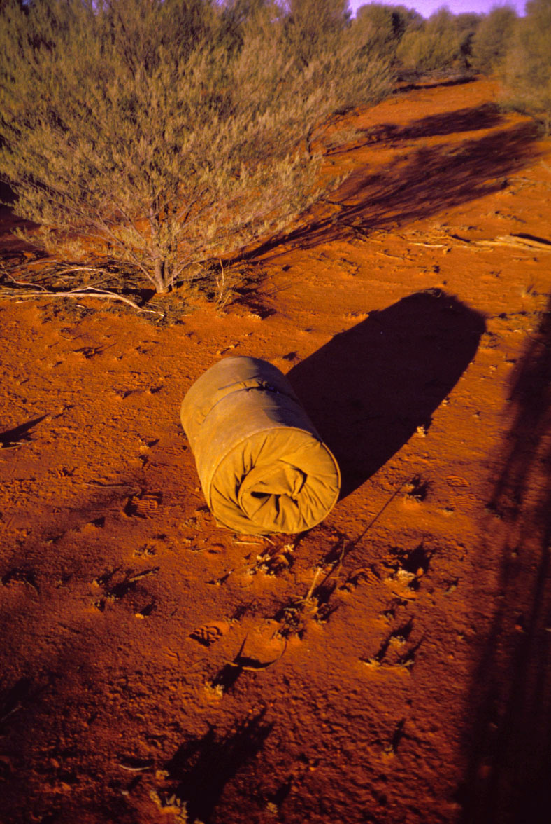
Story on the
Value of Scarcity
Paul Pholeros, Architect,
Professor and Director
of Healthabitat…
A Class in the Australian
Outback
Building “muscle memory”
…like Chef Moreno

Slide 64
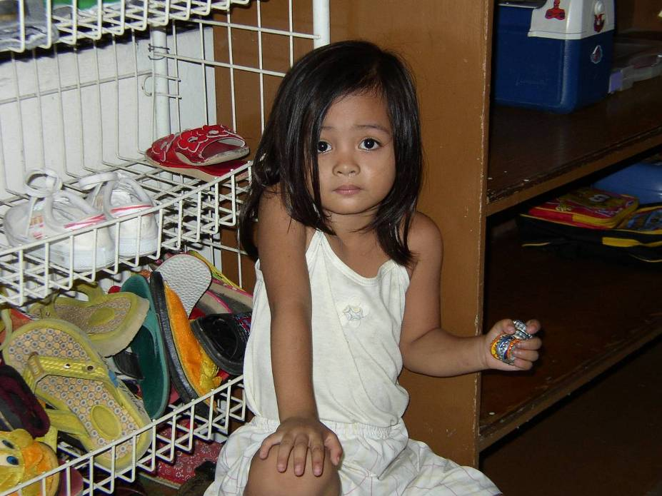

Slide 65
Bottle-caps
Simple, basic toys are good enough
She brought her toys with her to the center
She had already adopted these toys as hers
Now change the word
“toys” → “technologies”
65

Slide 66
How can you help?
Become a volunteer
Get trained in First Aid
Write applications for Apps Catalog (especially phone apps)
Write the connectors, mash-ups, analysis apps
In an emergency, volunteer for HQ work (have our back)
Make small donations

Slide 67
Three Take-aways
Crisis – the world stage is getting more challenging
Connections – responding to crisis with technology is becoming more social
Collaboration – working together is not an option, it’s an imperative

Slide 68
Further Reading
Blogs:
http://eghapp.blogspot.com/
http://granger-happ.blogspot.com/ (Dartmouth)
Web site (see the articles & presentations link) http://www.eghapp.com
Email: ehapp@ifrc.org
Twitter: @ehapp
LinkedIn: http://www.linkedin.com/profile/view?id=1906312
Book: Managing Technology to Meet Your Mission, chap. 11

Slide 69
Questions and Answers
Can you tell us a story/give us an example of technologies in action during a real disaster? (NetHope WiFi Network in Haiti)
What are the hottest new technologies (devices and applications) being used by disaster responders? (POTS – Trilogy SMS app)
How is citizen-originated data (from twitter, SMS, Facebook, etc.) being used by responders, and if it is not—how could it be used? (not very well; need to aggregate at the front and back-end streams)
What are the most needed/desired technologies (devices and applications) by disaster responders—that don't yet exist? (Cheap, self-contained broadband; aggregate assessment info)
What are the biggest roadblocks to new technology use, citizen data use among emergency responders? (The focus level)
What’s the best way for volunteer technical organizations to help disaster responders? (Aggregate info and translate info)

Slide 71
APPENDIX
pptPlex Section Divider
The slides after this divider will be grouped into a section and given the label you type above. Feel free to move this slide to any position in the deck.

Slide 72
Appendix

Slide 73
Moving the IT Agenda Up the Pyramid
Competitive
or Leading
BENEFICIARY
“Differentiating”
Beneficiary & Field Facing
Increasing Impact for Beneficiaries
PROGRAM
“Improving Program Delivery”
Increasing Impact for Beneficiaries
OPERATIONAL
“Helping the Organization Run”
Efficient
Donor & HQ
Facing
FOUNDATIONAL
“Keeping the Lights On”
73

Slide 74
We Need to Push the Pyramid at Both Ends
Get in
Competitive
or Leading
BENEFICIARY
“Differentiating”
Beneficiary & Field Facing
PROGRAM
“Improving Program Delivery”
Increasing Impact for Beneficiaries
OPERATIONAL
“Helping the Organization Run”
Efficient
Donor & HQ
Facing
FOUNDATIONAL
“Keeping the Lights On”
Get out

Slide 75
Questions to Frame the Strategy
In 3 years we could use technology to answer “How can…”
… we double impact on lives of vulnerable people in all regions of our work without doubling staff or budget?
… we deliver new programs in disaster relief, preparedness, and health for less cost & greater reach?
… we reach people with the technology they have already adopted? (e.g., mobile phones)
… staff in all offices and other stakeholders readily find each other based on expertise and interests?
… all our National Societies reach more of their donors for less cost to raise money?
… we motivate the greater use of technology, with a converging set of standards to increase our ability to Move Forward Together?

Slide 76
Key strategic questions
If we will have all the bandwidth we need globally, what changes for relief applications?
If the #1 device used in emergency response is the cell phone, what changes when the cell phone can operate like today’s laptops?
Do we build disconnected applications for the interim or wired applications for the future?
ONE MORE TIME: Where is the puck going to be?

Slide 77
NetHope Value Proposition –
Top 5 for Members
  Why NGOs want to be members:
    Increase Staff – NetHope’s virtual team and PM’s extend NGO IT departments
    Share Knowledge/Gain consulting – advice through members and partners estimated at $75K per year (500% ROI)
    Realize economies of scale – grants, purchasing
    Greater impact thru leverage of ICT, building local networking expertise, eliminating duplication of effort and resources
    Present unified face to donors and funding organizations

Slide 78
NetHope Value Proposition –
Top 5 for Corporate Partners
Why corporations work with NetHope?
  Broader impact: reaching greater number of beneficiaries thru single point of focus
  Better philanthropy leverage: Lower cost of admin thru single point of focus
  Work through NGO CIOs: leveraging the IT heads of largest international nonprofits who have the on-the-ground reach and experience
  Lower risk thru collaborations; better deployment of grants; members help each other implement and execute
  Support the model of NGO collaboration, leverage technology for capacity building

Slide 79
Interesting relationship between connectivity & poverty
U.S. Census Bureau
and Telegeography
Global Bandwidth
report

Slide 80

Spreading the word on Twitter
Tue
12
Jan 2010
Thu
14
Jan 2010
2.3M tweets
#Haiti
#Red Cross
7.0 Mw earthquake
hit Haiti
80

Slide 81
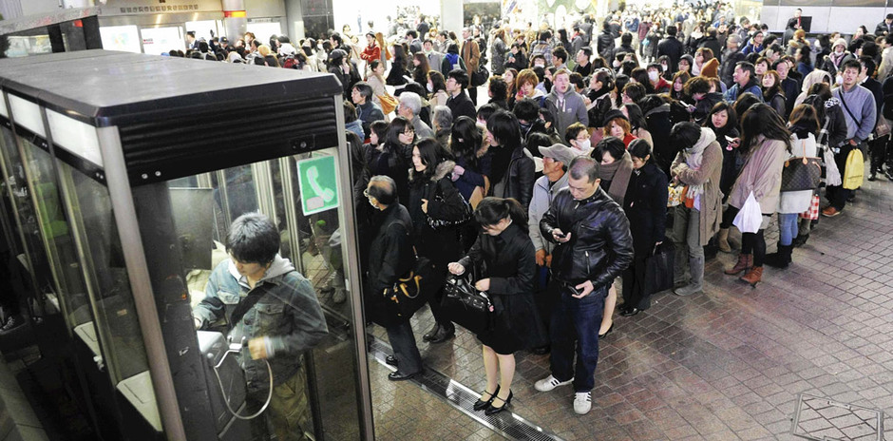
Communication is Fundamental
Queuing up to make a phone in Japan, 13 Mar 2011
81
Notes:
Lining up to make a call in Japan, 13 Mar 2011
http://news.enorth.com.cn/system/2011/03/12/006109266.shtml

Slide 82
People need information as much as water, food,
medicine or shelter.
Information can save lives, livelihoods and resources.
Information bestows power.”
82

Slide 83
NetHope Strategic Direction - 2011
Prime Members
Domain
New NetHope
growth area
(e.g. ICT4D)
3
1
NetHope began in quadrant 1, for example providing connectivity to members
Beneficiaries
New
NetHope
growth area
(e.g. NH Academy)
2
Customer
2
Primary growth area for NetHope leveraging strength in quadrant 1
New
NetHope Domain
(e.g.
Shared Services)
Primary NetHope
Domain
(e.g. Phase II VSATs)
3
NetHope’s supports and enables through technology but does not provide programs to the beneficiary since this is the members’ role
Members
4
1
4
Secondary growth area for NetHope
Vertical
(e.g. program sectors)
Horizontal
(e.g. tools & platforms)
Strategic Thrust
83

Slide 84
To Build Capacity We Need to Do Seven Things
More Effective Impact
At Greater Scale
Effective, Efficient, Scalable Programs
Hiring
Training
Partnering
Advocacy
Tools
Processes
Standards
Systems Impact
Funding Support
84
Notes:
84

Slide 85
What’s the model?
Demand = Need / Cost,
where Cost > zero
and Cost < market value
85

Slide 86
Nonprofits get by with a fifth (or less) of corp. IT costs
5x
18x
4x
Notes:
86

Slide 87
Key Conclusion
87
Even if nonprofits tripled IT spending, they would still be playing catch-up for just keeping the lights on.
Notes:
87

Slide 88
Non Profit IT Departments Can’t Play the Odds
IF
57% of ERP projects don't realize their ROI (Nucleus Research)
66% IT projects fail (Standish Chaos DB)
NGOs spend a 20th what corporations do (Tuck survey)
And we are spending donors’ dollars
THEN
We must find a better way...
88

Slide 89
Consider Mercy Corps
“Many of Mercy Corps’ field offices are located in austere environments with limited local IT support. In order to improve shared services within these offices, we adopted a server appliance strategy with two stretch goals: 100% reliability and 0% administration.”
That’s zero% administration!
They also follow the 80/5 Rule for network hardware: “80% of the functionality at 5% of the cost”
  Note the order of magnitude here: that’s 95% less for a “good enough” 80% solution.
89
Notes:
Quotes from Peter Dickenson, CIO at Mercy Corps, in an email of 5/27/08

Slide 90
What else is possible for nonprofits?
Collaborate or Perish
  Shared consulting/support
  Shared web/file server hosting & backup
  Shared fundraising systems guru
  Shared technology procurement
  Shared technology training
  The operative word here is Shared
90

Slide 91
Emerging Countries as a Leading Indicator
Some of the technologies being developed in and for developing countries may be a leading indicator of technology opportunities and trends in developed countries. --Jackie Fenn
The “weak signals” for good enough technology may come from the countries that have the greatest need for low-cost, pragmatic solutions
91
Notes:
Call with Jackie Fenn, VP and Gartner Fellow, on Aug. 23, 2007

Slide 92
Wisdom from Japan
A barber in north Japan “was giving free haircuts on Thursday with scissors and a razor borrowed from a friend in a nearby town.
‘We have to support each other,’ he said, ‘and this is what I know how to do.”
–International Herald Tribune, 27 March
92

Slide 93
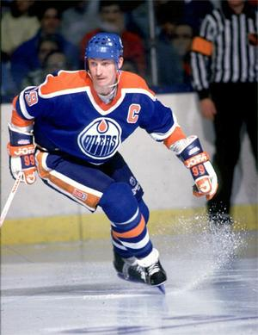
Advice from a Hockey Legend
“I skate to where the puck is going to be, not where it has been.”
--Wayne Gretzky
Notes:
http://stephenconnolly.files.wordpress.com/2007/06/300px-waynegretzky_oilers.jpg

Slide 94
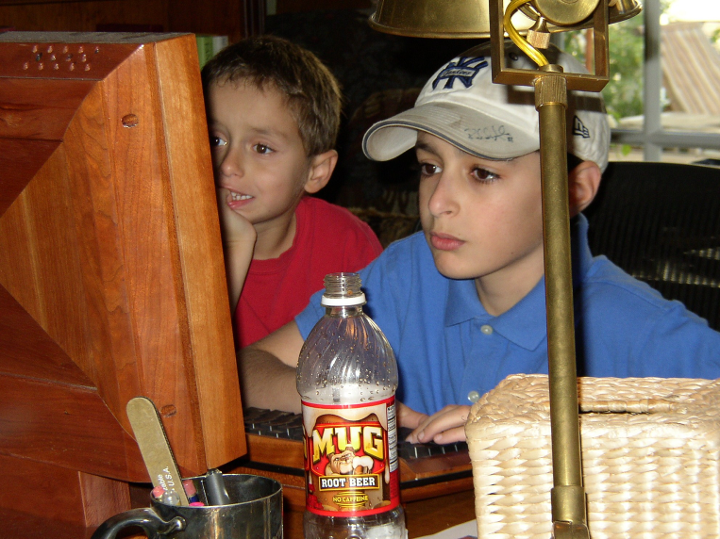
A Leading Indicator

Slide 95
Who are you spending time with?
“If you’re a CIO, you need to spend a lot of time out on the fringes of the Web because that’s where the innovation’s taking place. You need to spend a lot of time with people under 25 years old.”
–Gary Hamel
Notes:
Gary Hamel interview, CIO Magazine, November 15, 2007, p. 50-55.

Slide 96
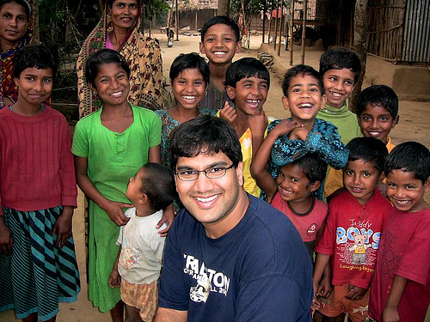
The Uncultured Project
2.2 M Views
96
Notes:
http://savetheworldblog.files.wordpress.com/2009/10/2606613587_44ea042f60.jpg
See Shawn Ahmed’s YouTube site, here: http://uncultured.com/

Slide 97
Current University Students
I asked Dartmouth Graduate students:
  So what do you use to communicate more,
  IM or Texting?
Answer: Neither
Neither?
We do everything in Facebook…
750M users and growing

Slide 98
The Context
The Apollo 13 story was featured in the 1995 film with Tom Hanks and Kevin Bacon. The incredible events that unfolded in April 1970 gripped the nation and the world. On April 13, 56 hours into the mission, an oxygen tank in the service module that contained the astronauts’ support systems exploded. What followed was a remarkable story of collaboration between the astronauts and mission control in Houston. While the world watched, they were able to bring a damaged spacecraft back to earth safely …
The NASA account of the accident is here: http://nssdc.gsfc.nasa.gov/planetary/lunar/ap13acc.html
98

Slide 99

The Movie Clip… watch for the collaboration
99

Slide 100
The Elements of a Collaboration
First, there was a burning need—there was a clear and present problem that had to be solved.
Second, there was scarcity—only a few resources were available.
Third, there was a strong desire to band together as a team and solve the problem.
These three factors: need, scarcity and social desire are the glue that makes collaboration work.
100

Slide 101
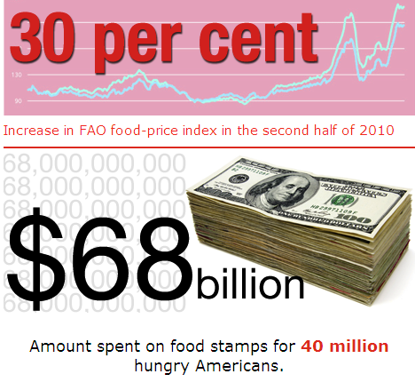
101

Slide 102
The Development Agency Support Consortium
Consortium of six NGOs (Christian Aid, VSO, Action Aid, Water Aid, British RC, IFRC); began Sept-2009
Address common issue of providing basic support outside normal UK office hours.
Excellent fix rates contracted with Microland in Bangalore for very basic service
Common Platform – members have similar elements of technical infrastructure (Desktop OS, Office productivity tools)
After-hours (UK) service with potential to upgrade to 24 x 7
Cost of the service is £3675 per month which is shared equally between the participating agencies (£612 each)
102
Notes:
http://www.microland.com/contact-us.php

Slide 103
What is important to our model of collaboration?
The whole is greater than the sum of the parts
It's about diversity: point-counter-point
Our giveback to the nonprofit community
Extending our IT departments
Mentoring newer, smaller members
Partnering with Corporations
Bottom line:
we are not competing; we have the same goal: meeting needs wherever they exist in the world; we believe we can do that together

Slide 104
IFRC Standards & Choices Catalog
Results of "discover and harvest" approach (Find promising IT applications already in use among NSs that can be polished, supported and taken to scale by National Societies (NS) or the Secretariat.)
Finding de facto standards of IT vendor applications, for which we can broker a group price plus donations (e.g. NAVision)
Investing in a NS application project so that the application can incorporate broader features, which encourages sharing (e.g., The British RC PMIS project)
Redefining a Secretariat department project so that it can also serve a NS audience.
104

Slide 105
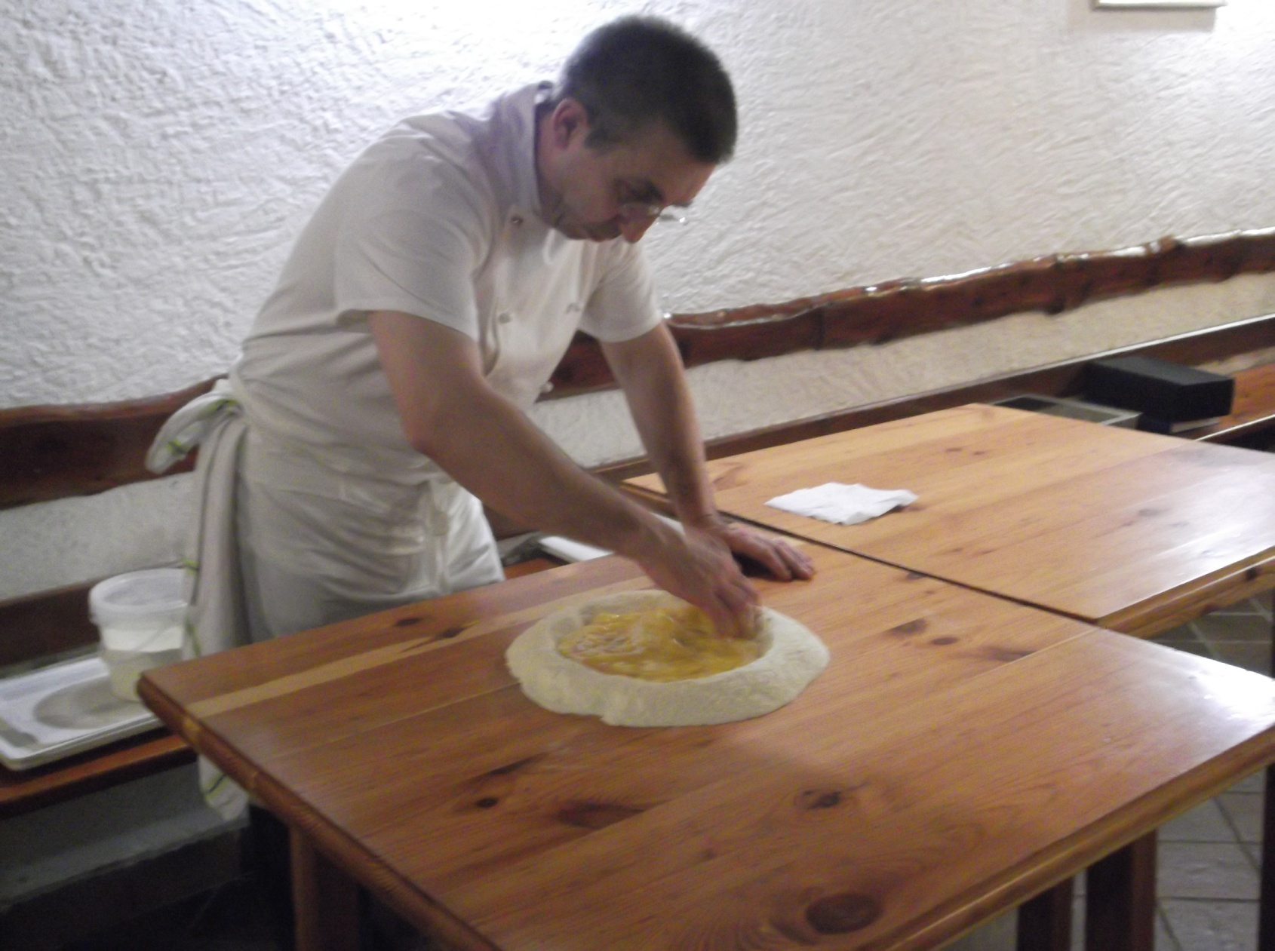
Philosopher Chef Moreno
“In a recipe,
you must do
interpretation…
without
passion,
it is nothing.”

